Slide 1
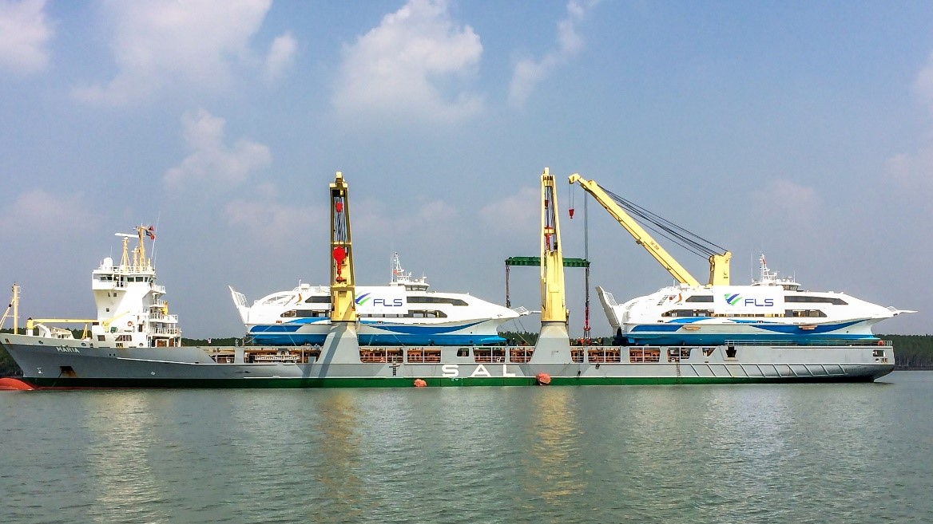
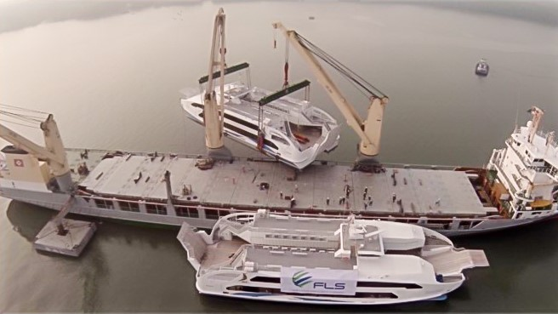
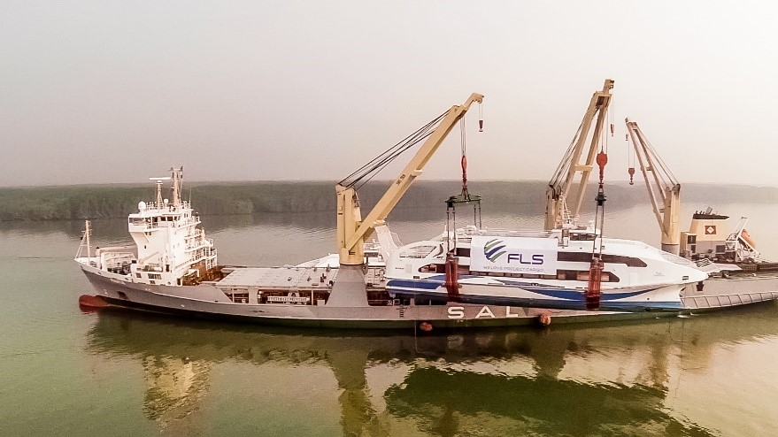
PROJECT REFERENCES
CASE STUDY - CATAMARAN
Project name: Catamaran
Volume: 2 Units: 55 x 16 x 16 m / 14,080 m³ each
Commodity: Complete Vessels, Both 200 tons each
Origin: Vung Tau Anchorage (Vietnam)
Destination: Port Sultan Qaboos (Oman)
Scope:
Pre-carriage ex shipper’s jetty up to port by tug.
Organizing – Loading onto vessel and ocean transport.
Loading and securing of the cargo on the vessel.
Extended Scope: FLS scope included the hiring and coordination of divers for positioning soft slings underneath the catamarans.

