Slide 1
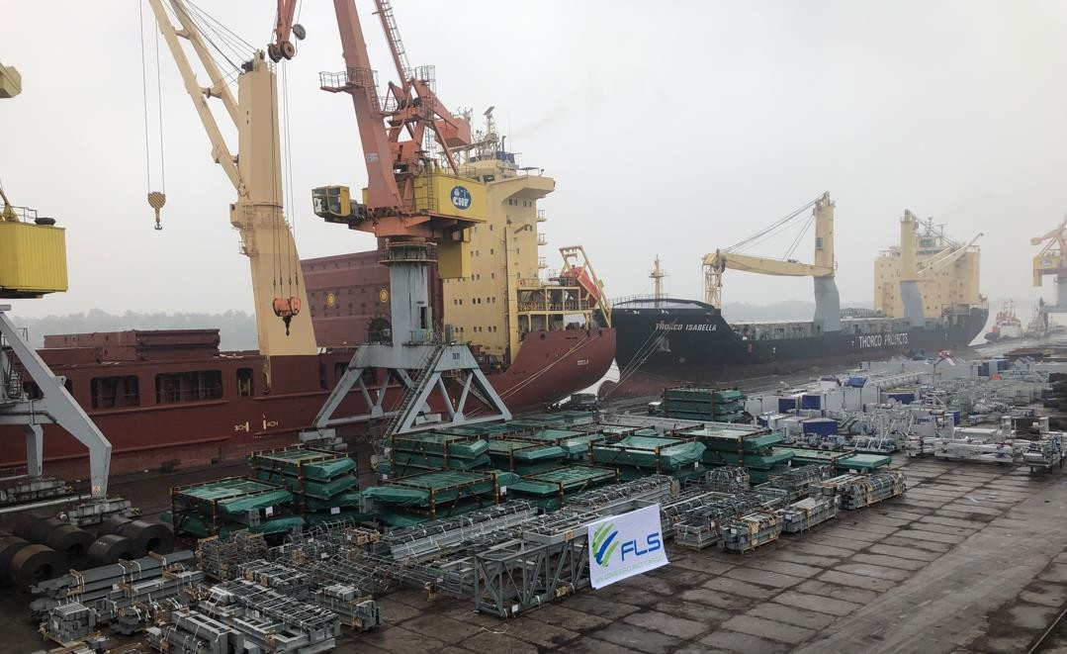
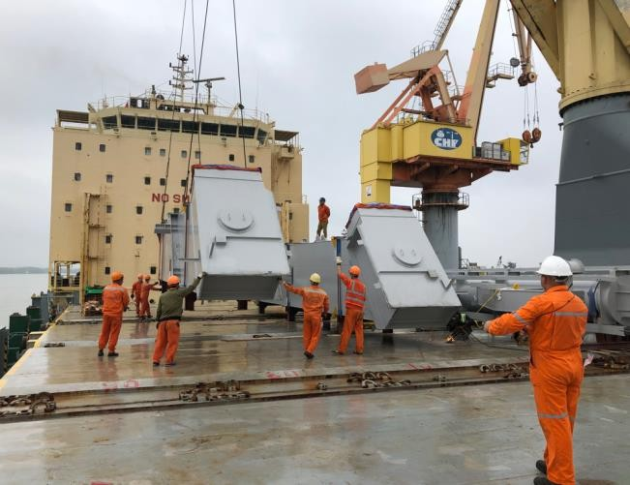
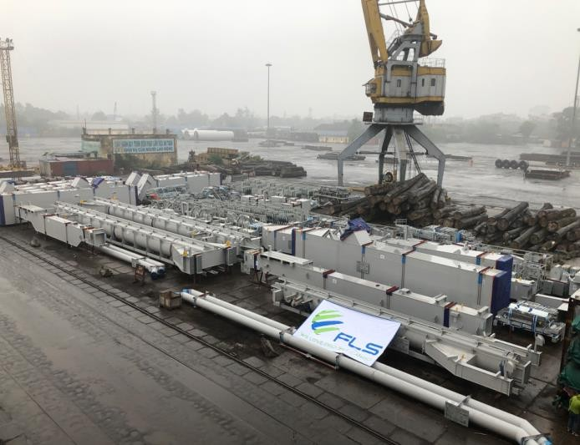
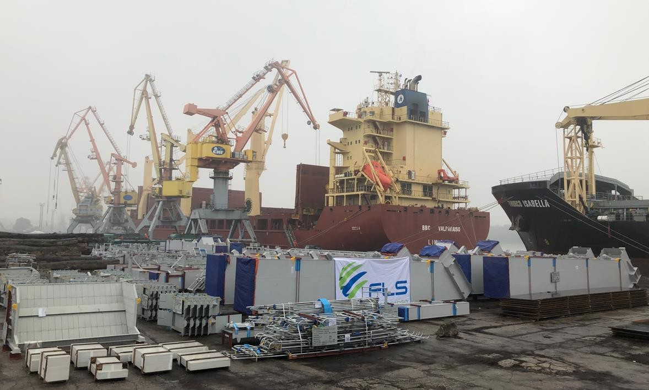
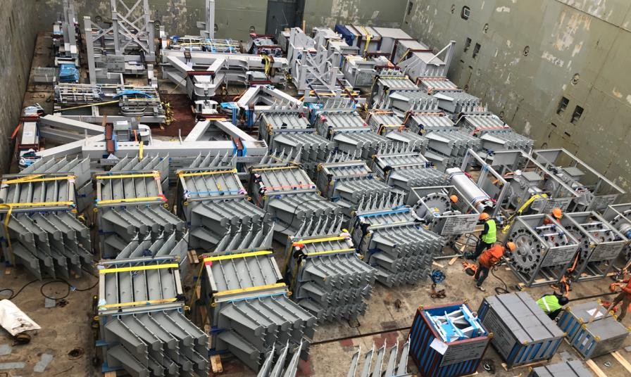
PROJECT REFERENCES
CASE STUDY – TAKRAF/TENOVA THERMAL PROJECT
Origin: Destination: Volume:
Hoang Dieu Port, Hai Phong Vietnam Gamagori Port, Japan
8,293 cbm / 638.2 MT
Scope:
Chartering of a suitable geared multi-purpose heavy lift vessel
Co-ordination of the FAS delivery, loading and stowage of the cargo on the vessel

