Slide 1

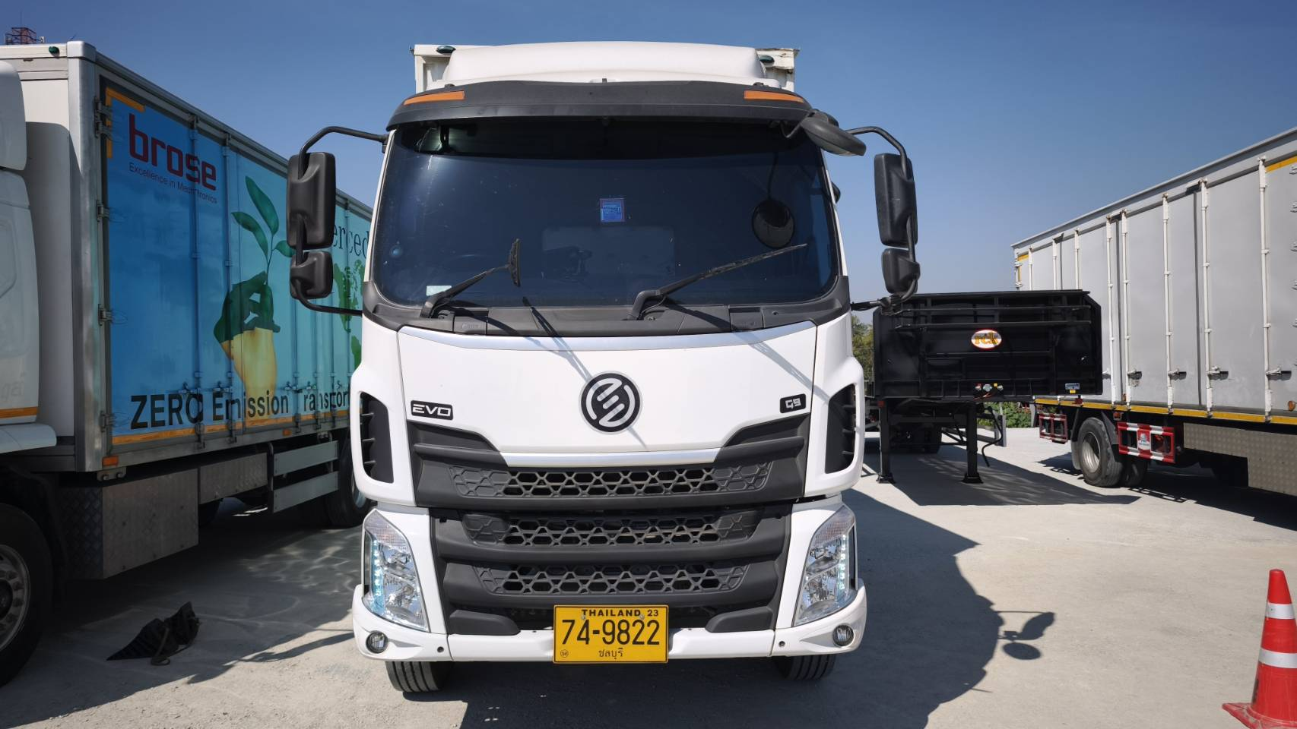
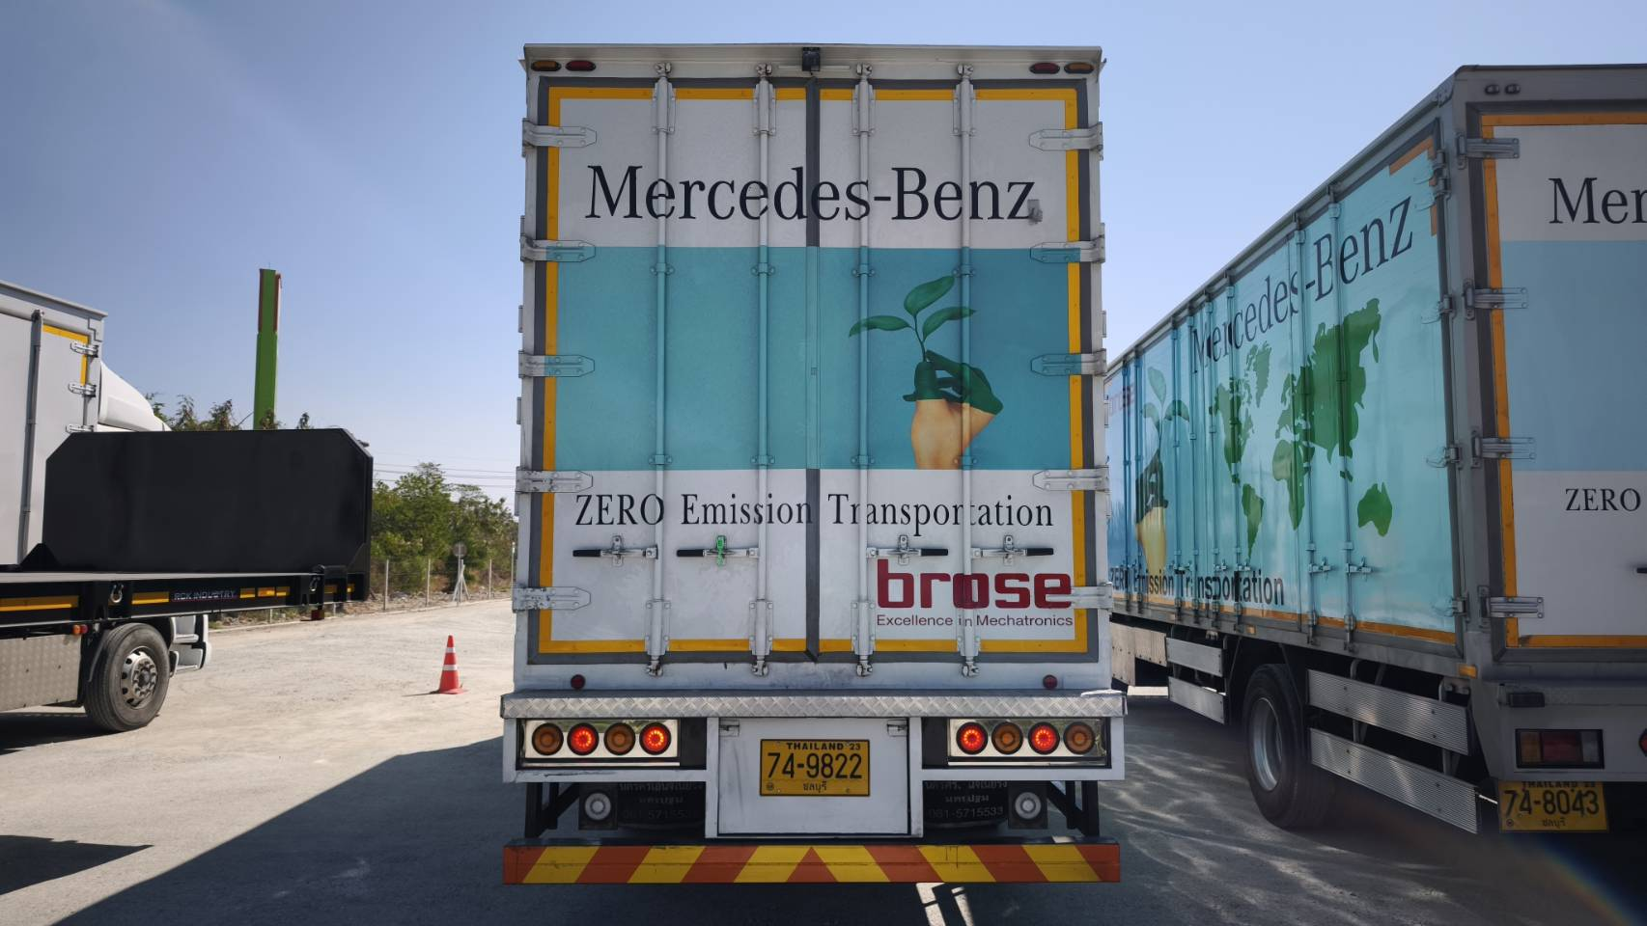
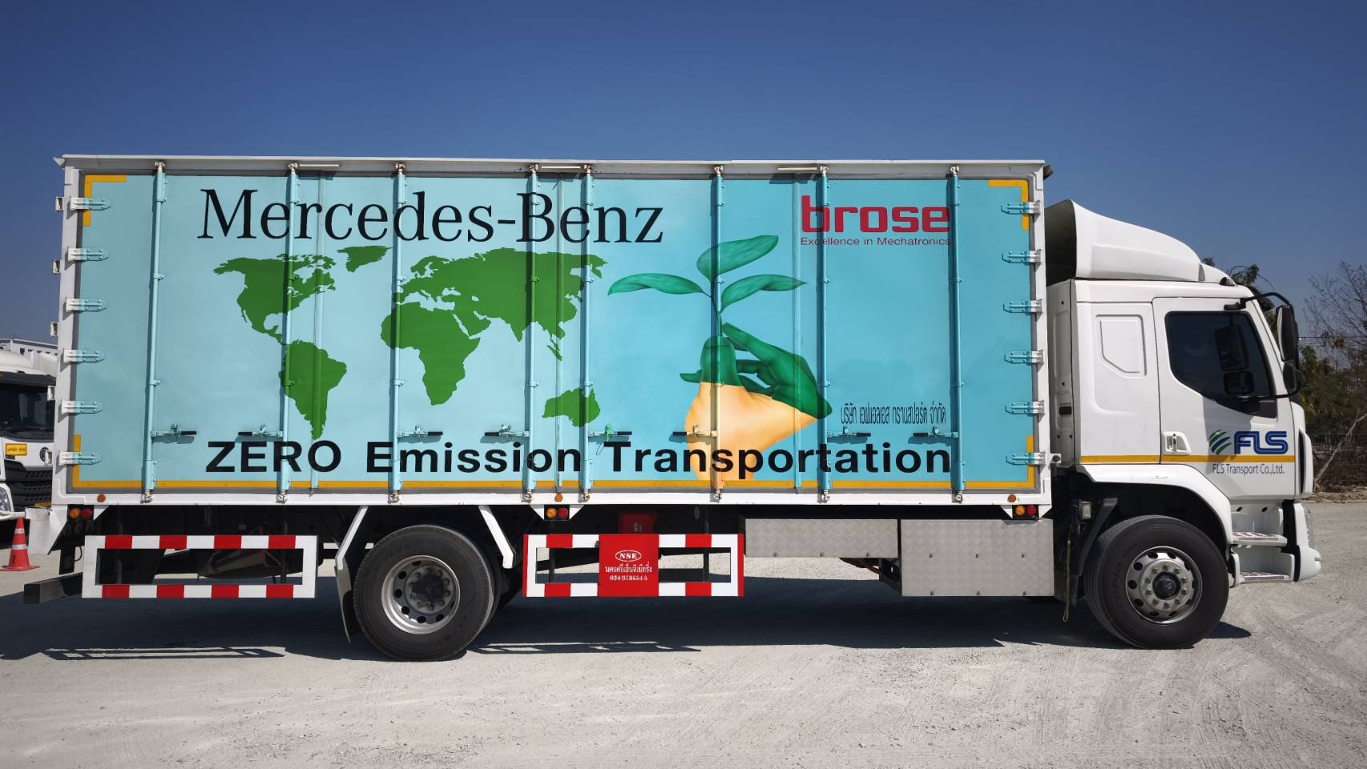
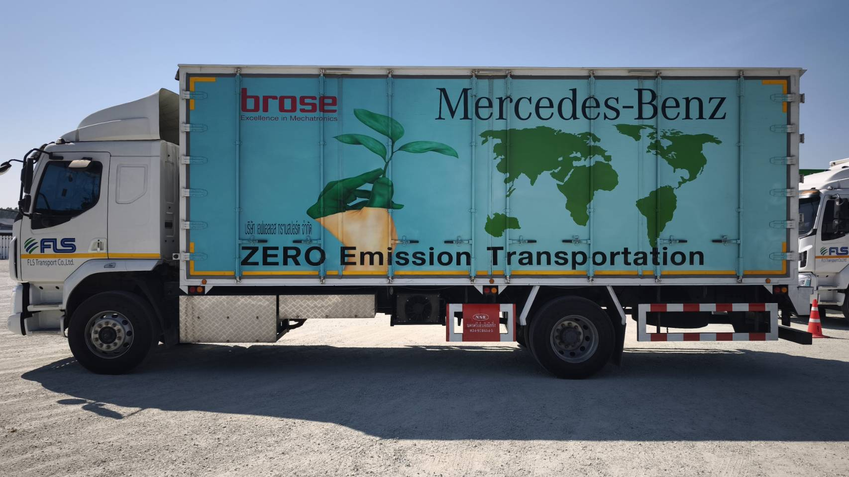
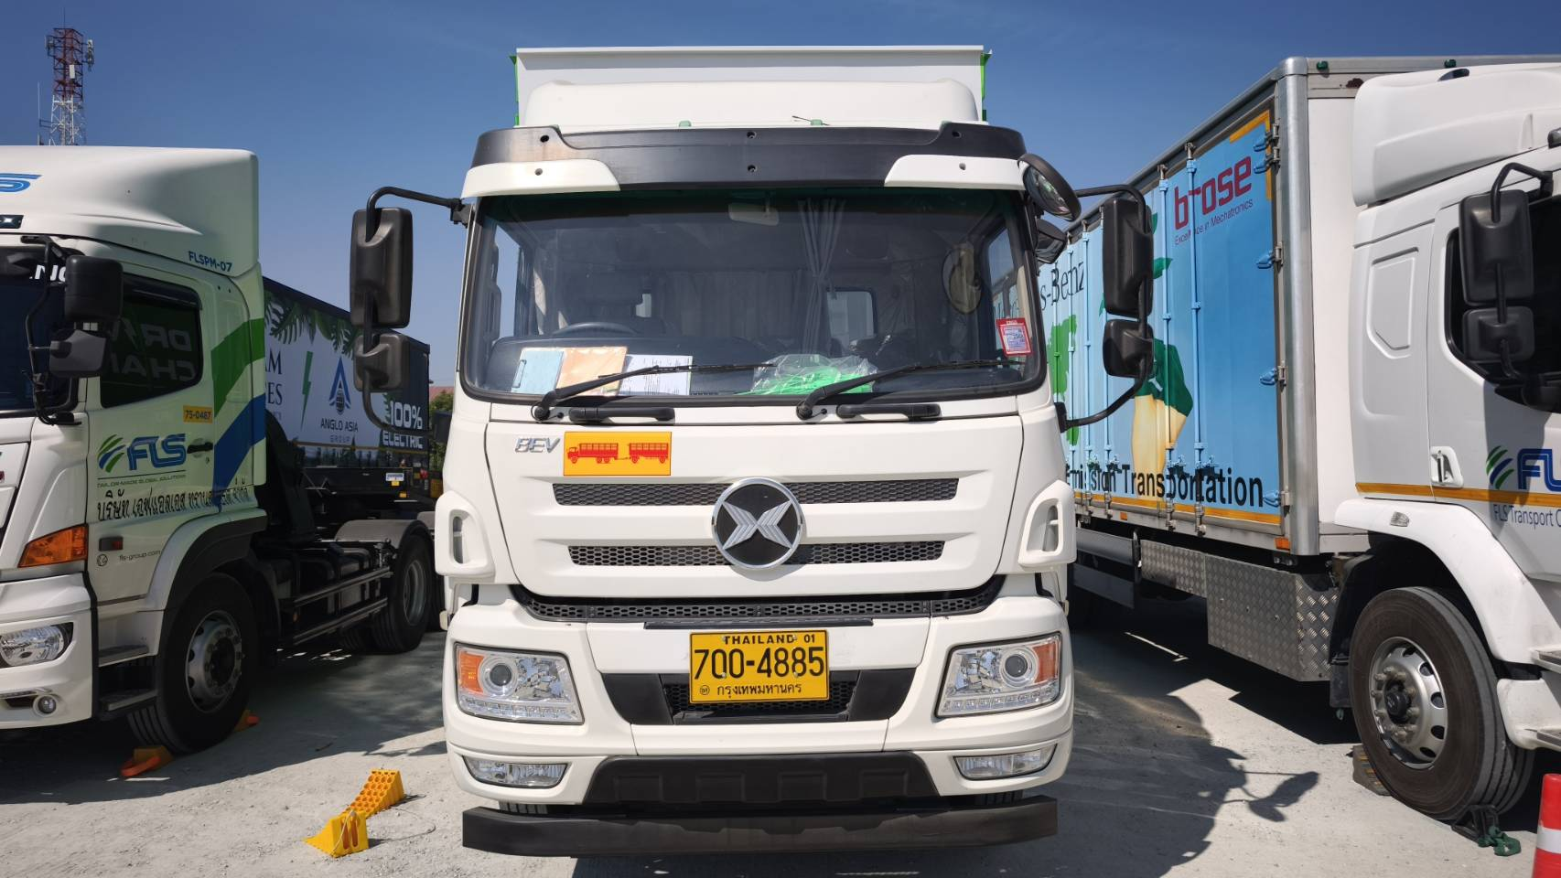
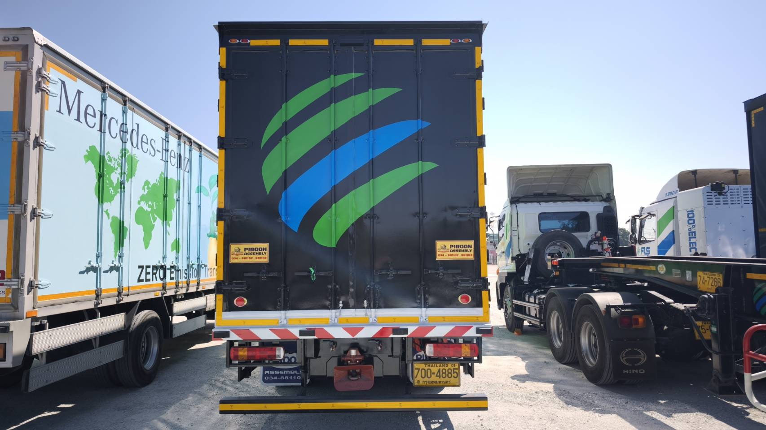
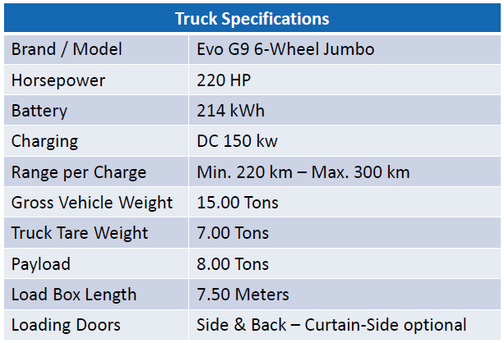
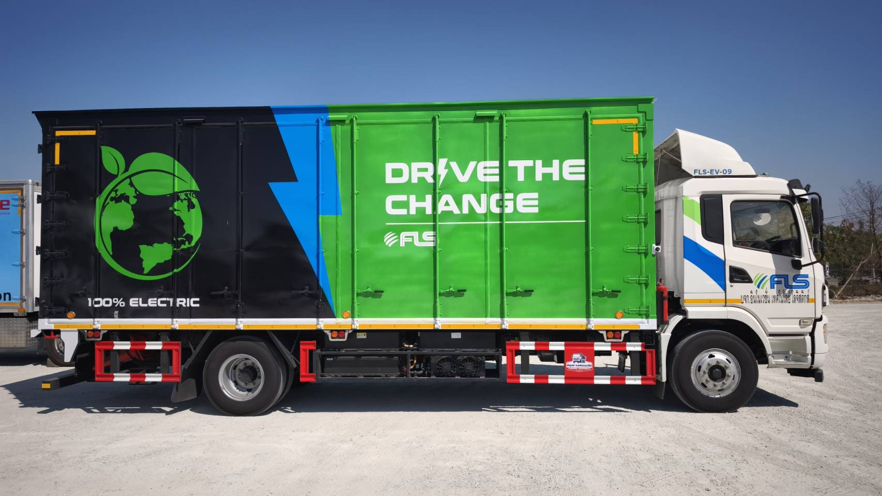
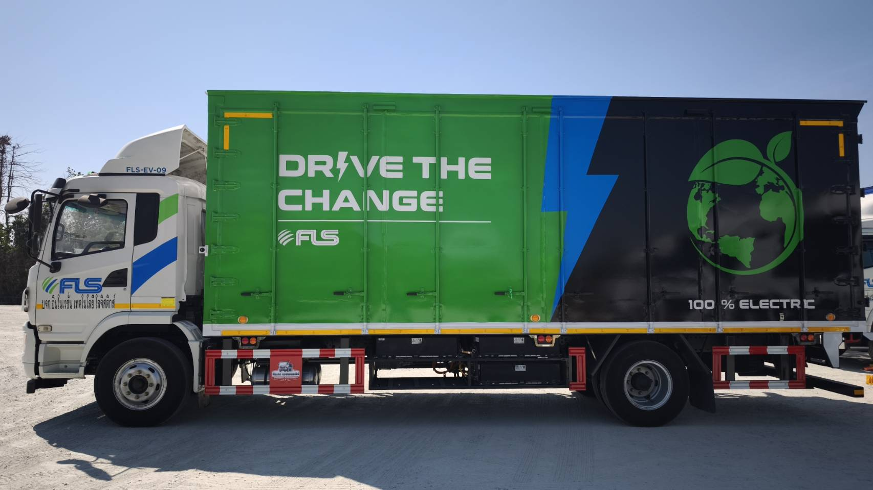
LOGISTICS REFERENCES
CASE STUDY - EV TRUCK – AUTOMOTIVE
Project name: | EV Truck – Zero emission project
Volume: | Daily Service
Commodity: | Automotive Parts
Origin: | Rayong, Thailand
Destination: | Samutprakarn, Thailand
Project duration: | Aug-23
Scope: | Scope A (Trucking Operations): Daily booking management – arrangement for collection as per route plan and time window Ensuring delivery to customer’s dock as per fixed delivery schedule Empty-return management Free-zone customs clearance Exception management – emergency trips, route adjustment Route & loading optimization

