Slide 1
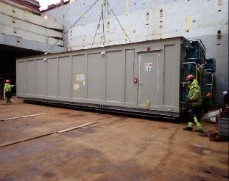
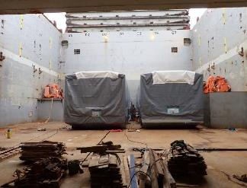
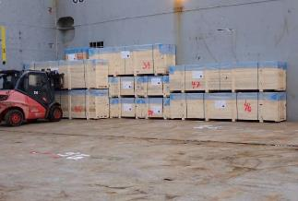
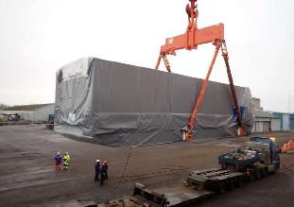
PROJECT REFERENCES
CASE STUDY – Saha cogen & egco cogen
Project Name: SAHA COGEN & EGCO COGEN
Volume: Approx 5,700 CBM
Commodity: Gas Turbine, Generator and Accessories
Origin: Mersin, Hamburg, Norrkoping
Destination: Laem Chabang, Thailand
Scope:
Booking vessel according to client’s requirement
Coordinating with shippers at origins for delivery cargo alongside
Coordinate with vessel agents and vessel owner, port Captain for proper loading / lashing method as per client’s instruction
Loading survey at Origins and Discharging supervision at destination

