Slide 1
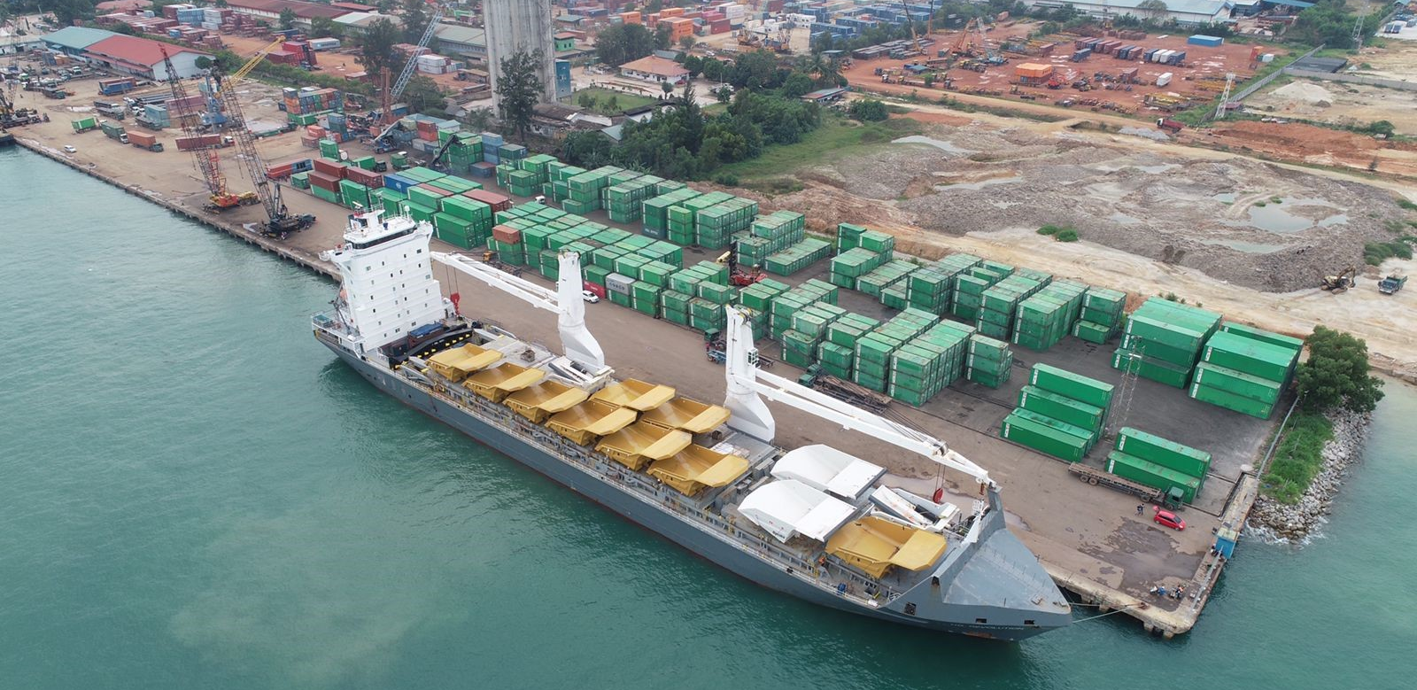
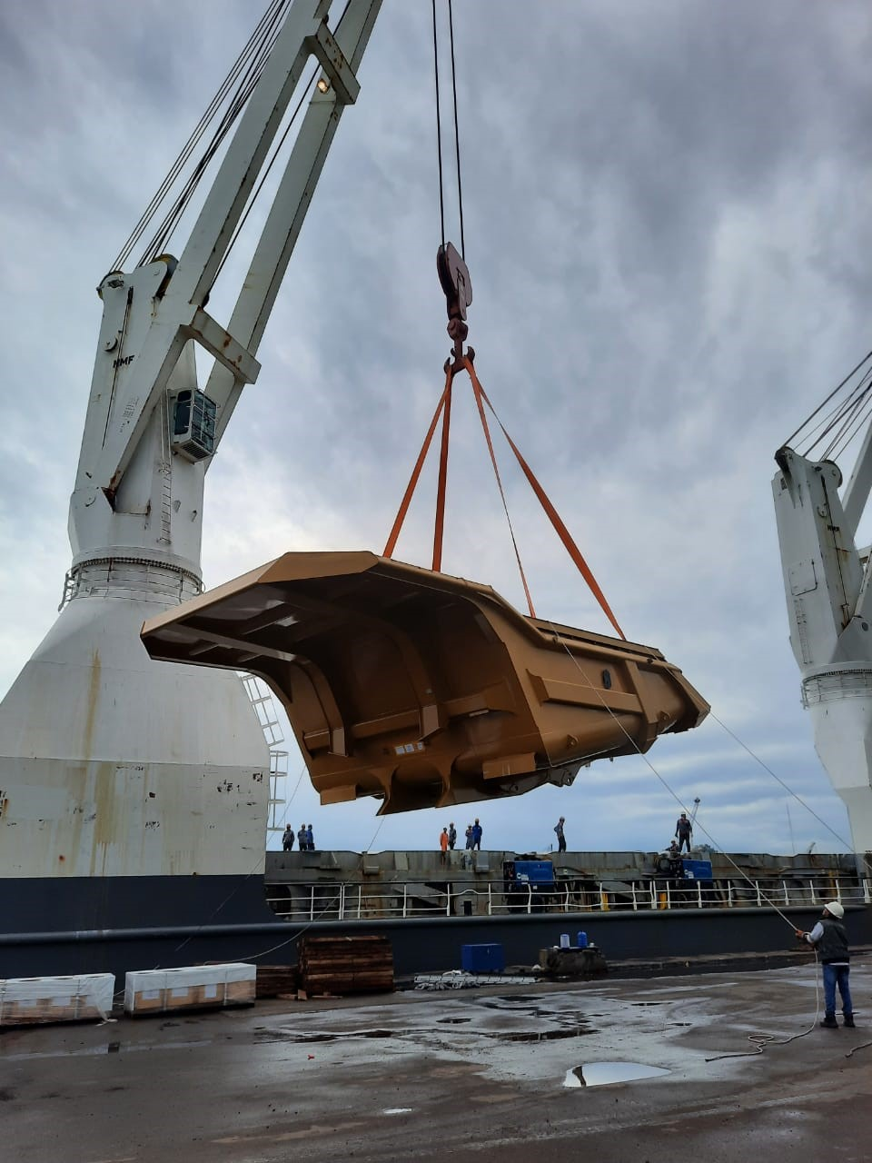
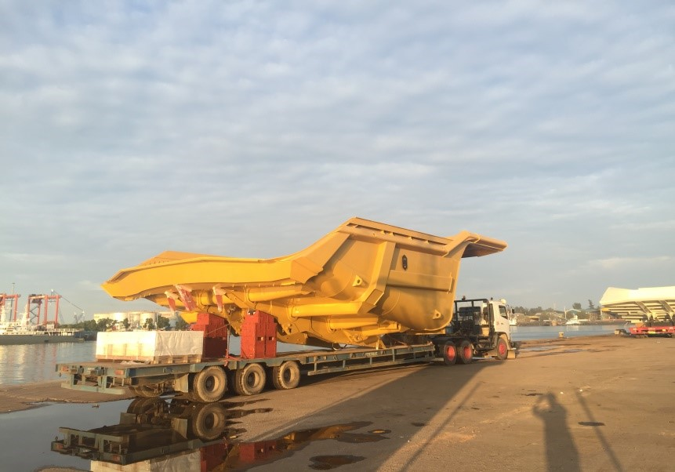
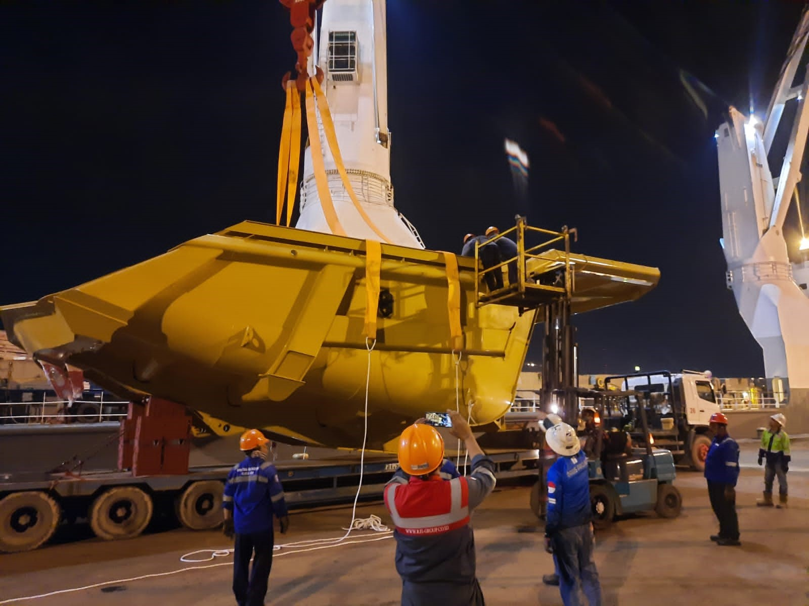
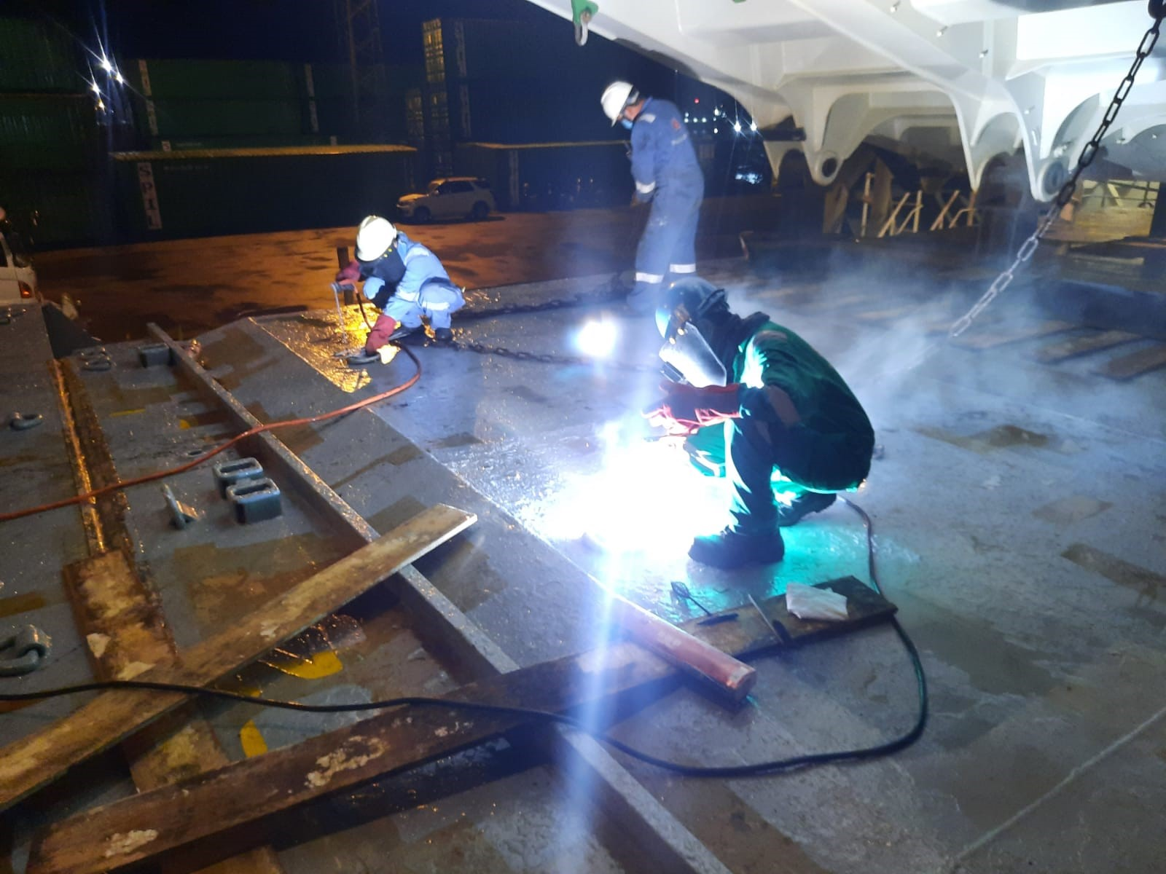
PROJECT REFERENCES
CASE STUDY – HEAVY EQUIPMENT – 9X CAT793 TRAYS
Project Name: Heavy equipment – 9x cat793 trays
Cargo: 9 x size: 13.2 x 8.24 x 4.75 m each
Shipper: Cebu (Philippines)
Destination: Mackay & Newcastle (Australia)
Scope:
Chartering of Breakbulk from Batam to Australia
Port Supervision in Batam for loading
Arrangement and procurement of lifting gears

