Slide 1
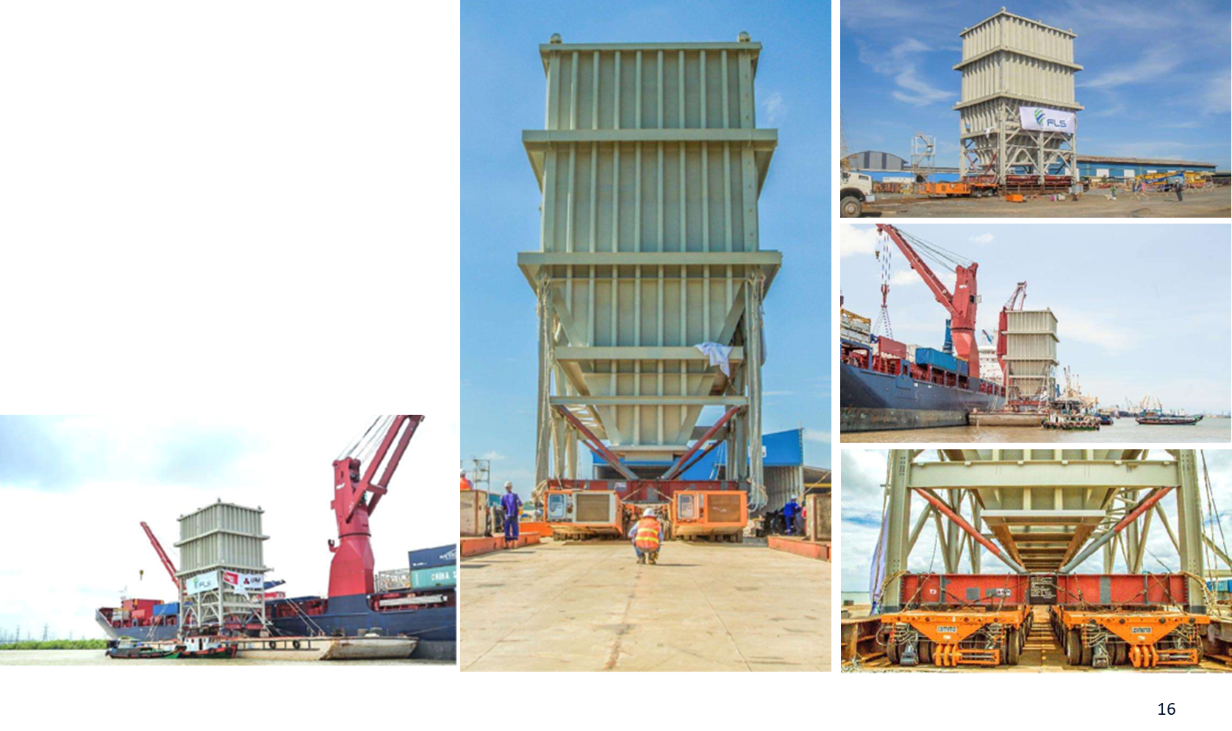
PROJECT REFERENCES
CASE STUDY – SURGE BIN
Project Name: Surge bin
Volume: Height: 24 m / 350 MT
Unit 2: 13.2 x 9.2 x 5.56 m / 61 MT
Commodity: Surge bin for coal export terminal
Origin: Phu My Vietnam
Destination: Gladstone, Australia
Scope:
Pre-carriage ex shipper’s jetty up to port via barge
Organizing and loading onto vessel + ocean transport
Loading and securing the cargo on the vessel

