Slide 1
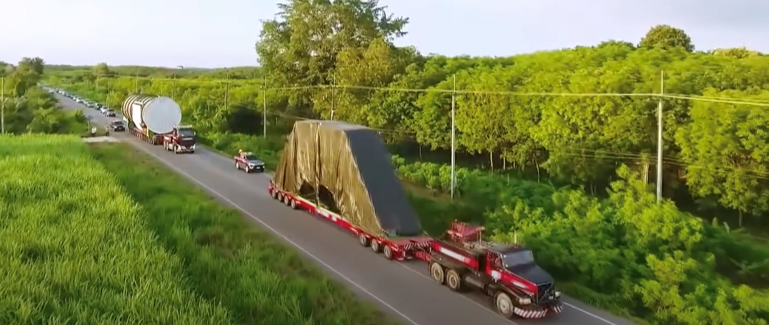
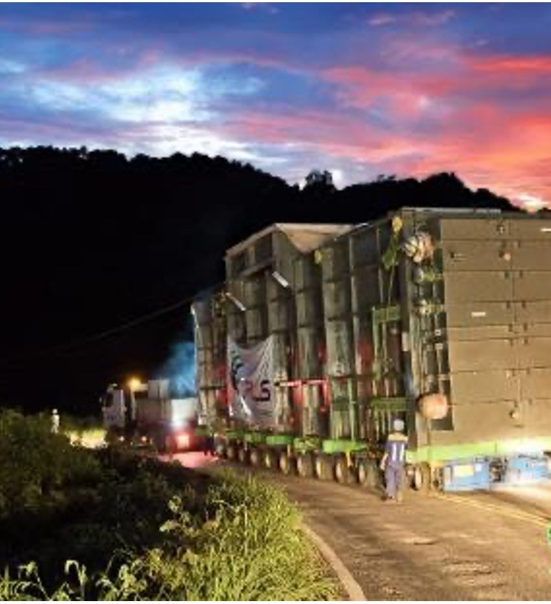
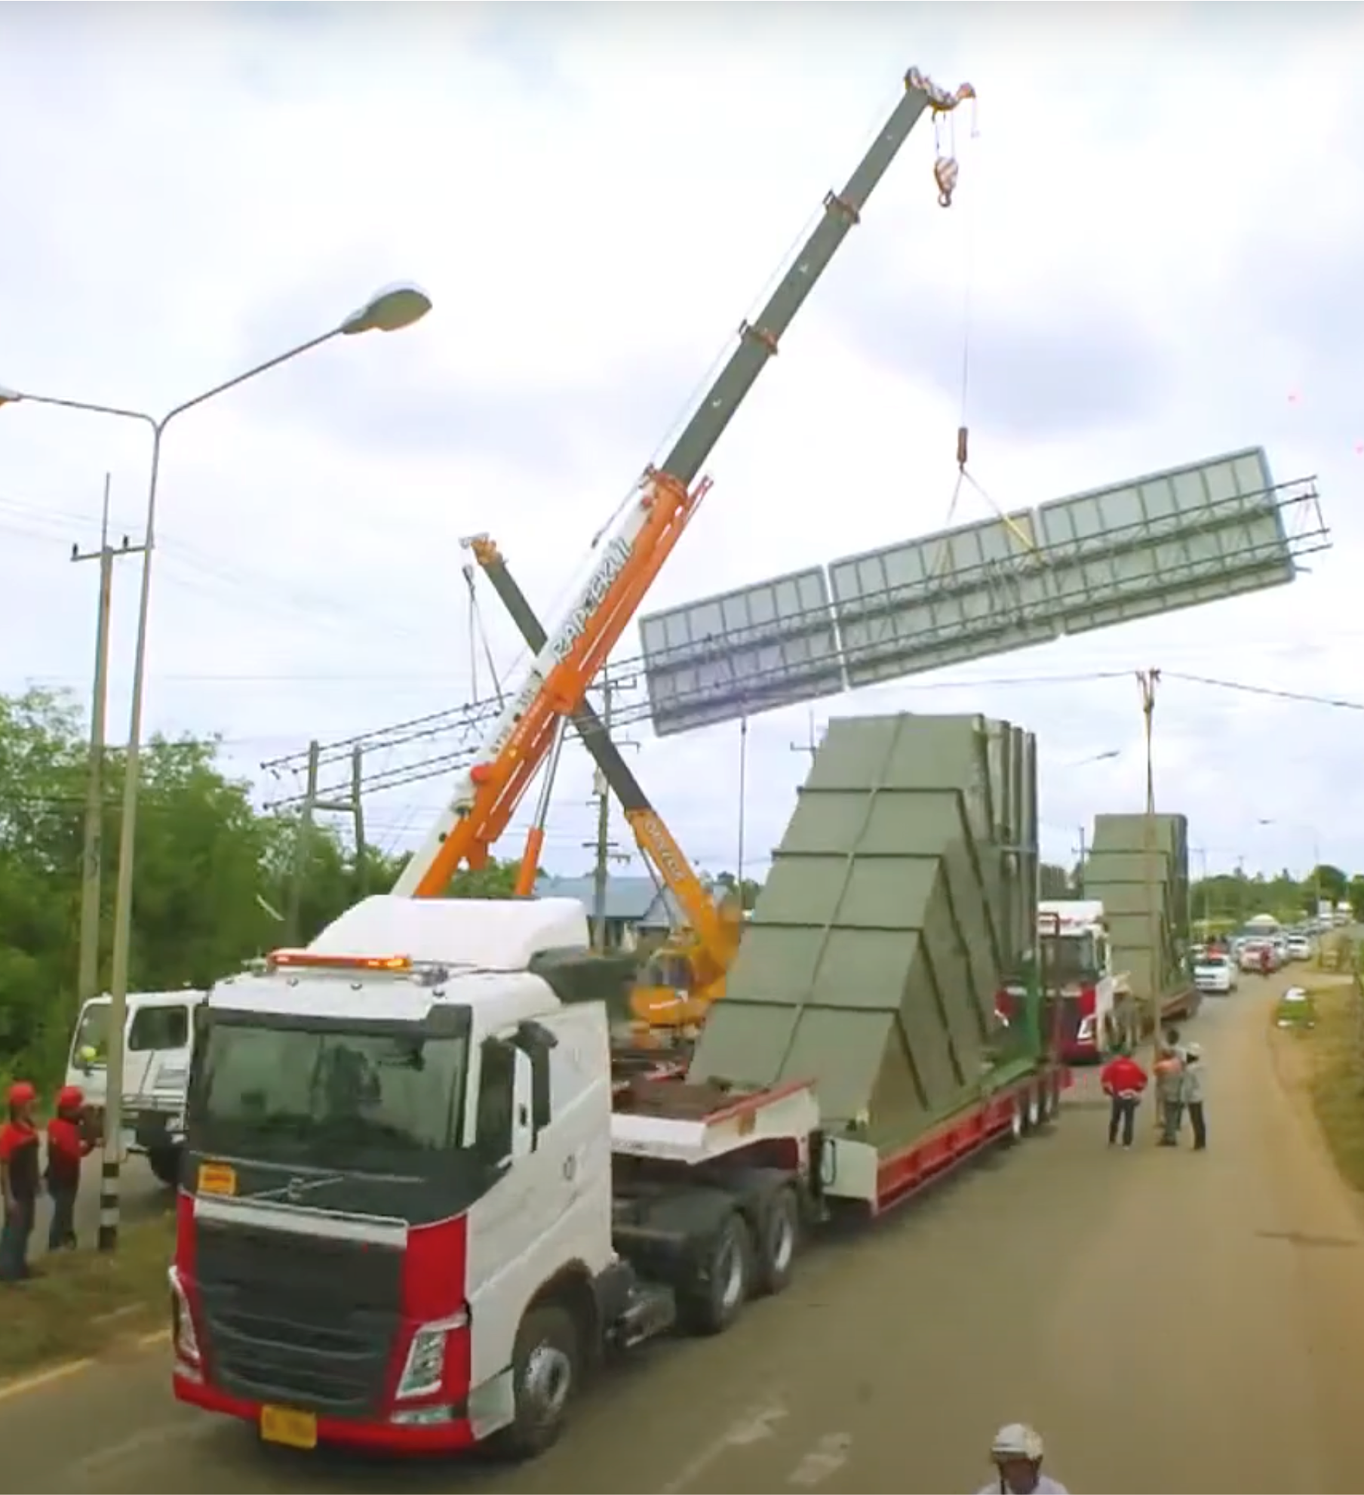
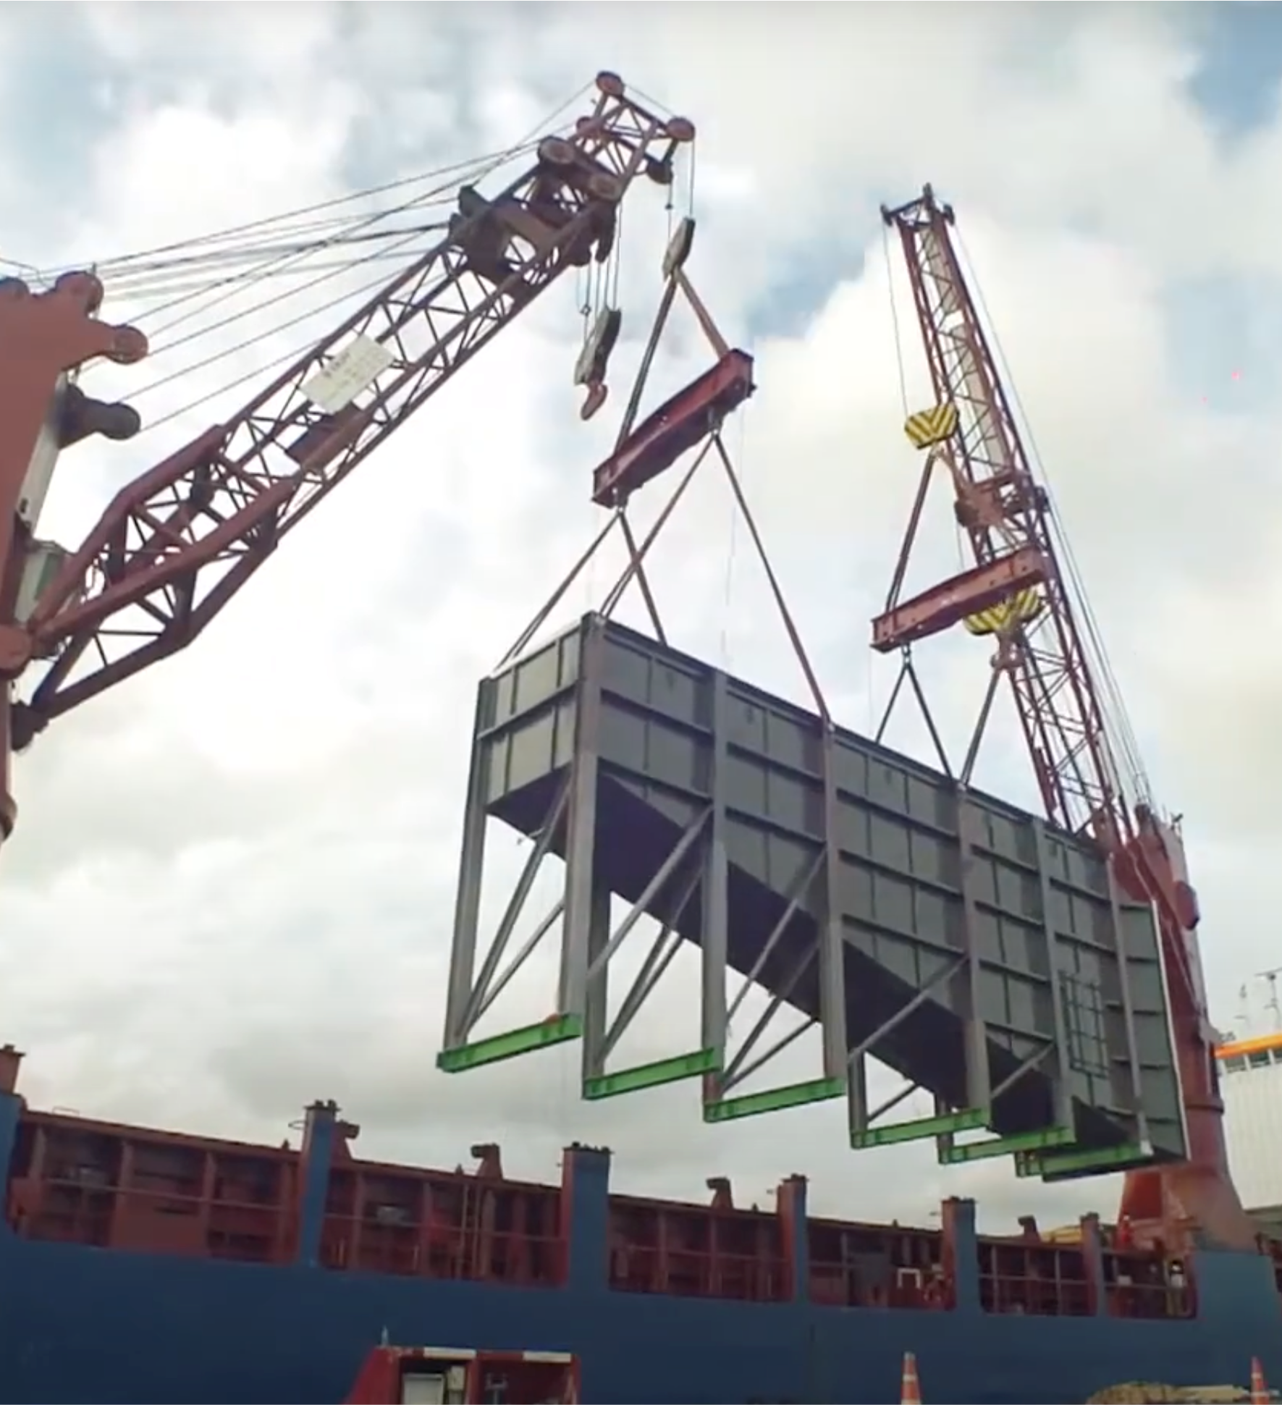
PROJECT REFERENCES
CASE STUDY – CAMERON PROJECT
Project Name: Cameron LNG Liquefaction Project
Client: Heurtey Petrochem
Volume: Appr. 10,000 cbm break bulk cargo, incl. items with 8.5 meters height, over 30 meters length and up to 190 metric tons heavy
Commodity: Waste Heat Recovery Units
Origin: Sattahip, Thailand
Destination: Houston, USA
Scope:
Arranging for road surveys and road permits from Department of Highways
Road transport from the fabrication shop in Khao Hin Sorn to Sattahip port
Signboard and cable lifting, trimming of trees
Port storage and handling
Export customs clearance
FAS delivery and loading supervision

