Slide 1
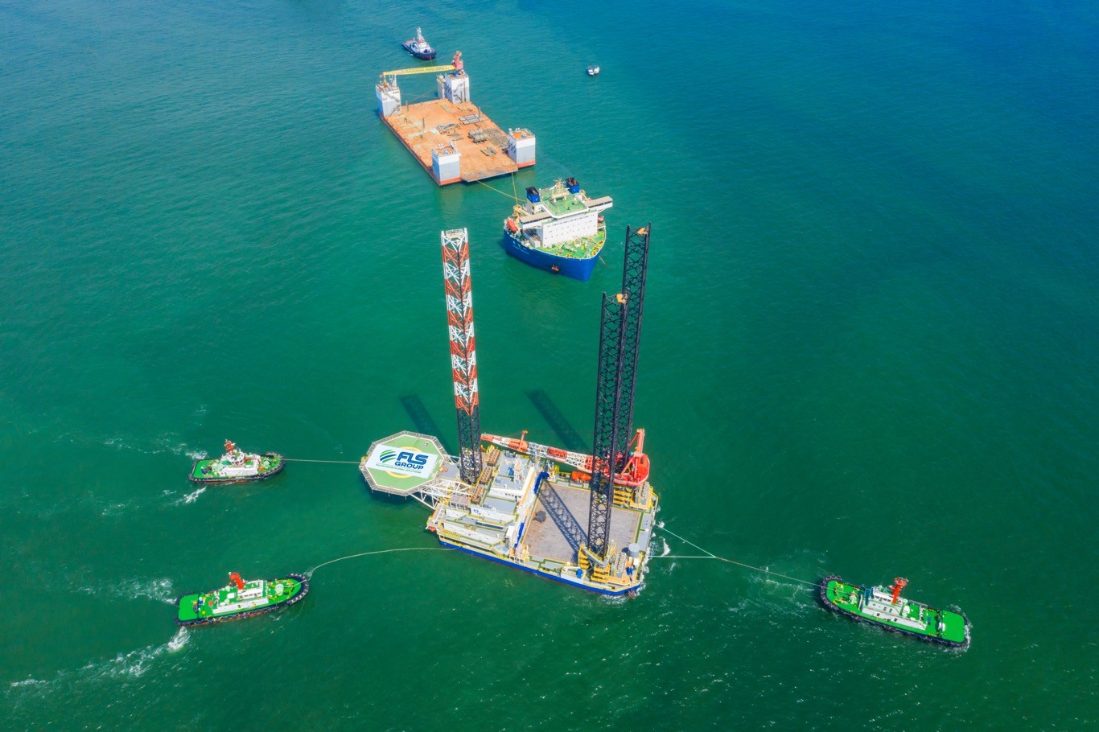
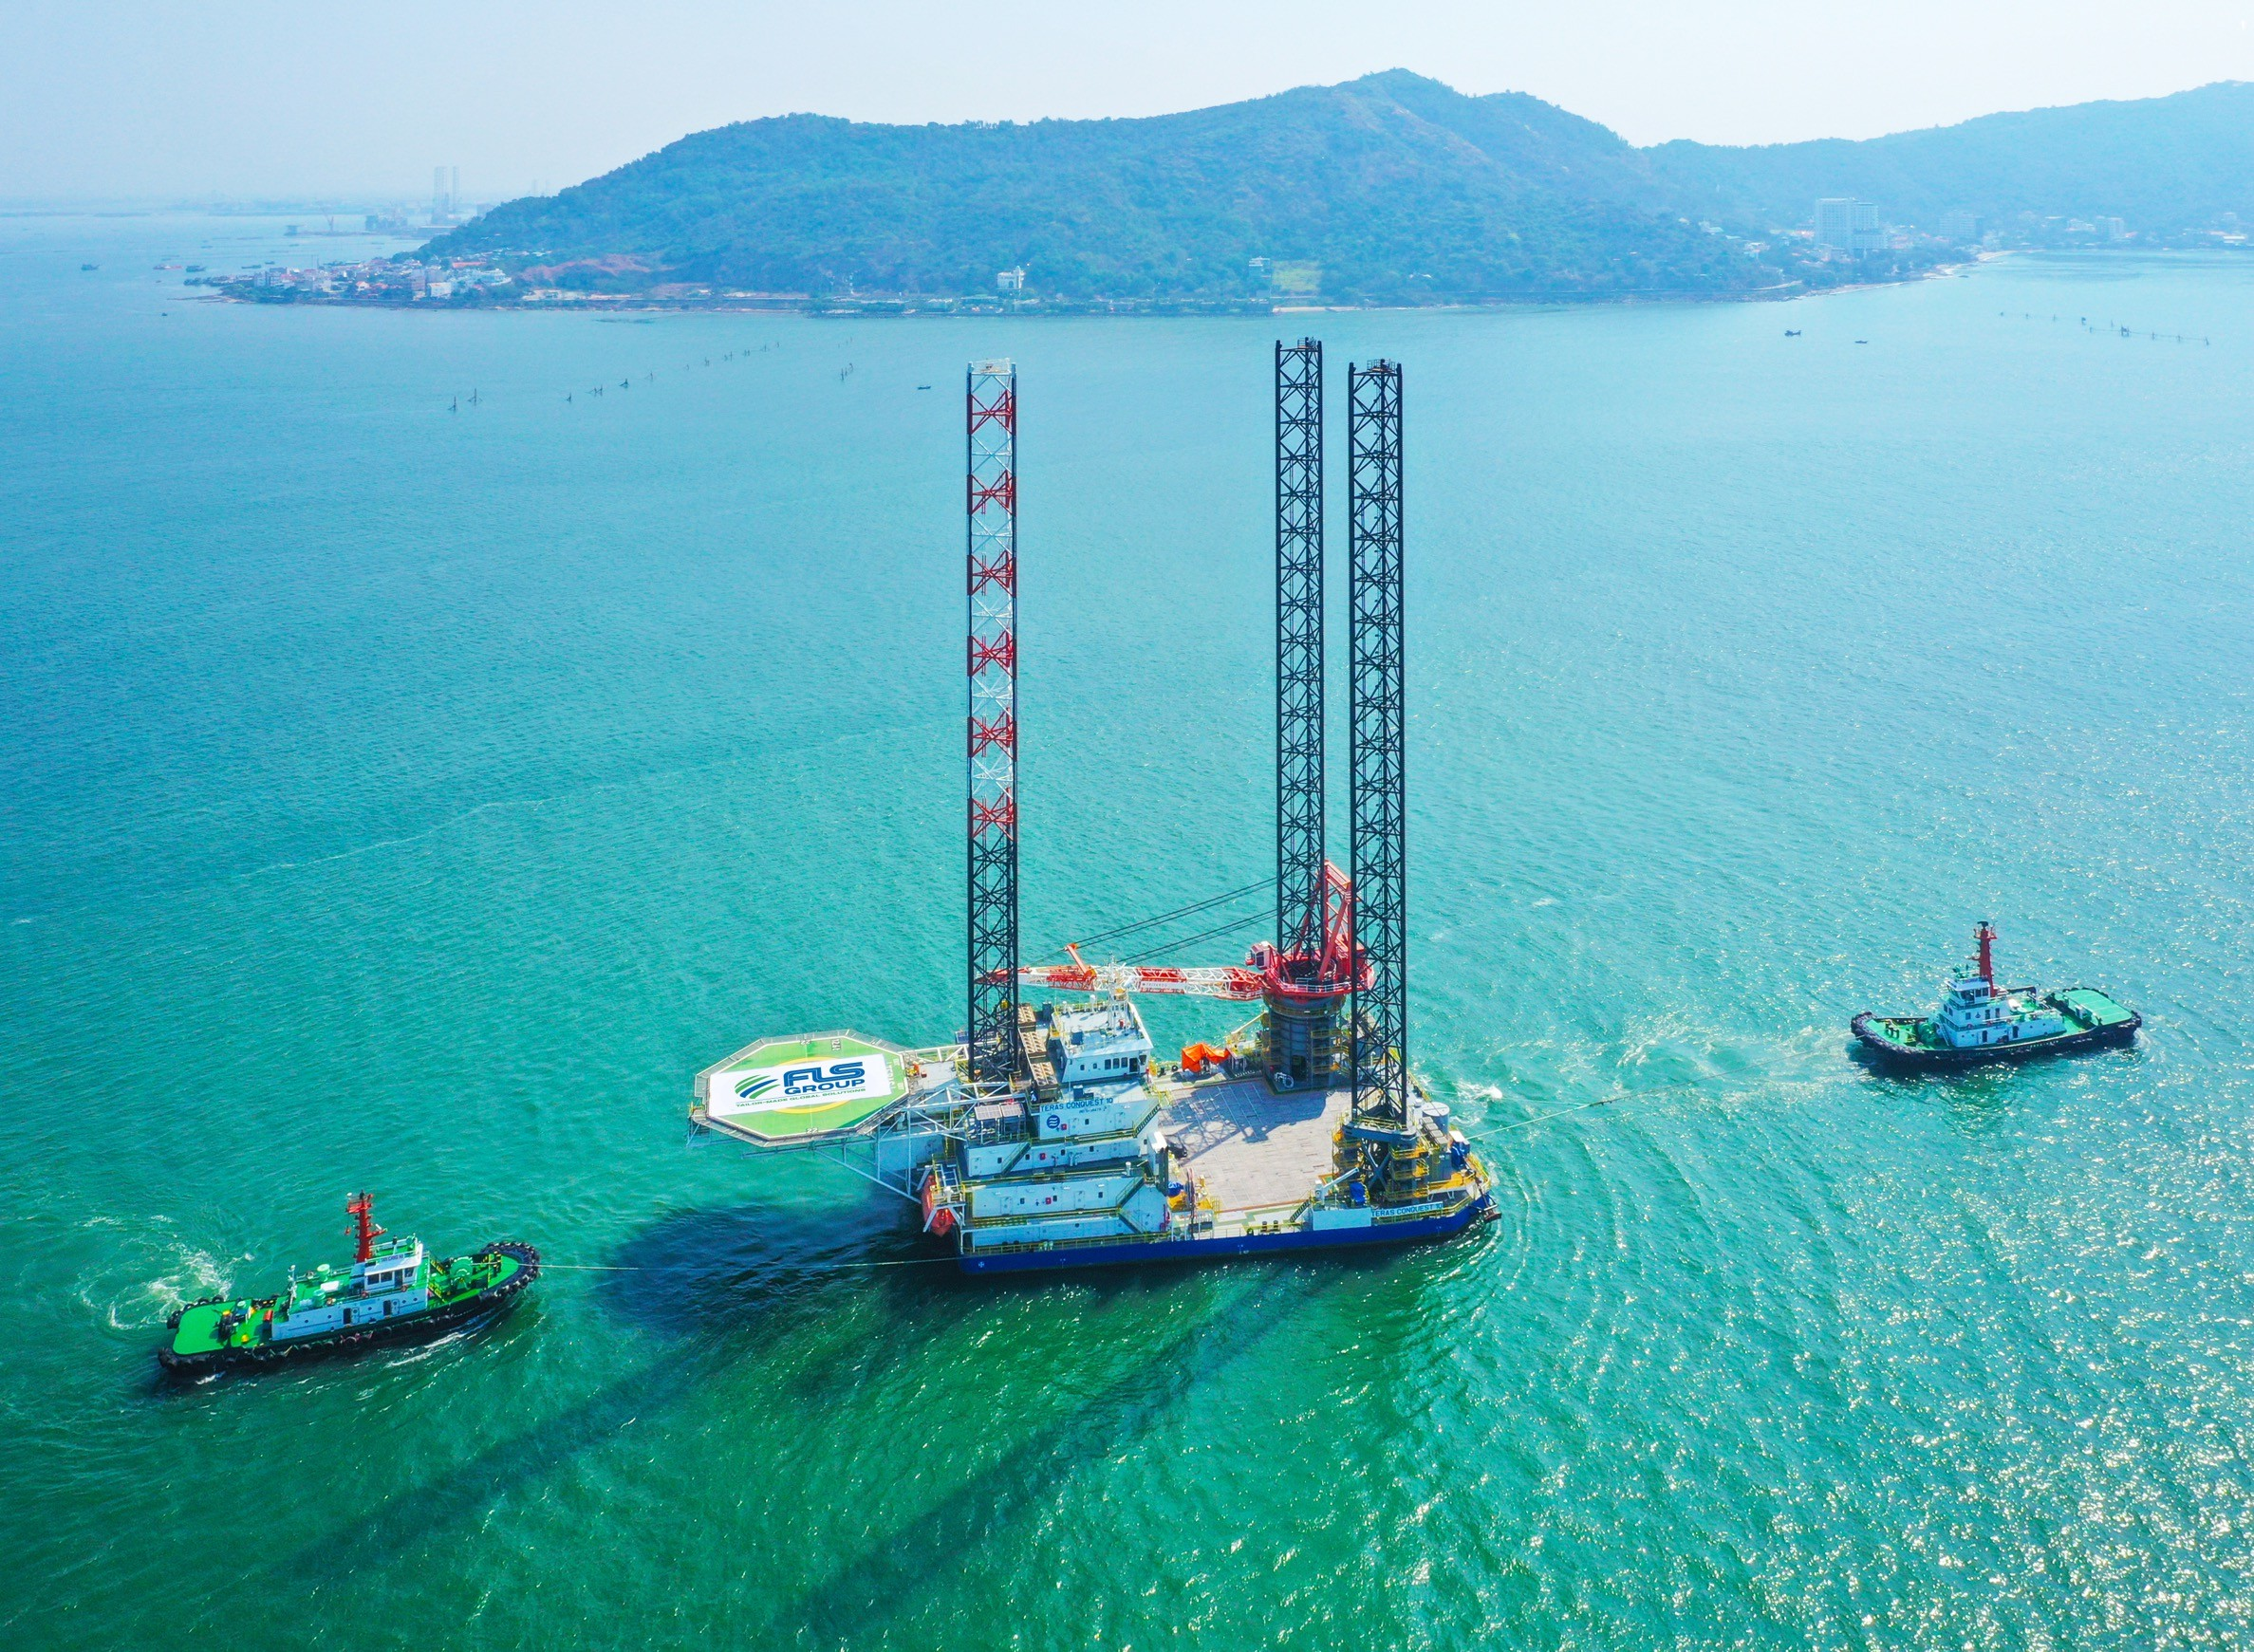
PROJECT REFERENCES
CASE STUDY – SEMI-SUBMERSIBLE (1/2)
Dimensions: Commodity: Origin: Destination:
101.5 x 52.5 x 31 m – 7,000 metric tons Drydock
Vung Tau, Vietnam
Balamban, Philippines
Chartering Semi-submersible Vessel for two Different Cargo Owners
Initially the Drydock was Supposed to be Dry-towed, but FLS Managed to Pair the Dock Together with a Liftboat. This way Both Owners Benefited From Each Other.
FLS Coordinated Towing From Ho Chi Minh City to Anchorage Outside of Vung Tau Port.
Some of the Most Powerful Tugs in Vietnam Were Required to Position the Dock Overnight Just in Time for Readiness of M/V XIANG YUN KOU.
The Port Authority Issued Strict Operational Saftey Guidelines That Have Been Fully Satisfied.
FLS was the Communication Tool Between Cargo and Vessel Owners, Customs, Port Authority, Tug Operators, Marine Warranty Surveyors and Stevedores.
Our Port Captains Have Been on Scene For an Entire Week to Accompany both Assets From Their Origins Until Departure out of Vietnam Waters.
Scope:

