Slide 1
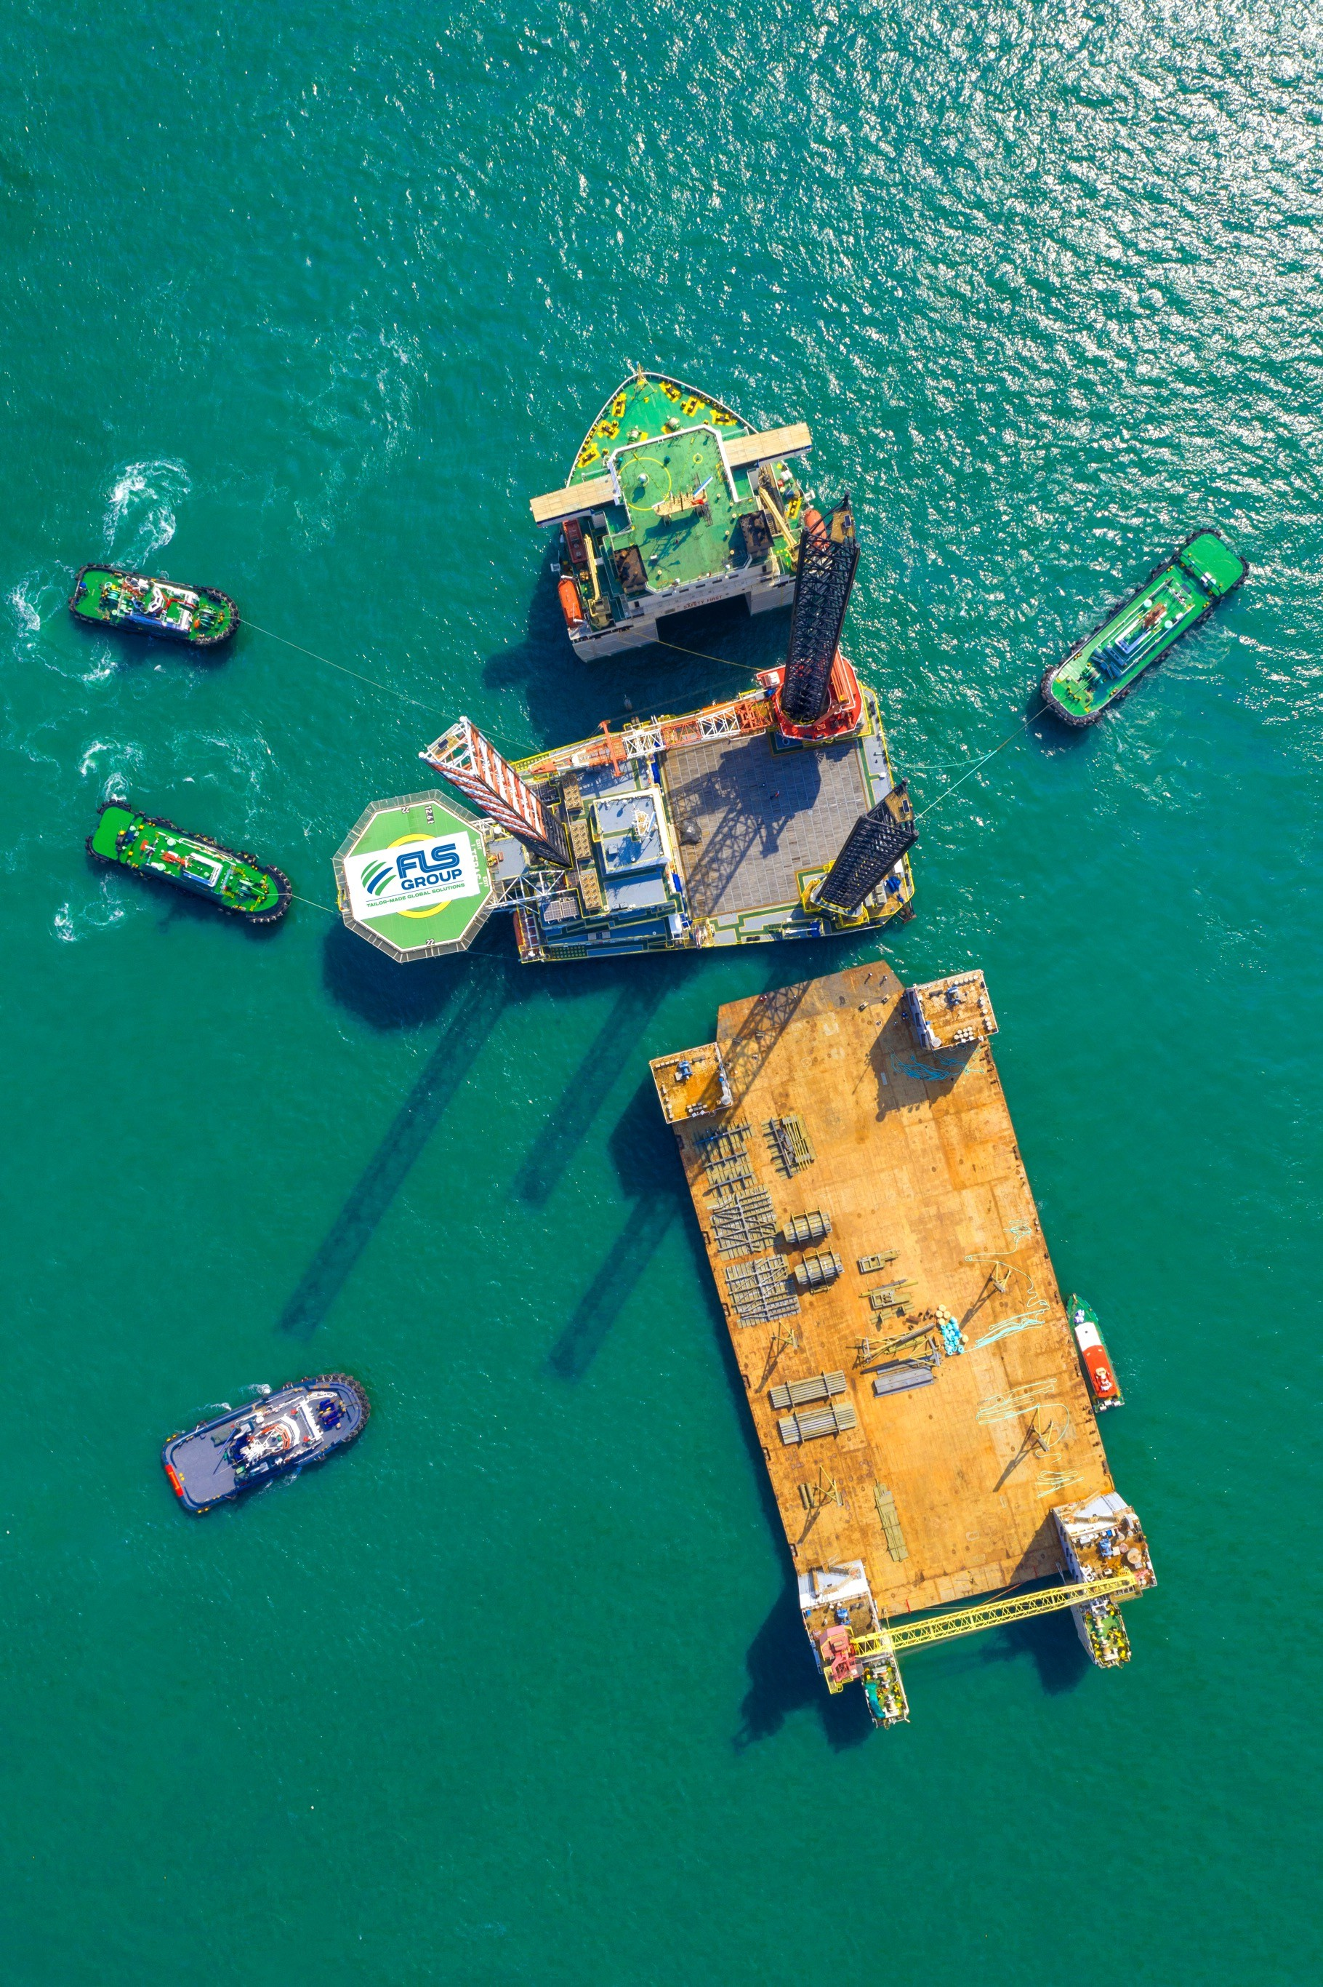
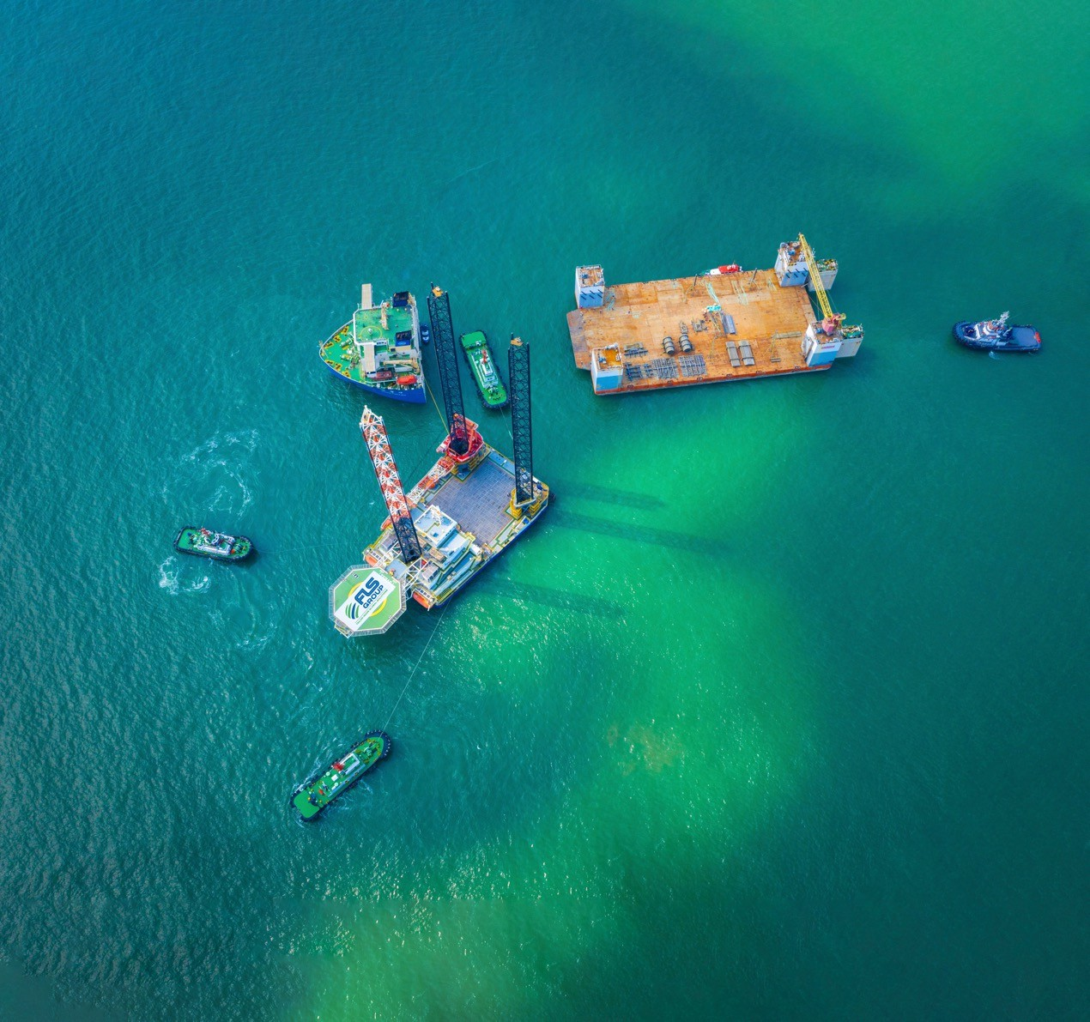
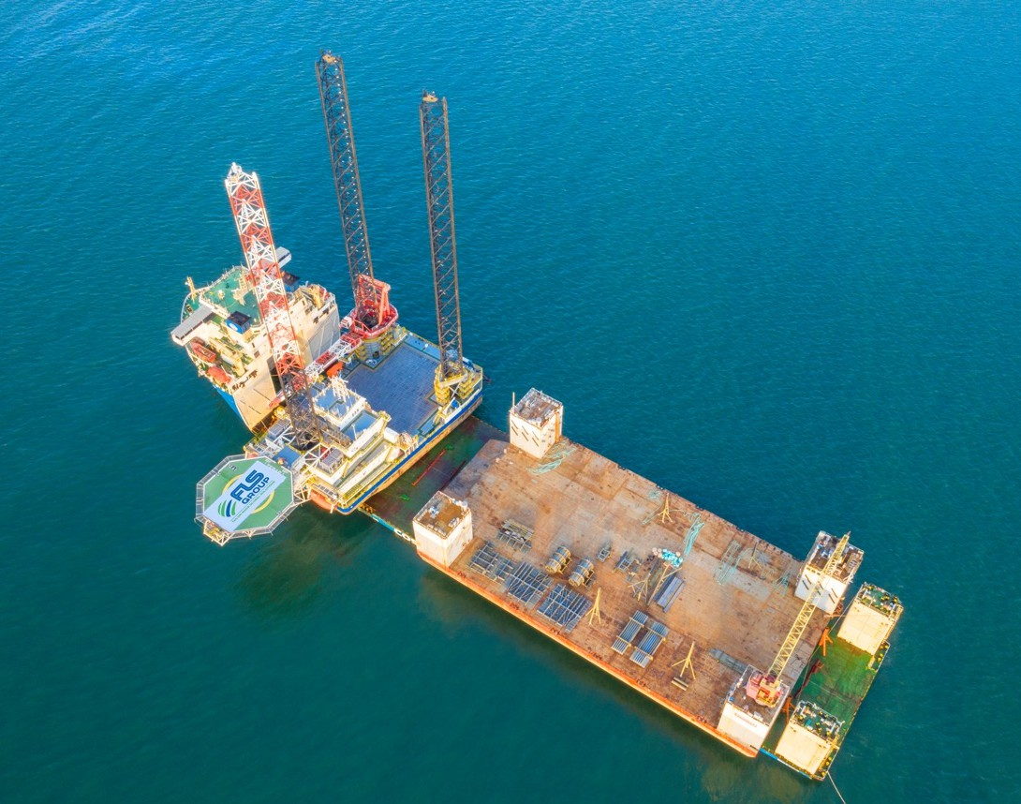
PROJECT REFERENCES
CASE STUDY – SEMI-SUBMERSIBLE (2/2)
Dimensions: Commodity: Origin: Destination:
90 x 42 x 102 m – 6,000 metric tons Liftboat
Vung Tau, Vietnam
Pasir Gudang, Malaysia
Cosco X Class Semi-submersible Vessel was Contracted Having Sufficient Deck Space
FLS Coordinated Towing From Shipyard to Anchorage
Preparation of two Transport Manuals (Liftboat and Drydock)
Approval Process for Both Manuals was Completed in Less Than two Weeks. Two Independent Marine Warranty Surveyors had to Sign-off the Parallel Operation
Scope:

