Slide 1
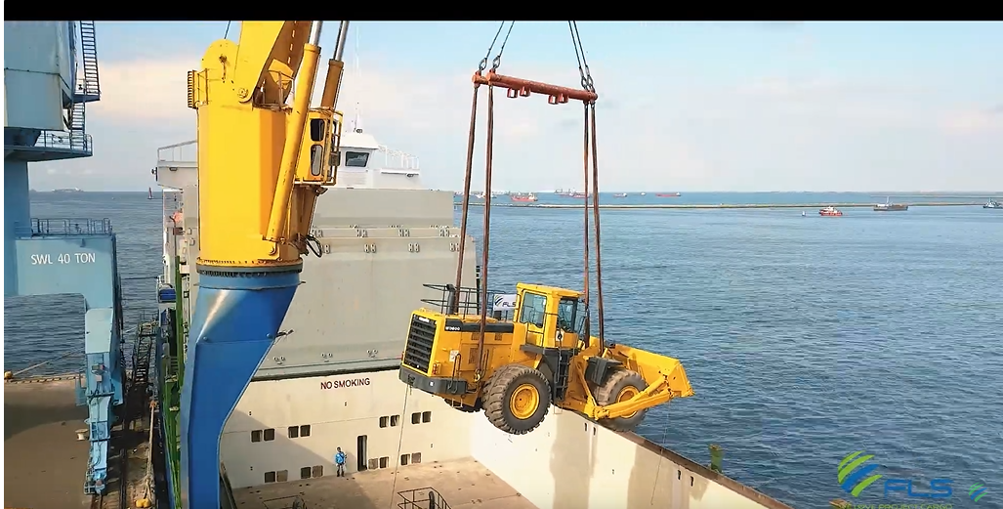
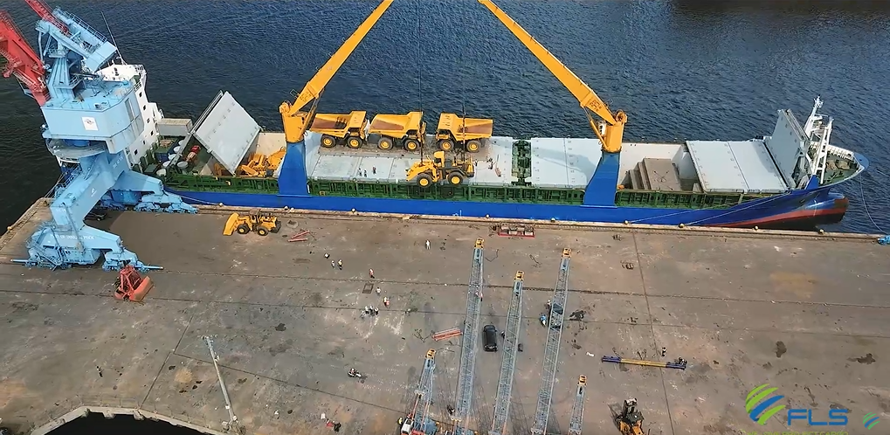
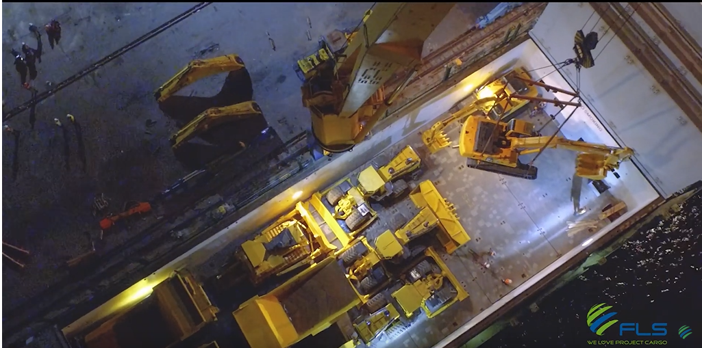
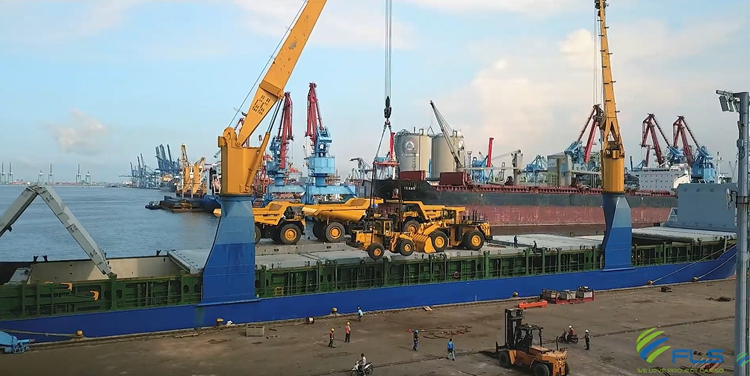
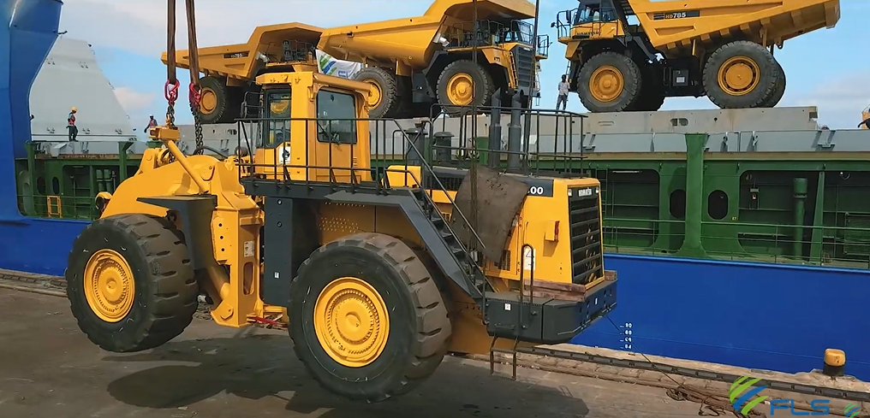
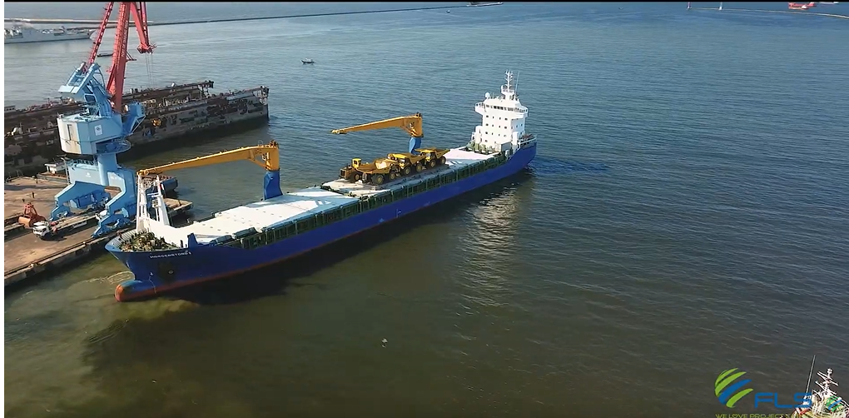
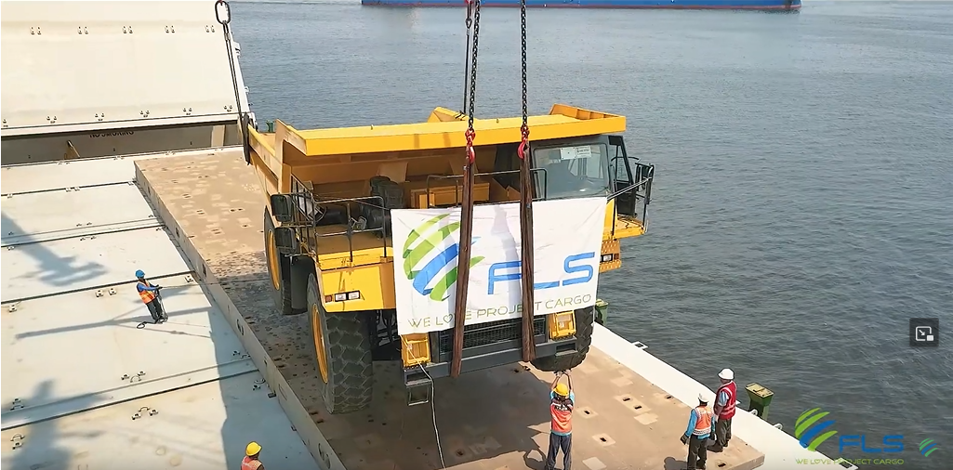
PROJECT REFERENCES
CASE STUDY – HEAVY MINING EQUIPMENT SHIPMENT
Project Name: Heavy mining equipment shipment
Cargo: Excavators, soil dozer, mining dump truck
POL: Ciwandan Port of Banten
POD: Jebel Ali International Port of UAE
Scope:
Vessel chartering services
Port and terminal handling services
Export customs clearance services
Stevedoring loading at Port of Shipment
Lashing, securing, and discharging all cargo material inside sea carrier
Sea freight from Port of Shipment up to Port of Discharging
Arrival at Port of Discharging under CFR terms

