Slide 1
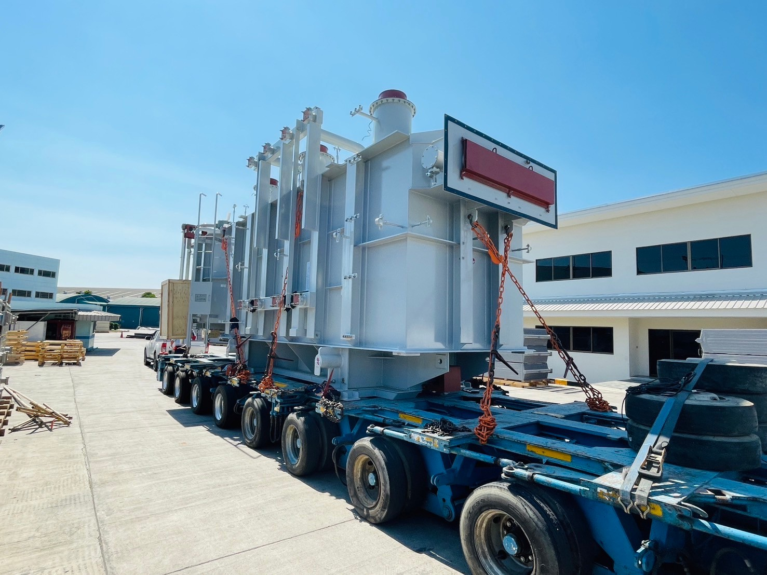
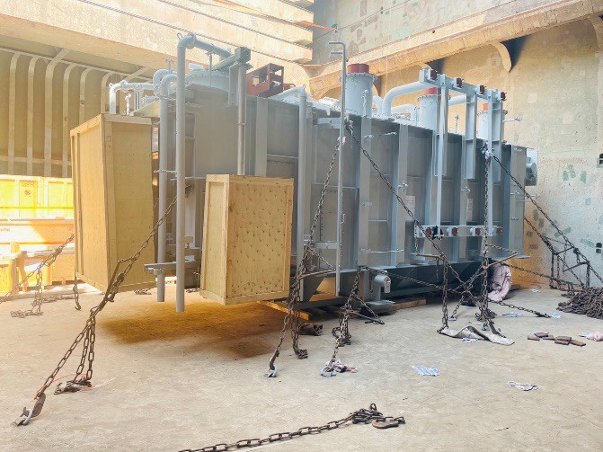
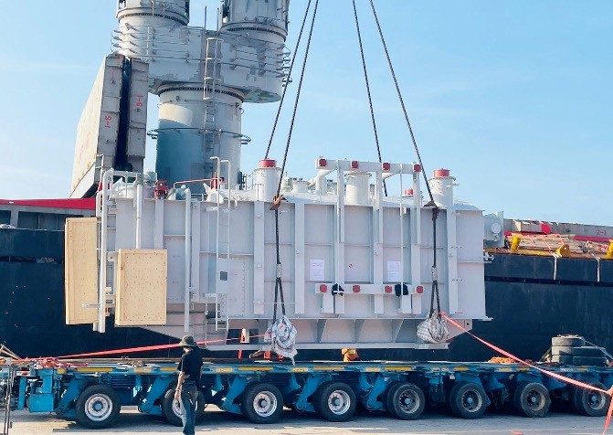
PROJECT REFERENCES
CASE STUDY – TRANSFORMERS #3
Volume: Commodity: Origin: Destination: Year:
268.139 CBM
Transformers and accessories (max weight 78.5mt) Daihen - Laem Chabang, Thailand
Cebu, Philippines 2024
Scope:
Arranging from EXW to FAS Delivery in Laem Chabang
Supervision at loading site
Liasing with all related parties for smooth

