Slide 1
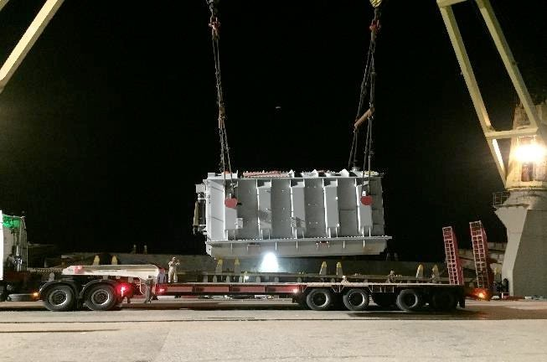
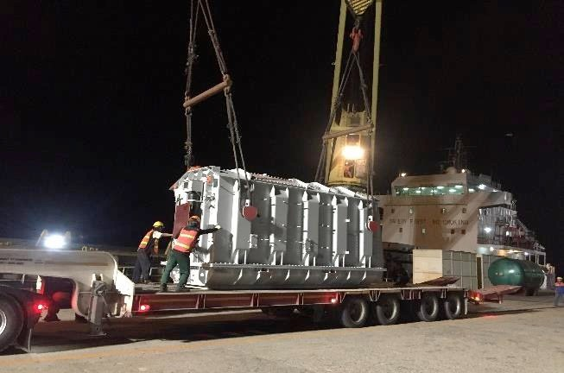
PROJECT REFERENCES
CASE STUDY – TRANSFORMERS #5
Volume: Commodity: Origin: Destination: Year:
Scope:
250 CBM
Transformers and accessories (max weight 44.1mt) Shanghai, China
Laem Chabang, Thailand for destination in Cambodia 2019
Supervision at discharge port
Receiving cargo alongside vessel
Liasing with all related parties for smooth operations
Delivery to destination in Cambodia site by truck
Permit for delivery in Thailand and Cambodia
Jacking and Skidding transformer to foundation

