Slide 1
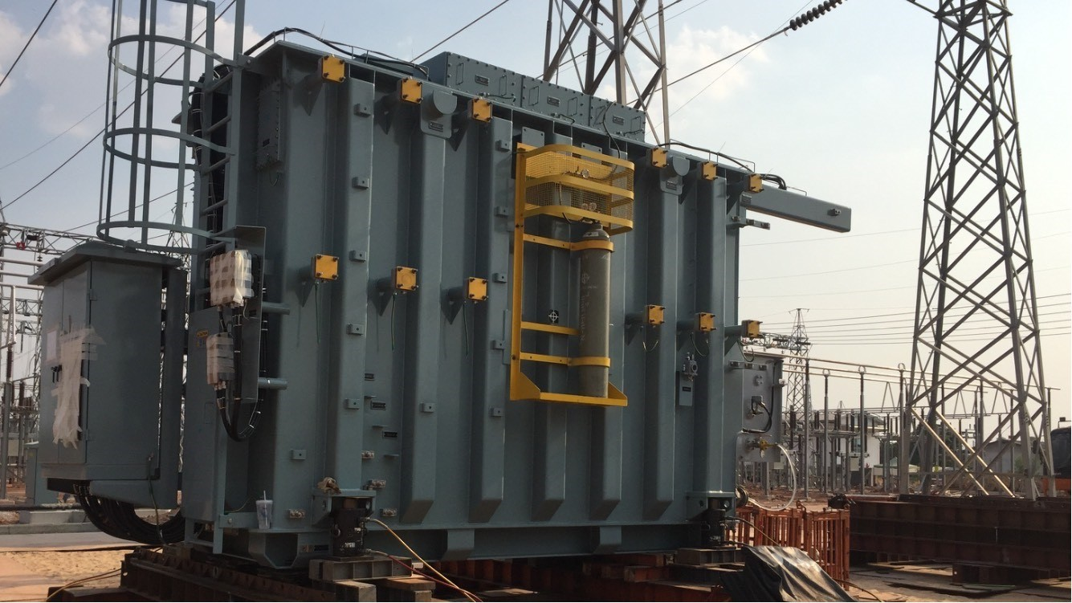
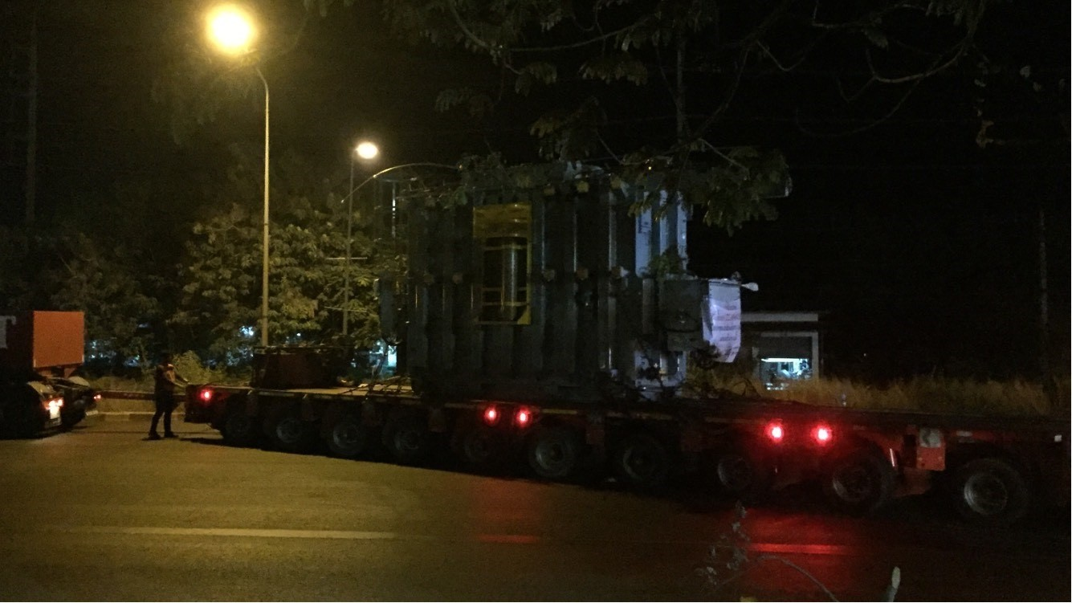
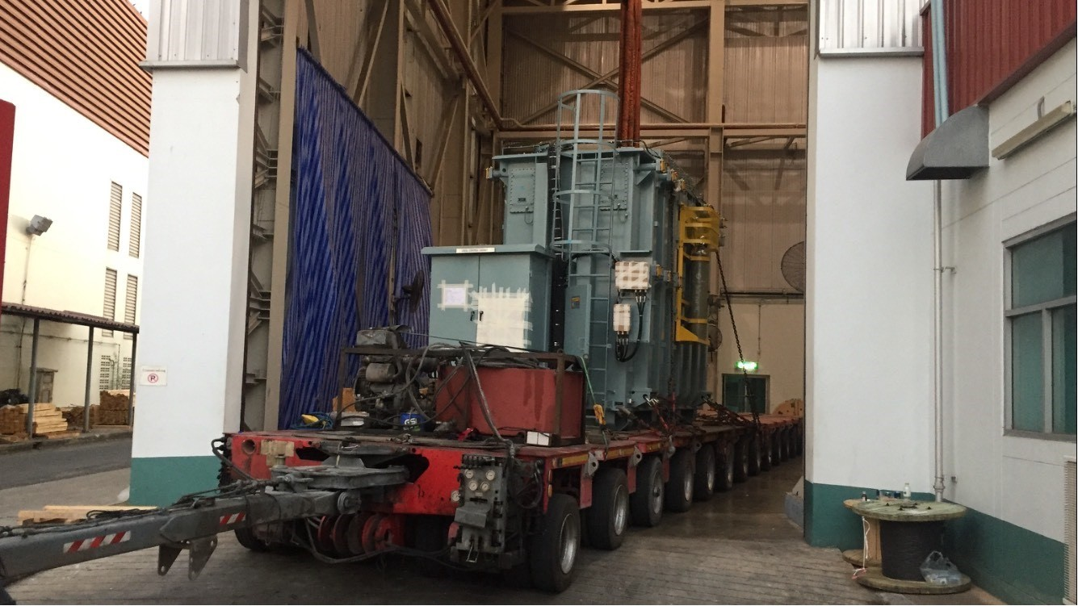
PROJECT REFERENCES
CASE STUDY – TRANSFORMERS
Commodity: Origin: Destination: Year:
Transformers and accessories (max weight 67mt) ThaiTrafo
Buriram, Thailand
2019
Trucking
Transportation plan and DOH permit
Jacking and skidding at site
Scope:

