Slide 1
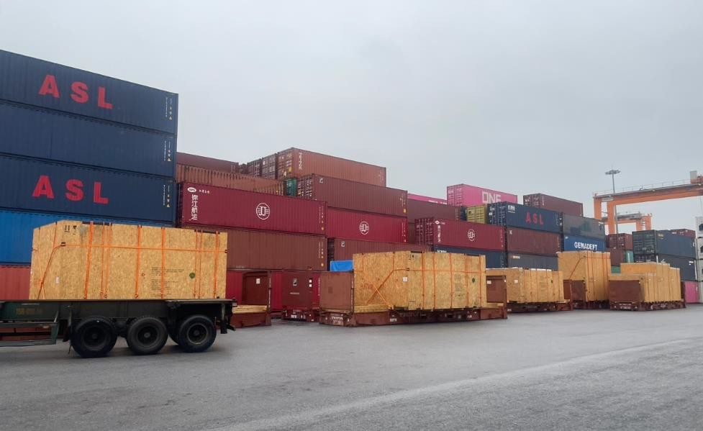
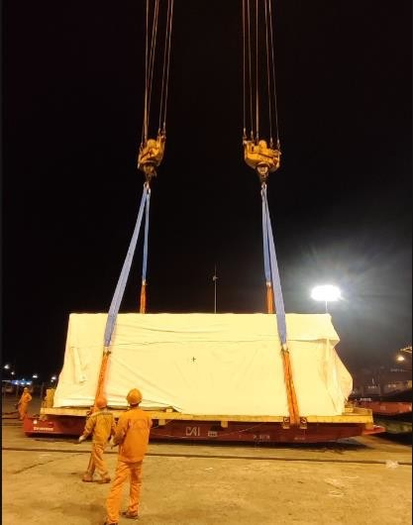
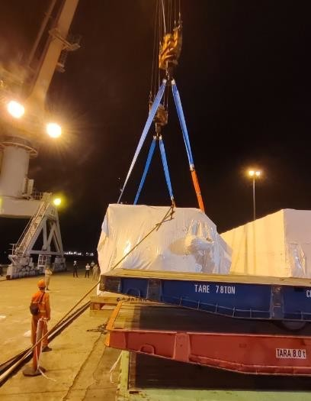
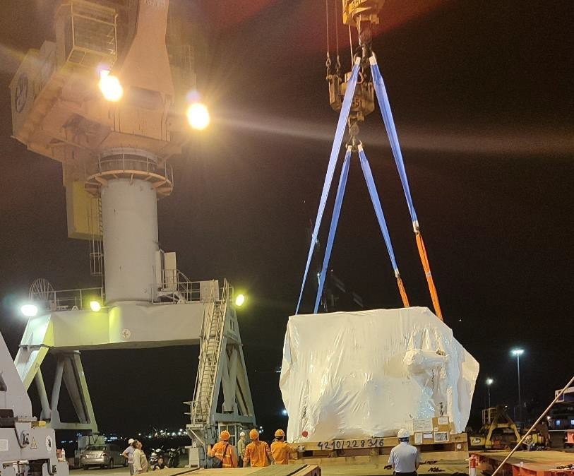
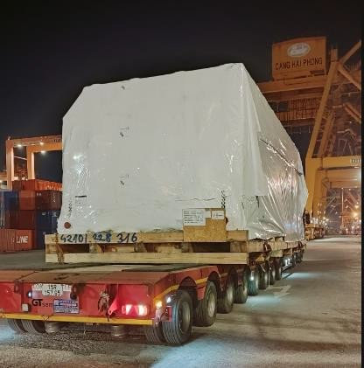
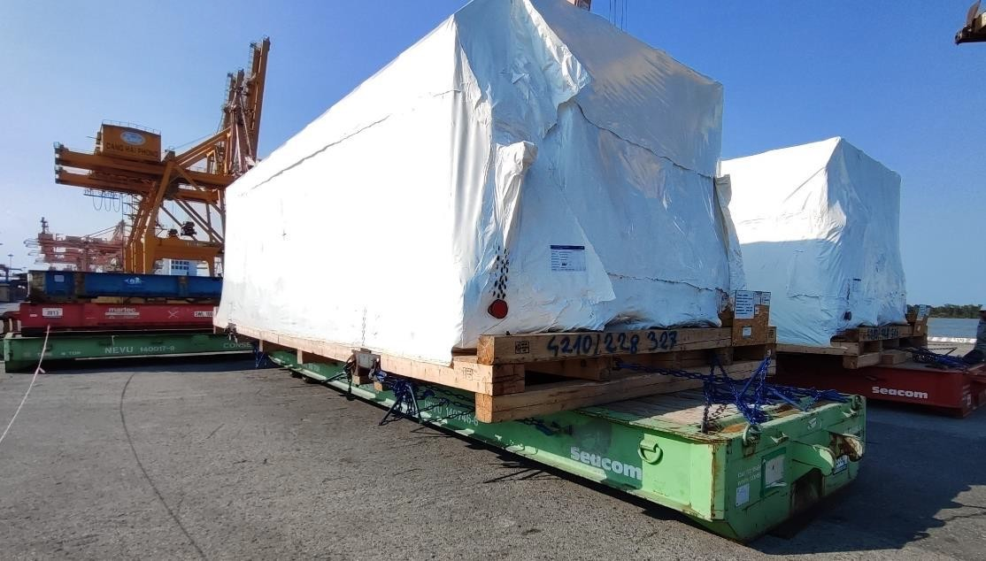
PROJECT REFERENCES
CASE STUDY – MEKONG WOOD MDF PROJECT #3
Project Name: Volume: Origin: Destination:
MEKONG WOOD MDF PROJECT
338 containers / Break Bulk + RoRo: 1,301.7cbm Germany, Turkey, Italy, Sweden, New Zealand Haiphong, Vietnam
Scope:
Delivery of in total 23 shipments ex different origin
locations around to the world up to Haiphong port
Chartering of suitable break bulk and RoRo vessels within the given deadline
Supervision both ends
Implementation of FLS tracking/project management system
Daily updates to the customer / jobsite

