Slide 1
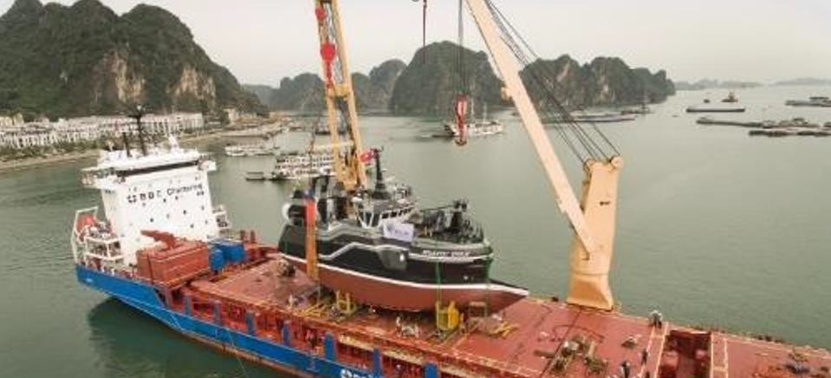
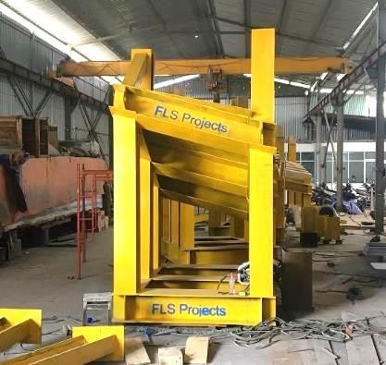
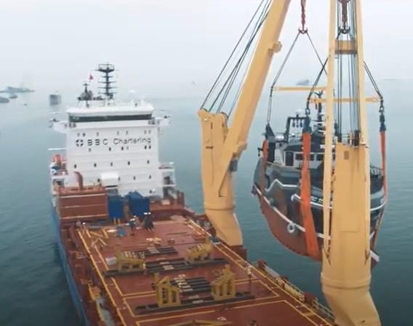
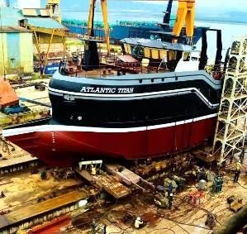
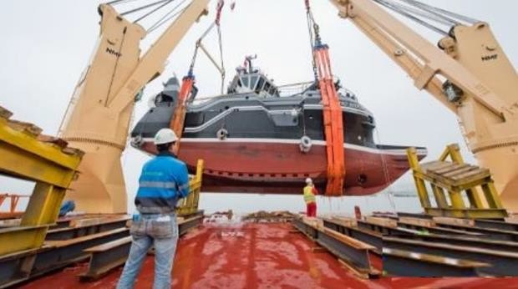
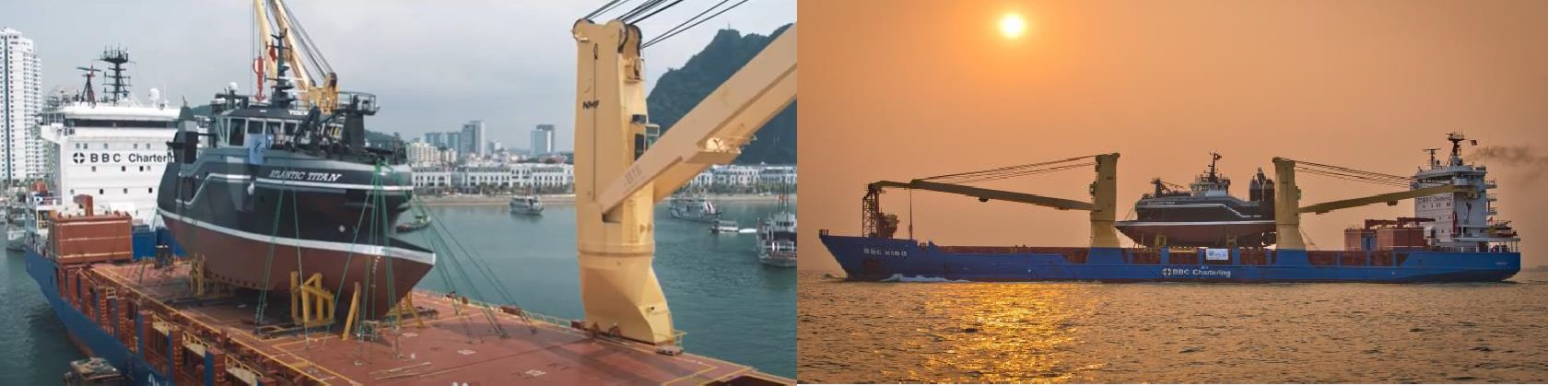
PROJECT REFERENCES
CASE STUDY –
ATLANTIC TITAN
Volume: Origin: Destination:
31.76 x 10.30 x 18 m / 575 MT
Ha Long Anchorage, Vietnam Port Hawkesbury, Canada
Scope:
Delivery from Vietnam to Montreal
Chartering of a suitable heavy lift vessel within tight schedule
In-house engineering &design/fabrication of special steel cradles (17 MT)
Hooking on including arrangement of divers
Supervision both ends
Lashing and securing on the vessel
Hiring of experienced marine divers to ensure the correct position of the slings under the hull

