Slide 1
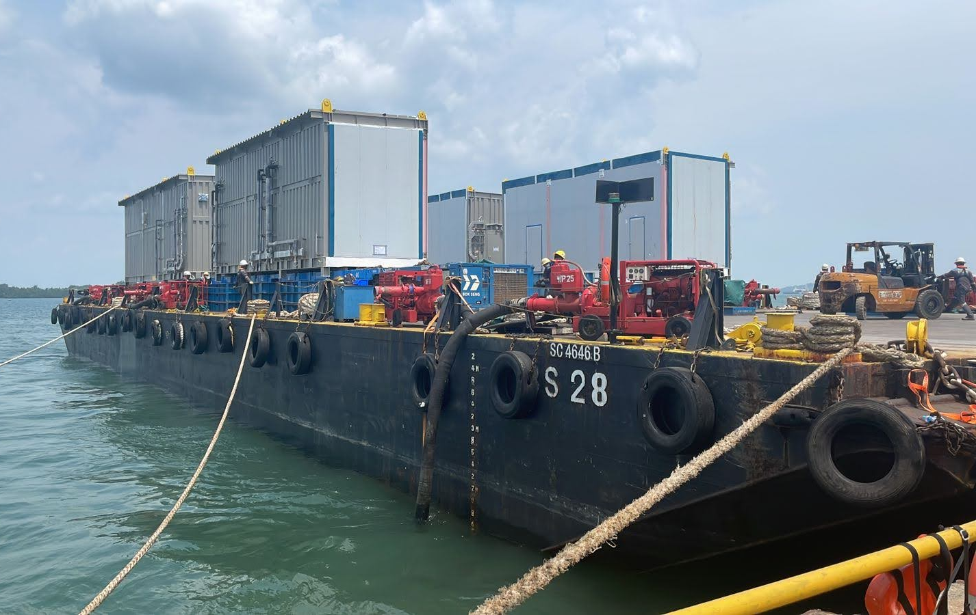
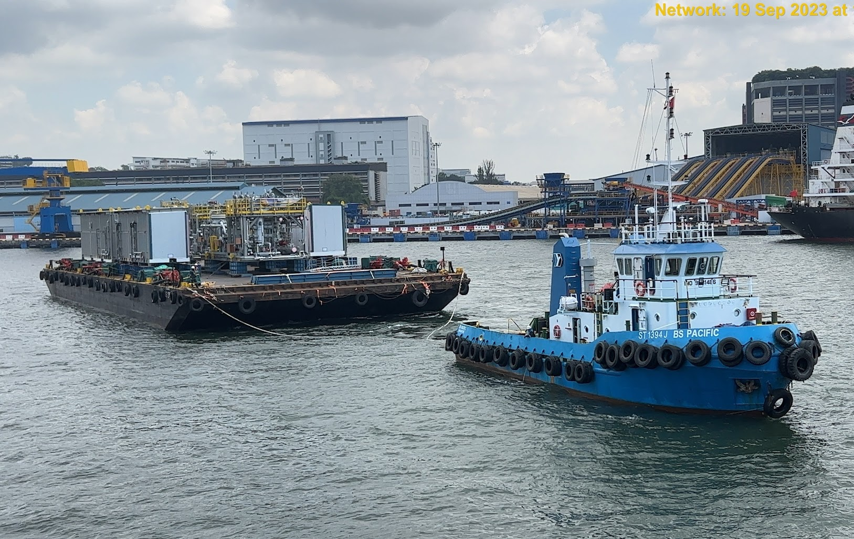
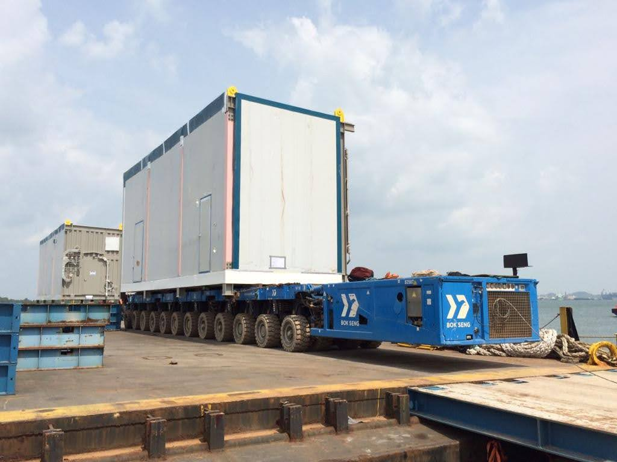
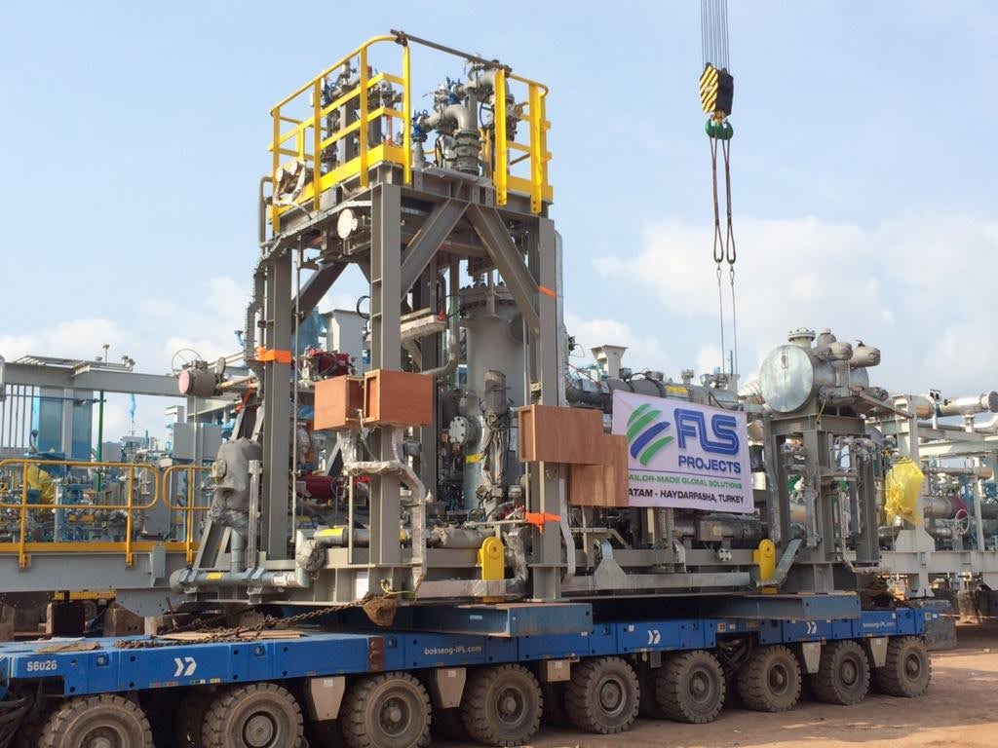
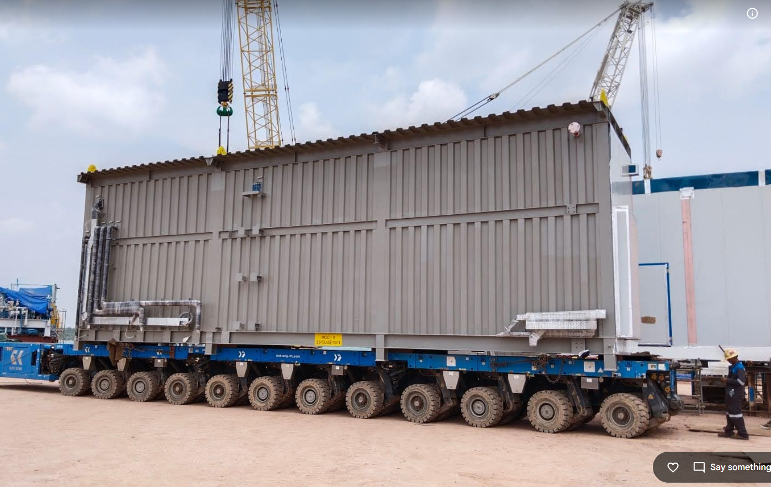
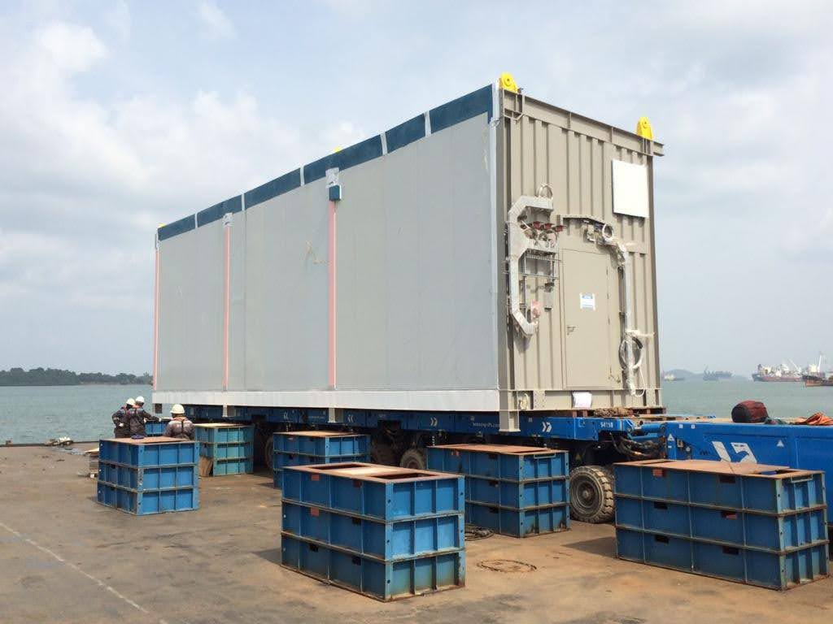
PROJECT REFERENCES
CASE STUDY – Roll-on / Roll-off and Barging of Modules/Sea Freight
Project Name: PROJECT DP3 COMPRESSION PACKAGE
Cargo: Compressor Modules and E-houses
Volume: 43 packages / 566,423 kgs / 3,824.08CBM
Heaviest 138Mt (MAIN INLET COMPRESSOR)
Origin: WASCO, Batam
Destination: Jurong, Singapore
Consignee: Total
Scope:
RORO ex Wasco Batam Jetty onto barge for the OOG items (Bok Seng’s Barge)
LOLO ex Wasco Batam Jetty onto barge for other smaller items (Infiniti’s Barge)
Freight from Batam to Singapore, Jurong port
Overside loading in Jurong port

