Slide 1
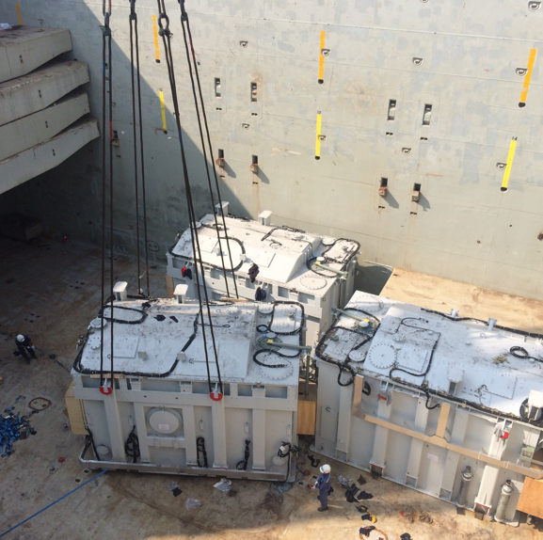
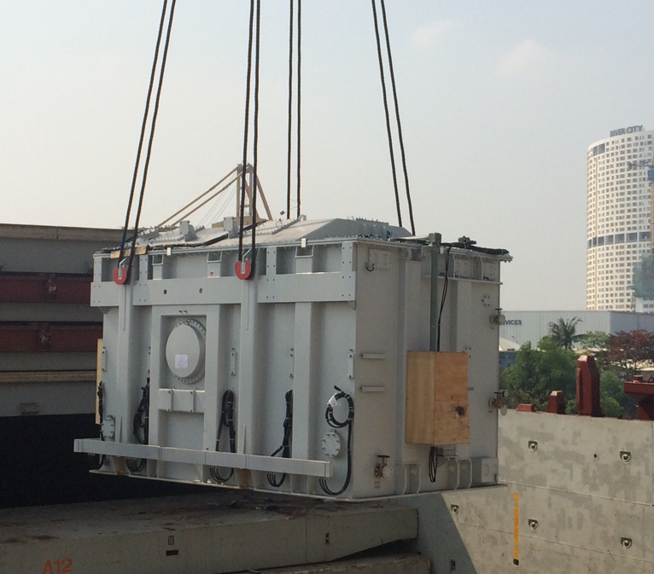
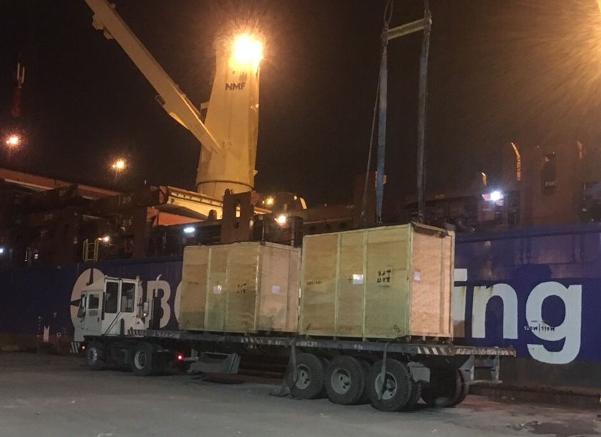
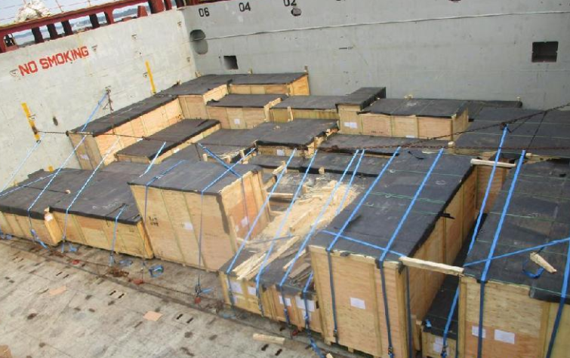
PROJECT REFERENCES
Case Study – 744.9m3, 546 tONS 500kv tan dinh substation PROJECT
Volume: 744.9 m3 ,546tons heavy 3x155tons
52 packages
Origin: Shanghai port, China
Destination: Ho chi Minh, VietNam
Scope:
Full liner terms ocean freight
Chartering heavy lift vessel
Port handling and discharge to FAS
Discharge cargo out vessel incl appropriate cargo stow arrangements. Cargo hold preparation for discharge by FLS own stevedores
Discharge and load on trucks under supervision by FLS Port Captain

