Slide 1
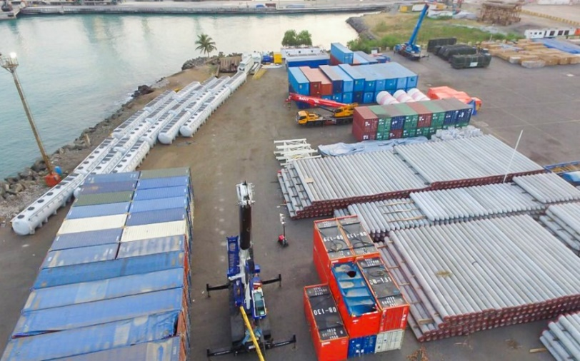


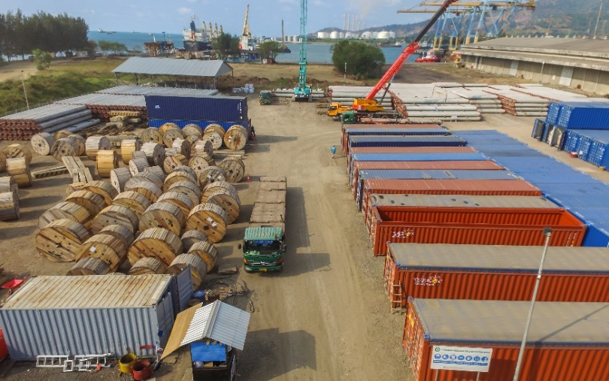
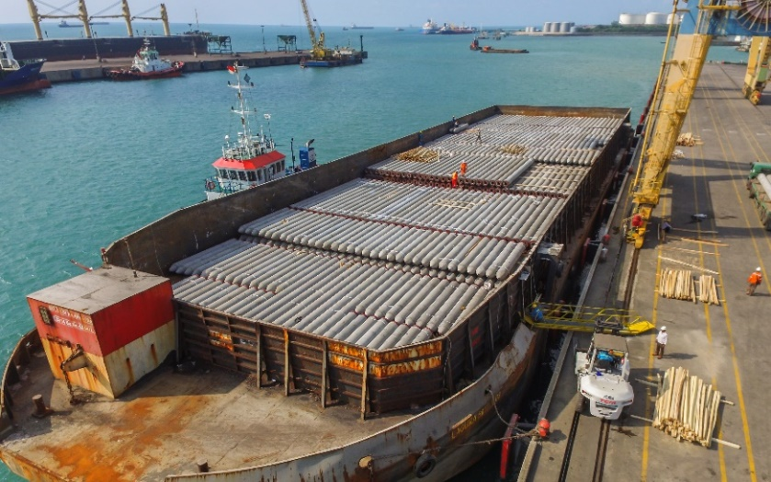
PROJECT REFERENCES
CASE STUDY – Tangguh Expansion Project (1/2)
Project Name: Tangguh Expansion Project
Client: Chiyoda, Saipem, Tripatra, SAE
Project Owner: British Petroleum (BP Plc)
Volume: Appr. 100,000+ FRT
Commodity: General cargo, Container
Origin: International, Domestic cargo
Destination: Tangguh Project Site, West Java
Project duration: 2017 – 2021 (4 Years)
Scope:
Receiving international cargo from vessel (incl. stevedoring) or at container yard
Receiving domestic cargo at EXW factory or FOT truck at yard
Transportation to yard and offloading to safe storage location
Building and maintaining Marshalling Yard
Inventory Management & Reporting
Repacking and container stuffing
Cargo preservation
Stowage planning and Lashing calculations
Coordination with port for berthing permits
Transportation from yard to port
Loading to barge, LCT and multi purpose vessel incl. stevedoring

