Slide 1
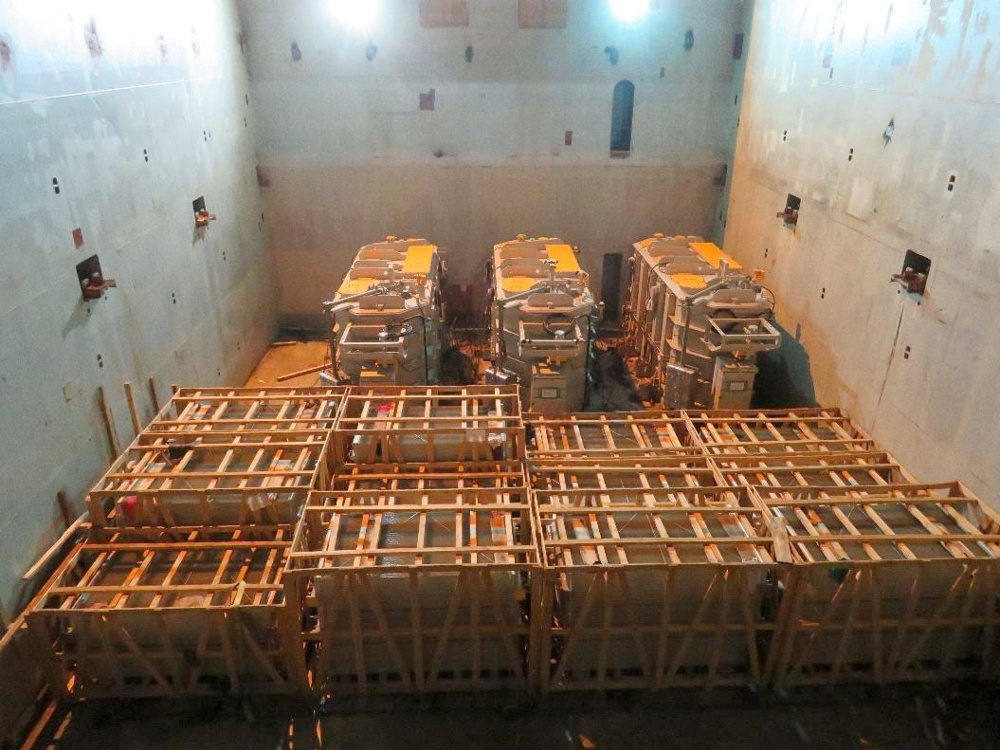
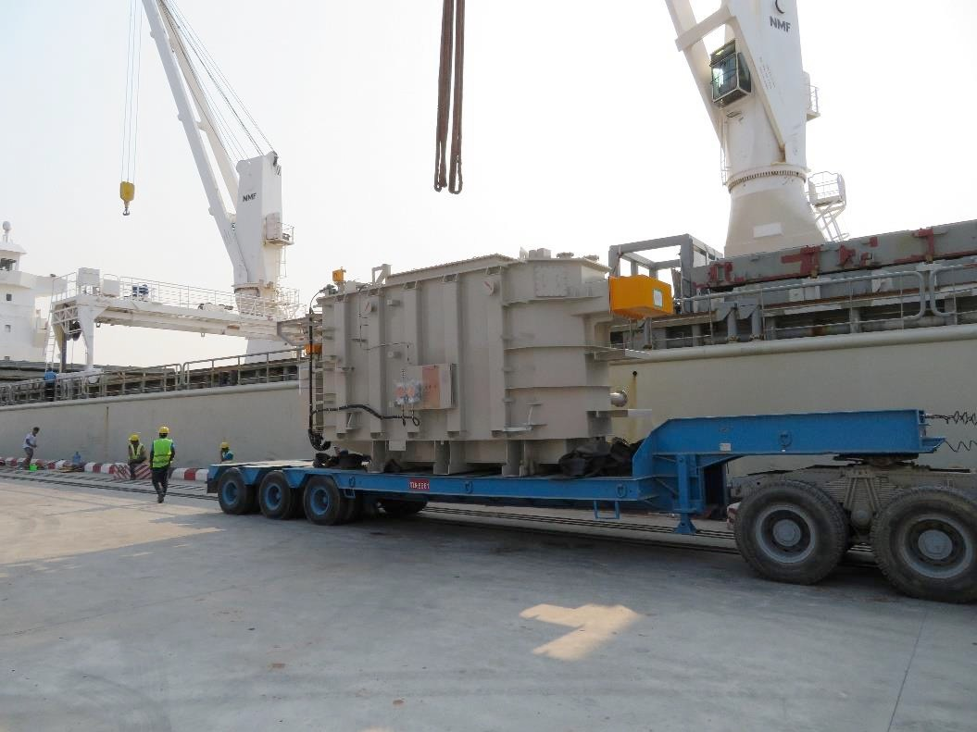
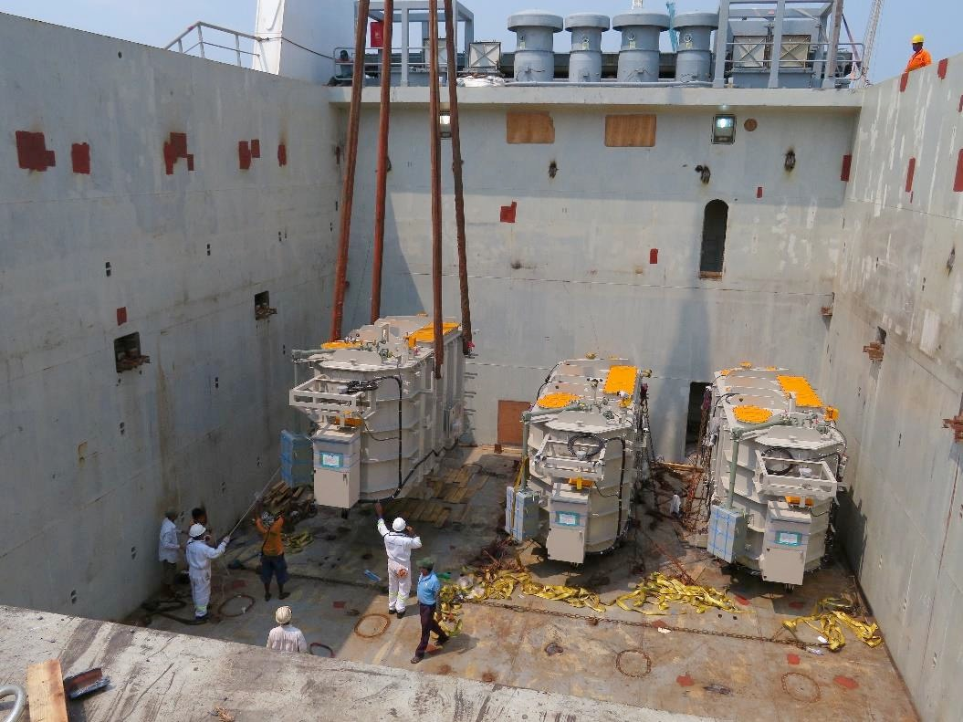
PROJECT REFERENCES
CASE STUDY – TRANSFORMERS #4
Volume: Commodity: Origin: Destination: Year:
505.4 CBM
3 Units of transformers and accessories (max weight 44mt) Yokohama, Japan
Yangon, Myanmar 2018
Chartering of suitable vessel for the cargo
Supervision at loading and discharge port
Liasing with all related parties for smooth operations
Scope:

