Slide 1
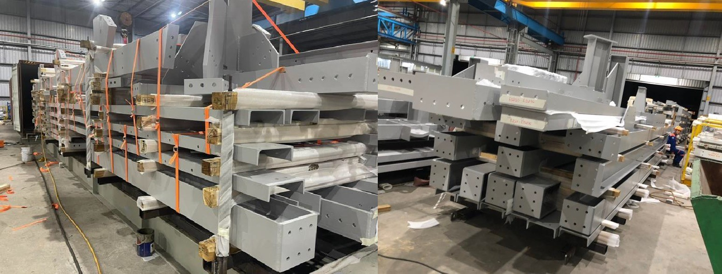
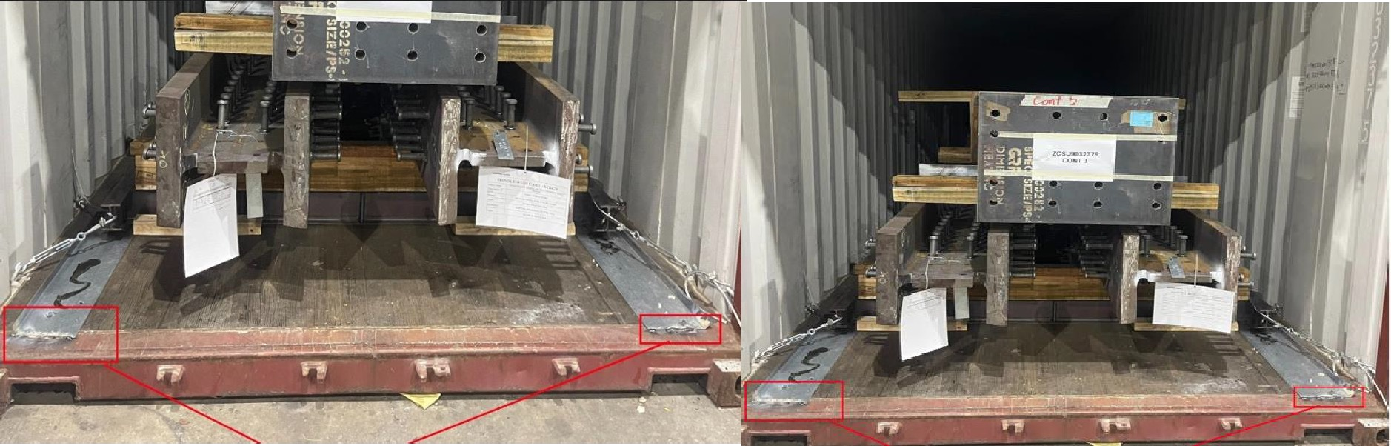
PROJECT REFERENCES
CASE STUDY – ALGOMA DUSTWOOD – WEATHERING STEEL PROJECT
Project Name:
Volume: Commodity: Origin (POL): Destination (POD):
Algoma Dusthood /Weathering steel project Steel Structures
Containers : 71 (40’HC and 45’HC) 1700 MT
Vung Tau
Vancouver – Toronto – Jobsite Saul St. Marie, Canada
Scope:
Handling and booking the transport from FOB Vung Tau up to DDP Canada
Supporting our client with a special tracking system tool, to keep control for every container
Co-ordination and supervision at the port and jobsite

