Slide 1
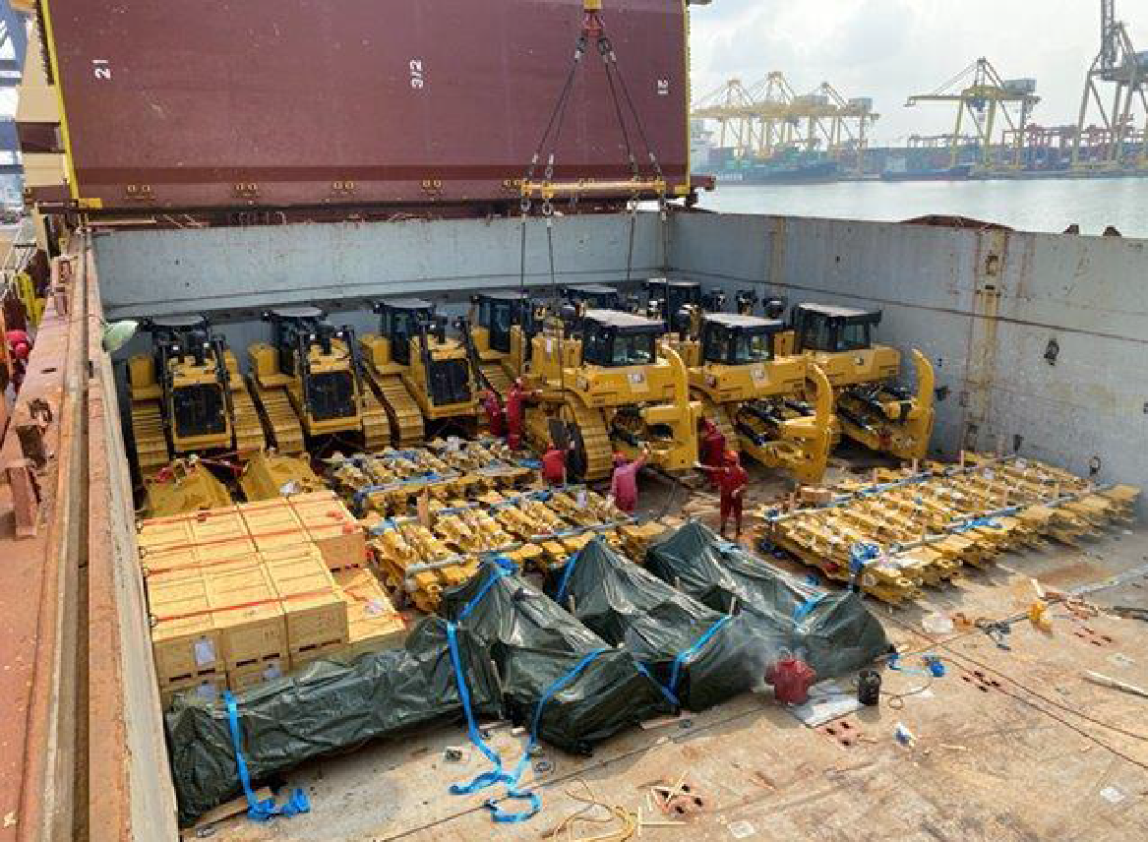
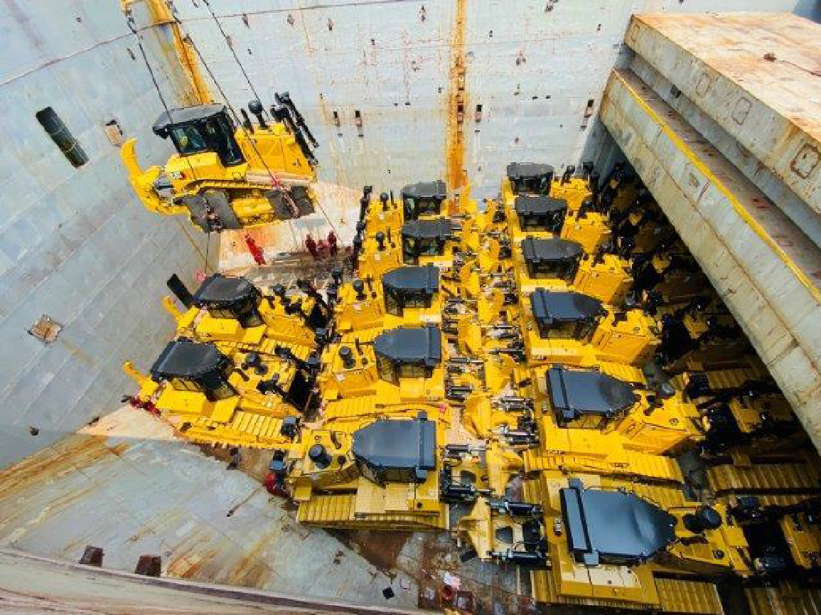
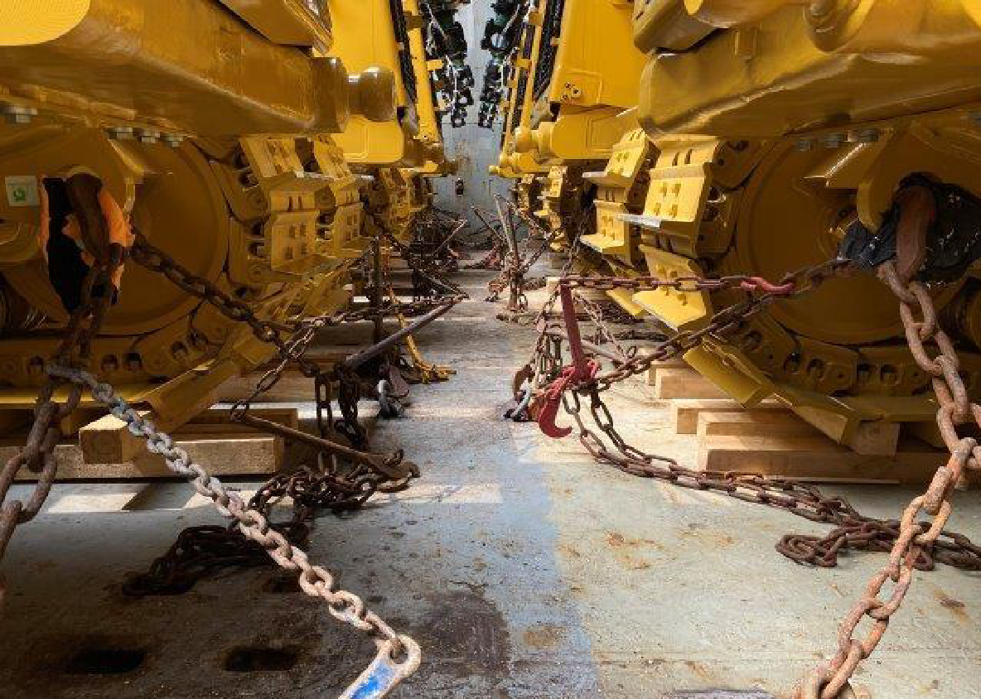
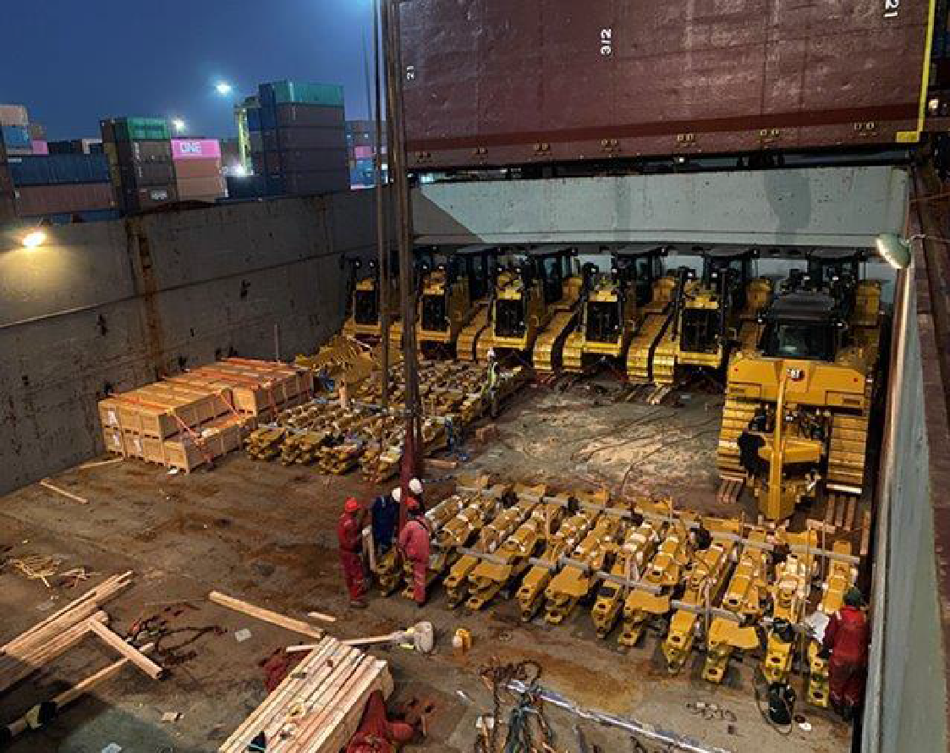
PROJECT REFERENCES
CASE STUDY - CATERPILLAR
Project Name:
Volume:
Commodity:
Origin:
Destination:
Various
Approx 5,000 CBM for 2 shipments under deck
Bulldozers / Excavators
Laem Chabang, Thailand
Middle East
Scope:
Booking vessel according to client’s requirement
Coordinating with agent and vessel for proper loading/lashing method as per client’s instruction
Port Storage and handling
Loading supervision at Origin and Discharging supervision at destination

