Slide 1
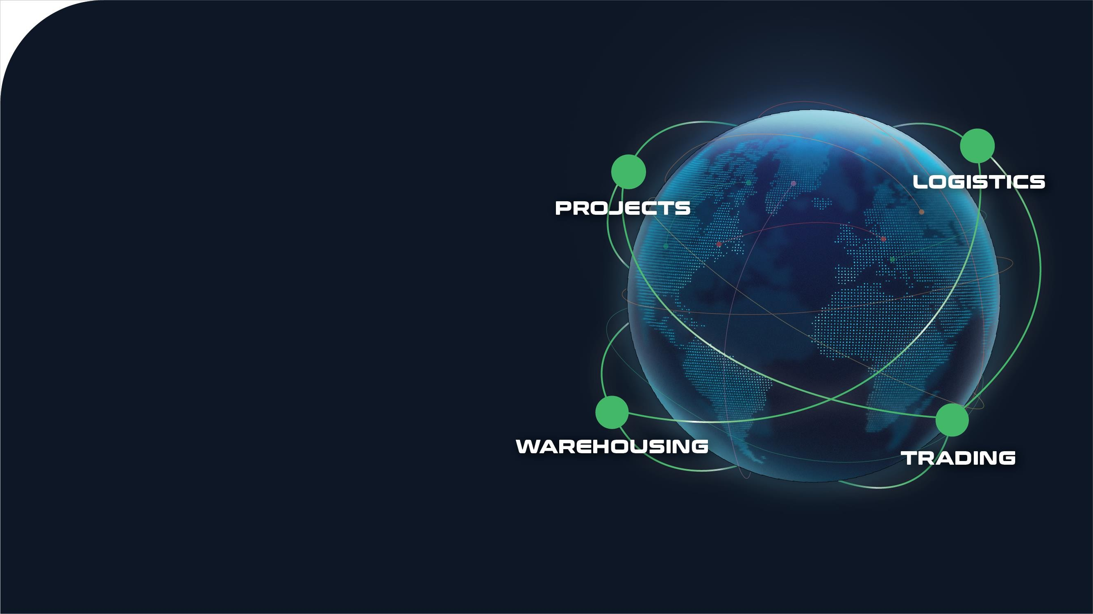




5th April
11

Slide 2


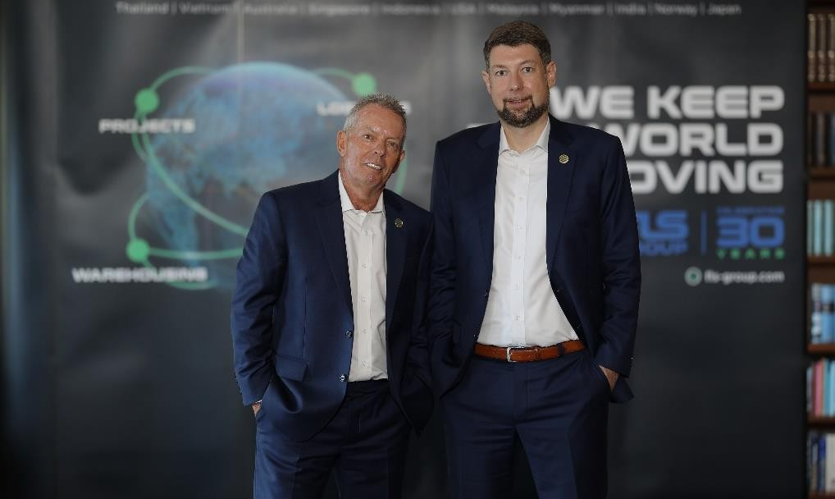

1998 to 2023
By the year 1998, FLS ventured more and more into handling export projects from steel fabricators in Thailand, Korea, China, Vietnam, Malaysia and Indonesia to worldwide destinations for many global engineering companies and EPC contractors.
FLS History
In order to support our customers with even better service and faster communication, we moved our office to Laem Chabang in June 2006. This strategic move – we are now located within maximum 50 km from Thailand’s most important project port facilities – proved to be very successful because it allows us to be even more “hands-on”.
Early Years
The company was founded in Bangkok in May 1993 by our
current Chairman Martin Haeberli.
Today our team consists of a number of expat and local project specialists, led by our CEO Torbjoern Larisch.
With his successful background in the project business, including many years of experience in the US, the Middle East and in Thailand FLS immediately started making an impact in Thailand’s project forwarding market.
Regional Expansion
2011 - FLS (Vietnam) Ltd.
2013 - FLS (Australia) Pty Ltd.
2014 - FLS (Singapore) Pte Ltd.
2014 - PT. Federal Logistik Sistem (Indonesia)
2016 - FLS USA
2018 - FLS Malaysia
2020 - FLS Myanmar
2022 - FLS India
2023 - FLS China and FLS Japan
Soon, FLS started winning various medium sized import projects in the industrial, power and mining sectors.
In the short to medium term further expansion is planned for South East Asia and the Middle East.

Slide 3
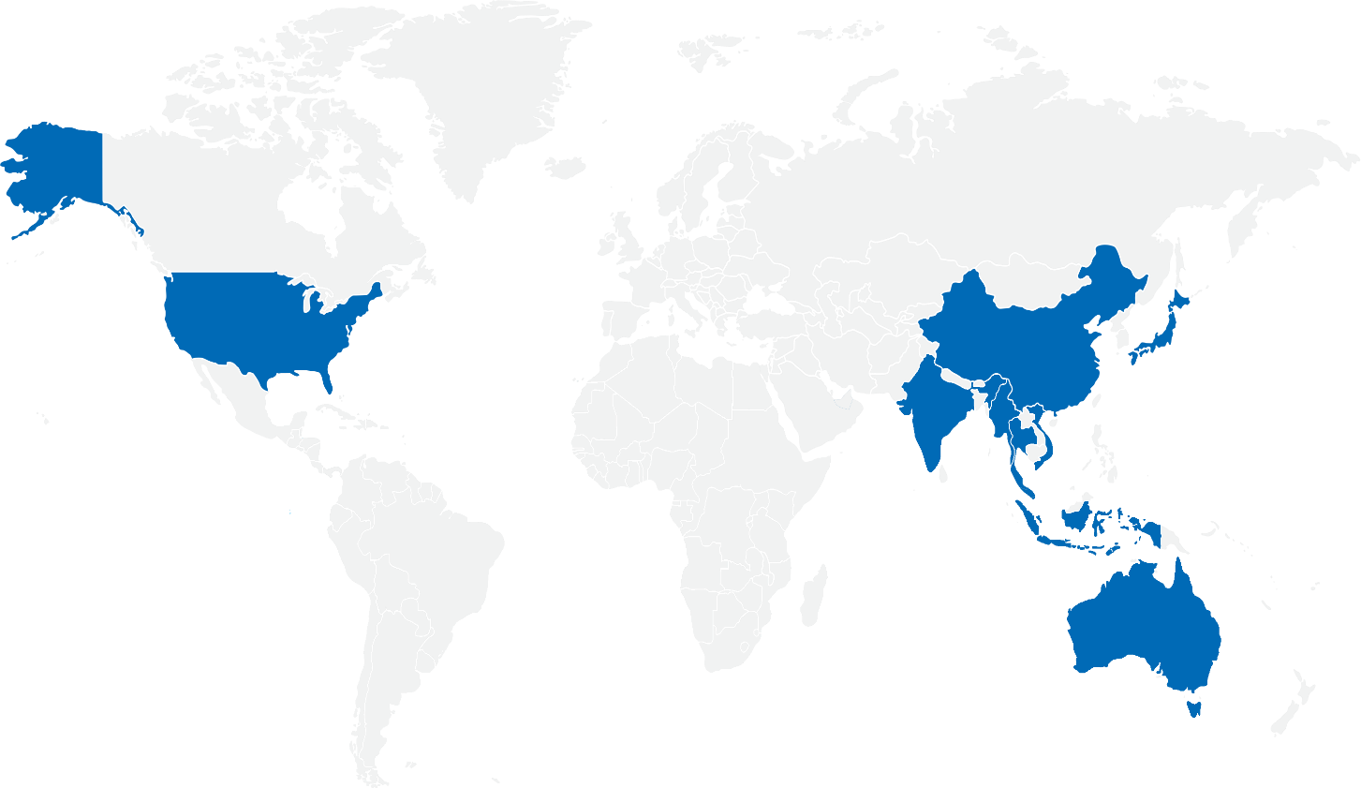






“24 hours a day, 7 days a week, 365 days each year: we constantly handle many different and challenging projects.”
Get to know us
ISO certified own operations in
“Our tailor-made logistic solutions provides our customers with a unique level of service and know-how.”
Services:
Thailand
Australia
Singapore
USA
India
Japan
Vietnam
Myanmar
Indonesia
Malaysia
China
“Turn-Key”, door to door project forwarding services
Heavy lift and oversized cargo handling
Full and part charter vessel chartering
Project related airfreight charters and container shipments
HSE and Compliance campaign for all offices.
A global network of carefully selected partners and agents.
Project supervision and coordination
Cargo loading / discharging supervision
Port, road and equipment surveys
Feasibility studies
Transport insurance coverage
Warehousing, storage and export packing
Customs clearance services
Member of:

Slide 4

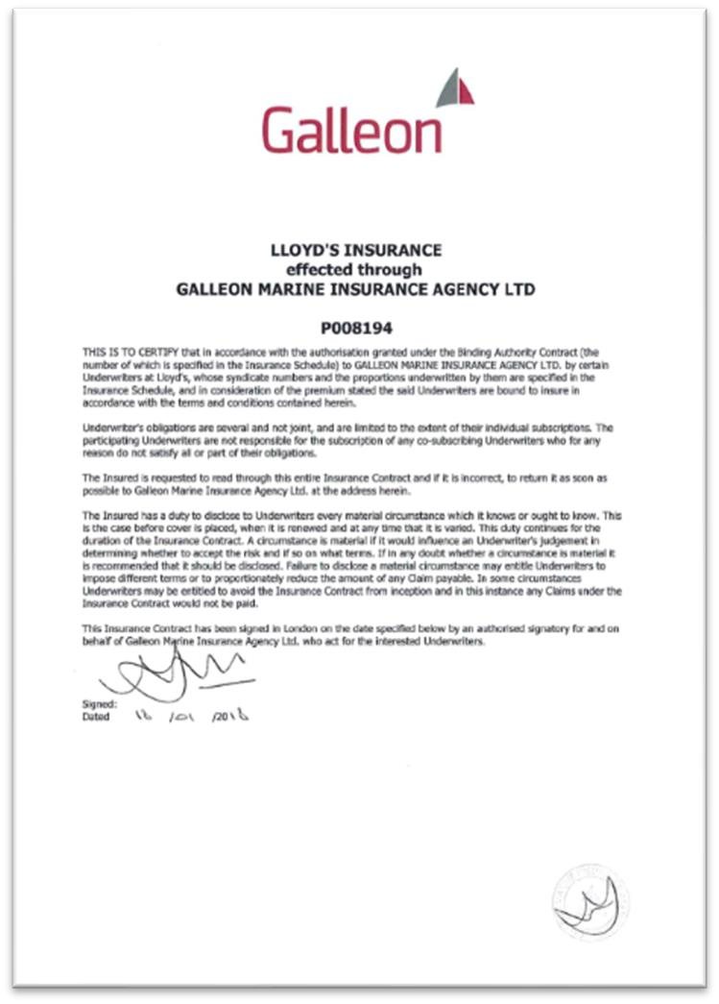
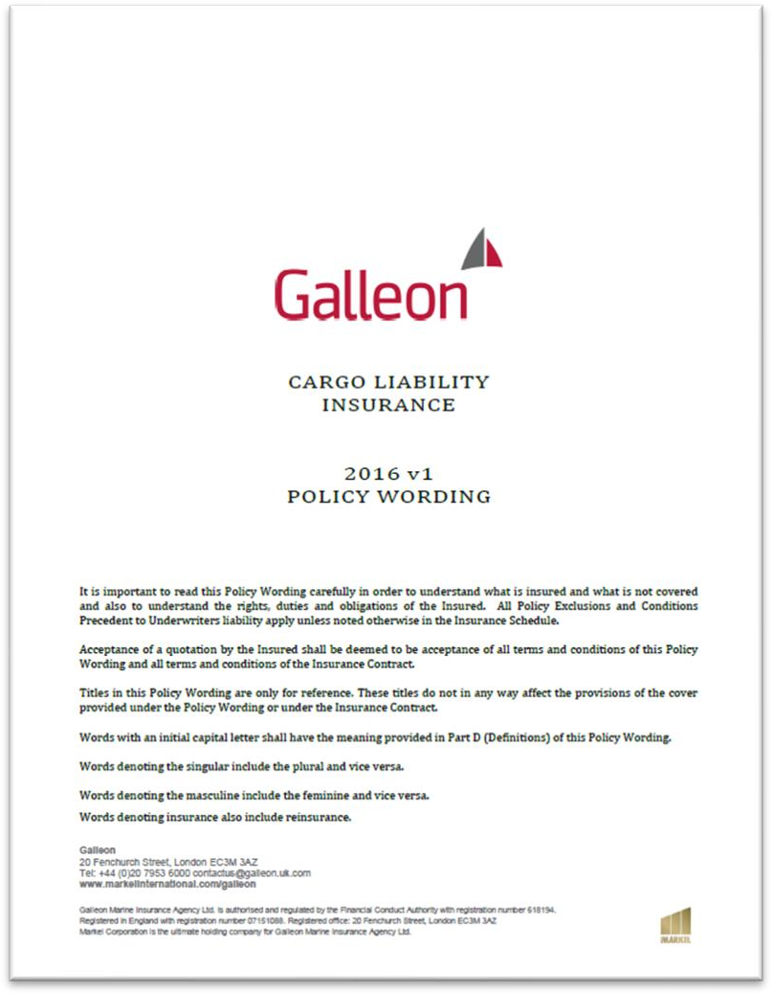

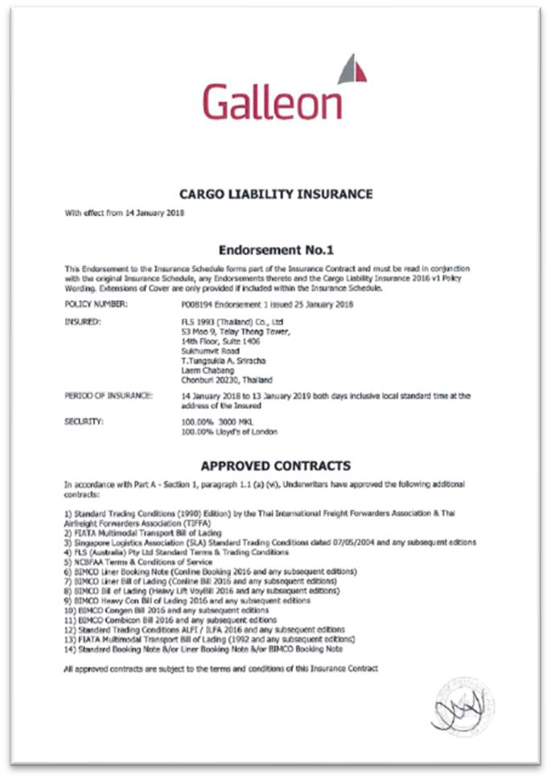


Slide 5

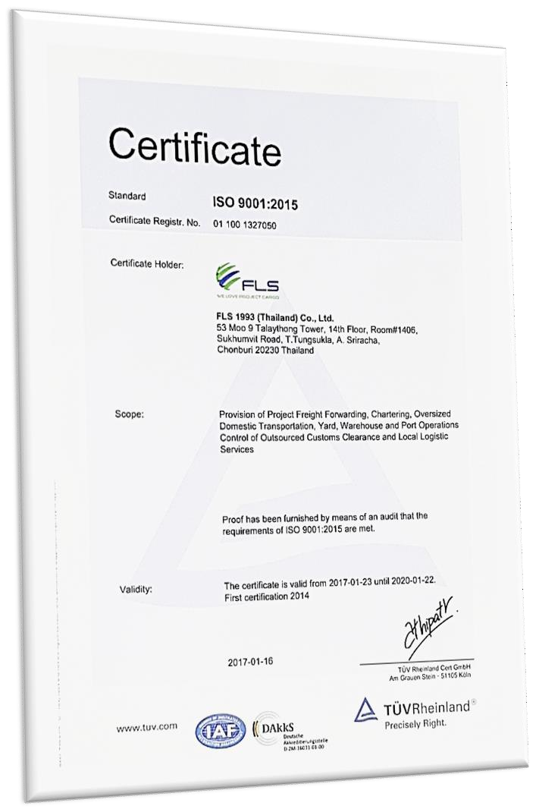
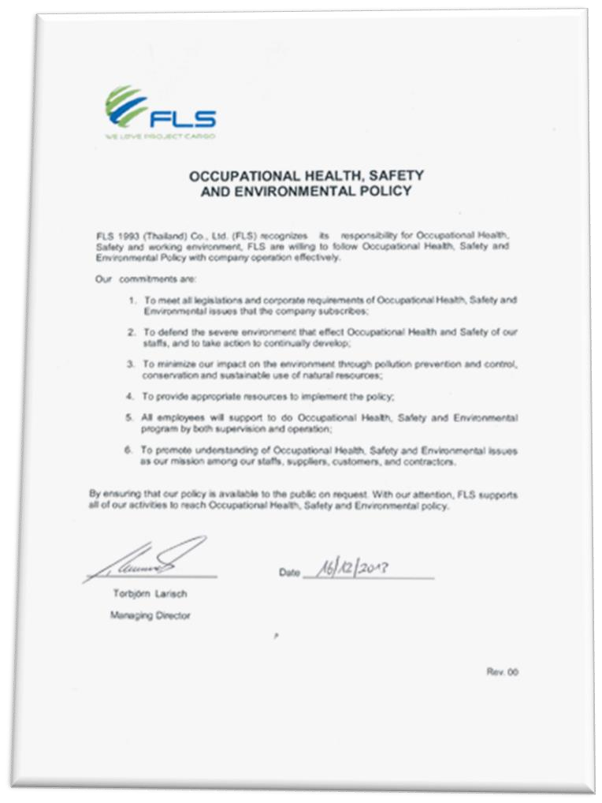
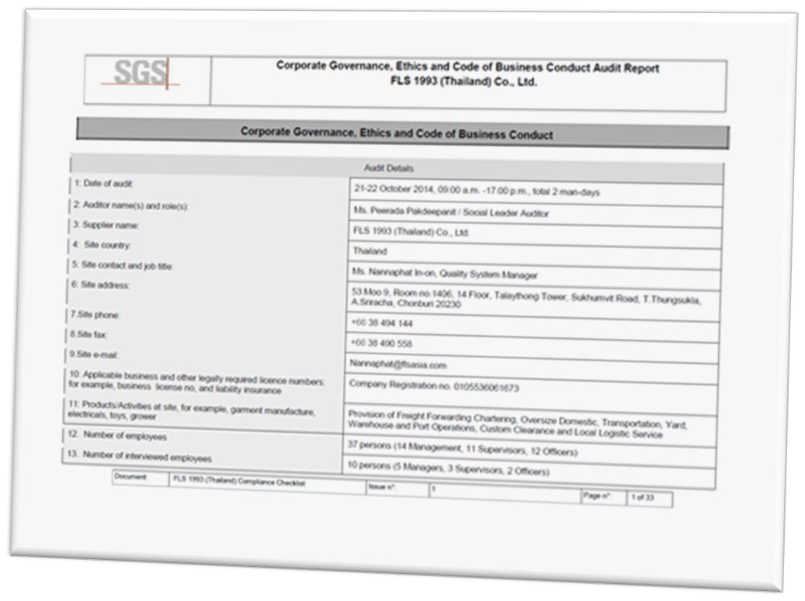
Corporate Governance, Ethics and Code of Business Conduct
ISO 9001:2015 Certificate
HSE Policy

Slide 6













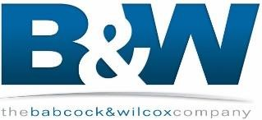








Since its earliest days, FLS has been a strong player in the power business. Today handling equipment for gas, coal and oil fired power plants as well as hydro power plants remains one of the core activities of FLS.
FLS offers unique expertise in handling Heat Recovery Steam Generators (HRSG), boilers, generators, steam
and gas turbines as well as all other related equipment.
The recent boom in the upgrade and green field construction of petro chemical plants worldwide has
strengthened FLS’ activity in this industry. We support the desire of many of our clients in this field, to ship modular in order to save construction time and cost on site. FLS’ conducts extensive studies before commencement of each project to find the best solution.
Petrochemical
FLS offers a wide range of services for the mining industry. Often these projects are located in remote locations with little or no transport infrastructure. FLS offers high level knowledge in providing logistics for the actual construction of mines to shipping consumables and equipment such as dump trucks and earth moving machines.
Mining
The construction of large infrastructure projects presents unique challenges. FLS’ has been supporting clients
in port as well as road construction for many years. Major infrastructure requires precise co-ordination to
ensure that equipment and materials from various suppliers are in the right place at the right time. FLS’ team draws on extensive knowledge and experience to give our clients the best possible options and project management in supply, shipping and transportation.
Infrastructure
Being a creative and innovative organization, FLS is always looking for new markets and challenges. From the construction of steel and other plants to the Oil & Gas industry, FLS continues to strive to lead by providing excellent services.
Other

Slide 7


QUALITY ASSURANCE
We are constantly focused to provide services that meet our customer’s, applicable statutory and regulatory requirements. Through our Quality Management System, we enhance customer satisfaction, developing processes for continual improvement and the assurance of conformity. We have adopted one of the world leading modular enterprise system that streamlines operations, accounting and business development.
HEALTH & SAFETY
Health & Safety is our first priority. FLS is constantly providing H&S trainings for all members of staff as well as blue collar and sub-contracting parties. We follow international rules and guidelines as we are very conscious and concerned to foster a safe and healthy work environment for our teams. We ensure that each project and every shipment will always be handled in a safe, timely, systematic and efficient manner. FLS will never compromise H&S of the people and the quality of the equipment used for considerations of cost.
FLS WILL SELECT AND WORK ONLY WITH AGENTS AND PARTNERS WHICH:
Are fully certified to international standards
Fulfil our own strict quality standards
Have sufficient insurance coverage
Operate with well maintained and regular tested equipment
Are well managed and staff regularly trained
Have a long successful history and proven track record
FLS REQUIRES THE ACTIVE COMMITMENT TO, AND ACCOUNTABILITY FOR, OCCUPATIONAL HEALTH, SAFETY AND ENVIRONMENT FROM ALL EMPLOYEES AND CONTRACTORS.
OCCUPATIONAL HEALTH, SAFETY AND ENVIRONMENTAL POLICY
Comply with all relevant legislations and corporate requirements of OHSE;
Meet specified customer requirements and ensure continuous customer satisfaction;
Protect, and strive for improvement of, the health, safety and security of our people at all times;
Eliminate accidents and minimize potential risks;
Set OHSE performance objectives, measure results, assess and continuously improve processes and services, through the use of an effective management system;
Plan for, respond to and recover from any emergency, crisis and business disruption;
Minimize our impact on the environment through pollution prevention, reduction of natural resource
consumption and emissions, and the reduction and recycling of waste;
Apply our technical skills to all OHSE aspects in the design and engineering of our services;
Communicate openly with stakeholders and ensure an understanding of our OHSE policies, standards, programs and performance. Reward outstanding OHSE performance;
Improve our performance on issues relevant to our stakeholders that are global concern and on which we
can have an impact and share with them our knowledge of successful OHSE programs and initiatives.

Slide 8



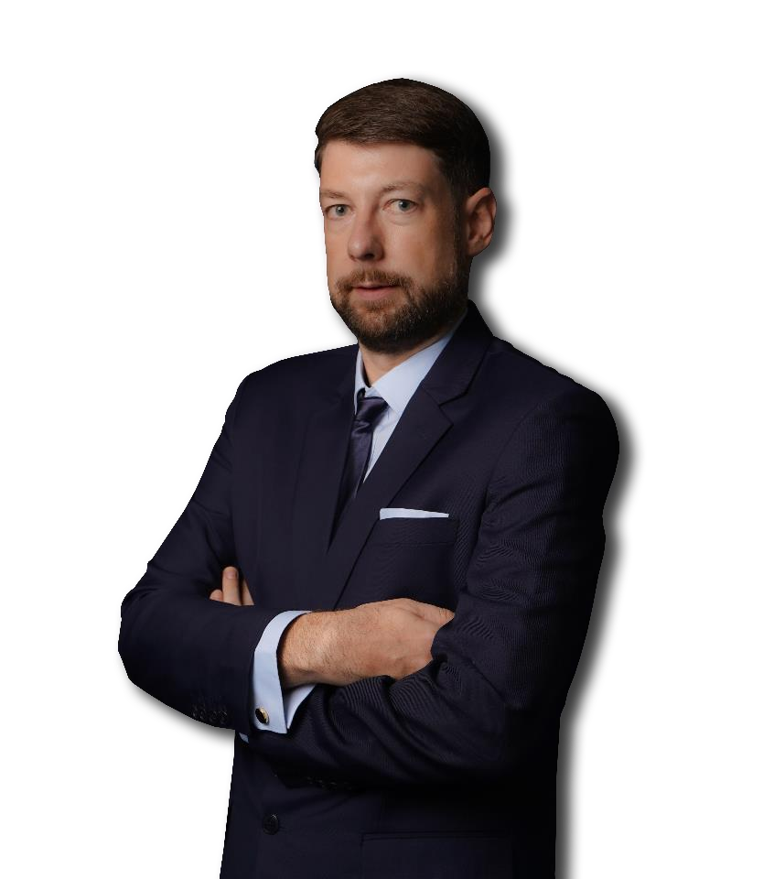
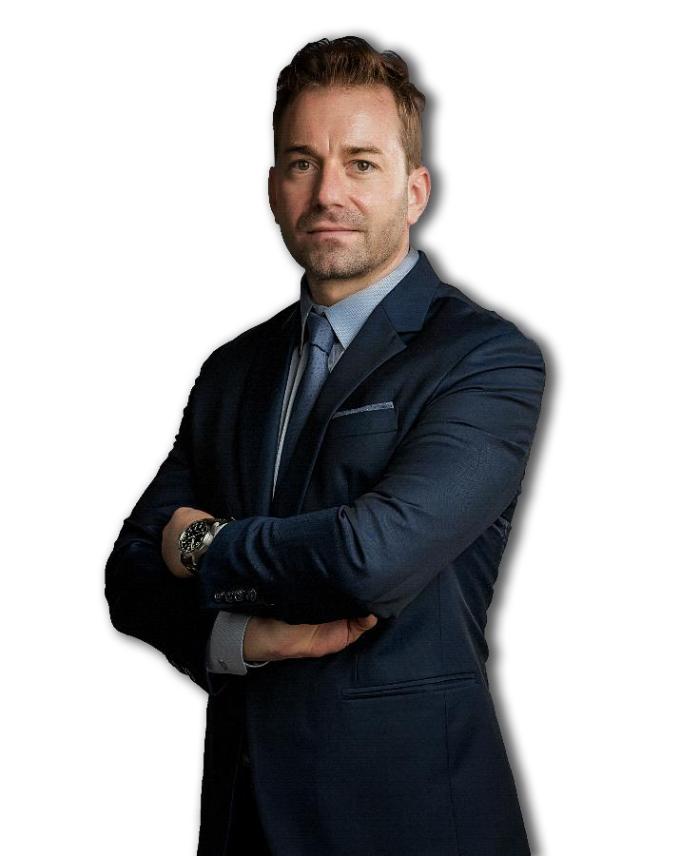
Torbjoern Larisch
CEO (TH)
Christopher Schnieders
Global Director Projects (VN)
Chris is a project logistics specialist, with more than 20 years’ experience in leading logistics teams for large scale industrial projects. Most notable experience was as project logistics lead on Fluor’s USD 6 Billion Ivanhoe Mines Oyu Tolgoi Copper Mine Construction Project in Mongolia, one of the largest copper/gold mines in the world. This involved the complete charter management of shipments amounting to 300,000 frtons from all over the world to Beijing, including 1,600 km trucking into inner Mongolia. He arrived in Saigon in 2006 and since then has built an extensive Network through which the company can provide outstanding services to its clients in Vietnam. Chris has the global responsibility for project logistics within the FLS Group
+84 986 580 829
christopher.schnieders@fls-group.com
Torbjoern has more than 20 years of experience in project freight forwarding and logistics. Prior to joining FLS team he spent 5 years working in South East Asia gaining valuable knowledge and experience in project handling. He speaks English and German fluently.
+66 84 362 3484
torbjoern.larisch@fls-group.com

Slide 9

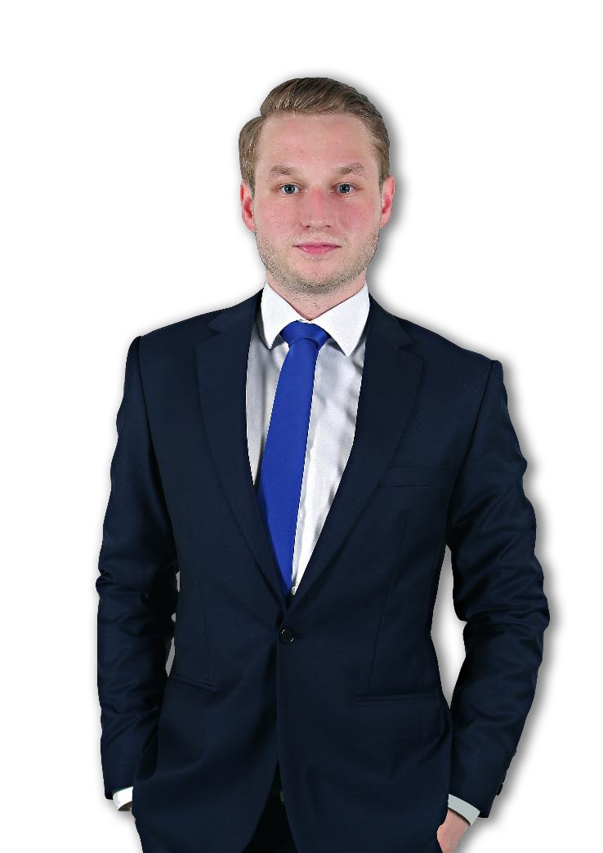
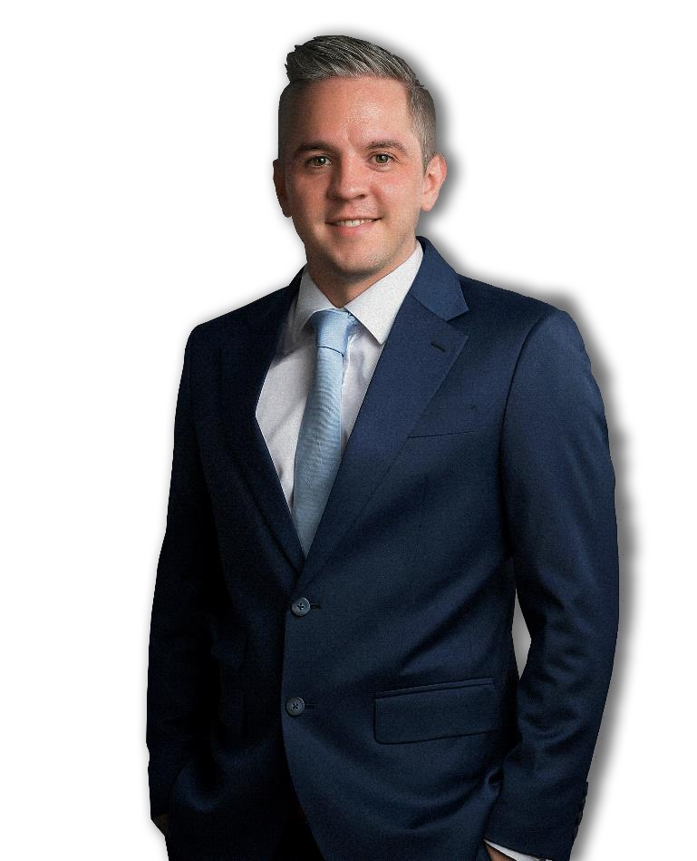
Sven Hoehle
General Manager (VN)
Johannes Linnenbruegger
Projects Operations Supervisor (VN)
Sven started his career in project freight forwarding and logistics back in 2009. Prior to joining the FLS Team he spent 6 years working in Germany gaining valuable knowledge and experience in Ocean Freight, Freight Forwarding and Project Handling. He speaks English and German fluently.
As a project freight forwarding and logistics professional, Johannes, or "Hansi," brings a wealth of experience to FLS Projects Vietnam. Prior to joining FLS, Hansi gained valuable insights in Germany and contributed to diverse project sites worldwide. Apart from that, he is working on supporting IT solutions, making him a versatile asset to any project team. He speaks English and German fluently.
+84 981 400 770
johannes.linnen@fls-group.com
+84 909 277 688
sven.hoehle@fls-group.com

Slide 10
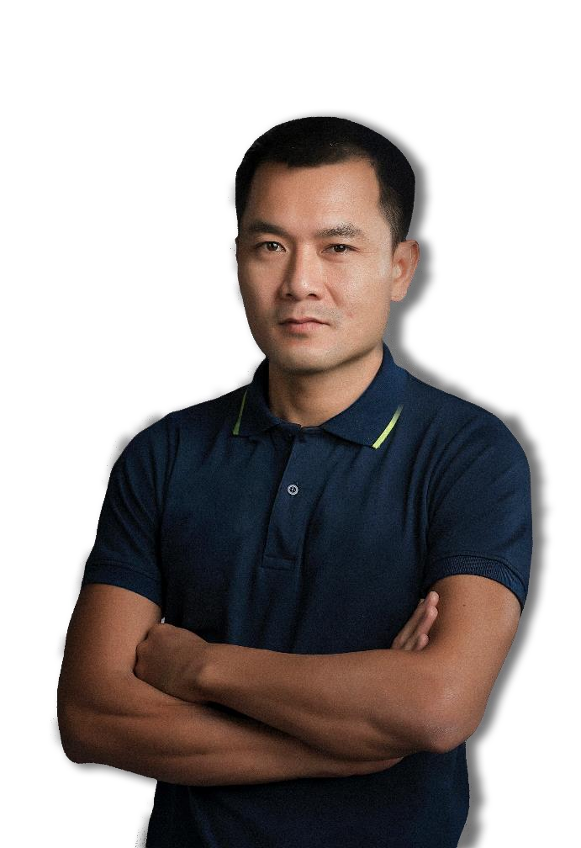

Le Quoc Trung
Port Captain / HSE Mgr (VN)
Trung has been in the shipping industry since 2006. Starting as a deck cadet he worked his way up the ladder to become a captain in 2013. As a seaman traveling the world on all sorts of vessels such as chemical tankers and general cargo ships he gained priceless knowledge. Being the man on the ground supervising all our port operations Trung will take outmost care of your valuable cargo. Self-explanatory the motto is always “safety first”. Trung is a Certified Marine Warranty Surveyor and has a perfect referenceas a HSE and Quality Manager.
Nguyen Manh Hung
Project Engineer (VN)
Hung has a vast experience in the Shipbuilding and Oil&Gas Industry. For 11 years he has been the Senior Commercial Executive of an international shipyard. Prior to that he worked as a Deputy Technical Manager in the Engineering Department of a Vietnam based Offshore Company. He was part of the QC and Production department and carried out project required documents, prepared tenders and commercial proposals and also overviewed the execution of the jobs. Hung speaks Vietnamese and English fluently.
+84 68 801 0168
trung.le@fls-group.com
+84 918 260 540
hung.nguyen@fls-group.com

Slide 11


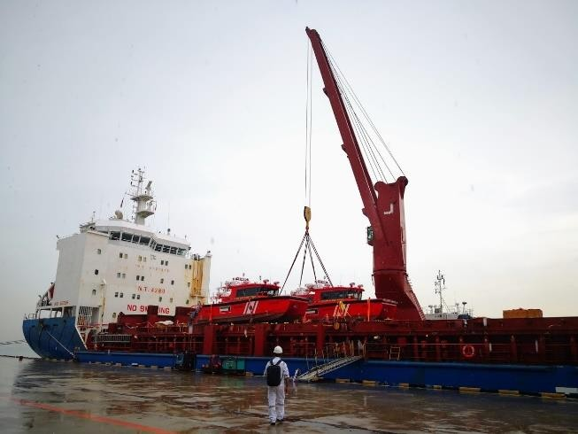
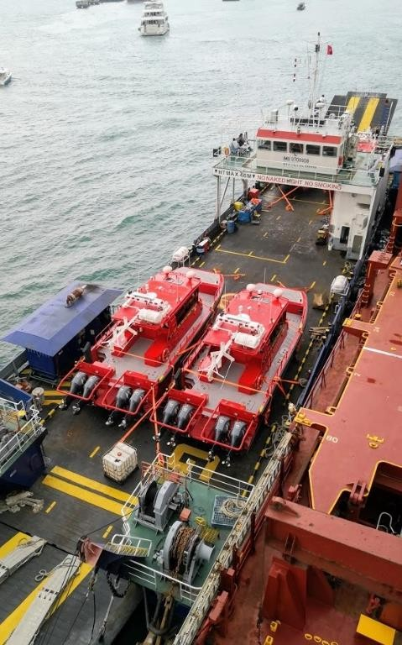
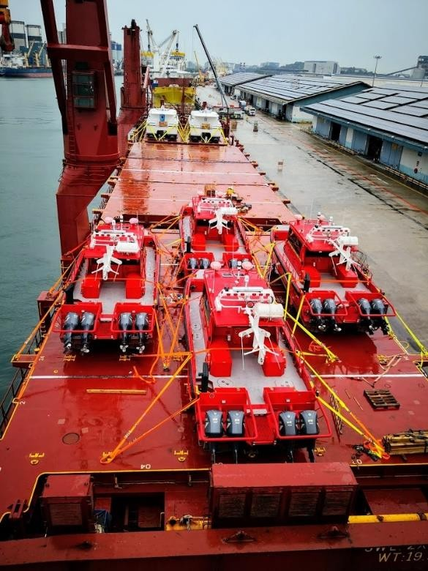
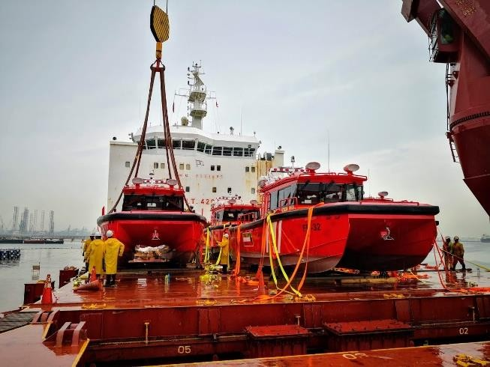
Origin (POL): Destination (POD): Volume:
Year:
Jurong Port, Singapore Kuwait, Middle East
13M X 4.8M X 5.22M / 12MT EACH
2019
Scope:
Chartering of breakbulk from Singapore to Kuwait
Port supervision in Singapore for loading from LCT
Arrangement and procurement of lifting gears

Slide 12

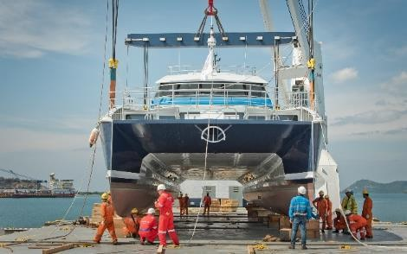
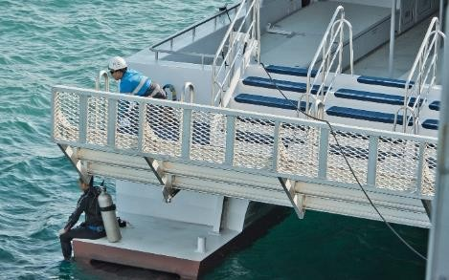
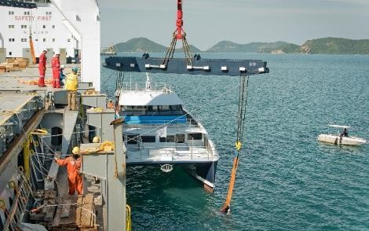
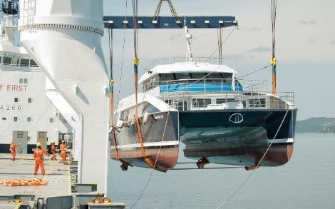
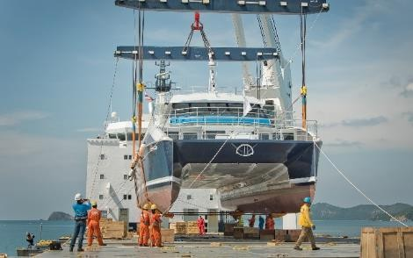
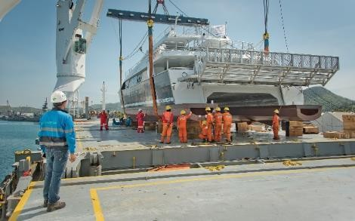
Project Name: Client: Volume: Commodity:
Aluminum Catamaran (Calypso 12) Calypso Reef Charters Pty., Ltd.
Appr. 1,490 cbm, 53 tons, 24m x 8m x 7m Aluminum Catamaran (Calypso 12) – 53 Tons Misc. Fabricated Steel
Sattahip, Thailand Cairns, Australia
Origin: Destination:
Scope:
Delivery from Sattahip, Thailand to Cairns, Australia
Chartering of suitable heavy lift vessel
Temporary steaming license
Supervision both ends
Lashing and securing on the vessel
Organizing – Loading onto vessel transport
Supervision loading
Lashing and securing on the vessel
Survey and consultation work
Co-ordination with suppliers
and ocean freight

Slide 13


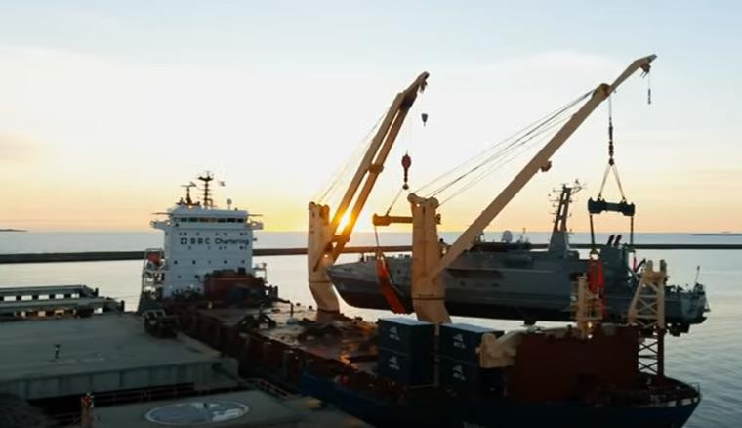
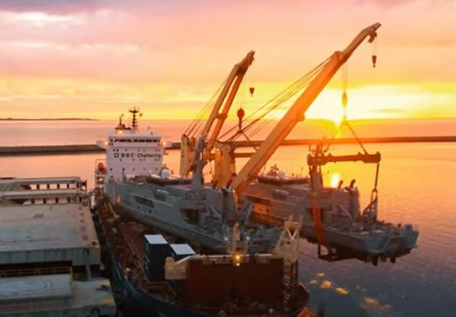
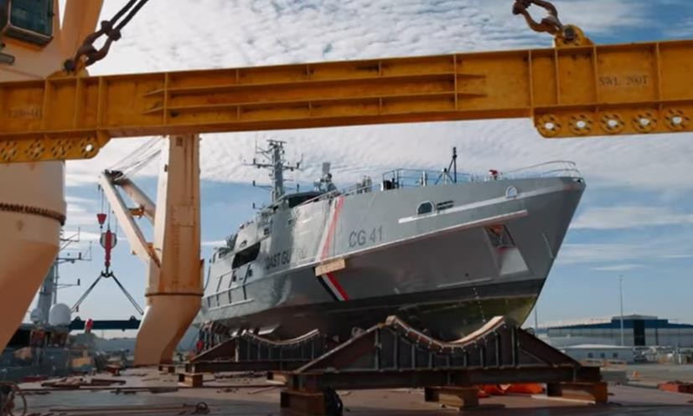
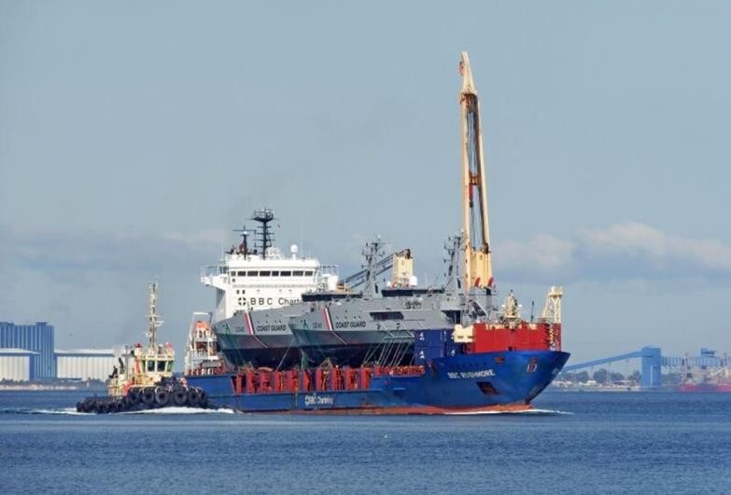
Dimensions: Commodity: Origin: Destination: Scope:
58 x 10.6 x 18.4 m – 308 metric tons Fully equipped patrol boats Henderson Western Australia Trinidad and Tobago
Chartering of suitable heavy lift vessel within tight schedule and on budget
In-house engineering & design of special transport cradles
Hooking on including arrangement of divers
Supervision both ends
Lashing and securing on the vessel
Hiring of experienced marine divers to ensure the correct placement of the slings under the hull

Slide 14
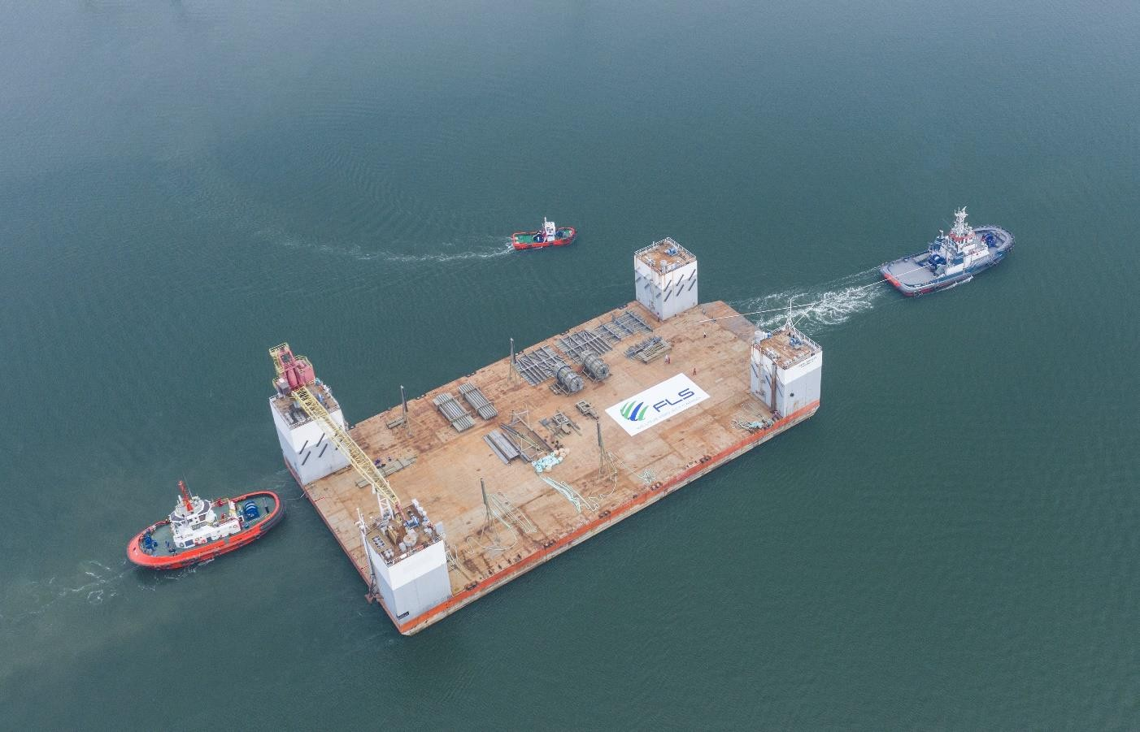


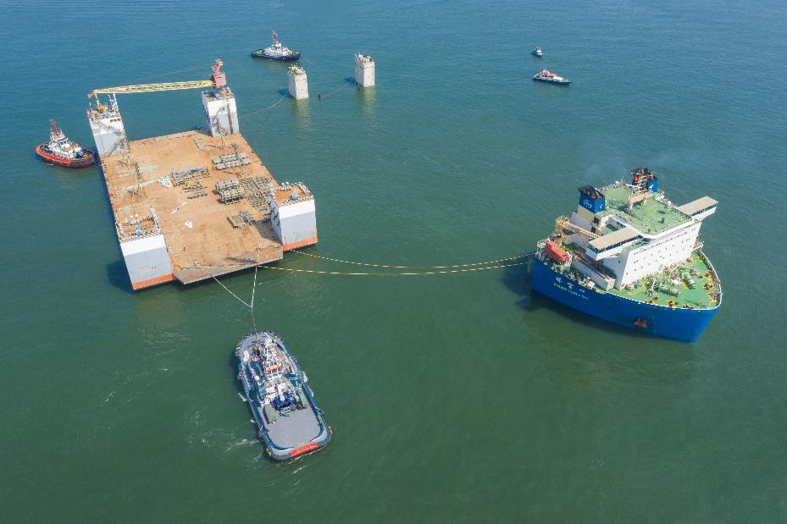
Dimensions: Commodity: Origin: Destination: Scope:
101.5 x 52.5 x 31 m – 7,000 metric tons Drydock
Vung Tau, Vietnam
Balamban, Philippines
Chartering semi-submersible vessel for two different cargo owners
Initially the drydock was supposed to be dry-towed, but FLS managed to pair the dock together with a liftboat. this way both owners benefited from each other.
FLS coordinated towing from Ho Chi Minh City to anchorage outside of Vung Tau port.
Some of the most powerful tugs in Vietnam Were required to position the dock overnight just in time for readiness of M/V XIANG YUN KOU
The port authority issued strict operational saftey guidelines that have been fully satisfied.
FLS was the communication tool between cargo and vessel owners, customs, port authority, tug operators, marine warranty surveyors and stevedores
Our port captains have been on scene for an entire week to accompany both assets from their origins until departure out of Vietnam waters

Slide 15
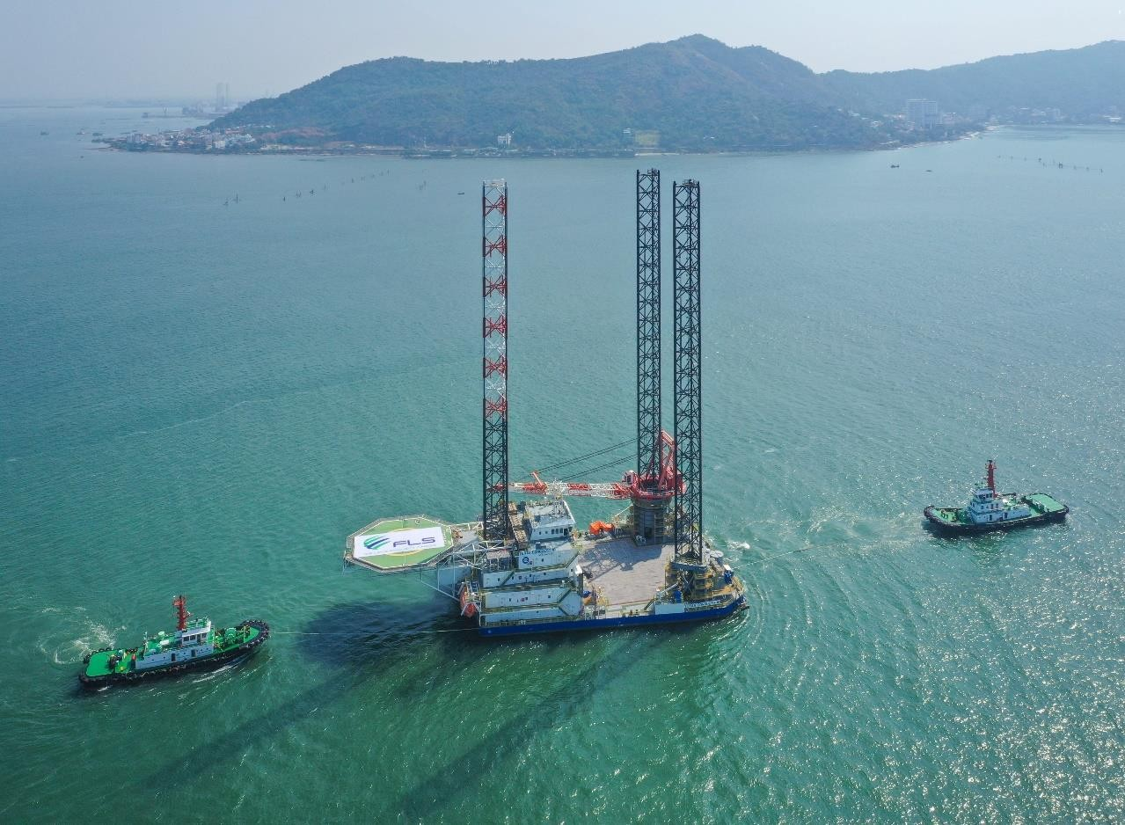

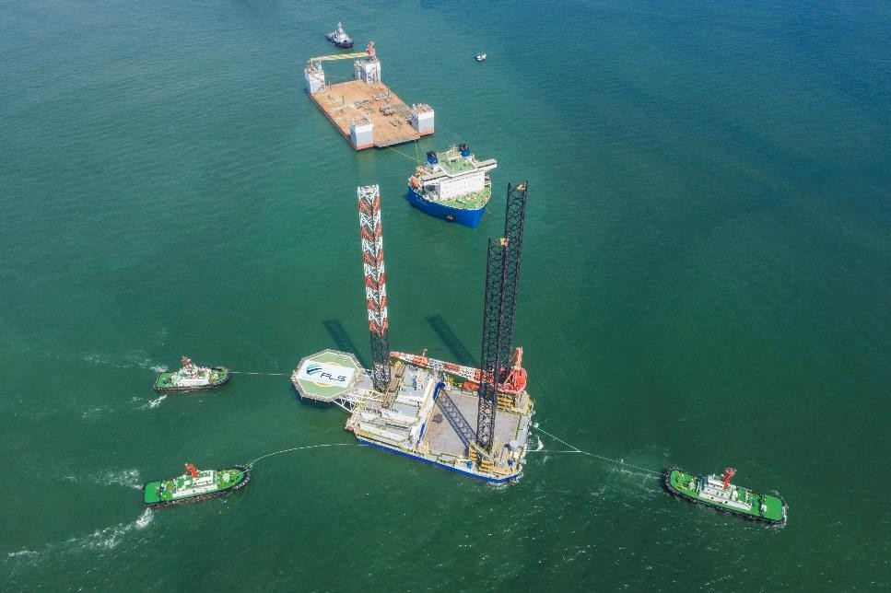
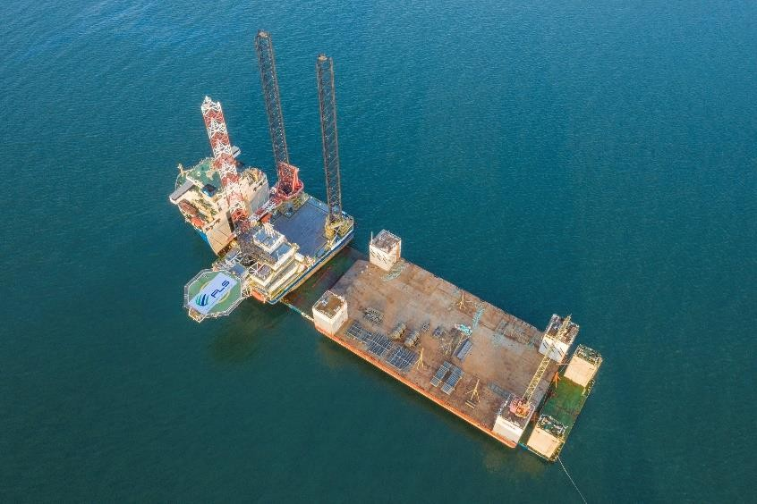
Dimensions: Commodity: Origin: Destination: Scope:
90 x 42 x 102 m – 6,000 metric tons Liftboat
Vung Tau, Vietnam
Pasir Gudang, Malaysia
Cosco X Class semi-submersible vessel was contracted having sufficient deck space
FLS coordinated towing from shipyard to anchorage
Preparation of two transport manuals (Liftboat and drydock)
Approval process for both manuals was completed in less than two weeks. two independent marine warranty surveyors had to sign-off the parallel operation

Slide 16
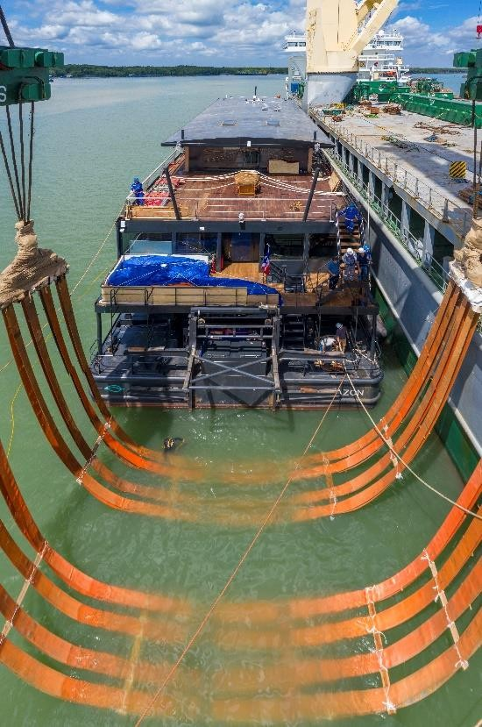
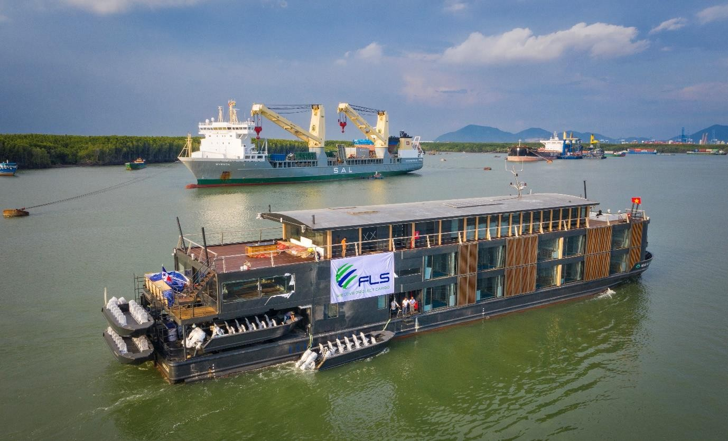
Dimensions: Commodity: Origin: Destination: Scope:
63 x 12 x 14 m – 800 mt
Fully equipped Amazon river cruise boat Vung Tau, Vietnam
Amazon Delta, Brazil
Chartering of heavy lift vessel with sufficient capacity
Divers for positioning of slings
In-house stevedores to conduct hooking-on
Protection of valuable In-/exterior
Loading supervision
Lift studies
lifting

Slide 17

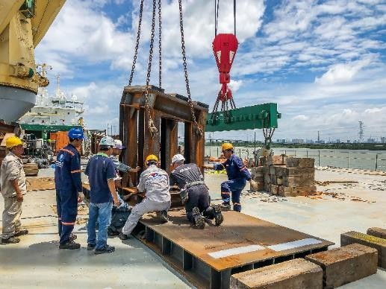
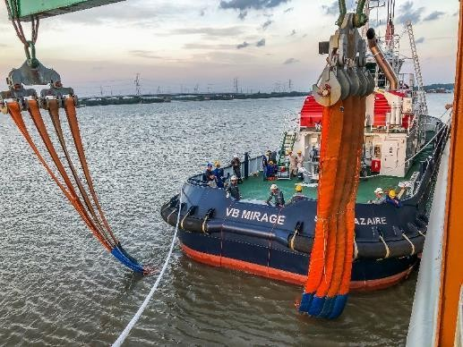

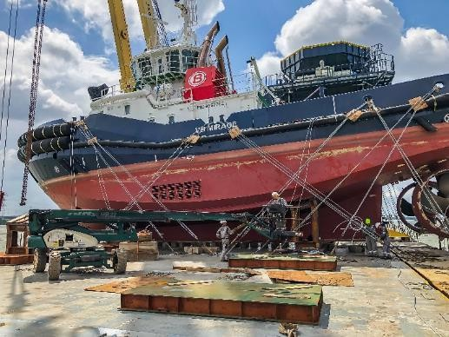
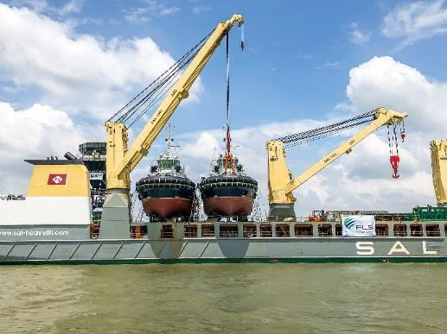
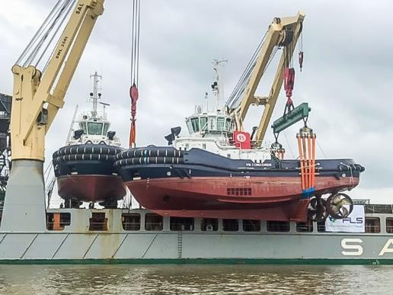
Origin (POL): Destination (POD):
Ho Chi Minh City, Vietnam St. Nazaire and Marseille, France
04 tugboats of 31.4 x 11 x 22.3 m / 530MT each
Volume:
Scope:
Delivery from Vietnam to ports of destination in France
Chartering of suitable heavy lift vessels
Hooking on with our own stevedoring team
Positioning of cradles, lashing and securing on the vessel
Loading supervision
Purchasing of lifting equipment in order to perform safe belly- lift

Slide 18
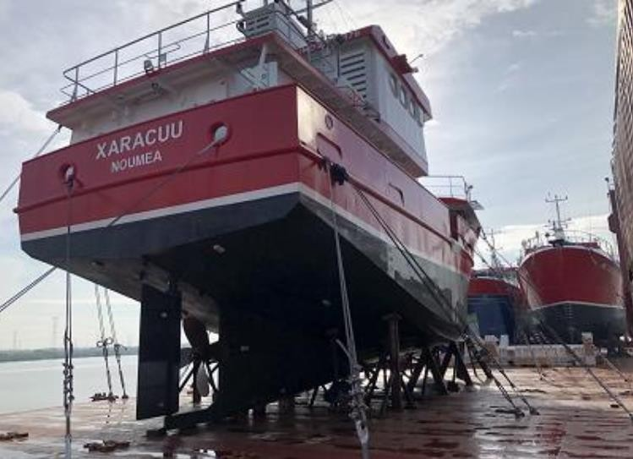
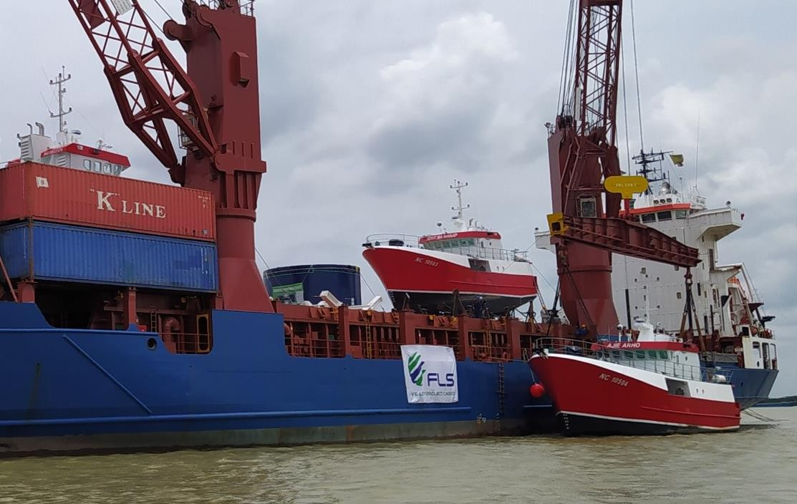
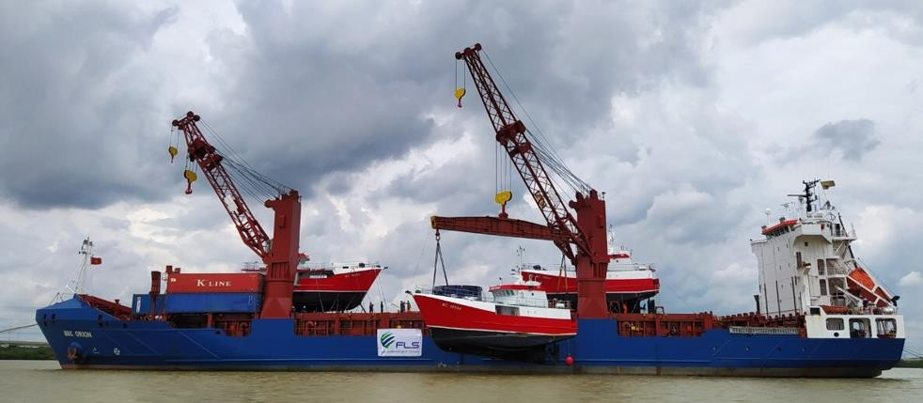
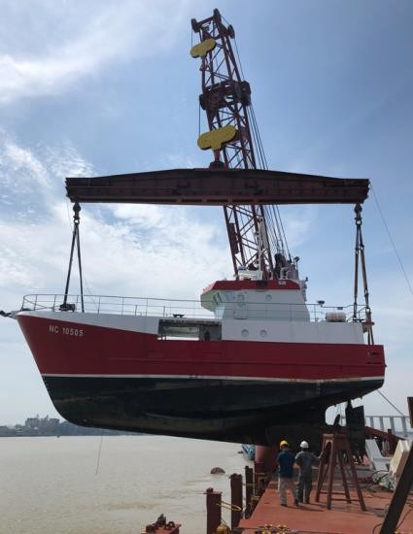
Origin (POL): Destination (POD): Volume:
Ho Chi Minh City, Vietnam Noumea , New Caledonia 03 Longliners boat of 22 x
6.81 x14 m / 130MTeach
Scope:
Delivery from Vietnam to ports of destination in Noumea
Chartering of suitable heavy lift vessels
Hooking on with our own stevedoring team
Positioning of cradles, lashing and securing on the vessel
Loading supervision
lashing and securing boats on the vessel

Slide 19
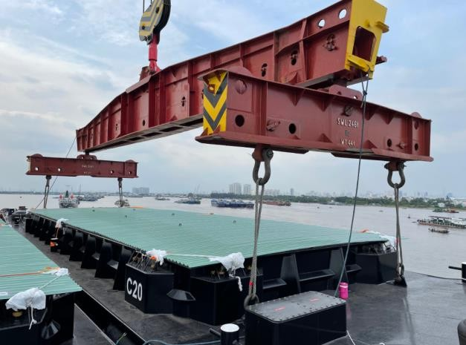
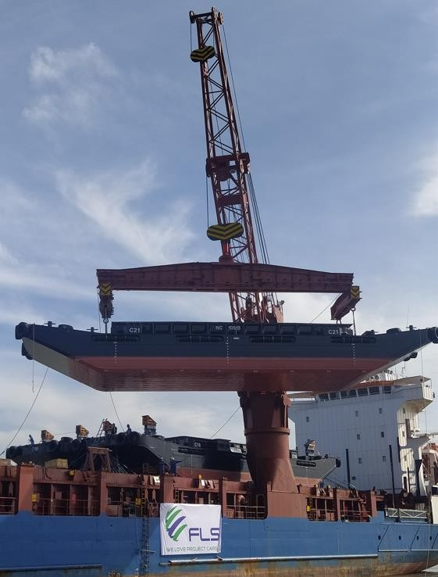
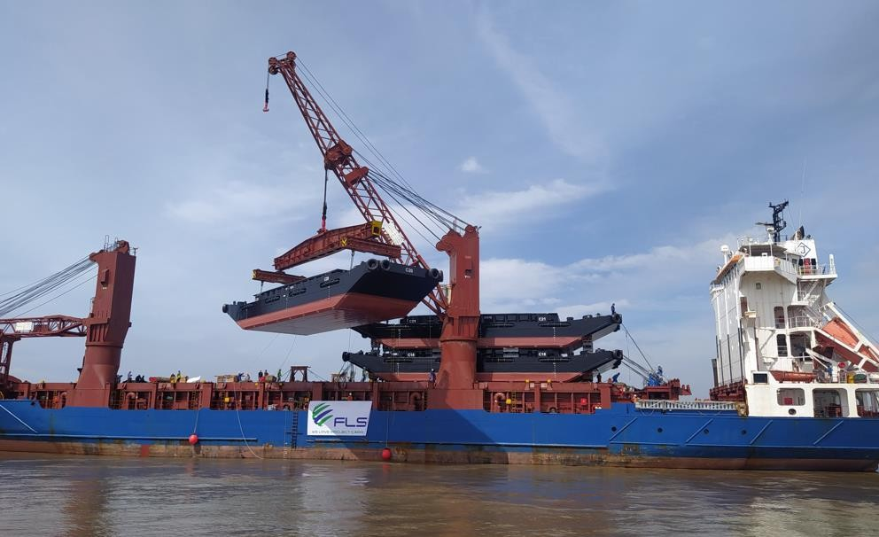
Origin (POL): Destination (POD): Volume:
Ho Chi Minh City, Vietnam Noumea , New Caledonia 04 Nickel Ore barges of 30 x 7.75x3.7m /128MT
each
Scope:
Delivery from Vietnam to ports of destination in Noumea , New Caledonia
Chartering of suitable heavy lift vessels
Hooking on with our own stevedoring team
Positioning of cradles, lashing and securing on the vessel
Loading supervision
lashing and securing barges on the vessel

Slide 20
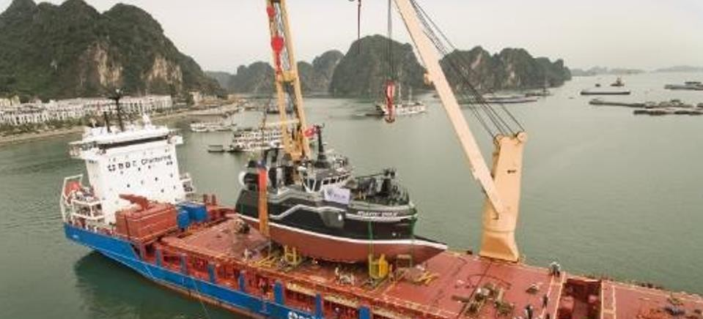

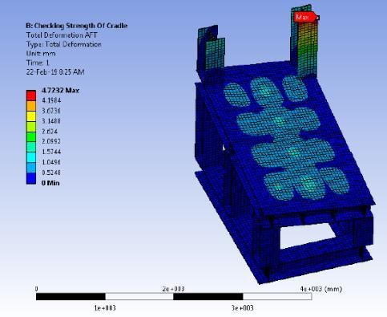






Volume: Origin: Destination: Scope:
31.76 x 10.30 x 18 m / 575MT
Ha Long anchorage, Vietnam
Port Hawkesbury, Canada
Delivery from Vietnam to Montreal
Chartering of suitable heavy lift vessel within tight schedule and in budget
In-house engineering & design and fabrication of special steel cradles (17 MT)
Hooking on including arrangement of divers
Supervision both ends
Lashing and securing on the vessel
Hiring of experienced marine divers to ensure the correct position of the slings under the hull

Slide 21







Origin (POL): Destination (POD): Volume: Commodity:
Vung Tau anchorage, Vietnam Port Sultan Qaboos, Oman
2 Units: 55 x 16 x 16 m / 14,080 cbm each Complete vessels, both 200 tons each
Scope:
Pre-Carriage ex shipper’s jetty up to port via tugboat
Organizing – Loading onto vessel and ocean transport
Loading and securing of the cargo on the vessel
Extended scope: FLS scope included the hiring and coordination of divers, which were needed to position the soft slings underneath the catamarans

Slide 22




Origin (POL): Destination (POD): Dimensions:
Cebu, Philippines Donghae, South Korea
50 x 11.5 x 15 m / 175MT
Scope:
Chartering of suitable heavy lift vessel within tight schedule and on budget
Purchasing of lifting equipment in order to perform safe belly-lift
Lashing arrangements
Supervision both ends

Slide 23



Origin (POL): Destination (POD): Volume:
Singapore
Chaguaramas, Trinidad and Tobago
1 vessels: 42 x 7.80 x 12.50 m / 120 MT
Scope:
Chartering of a suitable geared multi-purpose heavy lift vessel
Co-ordination of the FAS delivery incl. divers for positioning of the soft slings (belly lift)
Loading and stowage of the cargo on the vessel

Slide 24





Origin (POL): Destination (POD): Volume:
Vung Tau anchorage, Vietnam Kaohsiung, Taiwan
41 x 10.25 x 12.5 m / 121MT
Scope:
Delivery from Vietnam to port of destination in Taiwan
Chartering of suitable heavy lift vessel within tight schedule and on budget
Tug assistance
Temporary steaming license
Supervision both ends
Lashing and securing on the vessel
Customs clearance in Taiwan

Slide 25







Origin (POL): Destination (POD): Volume:
Vung Tau anchorage, Vietnam Port Tawfik, Egypt
40.4 x 7.9 x 13 m / 115MT
Scope:
Delivery from Vietnam to port of destination in Egypt
Chartering of suitable heavy lift vessel within tight schedule and on budget
Wet-towage from fabricator’s jetty up to FAS
Temporary steaming license
Hooking on with our own stevedoring team
Positioning of cradles, lashing and securing on the vessel
Customs clearance

Slide 26





Origin (POL): Destination (POD): Volume: Commodity: Duration:
Vung Tau anchorage, Vietnam Antwerp, Hamburg, Rotterdam
26.2 x 9.1 x 14.5 m / 3,450 cbm each Complete vessels; 80 – 95 tons each 2015 – 17
Scope:
“Turnkey” delivery including the pre carriage ex shipper’s jetty up to anchorage via tug boats
Organizing – Loading onto vessel and ocean transport
Unloading in Europe and towing to dedicated piers / shipyards
Customs clearance in Europe
Arrangement of additional works on boats, mooring arrangement etc.
26

Slide 27


Origin (POL): Destination (POD): Volume:
Singapore
Port Tawfik, Egypt + Rotterdam, Netherlands
2 vessels: 42 x 8 x 13.50 m / 220 MT
26 x 8.9 x 16.00 m / 80 MT
Scope:
Chartering of a suitable geared multi-purpose heavy lift vessel
Co-ordination of the FAS delivery, loading and stowage of the cargo on the vessel

Slide 28






Project Name: Client: Volume:
BioPower unit
BPS BioPower Systems Pty Ltd Unit 1: 36 x 18.3 x 8.3 m / 700 MT
Unit 2: 13.2 x 9.2 x 5.56 m / 61 MT
Renewable energy system Vung Tau, Vietnam Australia
Commodity: Origin (POL): Destination (POD):
Scope:
Chartering of a suitable geared multi-purpose heavy lift vessel
Co-ordination of the FAS delivery
Loading and securing of the cargo on the vessel
Subsea installation in Australia incl. all customs and quarantine formalities, as well as divers
Extended scope: Use of the ships Dynamic Positioning (DP2) System to discharge directly into the water onto the foundation

Slide 29





Project Name: Client:
Project Owner: Volume: Commodity:
Amrun Project, Weipa Goodline
Rio Tinto
5,500 FRT (Heaviest lift 120 MT)
Floating Jetty – 2 pontoons, 2 link spans and 4 struts.
Vung Tau, Vietnam Australia
Origin (POL): Destination (POD):
Scope:
Door to POD delivery incl. wet-towing of pontoons, barging, customs clearance both ends, loading and chartering of heavy lift vessel to Australia along with application for Quarantine documentation in accordance to strict Australian regulations making it possible to erect the two systems right alongside with the help of the vessel’s cranes
Note: Erecting the systems with the vessel’s gear saved time and especially a tremendous amount of money as the client did not have to mobilize heavy equipment to a remote area in Australia
Extended scope: Use of the ship cranes to assemble all pieces into a jetty alongside the vessel at POD

Slide 30





Origin (POL): Destination (POD): Volume:
Vung Tau anchorage, Vietnam Gladstone, Australia
3 x 70 x 9.5 x 7.5 m / 408 MT each
Scope:
Pre-Carriage ex shipper’s jetty up to port via
tugboat
Organizing – Loading onto vessel
Loading and securing of the cargo on the vessel
Ocean transport

Slide 31




Origin (POL): Destination (POD): Volume:
Vung Tau, Vietnam
AMC Henderson, Australia
3 x 11 m D x 5.5 m H; each 60 MT
Scope:
Project coordination
Barging from fabricator’s workshop to anchorage
Loading and chartering a heavy lift vessel to Australia along with application for Quarantine documentation in accordance to strict Australian regulations

Slide 32





Origin (POL): Destination (POD): Volume:
Jurong Port, Singapore
Port Blair India
30M X 6M X 2M / 55MT
23M X 7M X 2.9M / 61MT
Year:
2018
Scope:
Chartering of breakbulk from Singapore to port Blair India
Arrangement of crew to drive the 2 boats from shipyard in Singapore to Jurong port
Sourcing of divers to position slings for belly lifting
Port Supervision in Singapore for loading
Arrangement and procurement of lifting gears
Cradle fabrication on board the vessel for the monohull

Slide 33






Origin (POL): Destination (POD): Volume:
Year:
Scope:
Jurong Port, Singapore Constanta, Romania
38.00M X 7.70M X 10.00M/ 160MT
2020
Chartering of a breakbulk vessel from Singapore to Constanta, Romania
Engineering studies: Lifting, stowage and lashing plan
Divers for positioning of slings in water for belly lift at Jurong Port
Cradle design and fabrication
Cargo insurance
Export clearance

Slide 34







Origin (POL): Destination (POD):
Jurong Port, Singapore
Tincan Island, Lagos & Port Harcourt, Lagos, Nigeria
33.62M X 7.60M X 8.50M/ 160MT
40.00M X 7.60M X 8.50M/ 160MT
2020
Volume: Year: Scope:
Chartering of a breakbulk vessel from Singapore to Lagos and port Harcourt, Nigeria
Engineering studies: Lifting, stowage and lashing Plan
Arrangement and procurement of lifting gears and slings
Cradle design and fabrication
Divers for positioning of slings in water for belly lift at Jurong Port
Export Clearance

Slide 35





Origin (POL): Destination (POD): Volume:
Year:
Scope:
PSA Port, Singapore Lagos, Nigeria
23.90M X 8.00M X 12.00M/ 185MT
2020
Chartering of a breakbulk vessel from Singapore to Lagos, Nigeria
Engineering studies: Lifting, stowage and lashing plan
Arrangement and procurement of lifting gears and slings
Divers for positioning of slings in water for belly lift at Jurong port

Slide 36





Origin (POL): Destination (POD): Volume:
Year:
Jurong Port, Singapore Jebal Ali, UAE
36M X 7.6M X 10M / 130 MT EACH
2020
Scope:
Chartering of breakbulk from Singapore to Jebel Ali, U.A.E
Engineering studies: Lifting, stowage and lashing plan
Sourcing of divers to position slings for belly lifting
Arrangement and procurement of lifting gears
Cradle design, fabrication and supply

Slide 37








Project Name: Client:
Project Owner:
HTMS Nakha (LCS 102)
Royal Thai Navy
National Association of LCS (L) 1-130 in the United States
Appr. 6,100 cbm, 390 tons, 48m x 7m x
17.9m
1x LCS(L)(3)102 - WWII “Mighty Midgets”
landing craft support vessel Sattahip, Thailand California, USA
Volume:
Commodity:
Origin (POL): Destination (POD):
Scope:
Delivery from Satthahip, Thailand to Port of Destination in California, USA
Chartering of suitable heavy lift vessel
Tug assistance
Organizing – Loading onto vessel and ocean freight
transport
Supervision loading
Lashing and securing on the vessel
Survey and consultation work
Co-ordination with suppliers

Slide 38









fls-group.com

