Slide 1
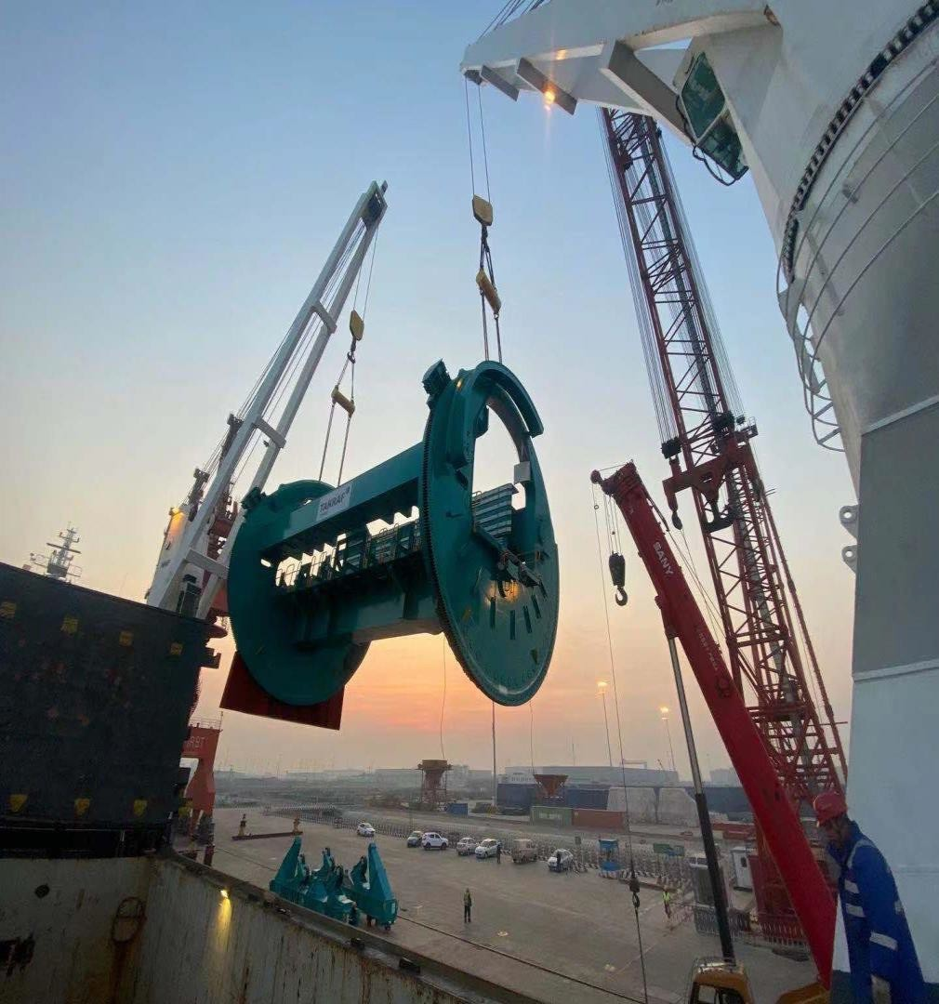
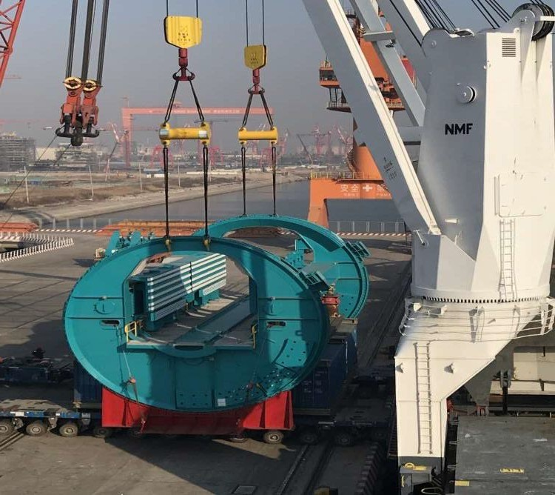
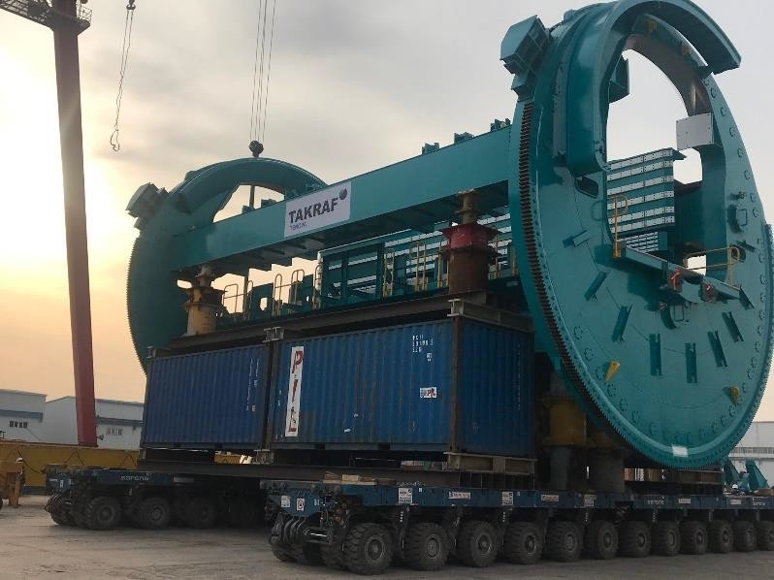
PROJECT REFERENCES
CASE STUDY – DUMPER CAGES FOR SHIPLOADER
Volume:
Origin:
Destination:
Approx. 7,000 FRT over three sailings/lots Dumper cages (each 230 MT plus accessories)
Tianjin, China
Squamish, Canada
Scope:
Chartering of suitable vessel for the cargo amount
Supervision at loading and discharge port
Close contact with all involved parties to manage the
Covid-19 impact

