Slide 1
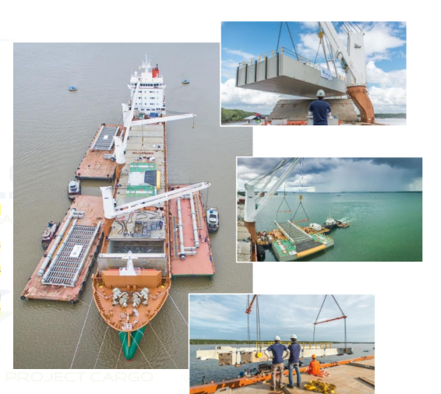
PROJECT REFERENCES
CASE STUDY – PONTOONS
Project Name: Amrun Project, Weipa
Cargo: 5,500 FRT (Heaviest lift 120 MT)
Floating Jetty – 2 pontoons, 2 link spans and 4 struts
Shipper: Vung Tau, Vietnam
Destination: Australia
Customer: Goodline
Scope:
Door to POD delivery incl. wet-towing of pontoons, barging, customs clearance both ends, loading and chartering of heavy lift vessel to Australia along with application for Quarantine documentation in accordance to strict Australian regulations making it possible to erect the two systems right alongside with the help of the vessel’s cranes
Note: Erecting the systems with the vessel’s gear saved time and especially a tremendous amount of money as the client did not have to mobilize heavy equipment to a remote area in Australia
Extended scope: Use of the ship cranes to assemble all pieces into a jetty alongside the vessel at POD

