Slide 1
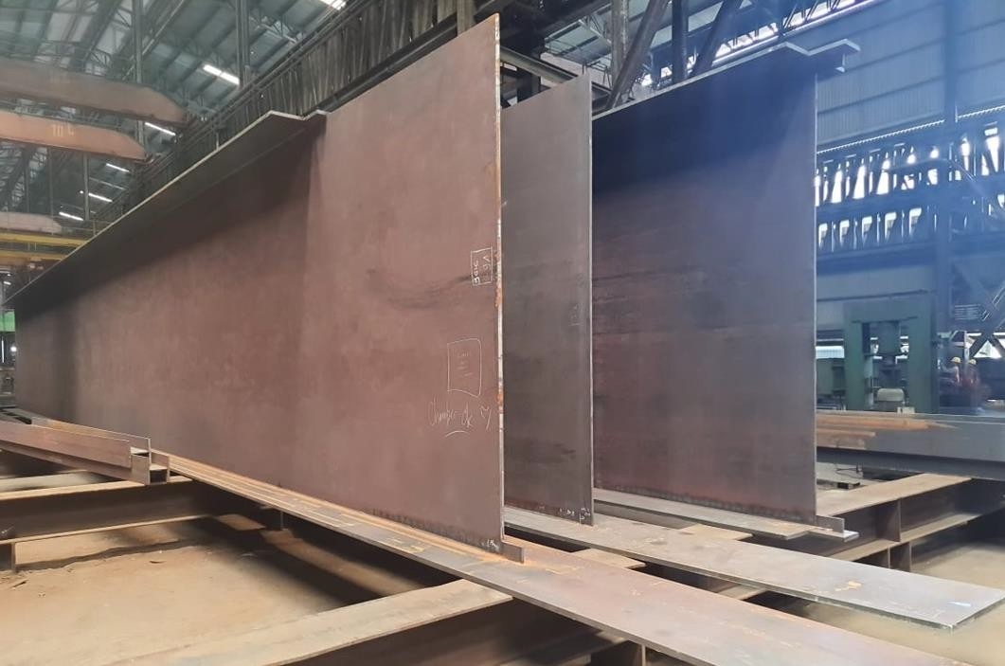
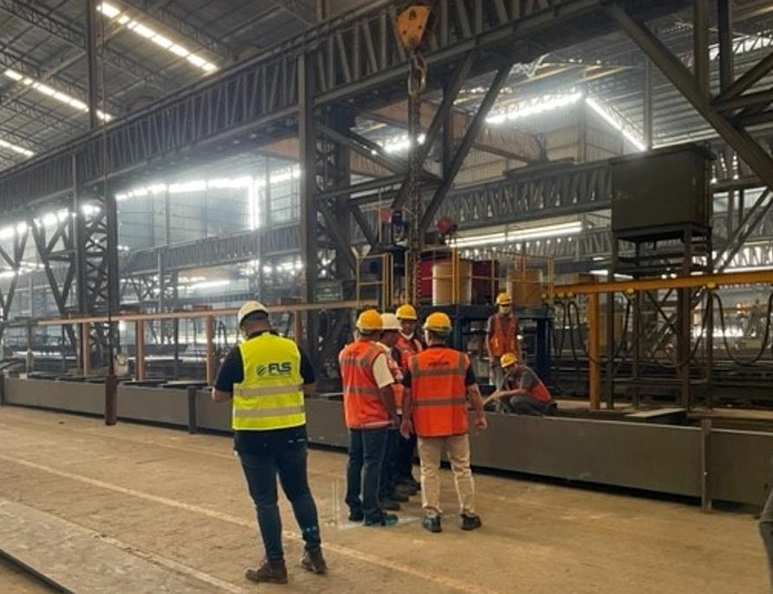
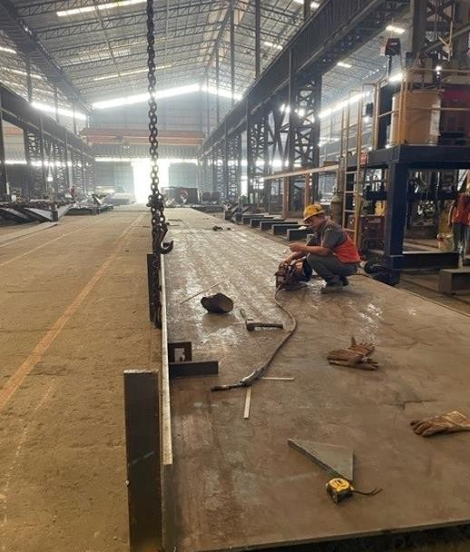
PROJECT REFERENCES
CASE STUDY – NITSULIN YUKON BRIDGE PROJECT
Project Name: Volume:
Commodity:
Origin (POL):
Destination (POD):
Nisutlin Yukon Bridge Project, Canada Containers 50 Containers and 1400 MT/ 3900 cbm Break Bulk
Steel Structures
Indonesia
Project site West coast, Canada
Scope:
Handling and booking the ocean freight for containers + break bulk ex Indonesia
Supporting the project owner with FLS supervising + know how from A-Z

