Slide 1
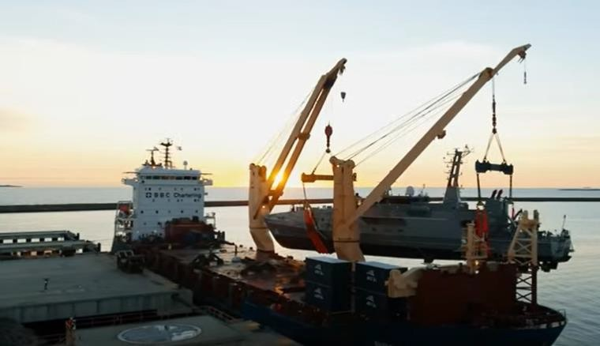
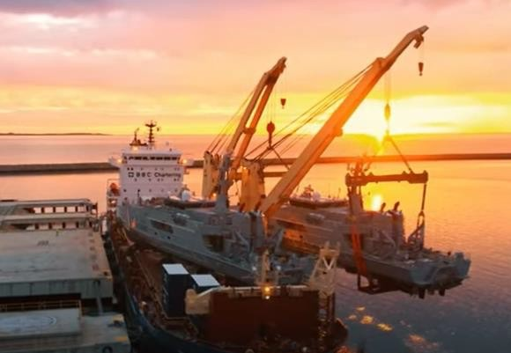
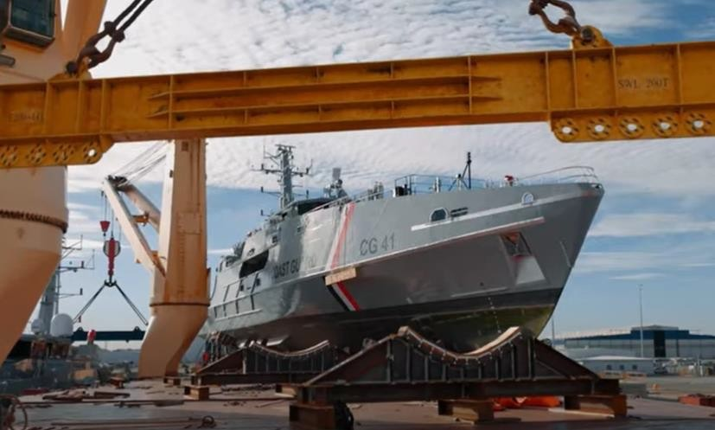
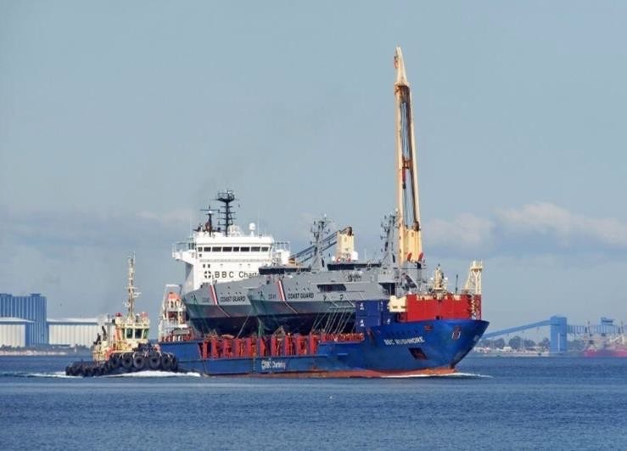
PROJECT REFERENCES
CASE STUDY – PATROL BOATS
Project name:
Dimensions: Commodity: Origin: Destination:
Patrol Boats
58 x 10.6 x 18.4 m – 308 MT
Fully equipped patrol boats Henderson, Western Australia
Trinidad and Tobago
Scope:
Chartering of suitable heavy lift vessel within tight schedule and on budget
In-house engineering & design of special transport cradles
Hooking on including arrangement of divers
Supervision both ends
Lashing and securing on the vessel
Hiring of experienced marine divers to ensure the correct placement of the slings under the hull

