Slide 1
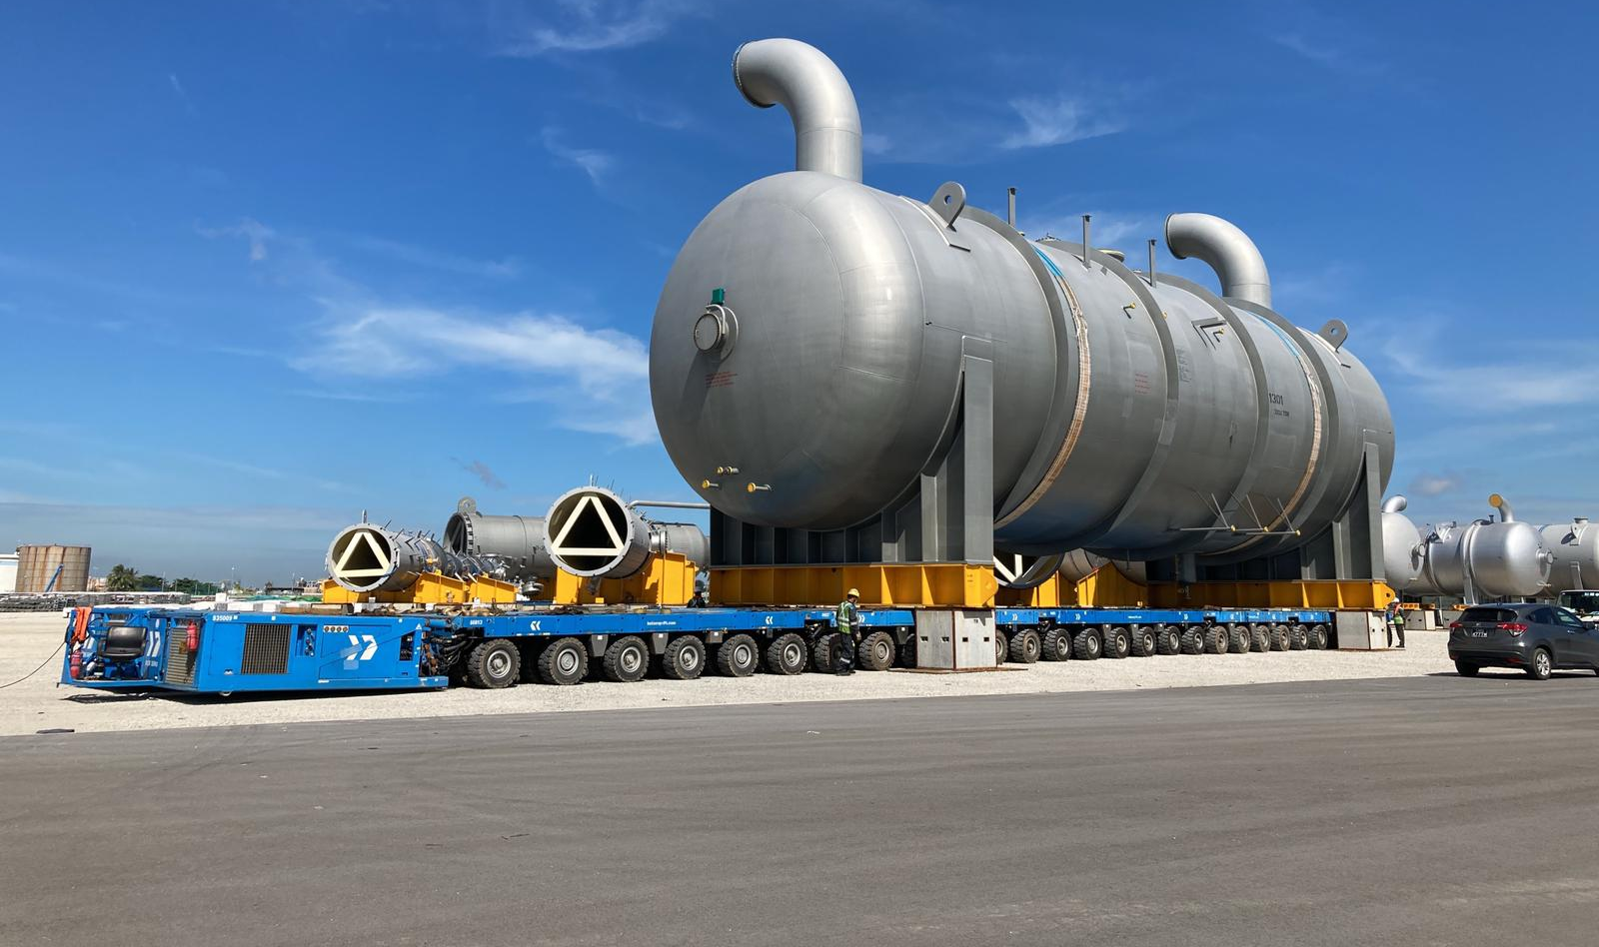
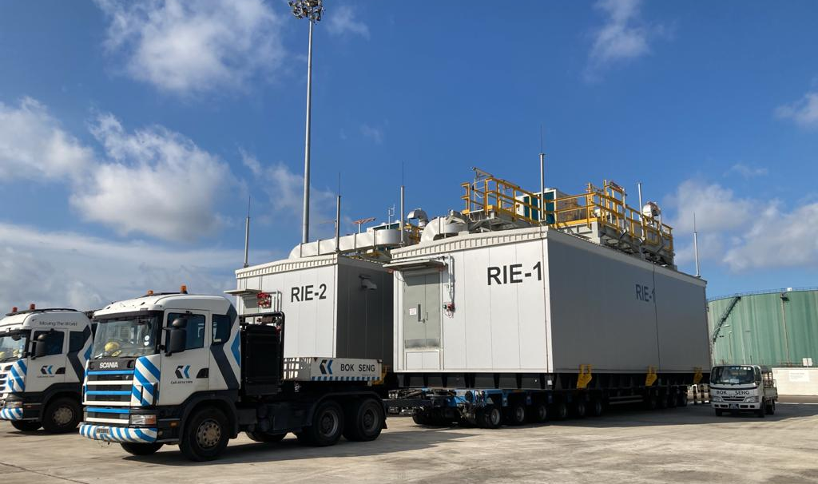
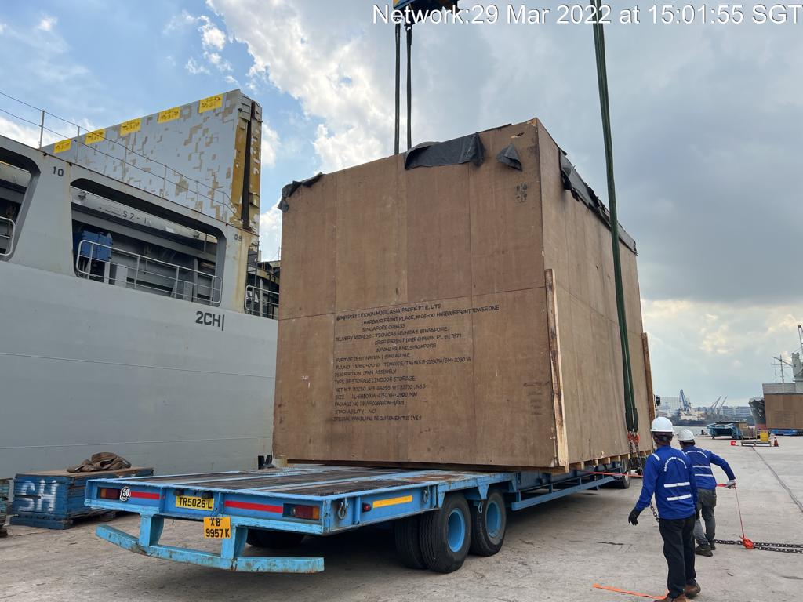
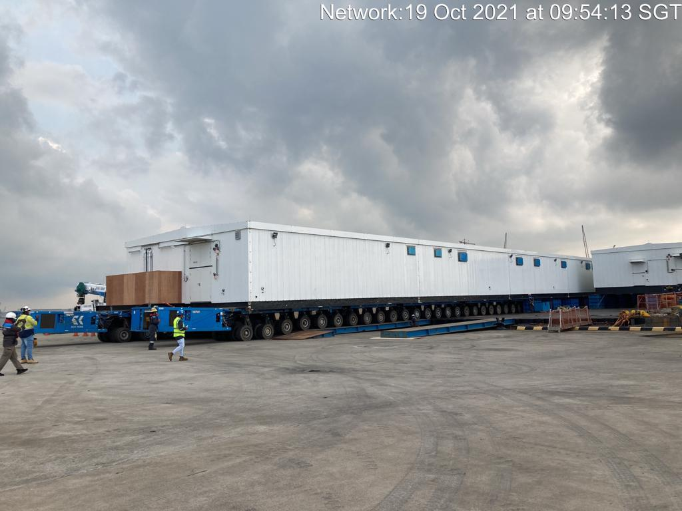
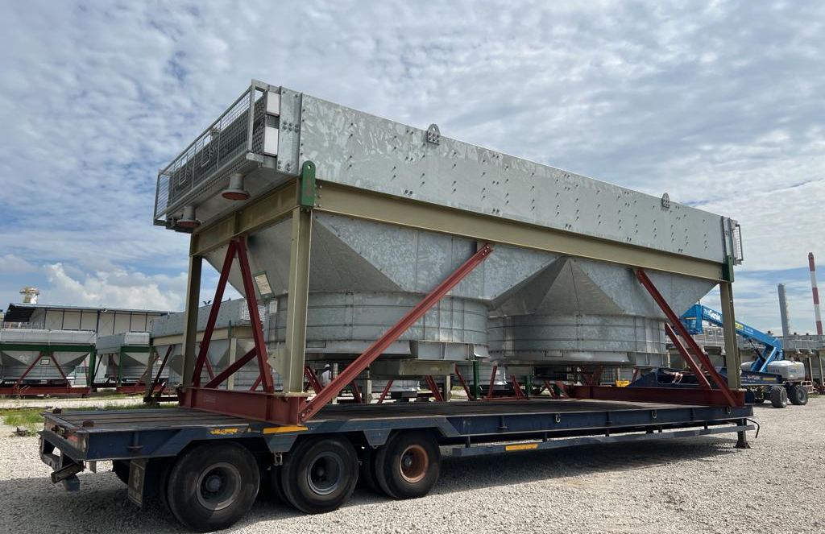
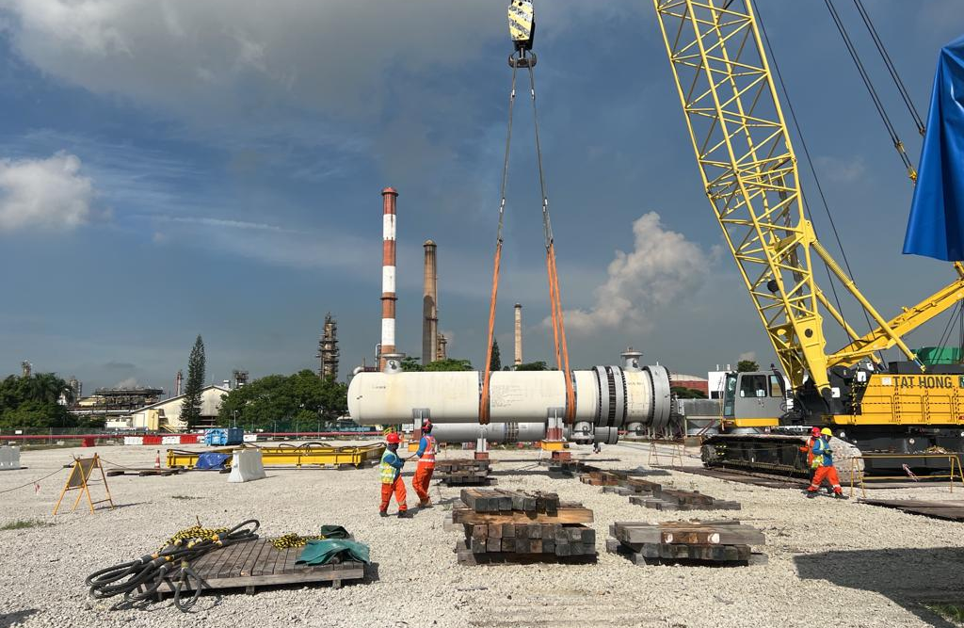
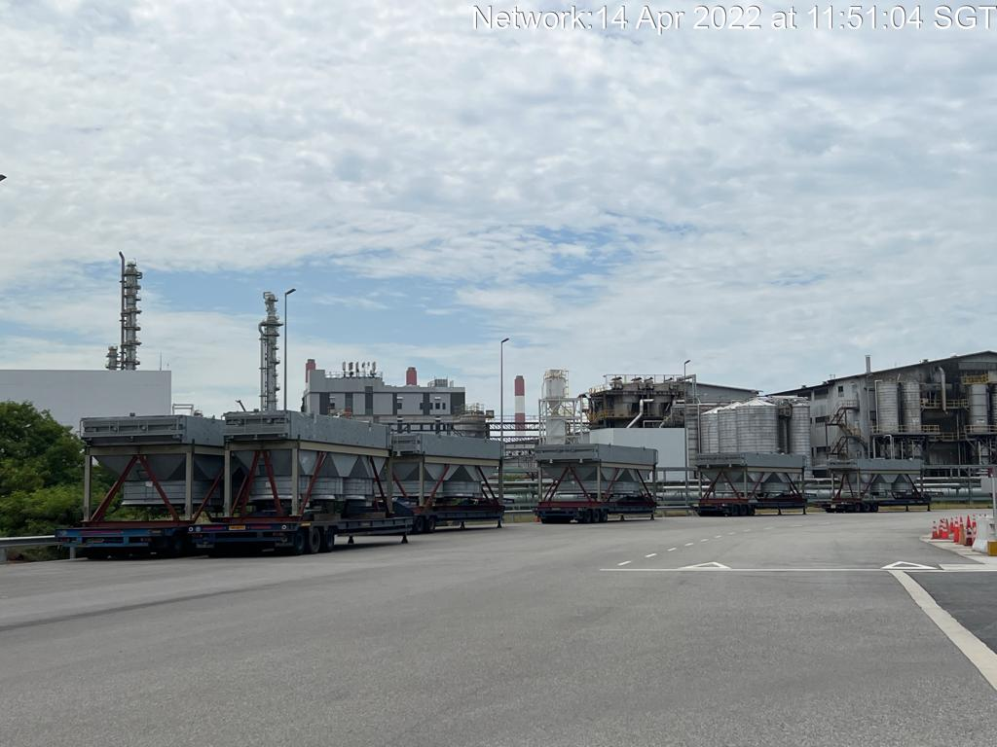
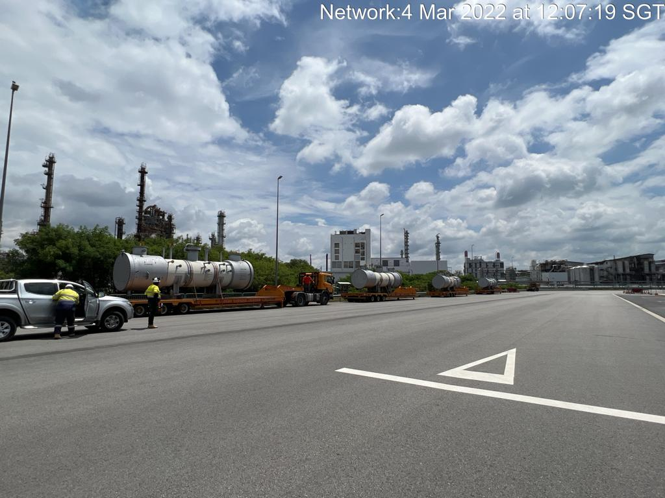
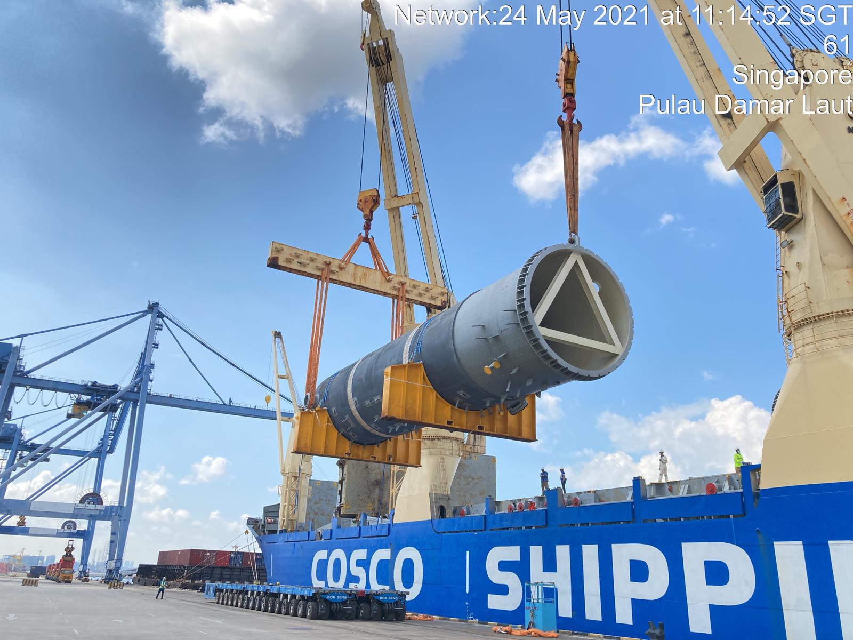
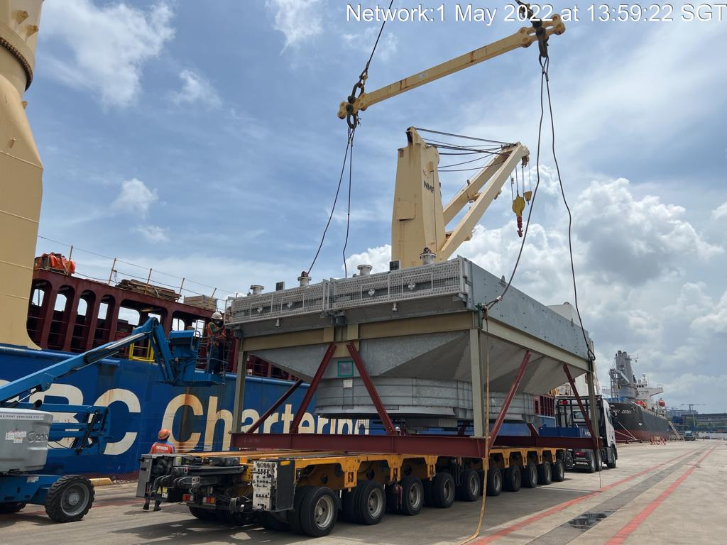
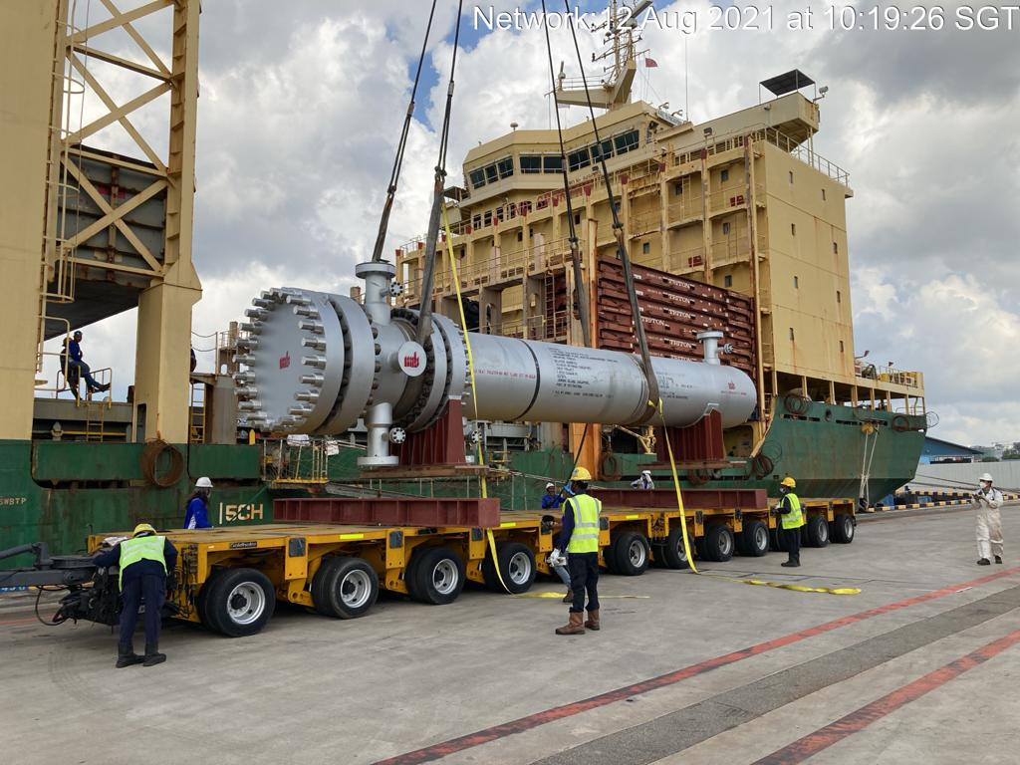
PROJECT REFERENCES
CASE STUDY – CRISP Project Package C
Project Name: CRISP Project
Client: UTE TR Jurong Project ( Spain )
Project Owner: Exxon Mobil Asia Pacific Pte. Ltd
( Singapore )
Volume: Appr. 200,000 rtons of Breakbulk and RORO
Commodity: Machinery and Equipment use for construction of Refinery Plant
Origin: Europe, Southeast Asia
Destination: Singapore
Project duration: 2020-Ongoing
Scope:
Import handling in Singapore,
Arrange road transport with Haulier to Jurong Island,
Site co-ordination with TR site team of the project
Unloading supervision for Breakbulk shipment
Co-ordination with Agents and Carrier
Co-ordinating with Transport Haulier for day and night delivery

