Slide 1
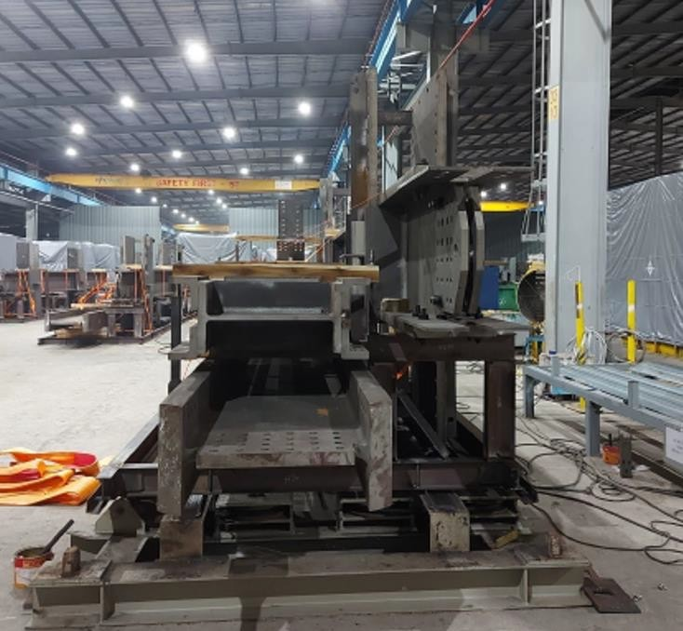
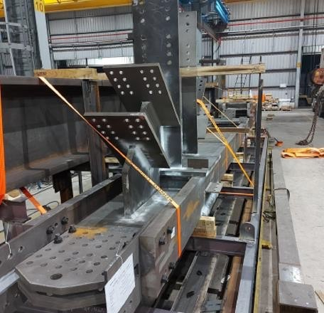
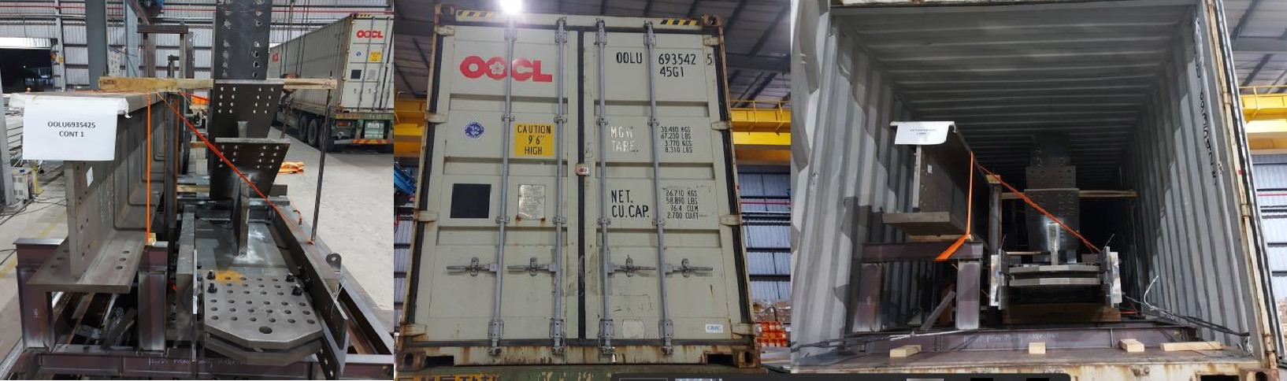
PROJECT REFERENCES
CASE STUDY – MGH PROJECT USA
Project Name: Volume: Commodity: Origin (POL): Destination (POD):
MGH Project Boston , USA
Containers : 128 (40’HC and 45’HC) 3000 MT Steel Structures
Vung Tau , Vietnam
Boston – Yard Boston, USA
Handling and booking the transport from FOB Vung Tau up to DDP Boston
Supporting the project owner with supervision/ know how from A-Z
Supporting our client with a special tracking system tool, to keep control for every container
Scope:

