Slide 1
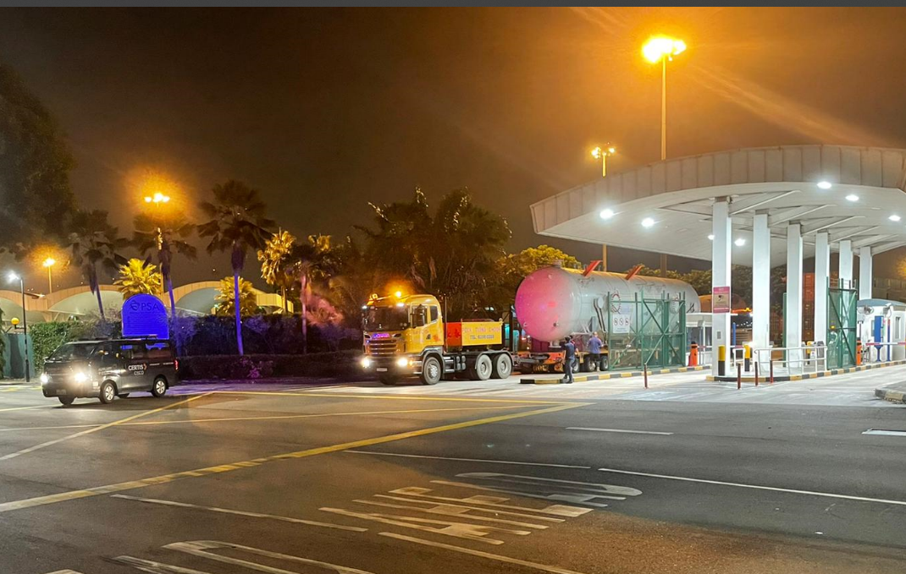
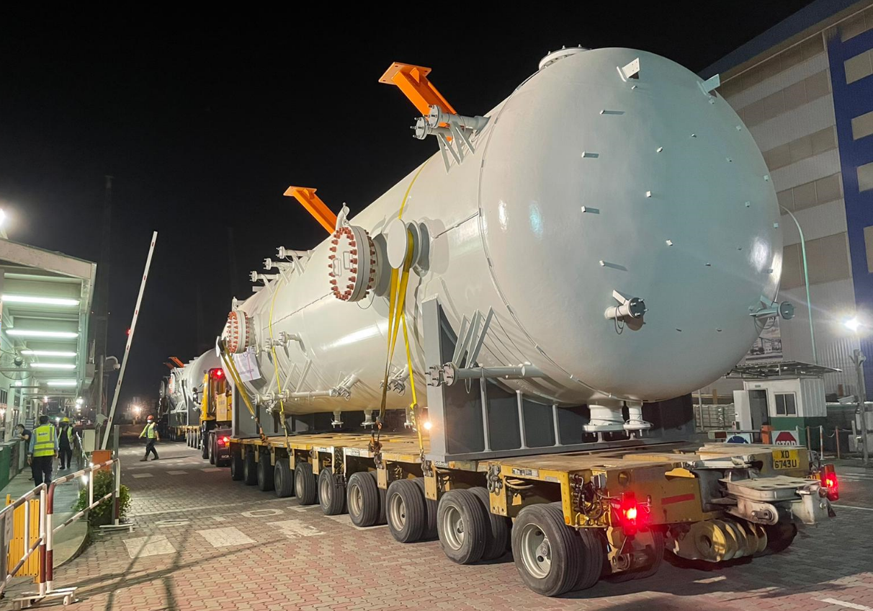
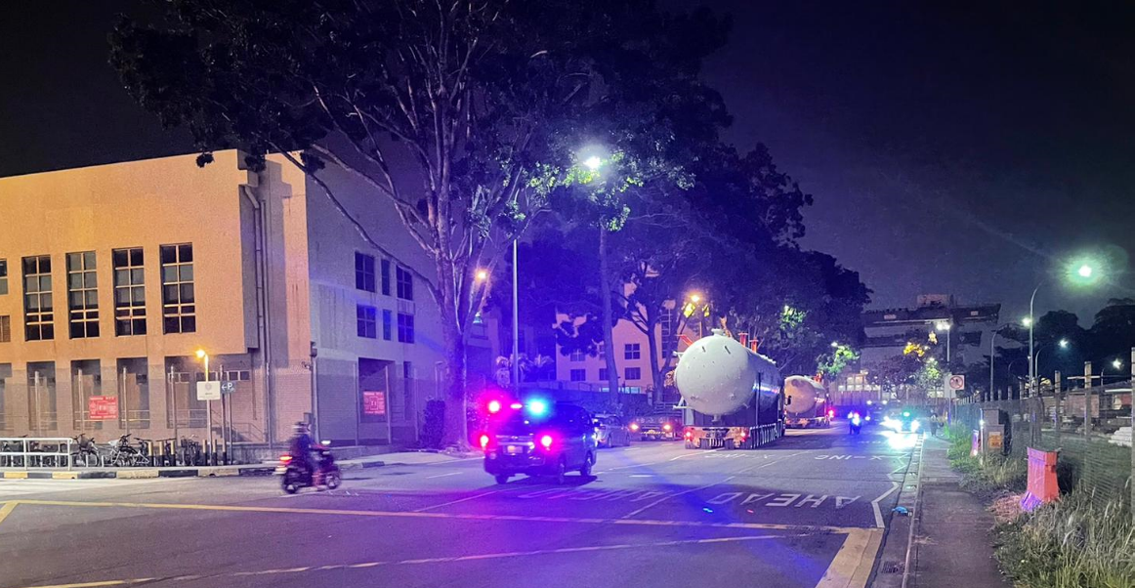
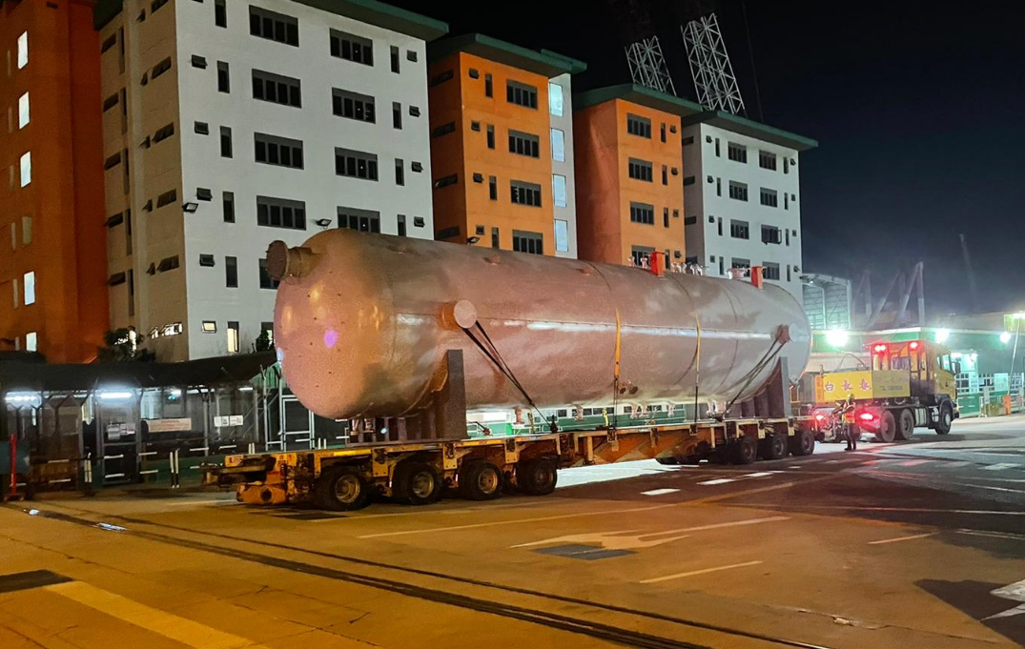
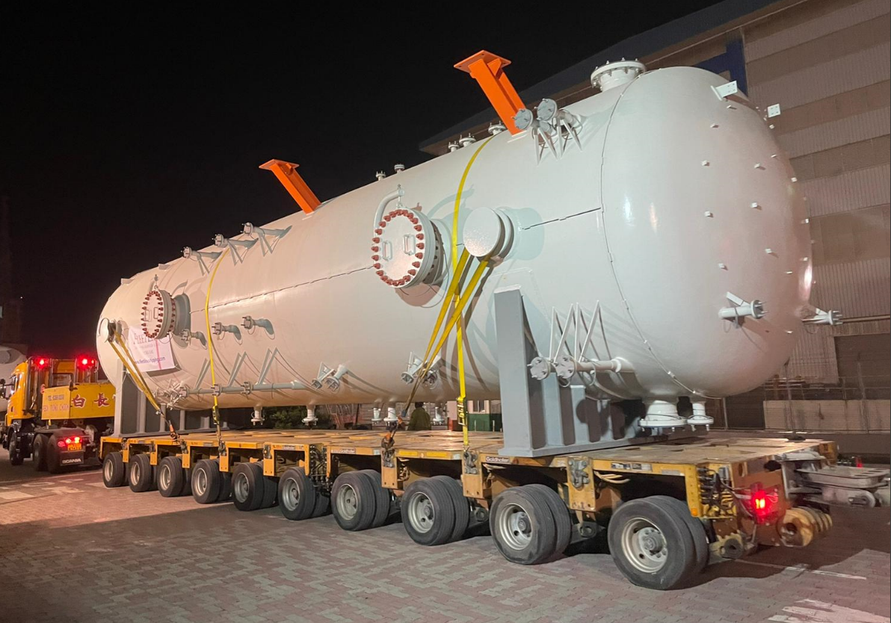
PROJECT REFERENCES
CASE STUDY – Local trucking & POLICE ESCORT of HP Separator to tuas yard of seatrium
Project Name: 09J110016 Shapoorji FPSO
EPC: EPC: Armada Madura EPC Ltd C/O Sembcorp Marine Rigs & Floaters Pte Ltd
Cargo: 4 X HP SEPARATORS
4 bare units / 223,250.00 kgs / 1,141.471 CBM
Shipper: Jord BV
Destination: TBY, Tuas yard Seatrium
Consignee: Seatrium
Scope:
Direct receiving BB units from container vessel at PSA Terminal and road transportation Sembcorp Tuas Mega Yard

