Slide 1
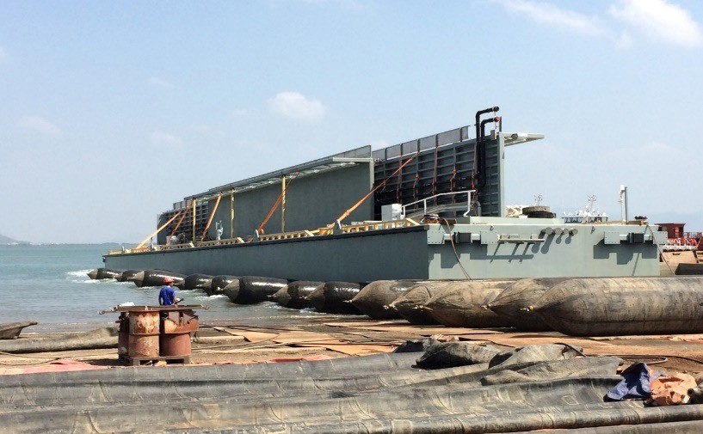
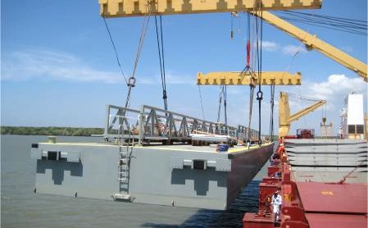
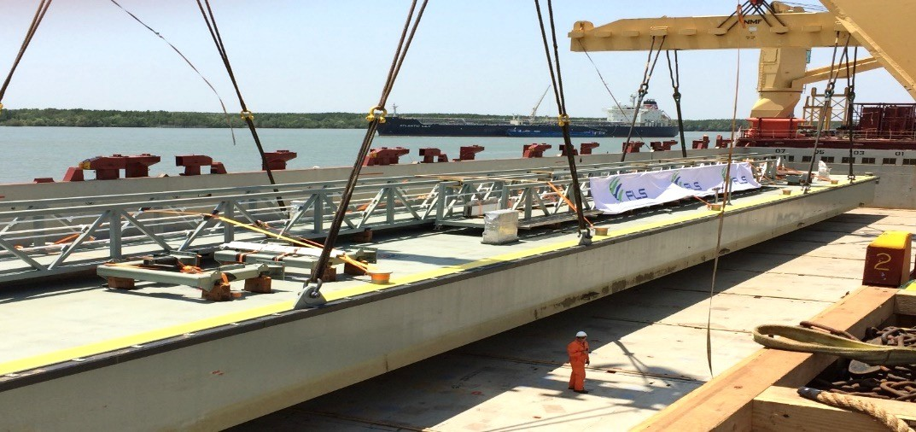
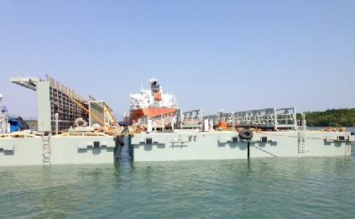
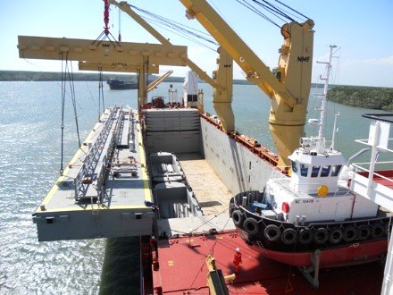
PROJECT REFERENCES
CASE STUDY – PONTOONS TO AUSTRALIA
Volume: Origin: Destination:
3 x 70 x 9.5 x 7.5 m / 408 MT each Vung Tau Anchorage, Vietnam Gladstone, Australia
Pre-Carriage ex Shipper’s Jetty up to Port via Tugboat
Organizing – Loading onto Vessel
Loading and Securing of the Cargo on the Vessel
Ocean Transport
Scope:

