Slide 1
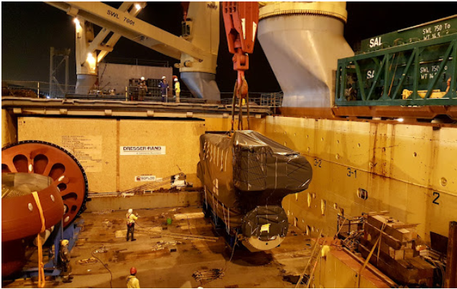
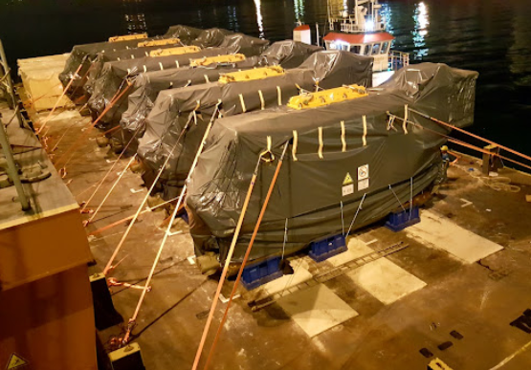
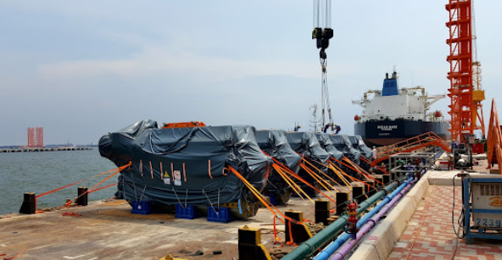
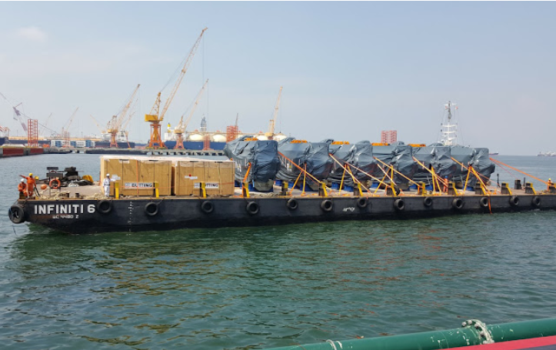
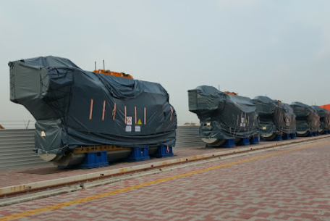
PROJECT REFERENCES
CASE STUDY – Overside receiving at Jurong port & Delivery to Sembcorp Tuas Mega yard
Project Name: 11-1119HEREEMA
Cargo: 6 UNITS MAN ENGINE (1040 x 320 x 560cm/158mt each) + 6 UNITS REACTORS
TOTAL: 984,470.00 KGS / 1,498.75 CBM
Shipper: MAN DIESEL & TURBO SE, Hamburg
Consignee: JURONG SHIPYARD PTE LTD
Destination: TBY, Tuas yard Seatrium
Consignee: Seatrium
Scope:
Overside receiving at Jurong port from vessel and load on barge.
Delivery to Sembcorp Tuas Mega yard by barge

