Slide 1
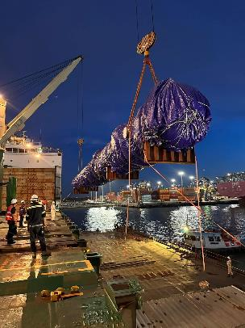
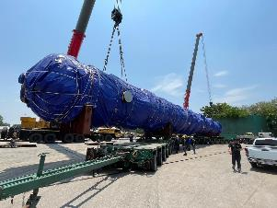
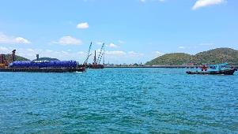
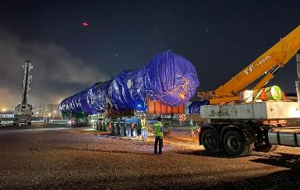
PROJECT REFERENCES
CASE STUDY - NATUREWORK
Project Name: | SEQUOIA PROJECT
Volume: | More than 500 containers, 50,000 CBM of BB
Commodity: | Steel parts, machine, tanks
Origin: | Various
Destination: | Laem Chabang, Thailand
Scope:
Import customs clearance under BOI privilege
Moving cargo from LCB port project site in Nakhon Sawan
Provide storage area for oversized cargo and normal cargo in LCB
Biggest Piece 46m L x 4.5m W x 4.9m H weight
Dimension increased and need to find solutions to move
Receiving alongside by Barge
Delivery to designed Jetty in Ayudhaya
Offloading cargo from barge to Hydraulic truck with Turn Tables
Delivery from jetty to jobsite in Nakhon Sawan – 5 days transit time
Challenge of delivery DC3:

