Slide 1
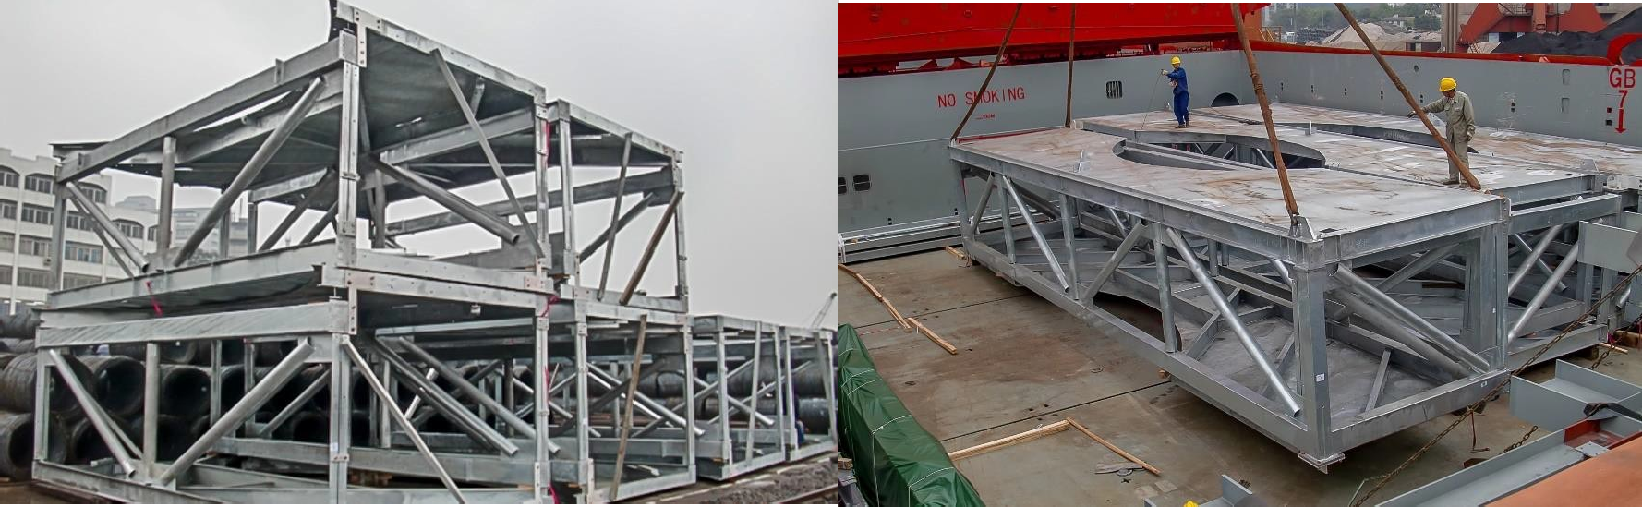
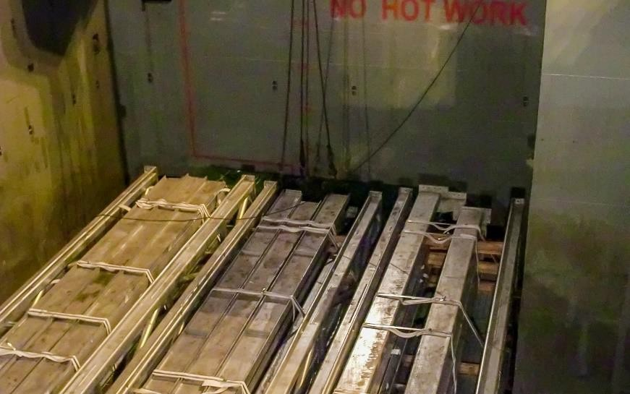
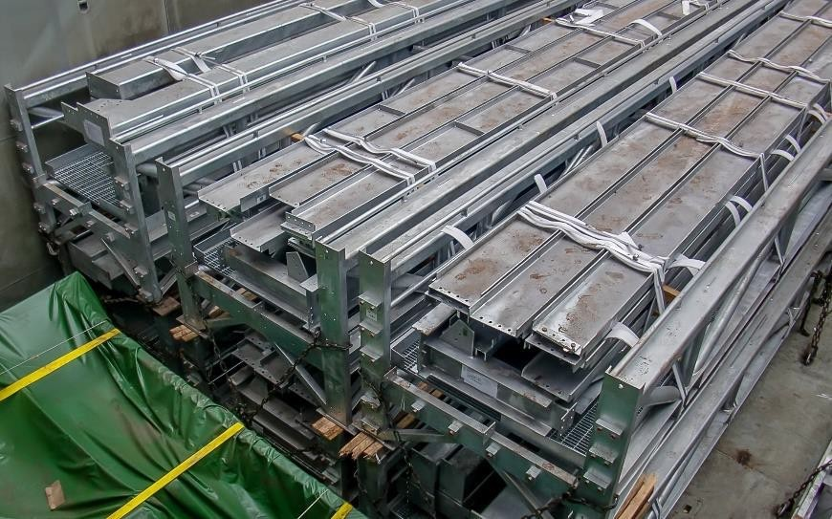
PROJECT REFERENCES
CASE STUDY – NORTH BATTLEFORD
Project Name: Project Owner: Volume: Commodity: Origin: Destination:
North Battleford Project GEA
4,000 cbm, Max. GW 40 MT
Steel beams, Modules Huangpu, China Everett, USA
Scope:
Loading and FAS delivery at Huangpu port
Loading and securing onto break bulk vessel
Break bulk ocean freight from port of Huangpu to port of Everett

