Slide 1
FLS PROJECT PRESENTATION
2025
1st April
1

Slide 2
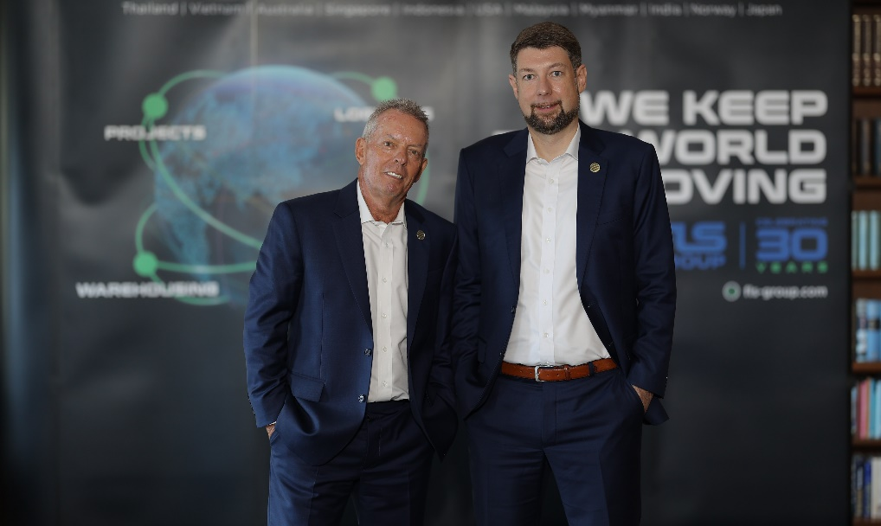
INTRODUCTION
1998 to 2023
By the year 1998, FLS ventured more and more into handling export projects from steel fabricators in Thailand, Korea, China, Vietnam, Malaysia, and Indonesia to worldwide destinations for many global engineering companies and EPC contractors.
To support our customers with even better service and faster communication, we moved our office to Laem Chabang in June 2006. This strategic move – we are now located within a maximum of 50 km from Thailand’s most important project port facilities – proved to be very successful because it allows us to be even more “hands-on”.
Today, our team consists of a number of expat and local project specialists, led by our CEO Torbjoern Larisch.
Regional Expansion
2011 - FLS (Vietnam) Ltd.
2013 - FLS (Australia) Pty Ltd.
2014 - FLS (Singapore) Pte Ltd.
2014 - PT. Federal Logistik Sistem (Indonesia)
2016 - FLS USA
2018 - FLS Malaysia
2020 - FLS Myanmar
2022 - FLS India
2023 - FLS China and FLS Japan
2024/2025 – FLS Philippines, FLS Norfolk, FLS Scandinavia, FLS Italy
In the short to medium term, further expansion is planned for Southeast Asia and the Middle East.
FLS History
Early Years
The company was founded in Bangkok in May 1993 by our current Chairman, Martin Haeberli.
With his successful background in the project business, including many years of experience in the US, the Middle East, and Thailand, FLS immediately started making an impact in Thailand’s project forwarding market.
Soon, FLS started winning various medium-sized import projects in the industrial, power, and mining sectors.
2

Slide 3





INTRODUCTION
Get to know us
“24 hours a day, 7 days a week, 365 days each year: we constantly handle many different and challenging projects.”
“Our tailor-made logistic solutions provides our customers with a unique level of service and know-how.”
Services:
“Turn-Key”, door to door project forwarding services
Heavy lift and oversized cargo handling
Full and part charter vessel chartering
Project related airfreight charters and container shipments
Project supervision and coordination
Cargo loading / discharging supervision
Port, road and equipment surveys
Feasibility studies
Transport insurance coverage
Warehousing, storage and export packing
Customs clearance services
Member of:
ISO certified own operations in
Thailand • Vietnam
Australia • Myanmar
Singapore • Indonesia
USA • Malaysia
India • China
FLS Philippines • Italy
Japan • Scandinavia
HSE and Compliance campaign for all offices.
A global network of carefully selected partners and agents.
3

Slide 4
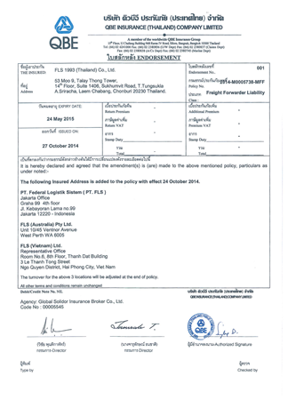
HSEQ PROCEDURES
Insurance
Details:
Transport Operator Liability Insurance covering all FLS offices
Max. liability coverage: 1,000,000 USD per claim or occurrence
as per request we can increase the maximum coverage against a premium – for instance as we did for the pontoon shipment for Goodline to Weipa Port (increased third party liability up to USD 20,000,000)
Endorsement

Slide 5
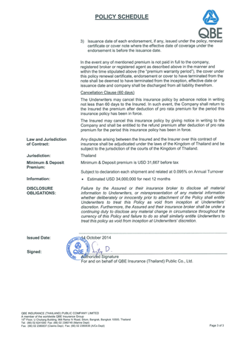
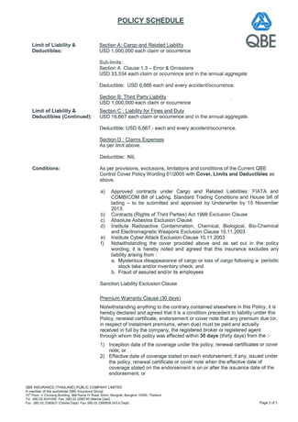
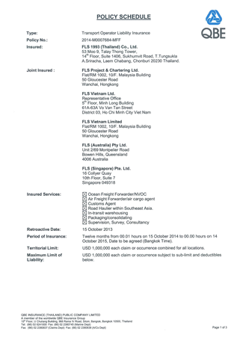
HSEQ PROCEDURES
Insurance
Insurance Policy

Slide 6
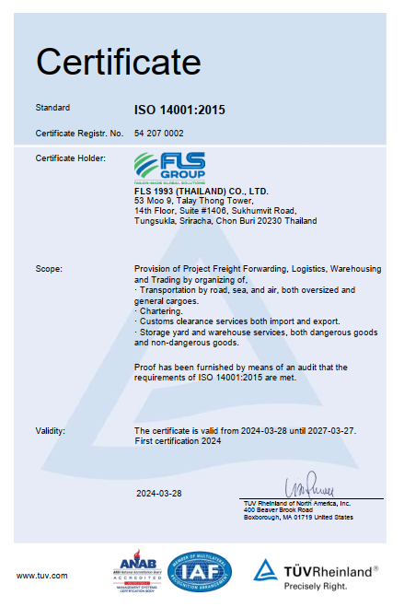
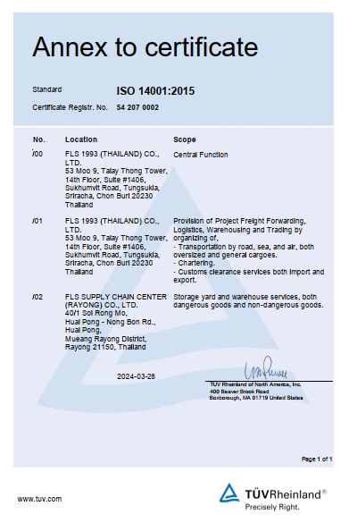
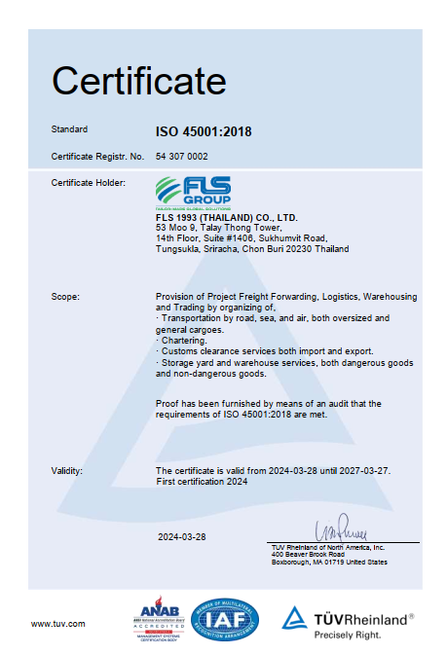
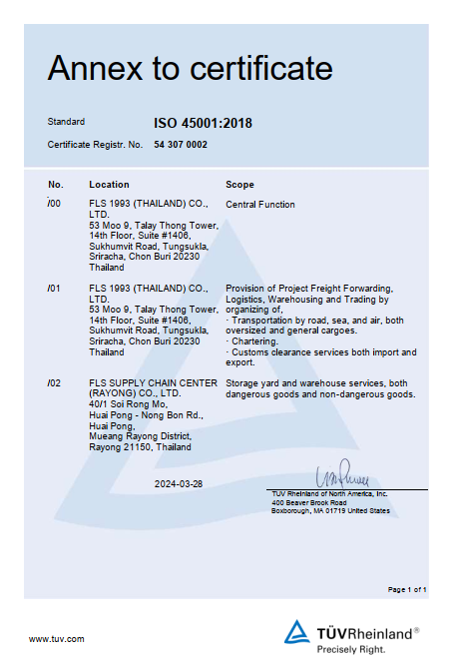
HSEQ PROCEDURES
Certifications
ISO 14001:2015 Certificate
ISO 45001:2018

Slide 7
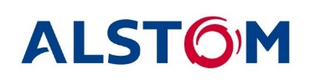



















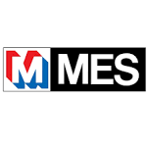


INTRODUCTION
Key Industries and Key Customers
Since its earliest days, FLS has been a strong player in the power business. Today handling equipment for gas, coal and oil fired power plants as well as hydro power plants remains one of the core activities of FLS. FLS offers unique expertise in handling Heat Recovery Steam Generators (HRSG), boilers, generators, steam and gas turbines as well as all other related equipment.
The recent boom in the upgrade and green field construction of petro chemical plants worldwide has strengthened FLS’ activity in this industry. We support the desire of many of our clients in this field, to ship modular in order to save construction time and cost on site. FLS’ conducts extensive studies before commencement of each project to find the best solution.
Petrochemical
FLS offers a wide range of services for the mining industry. Often these projects are located in remote locations with little or no transport infrastructure. FLS offers high level knowledge in providing logistics for the actual construction of mines to shipping consumables and equipment such as dump trucks and earth moving machines.
Mining
The construction of large infrastructure projects presents unique challenges. FLS’ has been supporting clients in port as well as road construction for many years. Major infrastructure requires precise co-ordination to ensure that equipment and materials from various suppliers are in the right place at the right time. FLS’ team draws on extensive knowledge and experience to give our clients the best possible options and project management in supply, shipping and transportation.
Infrastructure
Being a creative and innovative organization, FLS is always looking for new markets and challenges. From the construction of steel and other plants to the Oil & Gas industry, FLS continues to strive to lead by providing excellent services.
Other

Slide 8



INTRODUCTION
FLS HSE & Compliance
QUALITY ASSURANCE
HEALTH & SAFETY
OUR STANDARDS
FLS Quality Management Systems meet all our customer’s applicable statutory and regulatory requirements.
We use one of the world’s leading modular enterprise systems to streamline operations, accounting and business development.
Provide Health & Safety training for all members of staff as well as blue-collar and sub-contracting parties.
Follow international rules and guidelines to foster a safe and healthy working environment for our teams.
Ensure that each project and every shipment is handled in a safe, timely, systematic, and efficient manner.
We select and work only with agents and partners who:
are fully certified to international standards
fulfill our own strict quality standards
have sufficient insurance coverage
operate with well-maintained and regularly tested equipment
are well managed and staff regularly trained
have a long successful history and proven track record.

Slide 9

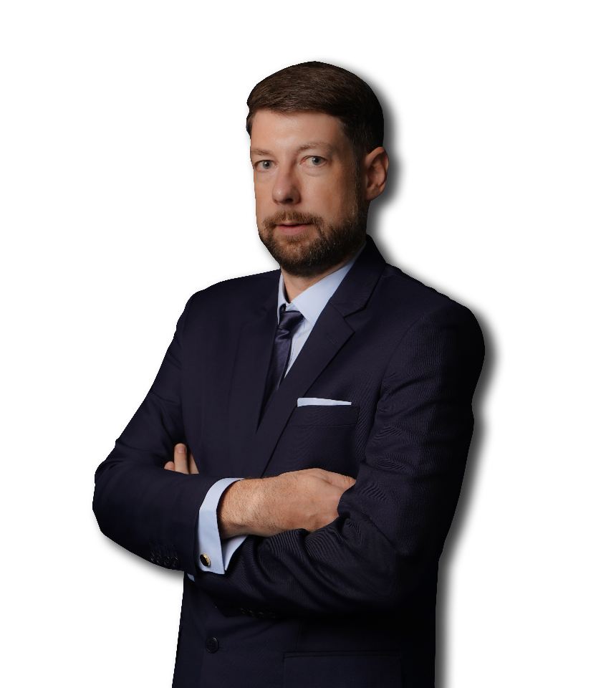
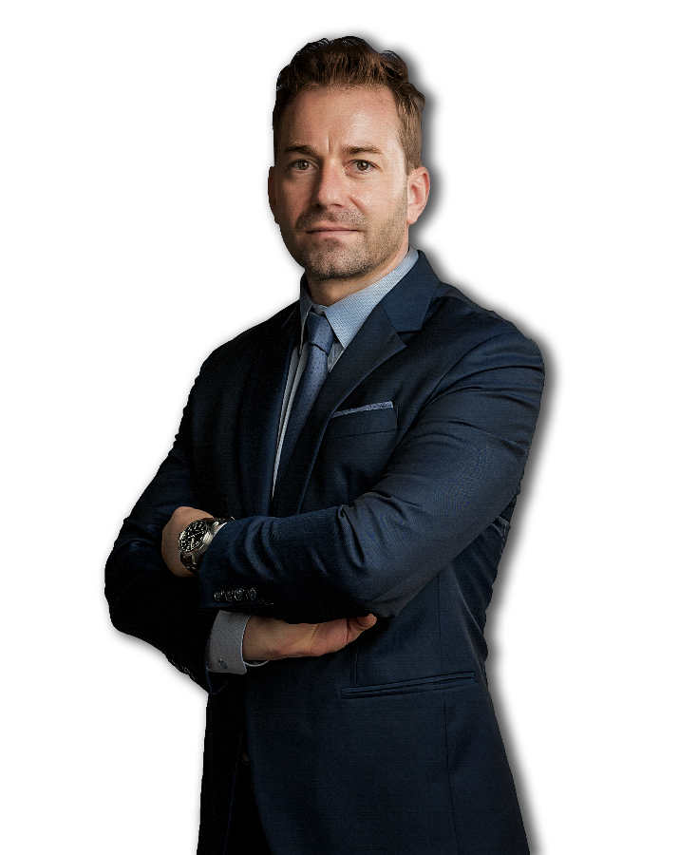
INTRODUCTION OF FLS VIETNAM
Torbjoern Larisch
CEO (TH)
Christopher Schnieders
Global Director Projects (VN)
Chris is a project logistics specialist, with more than 20 years’ experience in leading logistics teams for large scale industrial projects. Most notable experience was as project logistics lead on Fluor’s USD 6 Billion Ivanhoe Mines Oyu Tolgoi Copper Mine Construction Project in Mongolia, one of the largest copper/gold mines in the world. This involved the complete charter management of shipments amounting to 300,000 frtons from all over the world to Beijing, including 1,600 km trucking into inner Mongolia. He arrived in Saigon in 2006 and since then has built an extensive Network through which the company can provide outstanding services to its clients in Vietnam. Chris has the global responsibility for project logistics within the FLS Group
Torbjoern has more than 20 years of experience in project freight forwarding and logistics. Prior to joining FLS team he spent 5 years working in South East Asia gaining valuable knowledge and experience in project handling. He speaks English and German fluently.
+66 84 362 3484
torbjoern.larisch@fls-group.com
+84 986 580 829
christopher.schnieders@fls-group.com
9

Slide 10
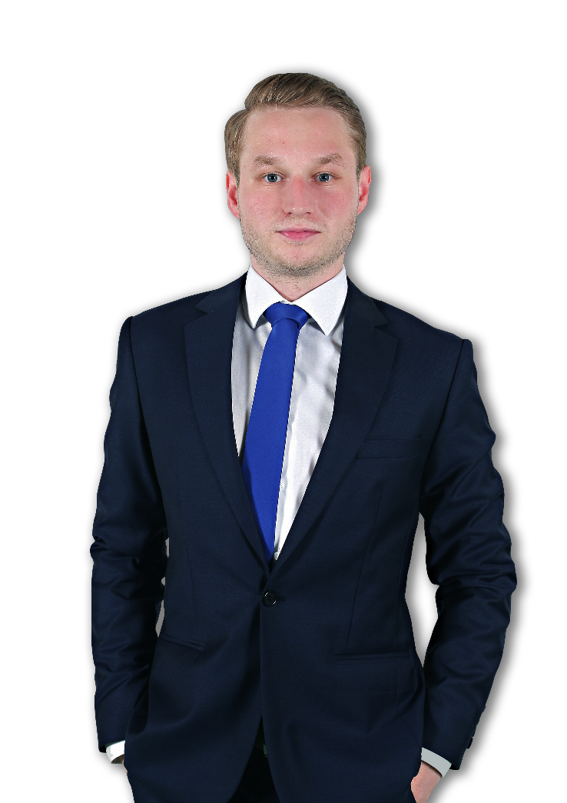
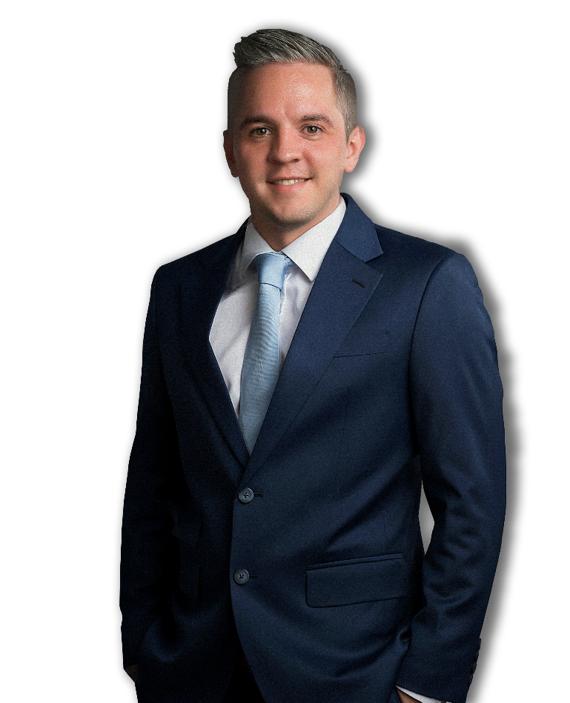
INTRODUCTION OF FLS VIETNAM
Sven Hoehle
Head of Global Project Solution (VN)
Johannes Linnenbruegger
Projects Operations Supervisor (VN)
Sven started his career in project freight forwarding and logistics back in 2009. Prior to joining the FLS Team he spent 6 years working in Germany gaining valuable knowledge and experience in Ocean Freight, Freight Forwarding and Project Handling. He speaks English and German fluently.
As a project freight forwarding and logistics professional, Johannes, or "Hansi," brings a wealth of experience to FLS Projects Vietnam. Prior to joining FLS, Hansi gained valuable insights in Germany and contributed to diverse project sites worldwide. Apart from that, he is working on supporting IT solutions, making him a versatile asset to any project team. He speaks English and German fluently.
+84 909 277 688
sven.hoehle@fls-group.com
+84 981 400 770
johannes.linnen@fls-group.com
10

Slide 11


INTRODUCTION OF FLS VIETNAM
Le Quoc Trung
Port Captain / HSE Mgr (VN)
Nguyen Manh Hung
Project Engineer (VN)
Trung has been in the shipping industry since 2006. Starting as a deck cadet he worked his way up the ladder to become a captain in 2013. As a seaman traveling the world on all sorts of vessels such as chemical tankers and general cargo ships he gained priceless knowledge. Being the man on the ground supervising all our port operations Trung will take outmost care of your valuable cargo. Self-explanatory the motto is always “safety first”. Trung is a Certified Marine Warranty Surveyor and has a perfect referenceas a HSE and Quality Manager.
Hung has a vast experience in the Shipbuilding and Oil&Gas Industry. For 11 years he has been the Senior Commercial Executive of an international shipyard. Prior to that he worked as a Deputy Technical Manager in the Engineering Department of a Vietnam based Offshore Company. He was part of the QC and Production department and carried out project required documents, prepared tenders and commercial proposals and also overviewed the execution of the jobs. Hung speaks Vietnamese and English fluently.
+84 68 801 0168
trung.le@fls-group.com
+84 918 260 540
hung.nguyen@fls-group.com
11

Slide 12
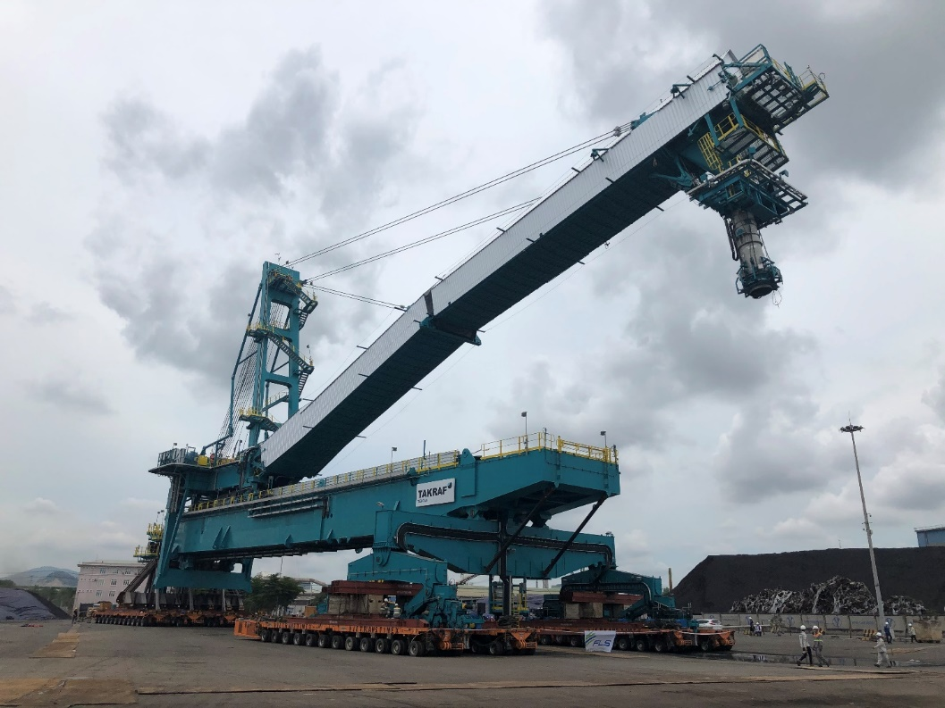
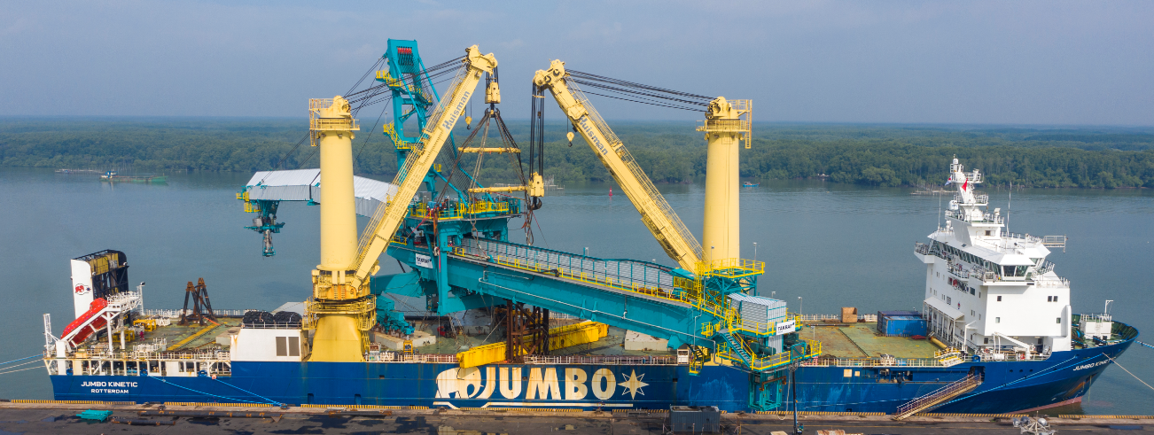
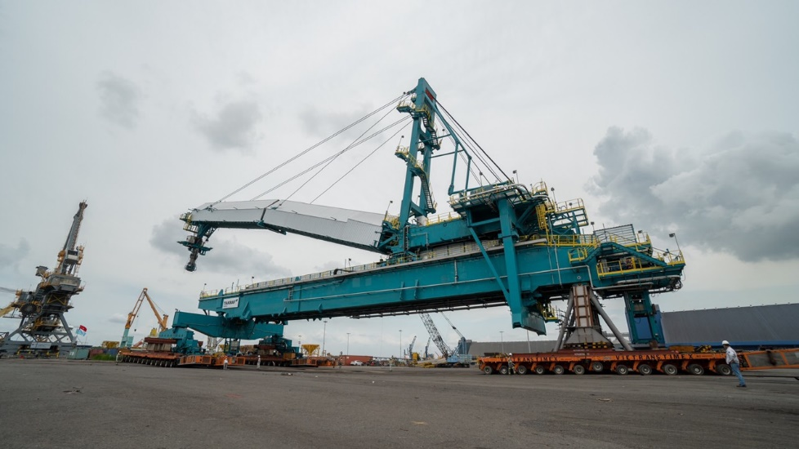
REFERENCES
CASE STUDY – 1500 TON BULK SHIPLOADER
Dimensions: 135 x 25 x 43 m – 1,500 MT
Commodity: Radial Quadrant Shiploader
Origin: Phu My, Vietnam
Destination: Vancouver, Canada
Scope:
Ground preparation (foundation)
Leveling of transport route
Removal of light towers, fire rquipment, concrete divider
Shifting via 96 SPMT axles
Setup + movements were shaped to match the schedule of the vessel, construction team + port operator
Supervision by multiple FLS professionals

Slide 13
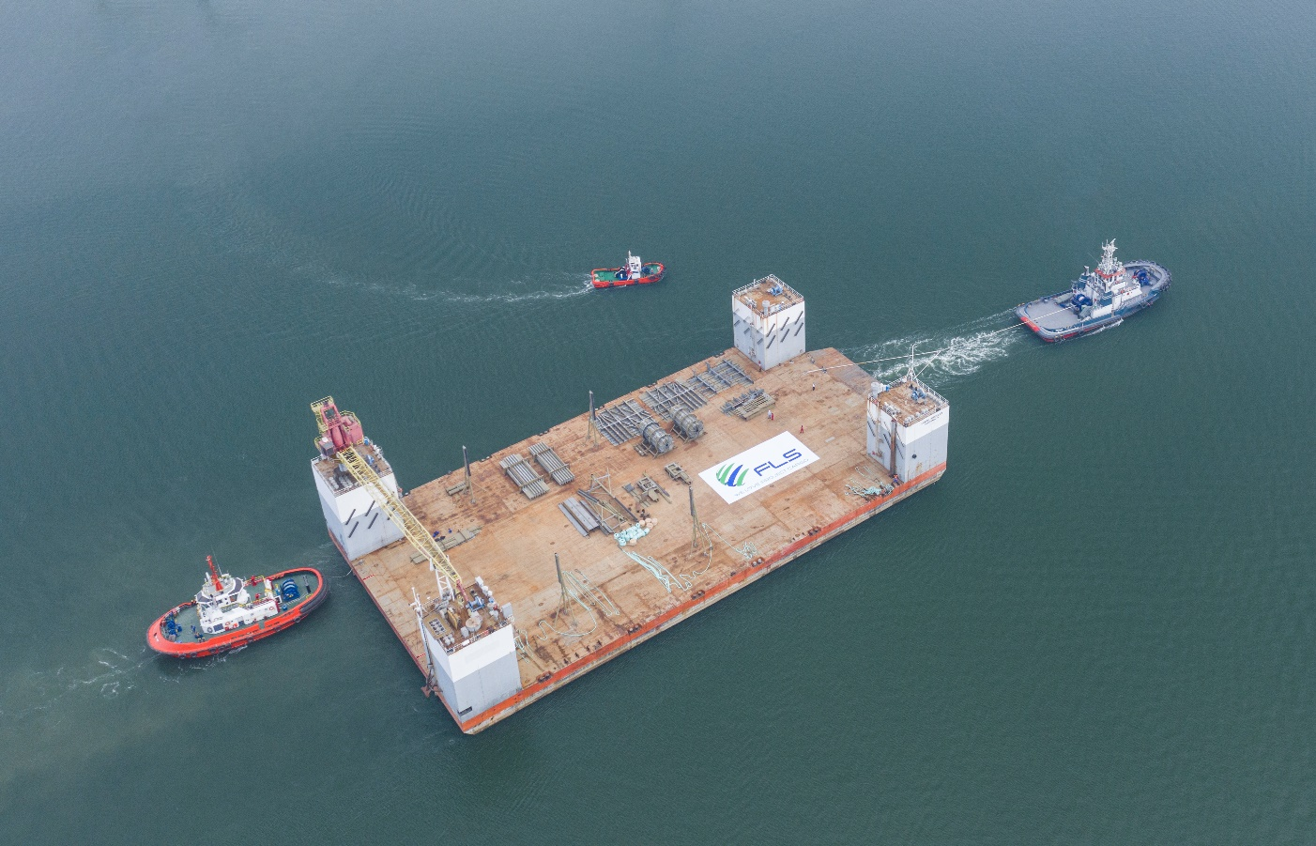
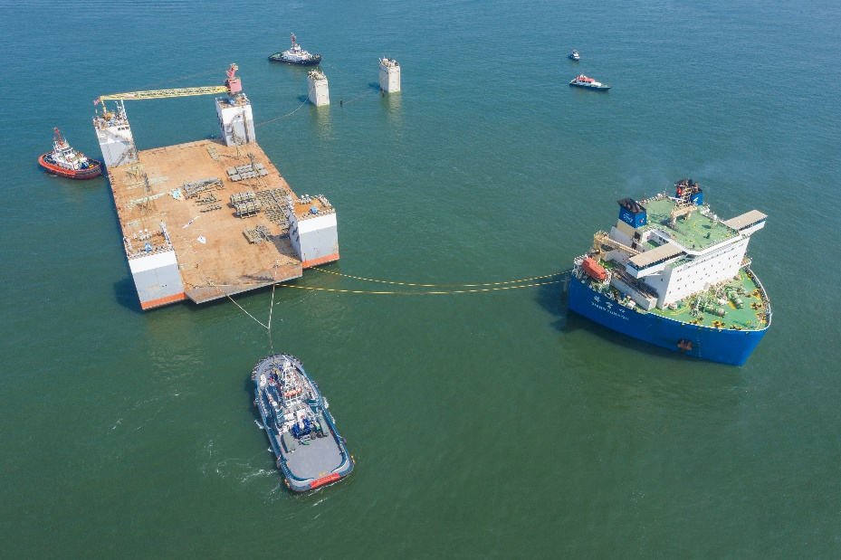
REFERENCES
CASE STUDY – SEMI-SUBMERSIBLE PART 1
Dimensions: 101.5 x 52.5 x 31 m – 7,000 MT
Commodity: Drydock
Origin: Vung Tau, Vietnam
Destination: Balamban, Philippines
Scope:
Chartering semi-submersible vessel for two different cargo owners
Initially the drydock was supposed to be dry-towed, but FLS managed to pair the Dock together with a liftboat. This way both owners benefited from each other.
FLS coordinated towing from Ho Chi Minh City to anchorage outside of Vung Tau port.
Some of the most powerful tugs in Vietnam were required to position the dock overnight just in time for readiness of M/V XIANG YUN KOU
The port authority issued strict operational saftey guidelines that have been fully satisfied.
FLS was the communication tool between cargo and vessel owners, customs, port authority, tug operators, marine warranty surveyors and stevedores
Our port captains have been on scene for an entire week to accompany both assets from their origins until departure out of Vietnam waters

Slide 14
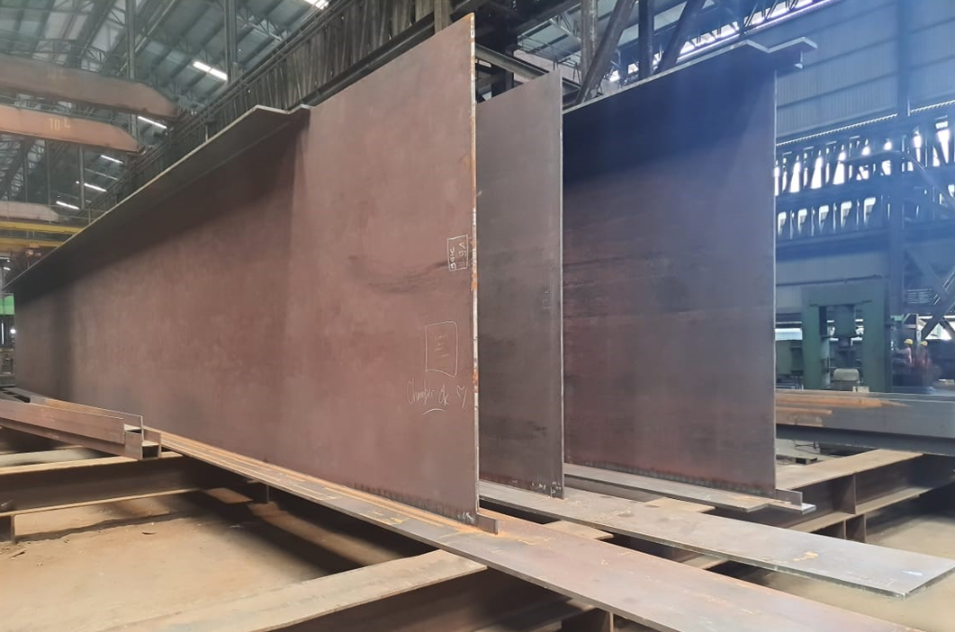
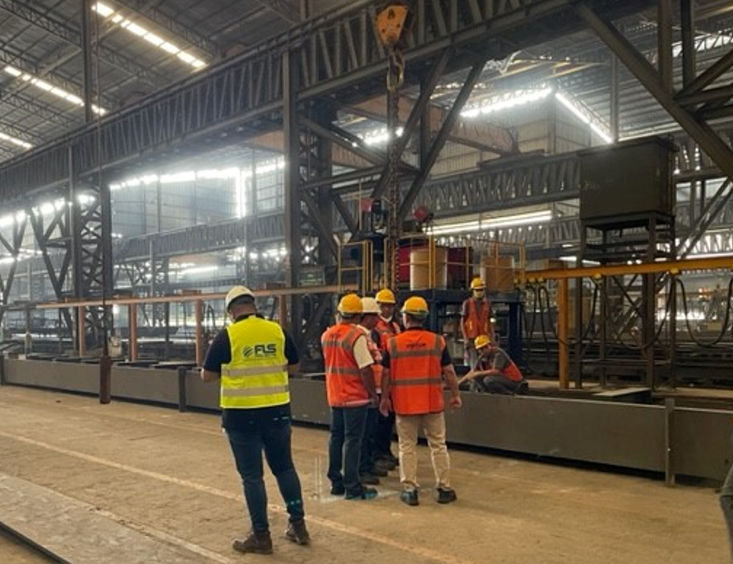
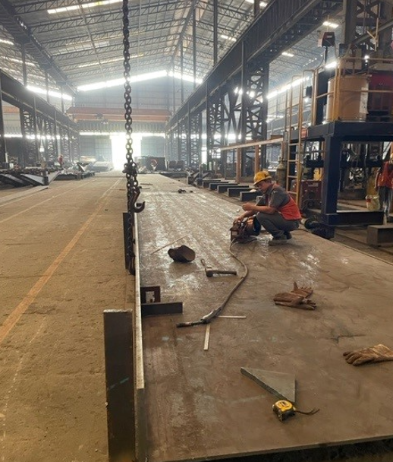
REFERENCES
CASE STUDY – NISUTLIN YUKON BRIDGE PROJECT
Project Name: Nisutlin Yukon Bridge Project, Canada
Volume: Containers: 50 Containers and 1400MT/ 3900
CBM Break Bulks
Commodity: Steel Structures
Origin (POL): Indonesia
Destination (POD): Project site West Coast, Canada
Scope:
Handling and booking the ocean freight for containers + break bulk ex Indonesia
Supporting the project owner with FLS supervising + know-how from A-Z

Slide 15
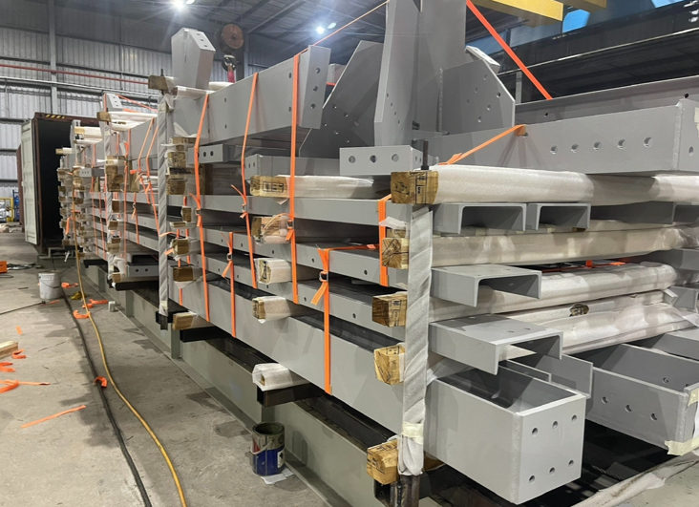
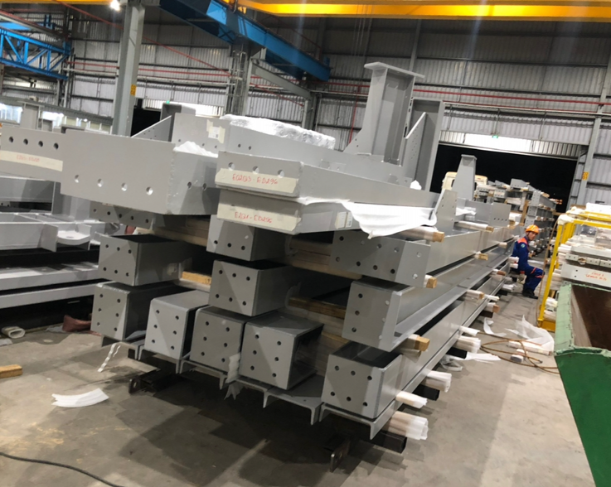
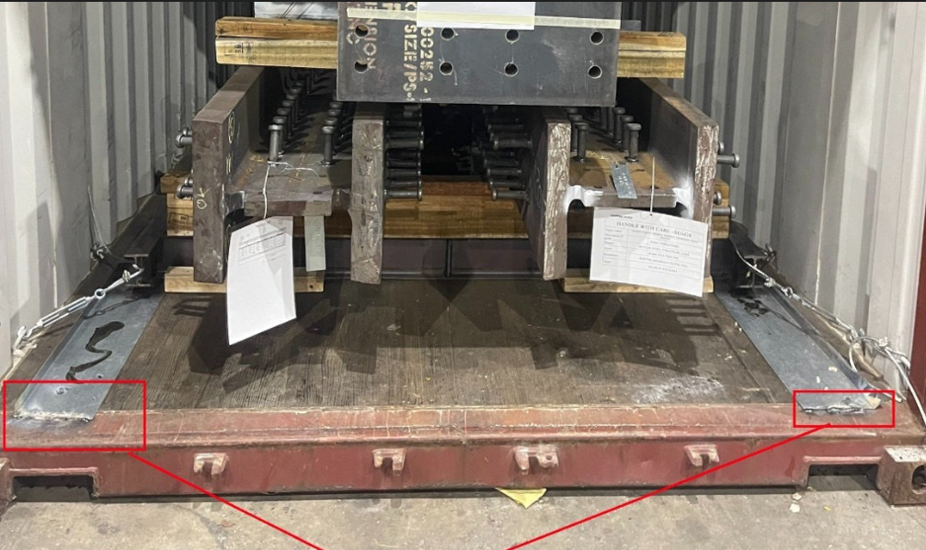
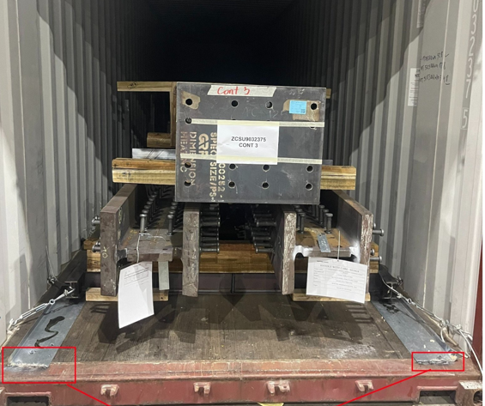
REFERENCES
CASE STUDY – ALGOMA DUSTHOOD –WEATHERING STEEL PROJECT
Project Name: Algoma Dusthood /Weathering steel project CANADA
Volume: Containers : 71 (40’HC and 45’HC) 1700MT
Commodity: Steel Structures
Origin (POL): Vung Tau , Viet Nam / Shipping March –July 2023
Destination (POD): Vancouver – Toronto – Jobsite Saul St. Marie, Canada
Scope:
Handling and booking the transport from FOB Vung Tau up to DDP Canada
Supporting our client with a special tracking system tool, to keep control for every container
Co-ordination and supervision at the port and jobsite

Slide 16
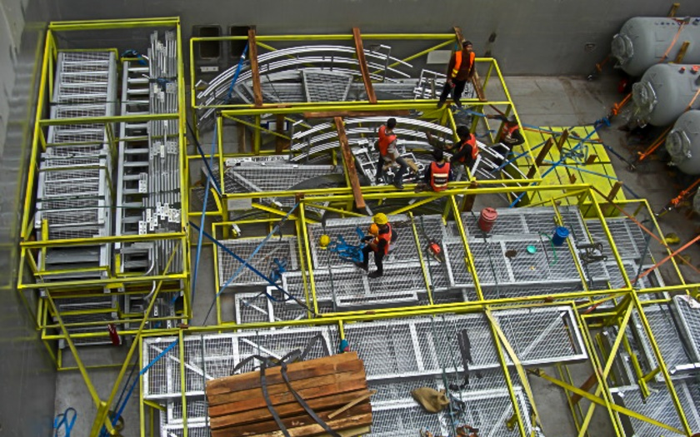
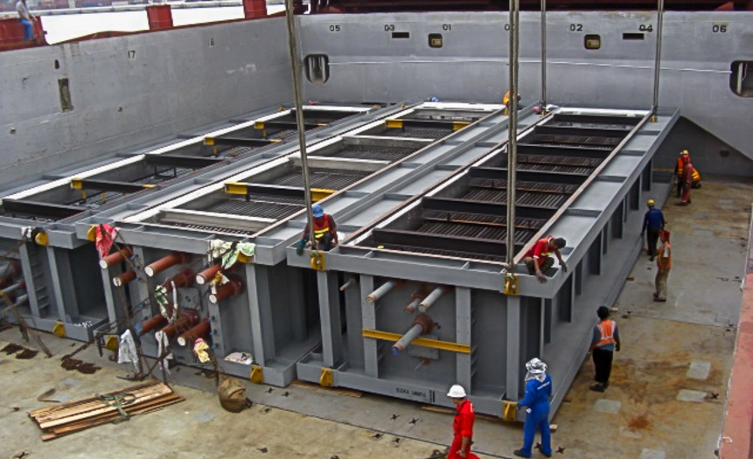
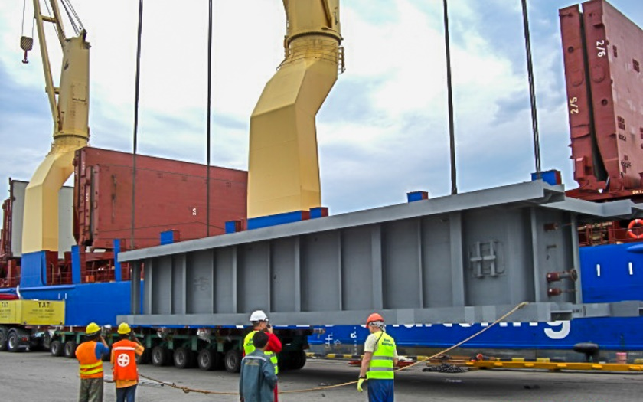
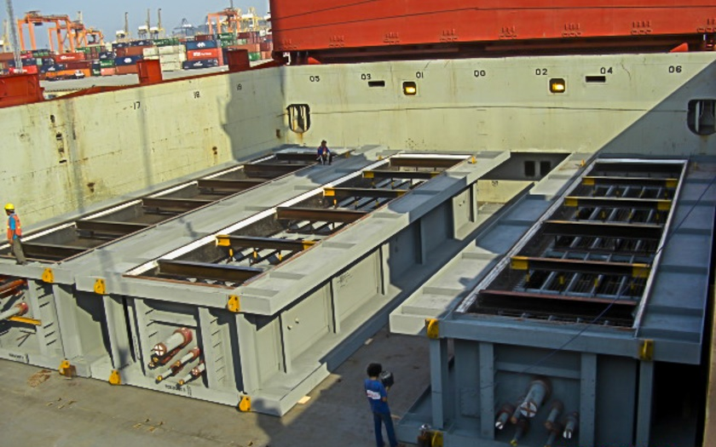
REFERENCE
CASE STUDY – LOS ESTEROS
Project Name: Los Esteros Project
Volume: 7,000 cbm, Max. GW 150 MT
Commodity: Steel beams, modules
Origin: Thailand
Destination: Stockton, USA
Scope:
Loading and FAS delivery at Laem Chabang port
Loading and securing onto break bulk vessel
Break bulk ocean freight from Laem Chabang port to port of Stockton

Slide 17
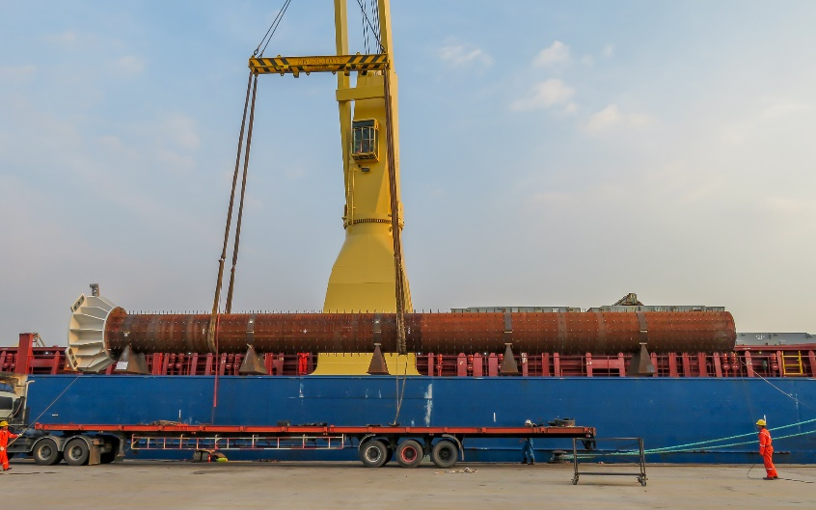
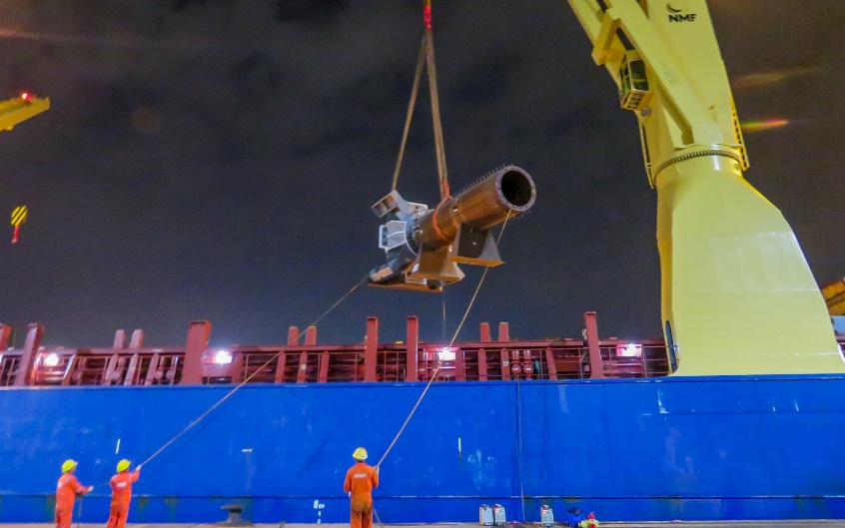
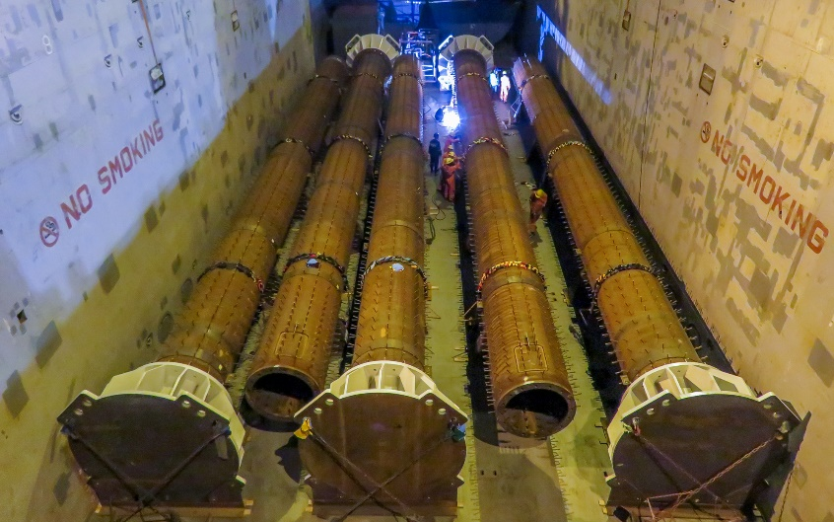
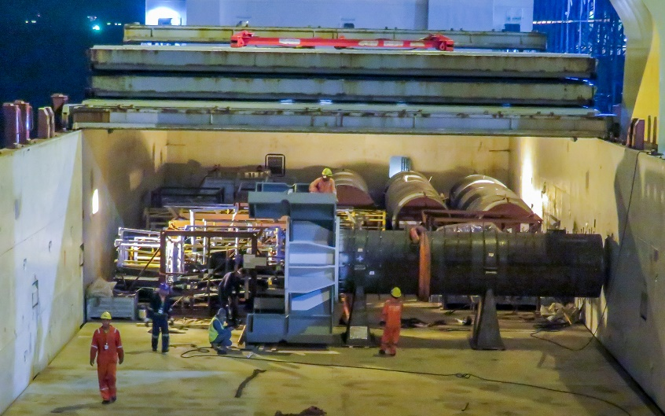
REFERENCE
CASE STUDY – LA RAMS STADIUM
Project Name: LA Rams Stadium
Volume: 2,000 cbm, max. GW 35 MT
Commodity: Steel pipe column
Origin: Thailand
Destination: Los Angeles, USA
Scope:
Pre-Carriage EXW to Laem Chabang port
Re-loading and FAS delivery at Laem Chabang port
Loading and securing onto break bulk vessel
Break bulk ocean freight from Laem Chabang port
up to Port of Los Angeles + on-carriage to site

Slide 18
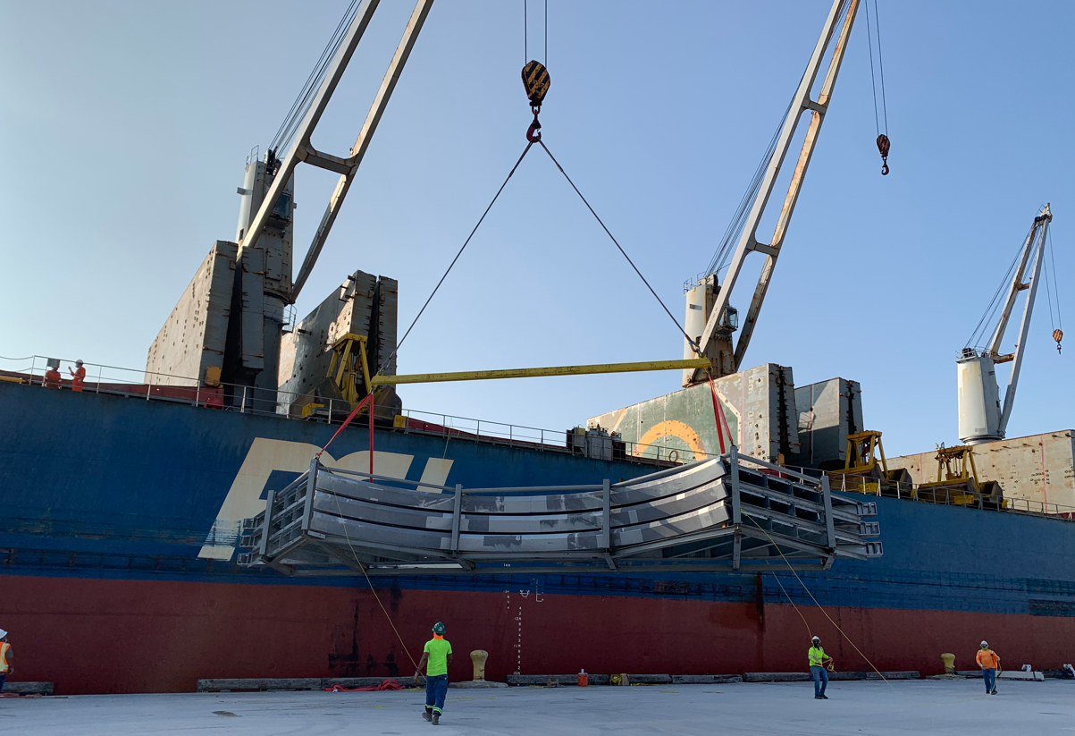
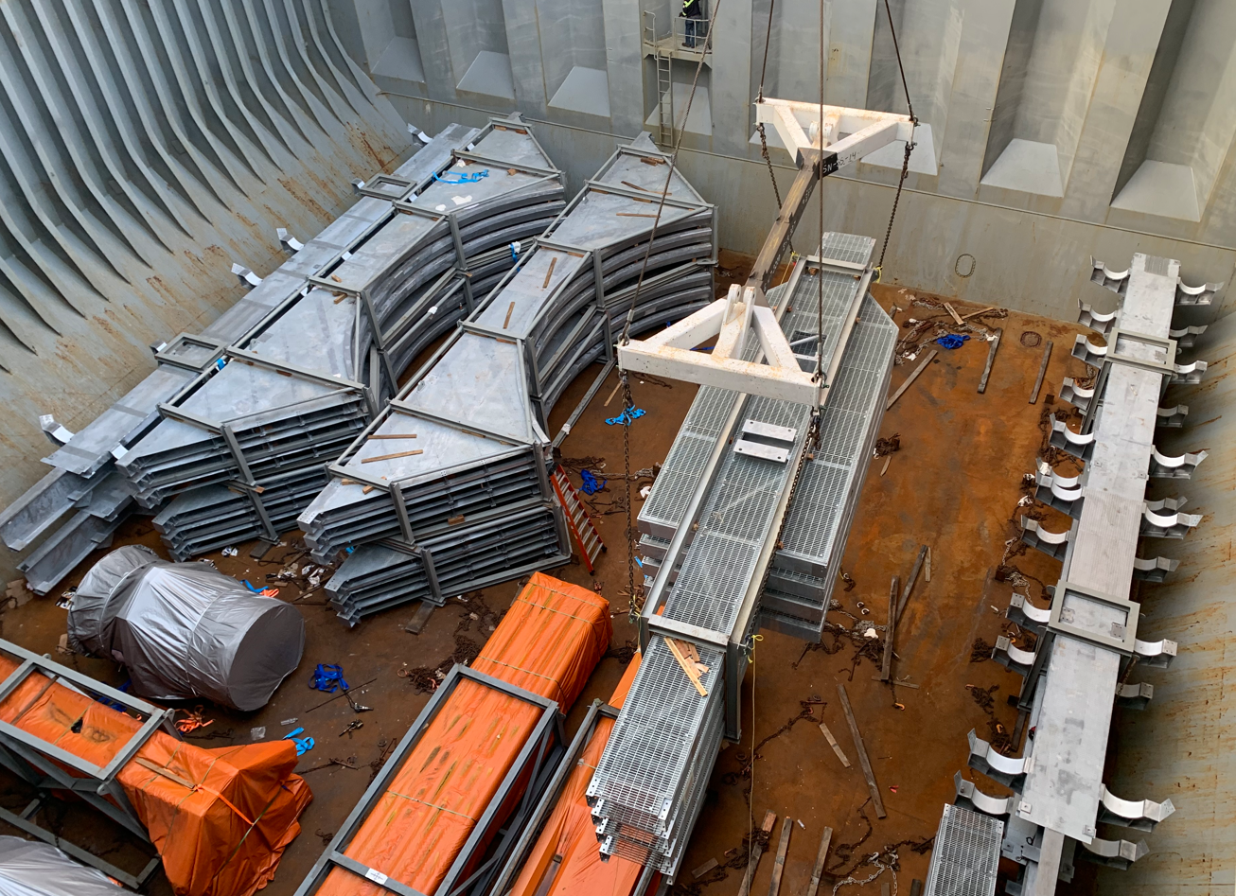
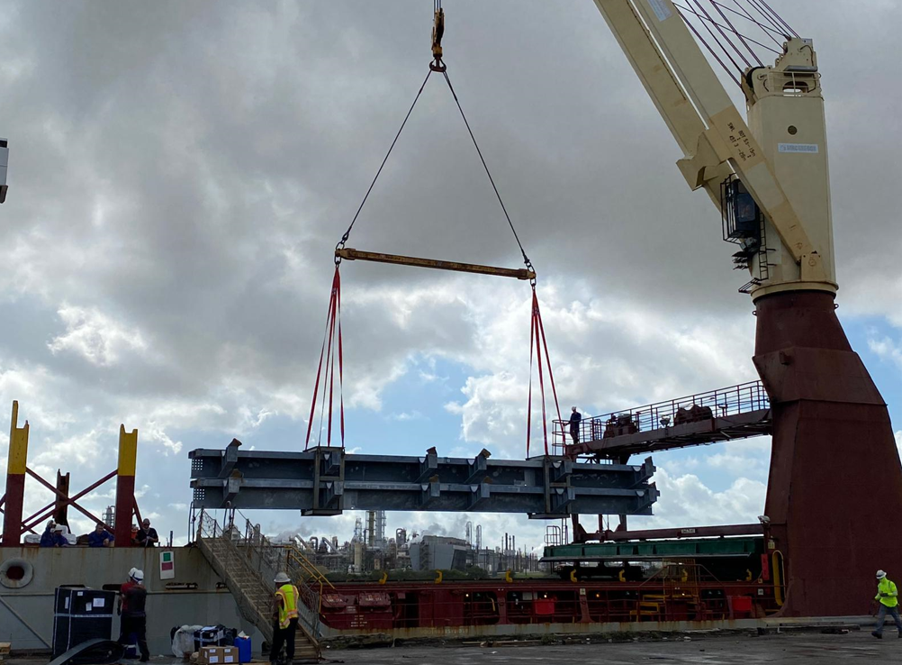
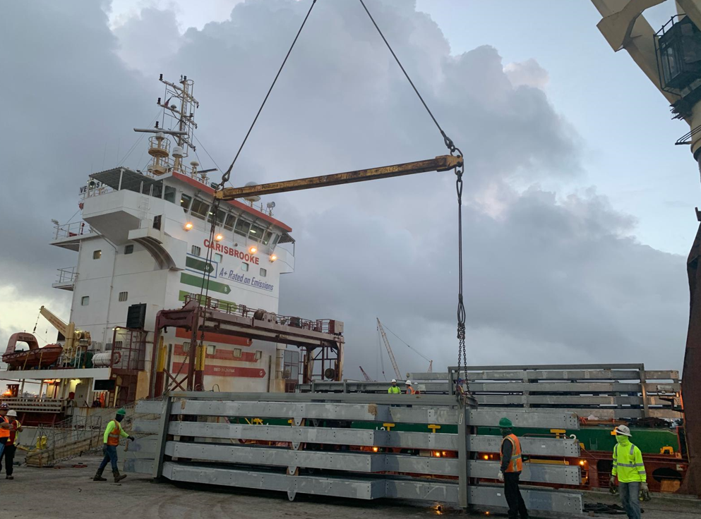
REFERENCE
CASE STUDY – JACKSON POWER PLANT ELWOOD, IL USA
Volume : 8,816 cbm , 1,538 MT Break Bulk
Containers 160 x40’ HC Weight 2,400 MT
Commodity:Steel Structures
Origin: Vung Tau, Vietnam , Shipping April to June 2020
Destination:Houston TX USA , DAP Elwood, IL, USA
Scope:
Trucking from workshop up to the export terminal
Chartering of a Suitable multi-purpose heavy lift vessel
.FLS was the communication tool between cargo and vessel owners, customs, port authority, tug operators, marine warranty surveyors and stevedores
Our port captains have been on scene for supervising purposes
Discharge in Houston, TX and trucking up to the job site in Elwood, IL, USA.

Slide 19
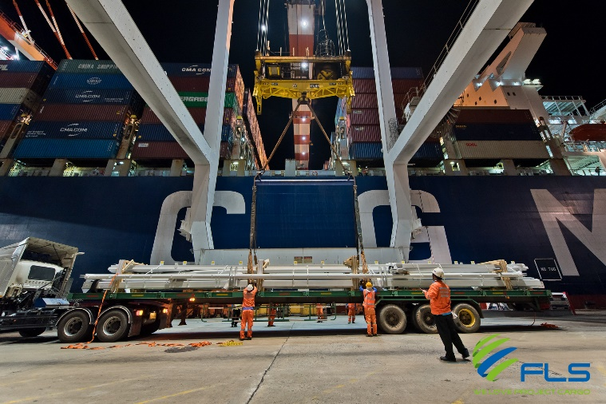
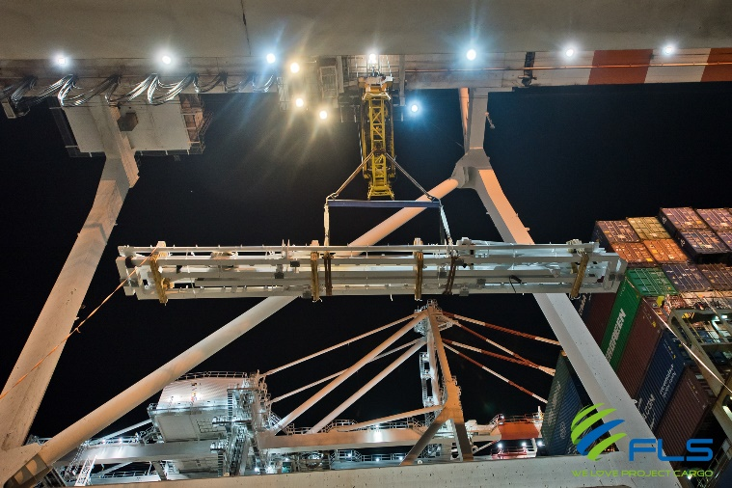
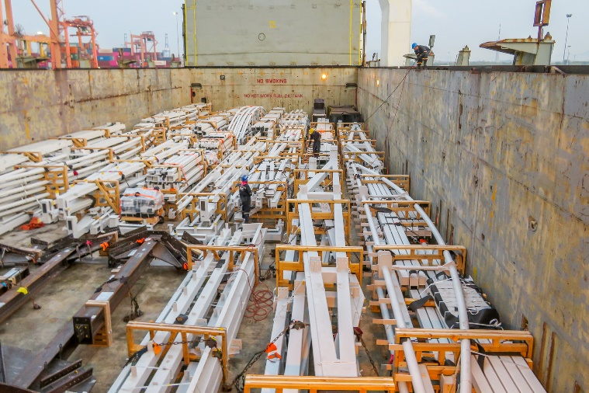
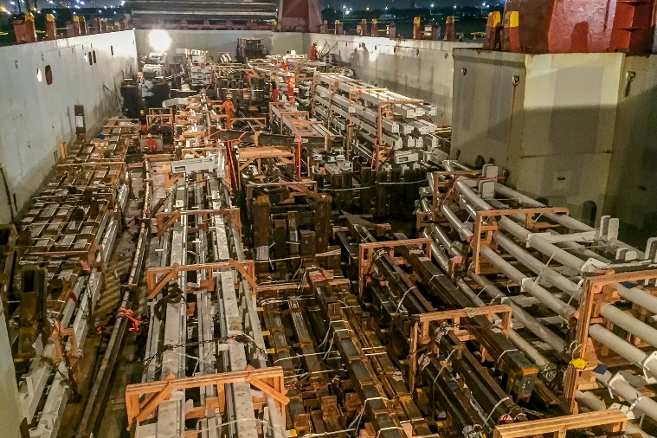
REFERENCE
CASE STUDY – LASED ROOF STEEL STRUCTURES
Project Name: Lucas Arts Museum
Project Owner: Thai Herrick
Volume: 10,000 cbm, Max. GW 20 MTons
Commodity: Various steel structures
Origin: Thailand
Destination: Los Angeles, USA
Scope:
Pre-Carriage EXW to Laem Chabang port
Re-loading and FAS delivery at Laem Chabang port
Loading and securing onto break bulk vessel
Break bulk ocean freight from Laem Chabang port to port of Los Angeles
On-carriage to site

Slide 20
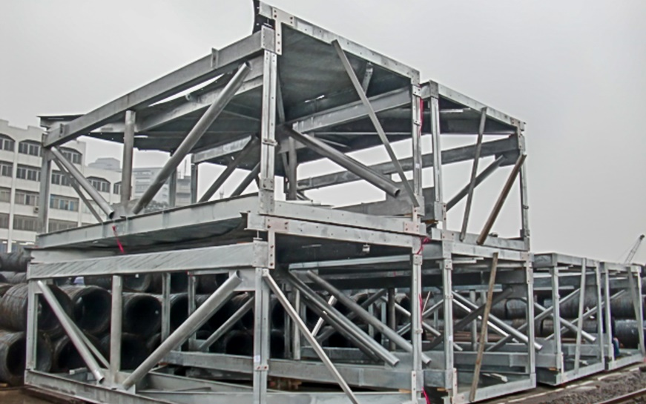
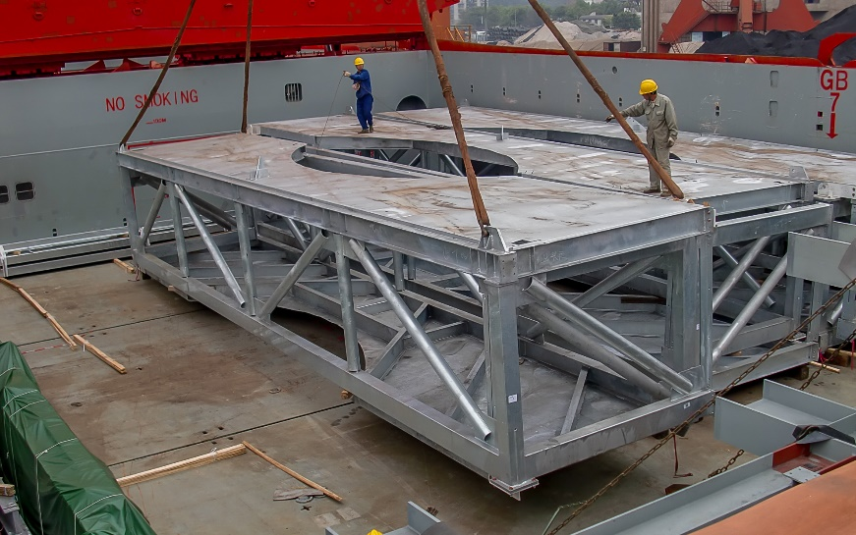
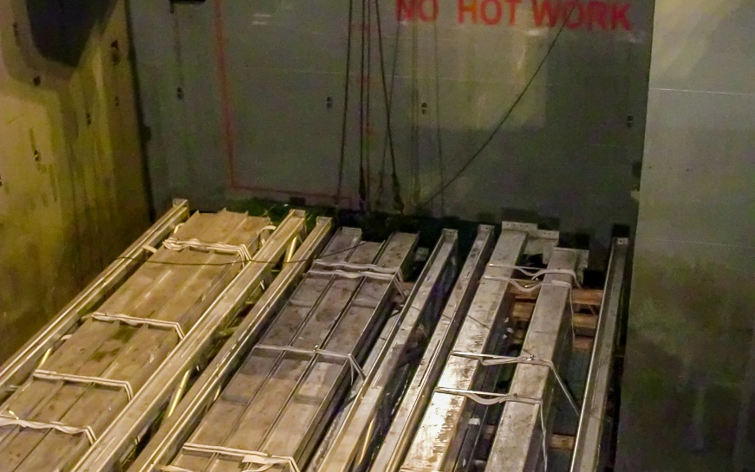
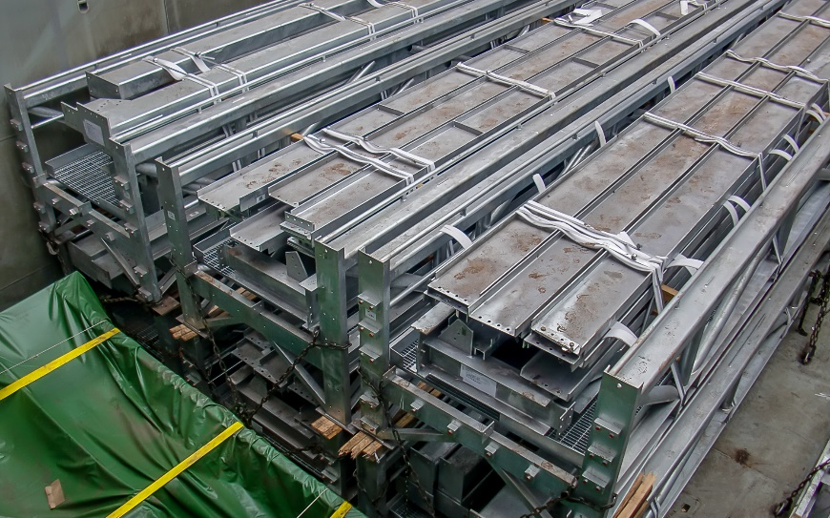
REFERENCE
CASE STUDY – NORTH BATTLEFORD
Project Name: North Battleford Project
Volume: 4,000 cbm, Max. GW 40 MT
Commodity: Steel beams, Modules
Origin: Huangpu, China
Destination: Everett, USA
Scope:
Loading and FAS delivery at Huangpu port
Loading and securing onto break bulk vessel
Break bulk ocean freight from port of Huangpu to port of Everett

Slide 21
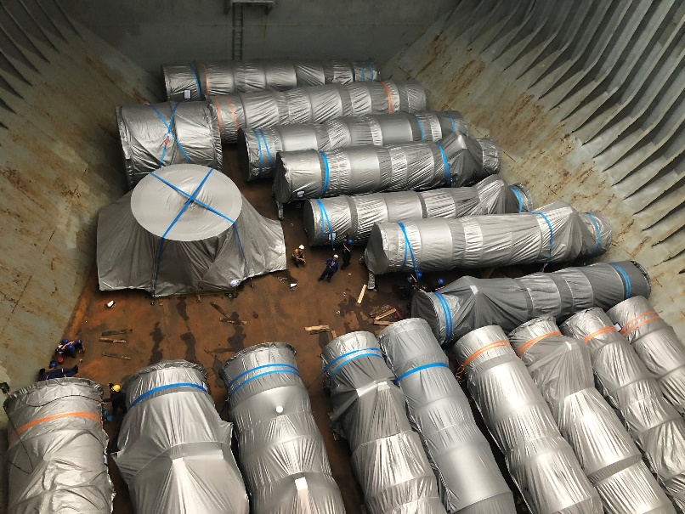
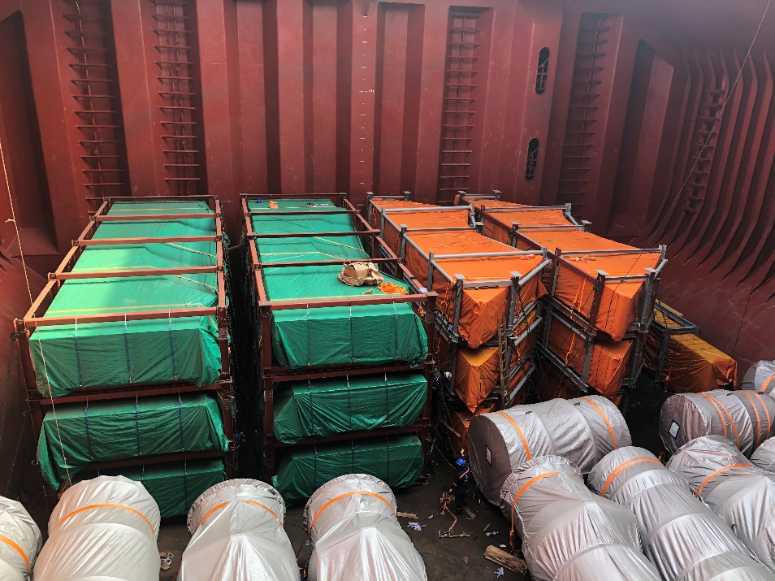
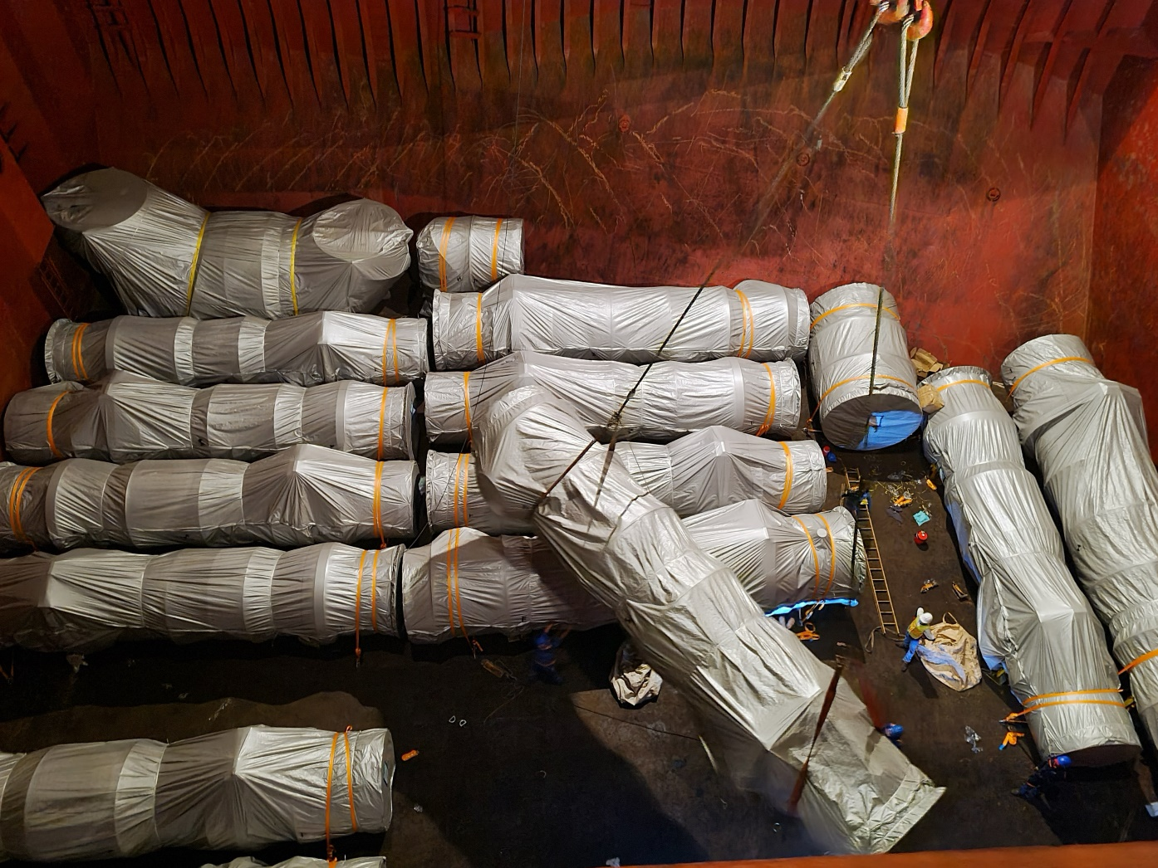
REFERENCE
CASE STUDY – NILES + GUERNSEY
Project Name: Niles + Guernsey Combined-Cycle Power Plants
Volume: Approx. 29,000 FRT
Origin: Phu My, Vietnam
Destination: Houston, TX, USA
Scope:
Packaging guidance and improvement
Chartering of suitable MPP bessels on 6 Voyages
In-house stevedores assisting during various lifting and lashing operations

Slide 22




REFERENCE
CASE STUDY – AURUBIS PROJECT USA
Project Name: Aurubis Project USA
Volume: Containers : 25 (40’FR and 40’HC)
Commodity: Steel Structures
Origin (POL): Vung Tau , Viet Nam /Sept –Dec 2023
Destination (POD): Charleston, USA
Scope:
Handling and booking the transport from FOB Vung Tau up to CFR Charleston/Savannah USA
Co-ordination and supervision of containers at discharge port
Worked on behalf of SMS Group

Slide 23



REFERENCE
CASE STUDY – DUMPER CAGES FOR SHIPLOADER
Volume: Approx. 7,000 FRT over three sailings/lots
Commodity: Dumper cages (each 230 MT plus accessories)
Origin: Tianjin, China
Destination: Squamish, Canada
Scope:
Chartering of suitable vessel for the cargo amount
Supervision at loading and discharge port
Close contact with all involved parties to manage the Covid-19 impact

Slide 24





REFERENCE
CASE STUDY – TENOVA S.P.A GENOA- ITALIA
Volume: 2,826 cbm / 350.99MT / 45 Pkgs
Origin: Hoang Dieu Haiphong, Vietnam
Destination:Port Antwerp, Belgium
Scope:
Delivery from Vietnam to Belgium ,Dec 2021
Chartering of suitable heavy lift vessel within tight schedule and in budget
Hooking on including arrangement of operation
Supervision both ends
Lashing and securing on the vessel
Experienced marine surveyor perform Control

Slide 25





REFERENCE
CASE STUDY – BAYTOWN REFINERY
Volume: Appr. 225,000 FRT
Commodity: Equipment for a Petrochemical Plant, 164 Modules
Origin: Worldwide
Destination: Houston, USA
Scope:
Surveys and selection of storage facility close to fabrication yard
Trucking from fabrication yard to storage area
Shrink wrapping of modules
Trucking from storage area to port
Stowage planning and scheduling
Shipping modules from sattahip, Thailand and Shanghai, China to Houston, USA on 13 full charter vessels
Surveys and selection of suitable jetty location
Barging from Houston port to jetty with 28 barge trips
Trucking from jetty to site
Coordination with local authorities for permits

Slide 26





REFERENCE
BAYTOWN REFINERY – LETTER OF RECOMMENDATION

Slide 27



REFERENCE
CASE STUDY – 800 TON RIVER CRUISE BOAT
Dimensions: 63 x 12 x 14 m – 800 MT
Commodity: Fully Equipped Amazon River Cruise Boat
Origin: Vung Tau, Vietnam
Destination: Amazon Delta, Brazil
Scope:
Chartering of heavy lift vessel with sufficient lifting capacity
Divers for positioning of slings
In-house stevedores to conduct hooking-on
Protection of Valuable In-/exterior
Loading Supervision
Lift Studies

Slide 28




REFERENCE
CASE STUDY – 2 CAPE-CLASS PATROL BOAT
Dimensions: 58 x 10.6 x 18.4 m – 308 MT
Commodity: Fully equipped patrol boats
Origin: Henderson, Western Australia
Destination: Trinidad and Tobago
Scope:
Chartering of suitable heavy lift vessel within tight schedule and on budget
In-house engineering & design of special transport cradles
Hooking on including arrangement of divers
Supervision both ends
Lashing and securing on the vessel
Hiring of experienced marine divers to ensure the correct placement of the slings under the hull

Slide 29





REFERENCE
CASE STUDY – PONTOONS TO GLADSTONE
Volume: 3 x 70 x 9.5 x 7.5 m / 408 MT each
Origin: Vung Tau anchorage, Vietnam
Destination:Gladstone, Australia
Scope:
Pre-Carriage ex shipper’s jetty up to port via tug boat
Supervising of the loading operation
Loading and securing the cargo on board the vessel
Ocean transport up to Gladstone

Slide 30




REFERENCE
CASE STUDY – BIOPOWER UNIT
Project Name: BioPower Unit
Volume: Unit 1: 36 x 18.3 x 8.3 m / 700 MT
Unit 2: 13.2 x 9.2 x 5.56 m / 61 MT
Commodity: Renewable Energy System
Origin: Vung Tau Anchorage, Vietnam
Destination: Australia
Scope:
Chartering of a suitable geared multi-purpose heavy lift vessel
Co-ordination of the FAS delivery (Roll-out onto barge via SPMT’s)
Loading and securing the cargo board of the vessel
Subsea installation in Australia incl. all customs and quarantine formalities, as well as divers
Extended scope: Use of the ships dynamic positioning (DP2) system, to discharge from deck under water onto the foundation

Slide 31





REFERENCE
CASE STUDY – THERMAL PROJECT
Origin: Hoang Dieu Port . Hai Phong Vietnam
Destination: Gamagori Port, Japan
Volume: 8,293 cbm / 638.2 MT
Scope:
Chartering of a suitable geared multi-purpose heavy lift vessel
Co-ordination of the FAS delivery, loading and stowage of the cargo on the vessel

Slide 32








REFERENCE
CASE STUDY – ATLANTIC TITAN
Volume: 31.76 x 10.30 x 18 m / 575 MT
Origin: Ha Long Anchorage, Vietnam
Destination:Port Hawkesbury, Canada
Scope:
Delivery from Vietnam to Montreal
Chartering of a suitable heavy lift vessel within tight schedule
In-house engineering &design/fabrication of special steel cradles (17 MT)
Hooking on including arrangement of divers
Supervision both ends
Lashing and securing on the vessel
Hiring of experienced marine divers to ensure the correct position of the slings under the hull

Slide 33



REFERENCE
CASE STUDY – LUSAIL WORLD CUP STADIUM
Project Name: Lusail World Cup Stadium
Volume: 6,500 FRT over 4 shipments
Commodity: Structural steel for roof of World Cup 2022 stadium
Origin (POL): Ho Chi Minh City, Vietnam
Destination (POD): Hamad, Qatar
Scope:
Chartering of suitable vessel + supervising on board
Co-ordination and supervision of the loading operation

Slide 34




REFERENCE
CASE STUDY – PONTOONS TO AUSTRALIA
Volume: 5,500 FRT (Heaviest lift 120 MT)
Commodity: Floating Jetty – 2 Pontoons, 2 Link Spans and 4 Struts.
Origin: Vung Tau Anchorage, Vietnam
Destination: Australia
Scope:
Door up to POD delivery incl. wet-towing of pontoons, barging, customs clearance both ends, loading and chartering of heavy lift vessel to Australia along with application for quarantine documentation in accordance to strict Australian regulations making it possible to erect the two systems right alongside with the help of the vessel’s cranes.
Note: erecting the systems with the vessel’s gear saved time and especially a tremendous amount of money as the client did not have to mobilize heavy equipment to a remote area in Australia
Extended scope: Use of the ship cranes to assemble all pieces as jetty alongside the vessel at POD

Slide 35





REFERENCE
CASE STUDY – SURGE BIN
Volume: Height :24 m /350 MT
Unit 2: 13.2 x 9.2 x 5.56 m / 61 MT
Commodity:Surge bin for coal export terminal
Origin: Phu My Vietnam
Destination:Gladstone, Australia
Scope:
Pre-carriage ex shipper’s jetty up to port via barge
Organizing and loading onto vessel + ocean transport
Loading and securing the cargo on the vessel

Slide 36



REFERENCE
CASE STUDY – 2 X PONTOON’S TO AUSTRALIA
Volume: 3,250 FRT; Heaviest Lift 100 MT
Commodity: Floating pontoons
Origin: Vietnam
Destination: Australia
Scope:
Door to Door transport Incl. barging and towing both ends
Customs clearance + quarantine management allowed for direct discharge to Australian waters
FLS In-house stevedores and engineering department, developed a suitable solution, to stack the pontoons, which reduced the shipping cost significantly

Slide 37
office.vn@fls-group.com
+84 828 73 002 864
37

