Slide 1

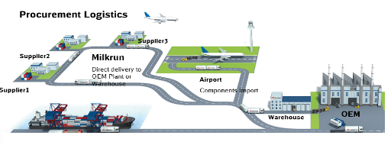
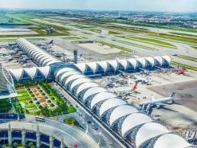
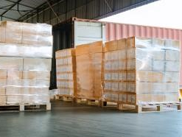
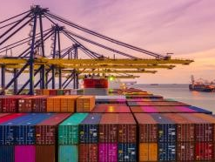
FLS LOGISTICS CASE STUDY
INBOUND SUPPLY CHAIN OPERATIONS - AUTOMOTIVE
Customer name | DUCATI
Project Name | Milk-run, ocean & air inbound operations
Volume | Approx. 1,400 shipments / year
Commodity | Automotive Production Materials
Origin | Asia Pacific
Destination | Thailand
Project duration | 2018 – Today (Ongoing)
Scope | Scope A (Milk-run Operations): Daily supplier booking management – arrangement for collection as per route plan and time window Ensuring delivery to customer’s dock as per fixed delivery schedule Empty-return management Free-zone customs clearance Exception management – emergency trips, route adjustment Route & loading optimization Scope B (Intra-Asia Ocean/Air Operations): Supplier booking coordination – control tower Port-to-door ocean & air-freight arrangements Import customs clearance processing (free-zone) Exception management – emergency air/road solutions Tracking & tracing – reporting: supply chain visibility Customs post-reviews DG handling
42 suppliers, >600 Trips annually
Route plan design & optimization
Strict schedule adherence & On-time KPI Recording
GPS & Geo-Fencing solution
11 origins >50 Tons urgent cargo
Emergency Solutions tailored to meet MRD in plant
Road (cross-border) options as alternative
Sea Port
Component Import
Sea Port
Component Import
>250 TEU + approx. 1,400 CBM annually
Port-to-Door Monitoring + Reporting
Consolidation Concepts for Optimization
Supplier Management Support – Dedicated Operations Team

