Slide 1
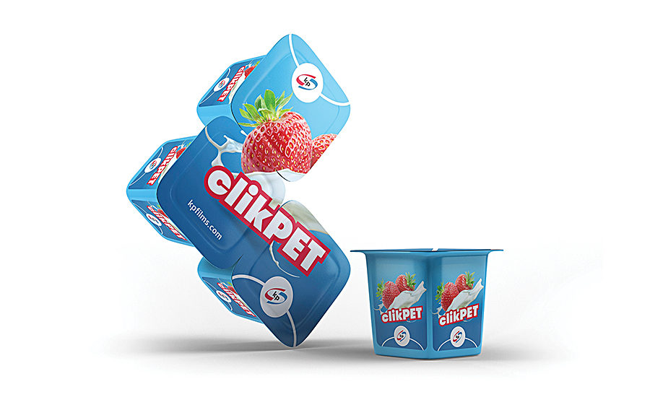


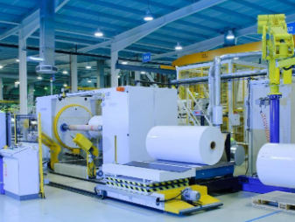
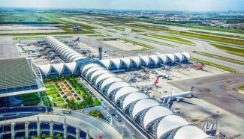
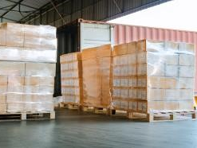
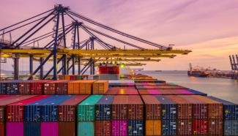
LOGISTICS REFERENCES
OUTBOUND SUPPLY CHAIN OPERATIONS – CONSUMER PRODUCT
Customer name: | KLÖCKNER PENTAPLAST
Project Name: | Ocean & Air Outbound Operations
Volume: | Approx. 1,100 TEU(s) / year
Commodity: | PVCD Film (dry/reefer container)
Origin: | Laem Chabang, Thailand
Destination: | APAC, Middle East 58 countries
Project duration: | 2020 – Today (Ongoing)
Scope: | Scope A (Customs Clearance): Exclusive contract to handle all import and export customs clearance Quick response time of providing export entry, within 20 minutes after receive invoice/packing list from customer Dedicated team of customs specialists to advice on HS codes, free trade agreements, import and export licenses, duty and taxes Provision of FTA, legalization and other consular services Scope B (Pre- and On-carriage): Exclusive contract for all in- and outbound transport Daily delivery of LCL and airfreight shipments from or to airport and seaport Daily container deliveries from & to the seaports (incl. temperature control for reefer container) Delivery solution for emergency plan of loading (changing plan in short notice) Scope C (Ocean/Air Operations): Booking coordination Door-to-port ocean & door-to-door air-freight arrangements Exception Management – Emergency air / ocean solutions Tracking & tracing – reporting: supply chain visibility
1

