Slide 1
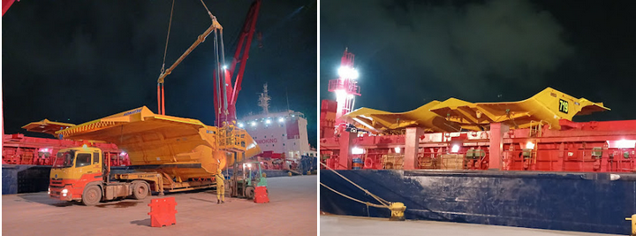
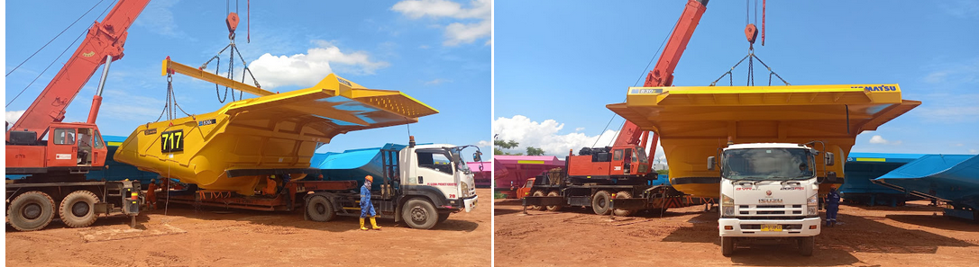
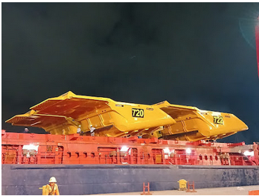
PROJECT REFERENCES
CASE STUDY – 7 UNITS OF DUMP TRAYS
Project Name:
Cargo:
Shipper:
Destination:
Consignee:
Scope:
7 units of Dump Trays
7 units capcoal kom 830-hpy c/w body additions total: 242,431.00 kgs / 3,963.249 cbm
Kabil, Batam, Indonesia
Mackay, Australia
Mrl asset management pty ltd
Chartering of Breakbulk from Batam to Australia
Port Supervision in Batam for loading
Arrangement and procurement of lifting gears

