Slide 1
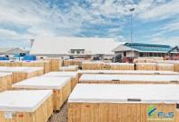
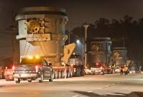
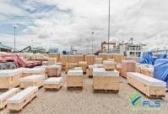
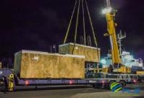
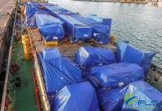
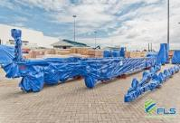
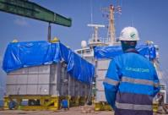
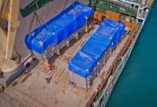
LOGISTICS REFERENCES
CASE STUDY – In and outbound SUPPLY CHAIN OPERATIONS - industrial
Volume:
Commodity:
Origin:
Destination:
Project Duration:
Approx. 2,880 shipments per year
Raw Materials (IM) & components for steel mills (ex)
Worldwide
Worldwide
2008 – today (ongoing)
Scope A
(Customs Clearance):
Since 2011 exclusive contract to handle all import and export customs clearance
Over 200 customs clearance files per month
Dedicated team of customs specialists to advice on HS codes, free trade agreements, import and export licenses, duty and taxes
Provision of FTA, COC, legalization and other consular services
Since 2011 exclusive contract for all in- and outbound road transport
Daily delivery of LCL and airfreight shipments from or to airport and seaport
Daily container deliveries from and to the seaports (incl. OOG flat rack and open top)
Road transport of oversized and heavy project cargo from or to factory (the heaviest unit moved so far: a 460 tons heavy reactor for export to Kuwait)
Dedicated team of truck planners
Since 2008 nearly 25,000 teu handled by FLS
Within 11 years, over 450,000 freight tons of project cargo shipped via FLS and our partners
Until to date, over 4,500 airfreight shipments handled
We have connected Danieli with suppliers and customers in more than 60 countries worldwide
Scope B
(Pre- and On-carriage):
Scope C
(Global Ocean And Air Operation):
1

