Slide 1
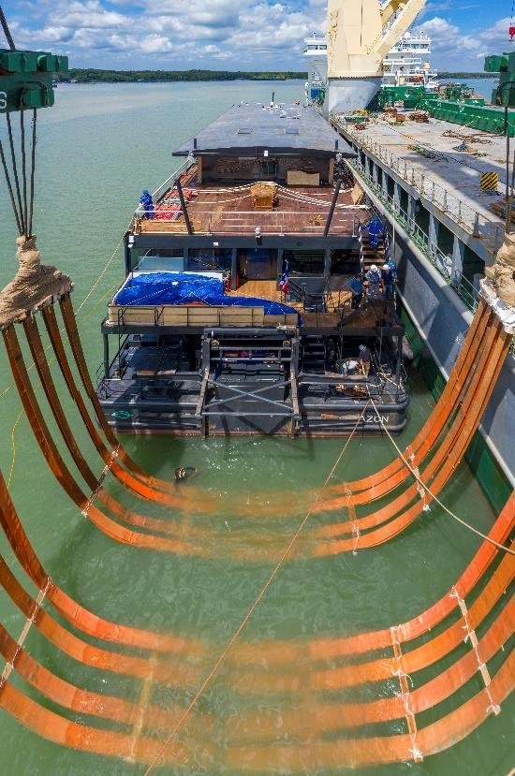
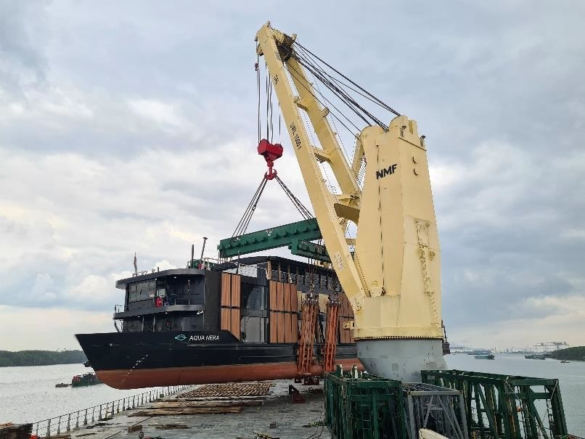
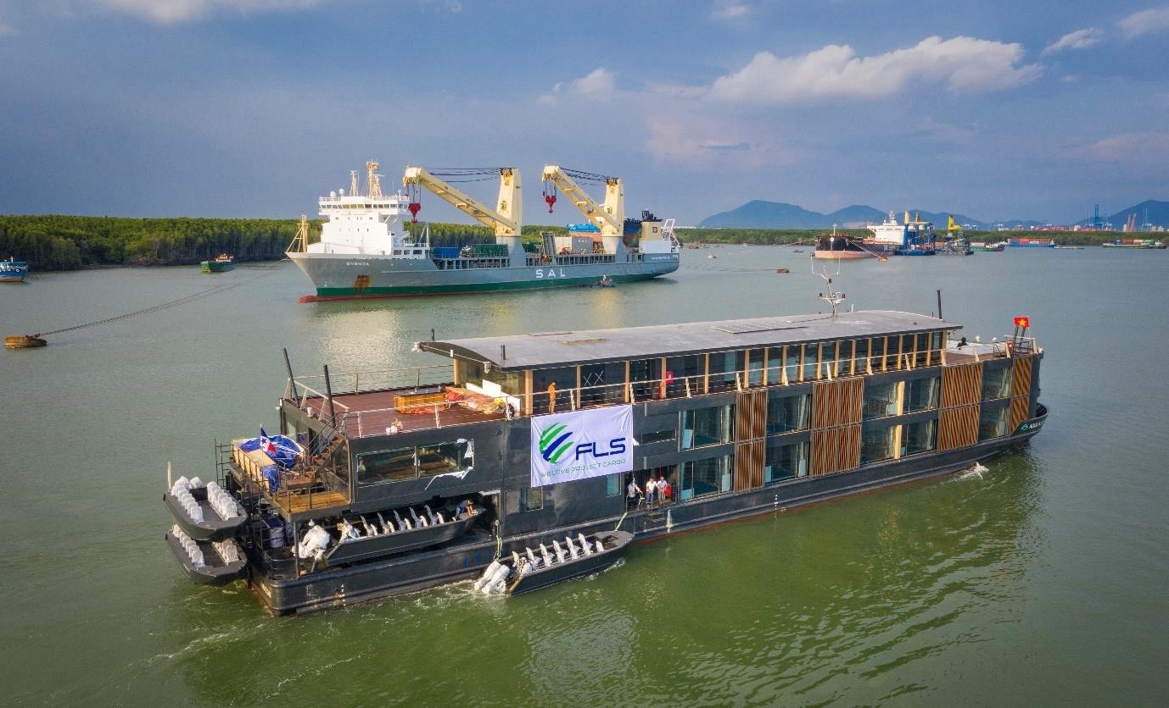
PROJECT REFERENCES
CASE STUDY – 800 TON RIVER CRUISE BOAT
Dimensions: Commodity: Origin: Destination:
63 x 1 2 x 14 m – 800 MT
Fully Equipped Amazon River Cruise Boat Ha Long anchorage
Amazon Delta, Brazil
Scope:
Chartering of heavy lift vessel with sufficient capacity
Divers for positioning of slings
In-house stevedores to conduct hooking-on
Protection of Valuable In-/exterior
Loading Supervision
Lift Studies

