Slide 1
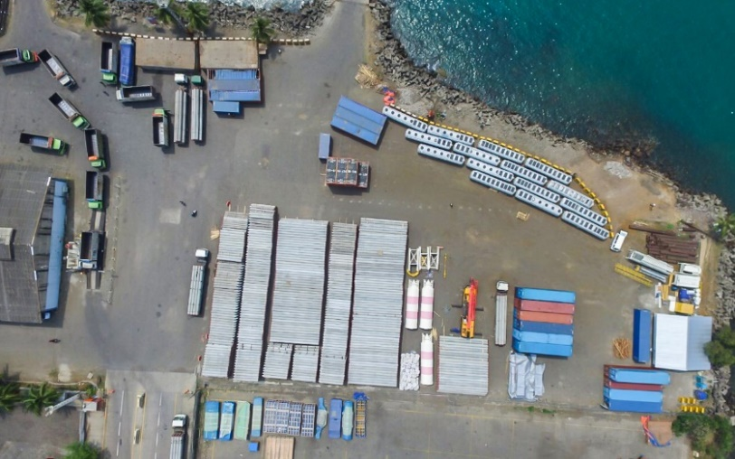
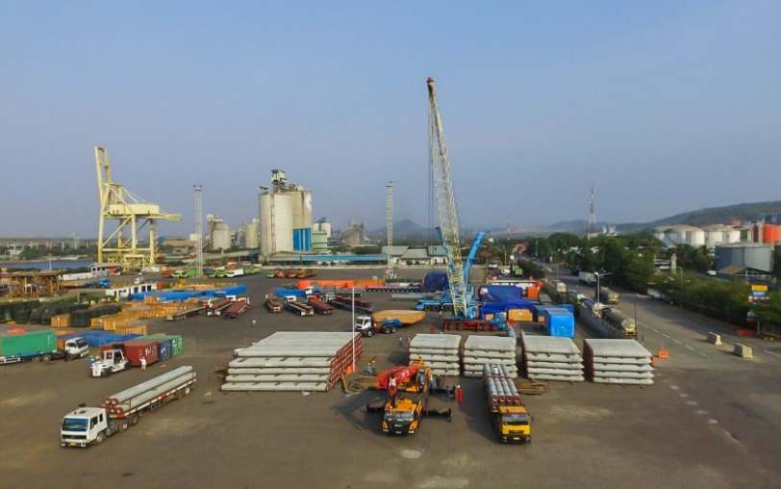
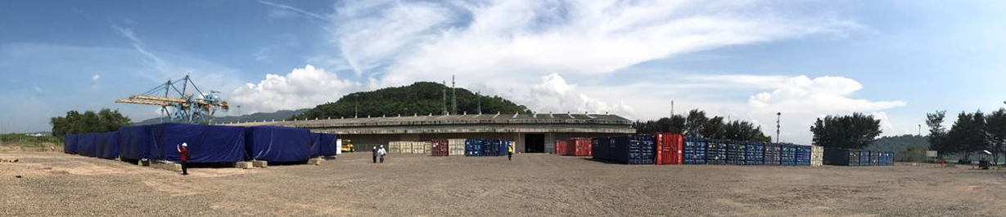
PROJECT REFERENCES
CASE STUDY – Tangguh Expansion Project(2/2)
Dedicated FLS Project Team
Project Manager
Site Manager
Lifting Engineer
Quality Supervisor
HSSE Supervisor
Shipping Coordinator
Operations Crew
New-built Facility
10,000sqm open storage
1,200sqm indoor storage
400sqm hazardous shelter
200sqm cold storage
All built within 1 month
Security measures
Onsite Clinic
Highest HSSE Standards
Detailed Documentation developed in cooperation with Client
Processes and Procedures meeting BP requirements
Permanent Supervision by Client
Extensive Planning and Assessment of Risks for each Activity
Regular Meetings to share experiences and lessons learnt with all other subcontractors
Regular Audits and Workshops
Project Overview
Existing LNG Plant with 2 operating trains
USD 2.2bn EPC contract to build train #3
EPC Joint Venture: Chiyoda, Saipem, Tripatra, SAE
FLS has been awarded the scope of Cilegon Marshalling Yard in West Java
1,000,000+ FRT to be handled
4 years duration

