Slide 1
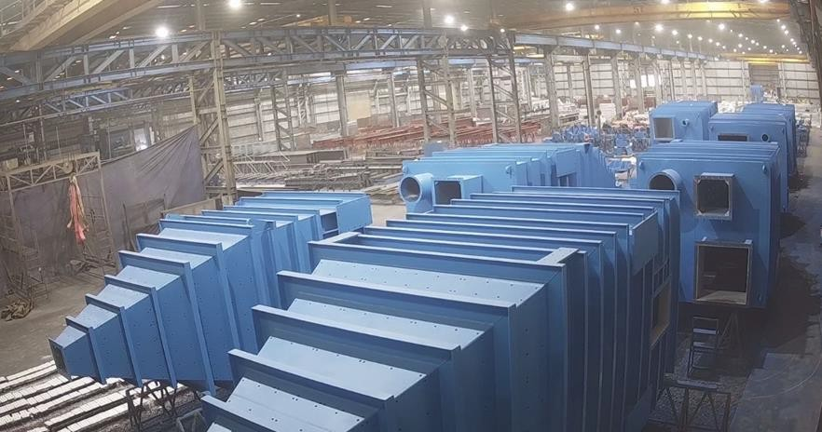
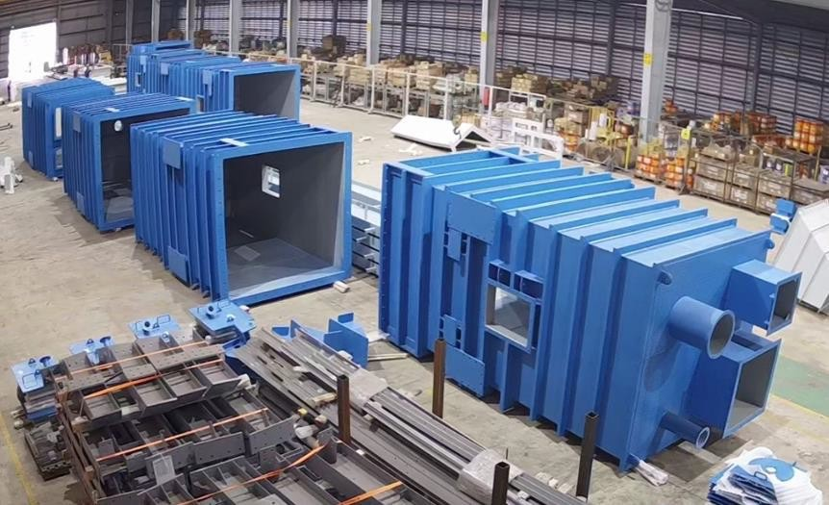
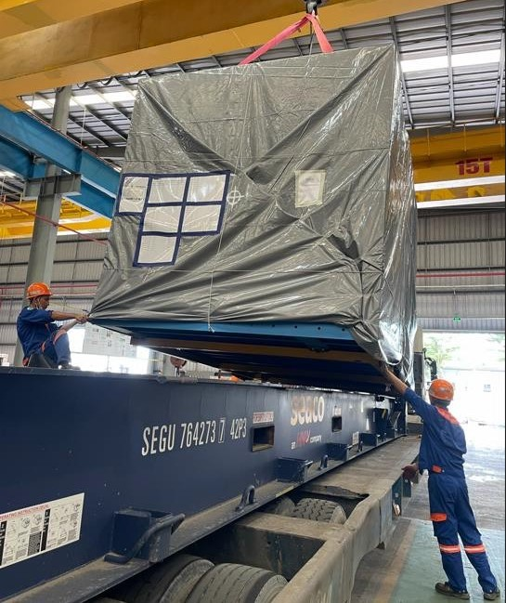
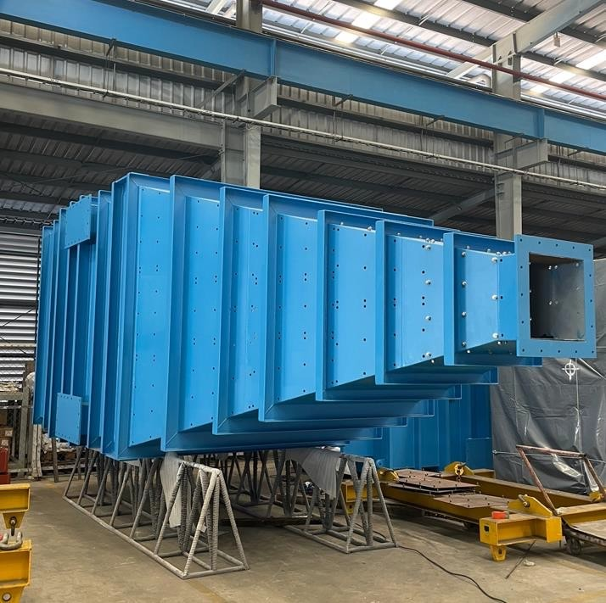
PROJECT REFERENCES
CASE STUDY – AURUBIS PROJECT USA
Project Name: Volume: Commodity:
Period:
Origin (POL): Destination (POD):
Aurubis Project USA
Containers: 25 (40’FR and 40’HC) 600MT Steel Structures
2023-2024
Vung Tau, Vietnam Charleston, USA
Handling and booking the transport from FOB Vung Tau up to CFR Charleston/Savannah USA
Co-ordination and supervision of containers at loading port
Worked on behalf of SMS Group
Scope:

