Slide 1
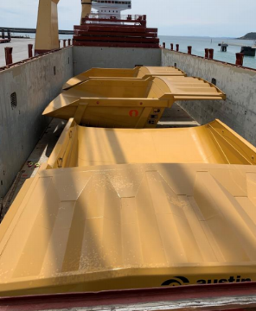
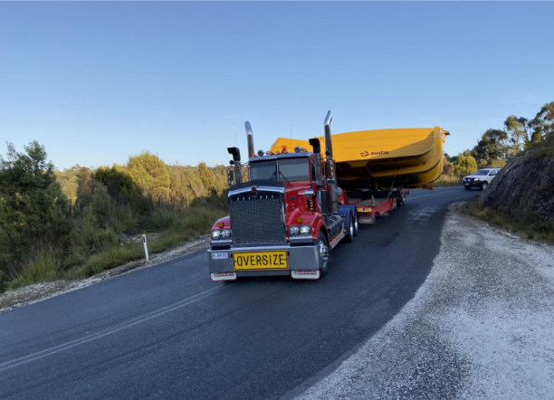
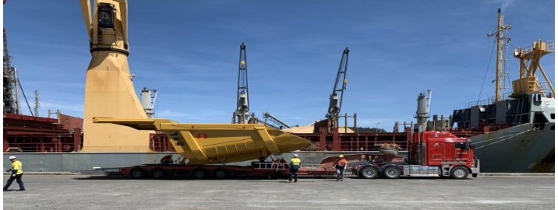
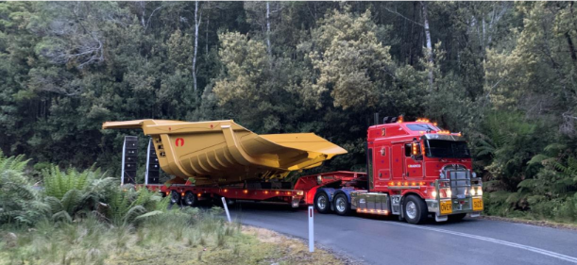
PROJECT REFERENCES
CASE STUDY – SAVAGE RIVER PROJECT
Project Name: Savage River Project
Cargo: 5 x CAT 789 Dump Trays
shipper: Kabil, Batam, Indonesia
Destination: Mackay, Australia
Consignee: Austin Engineering
Scope:
Chartering of Breakbulk from Batam to Australia
Port Supervision in Batam for loading
Arrangement and procurement of lifting gears
Port Handing in Australia and Delivery to Site

