Slide 1
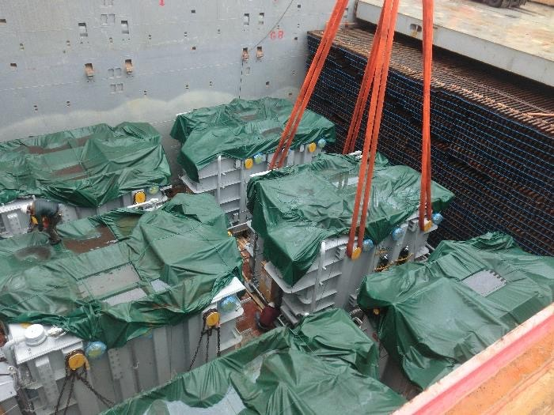
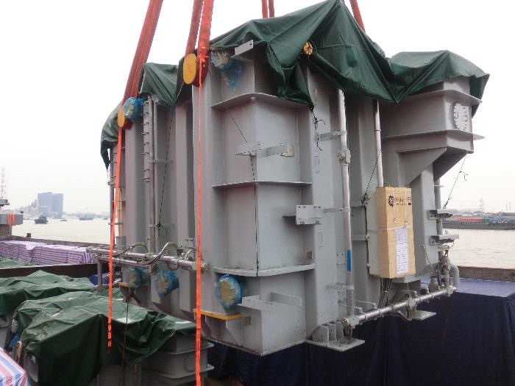
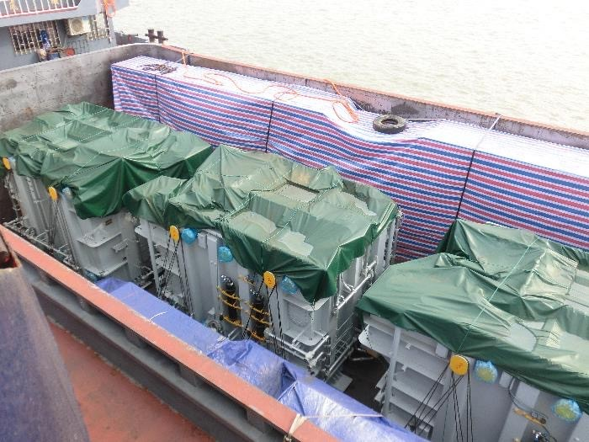
PROJECT REFERENCES
CASE STUDY – TRANSFORMERS #1
Volume: Commodity: Origin: Destination: Year:
4,000 CBM
Transformers and accessories (max weight 143mt) Shanghai, China
Laem Chabang, Thailand for destination in Laos 2018
Scope:
Chartering of suitable vessel for ocean transportation
FLS Supervision at loading and discharge port
Liasing with all related parties for smooth operations
Delivery to destination in Laos site
Permit for delivery in Thailand and Laos

