Slide 1
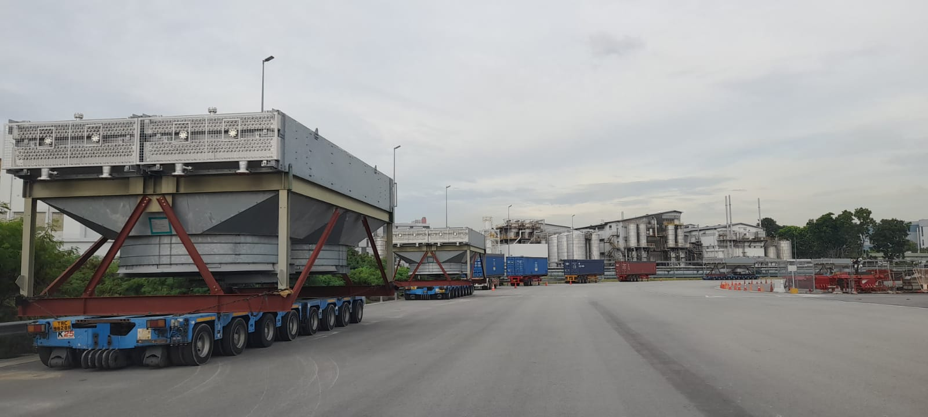
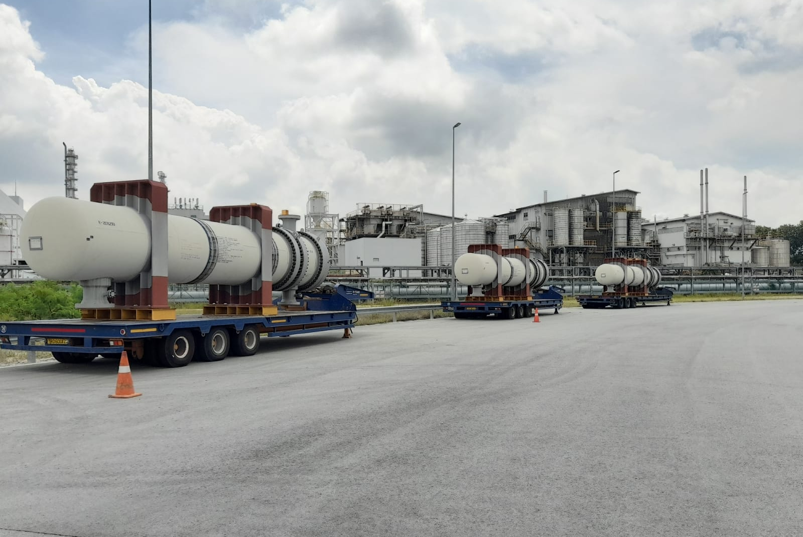
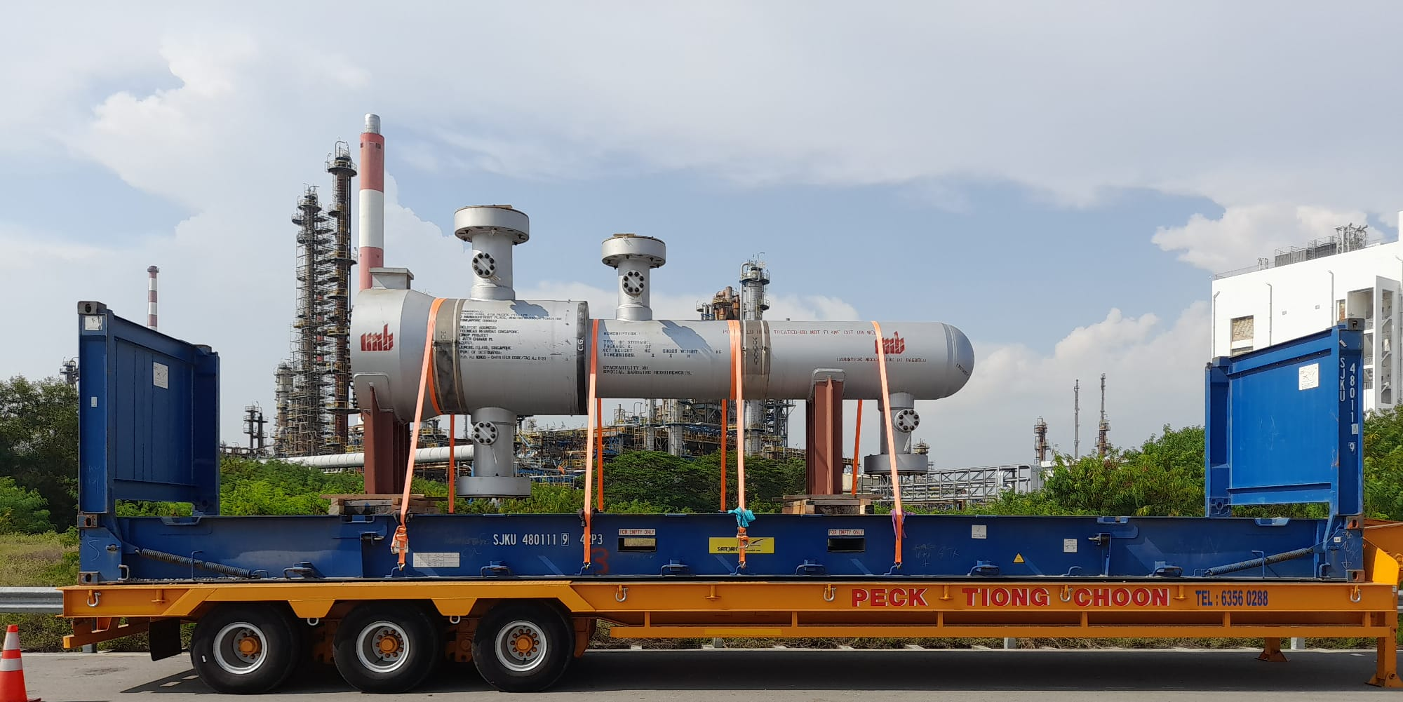
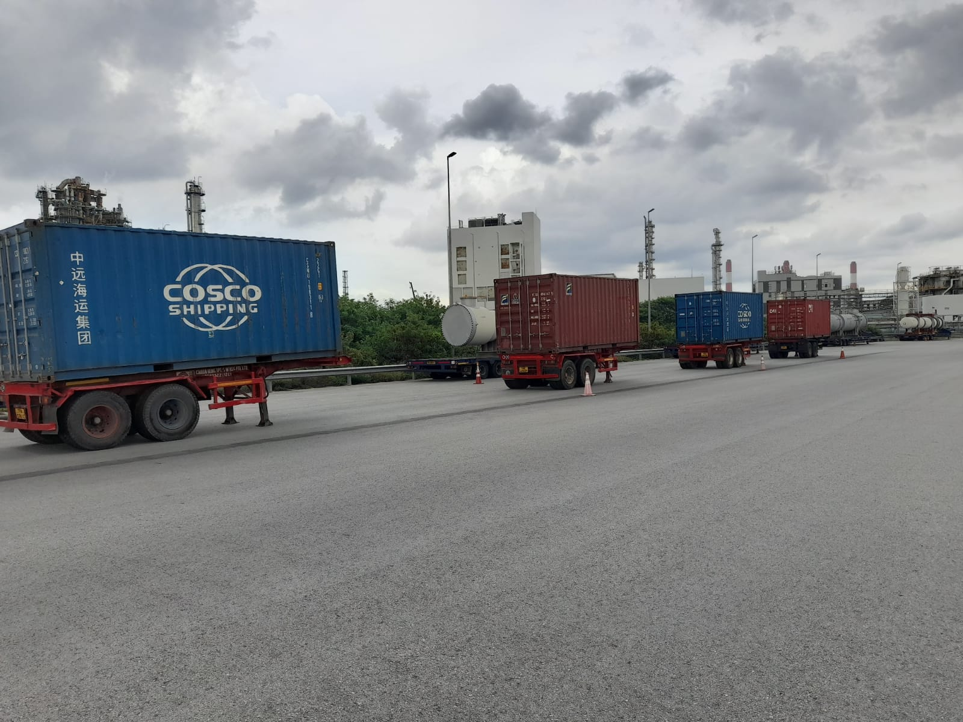
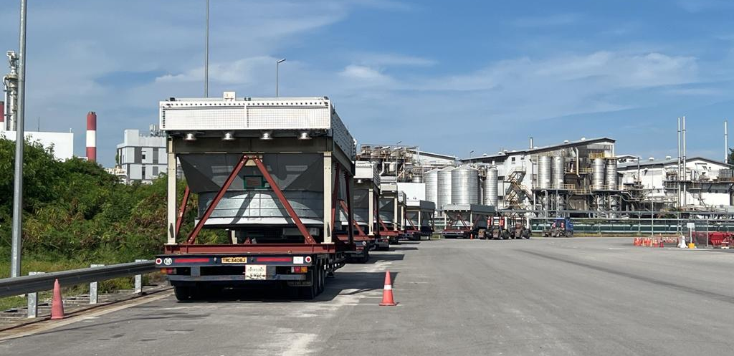
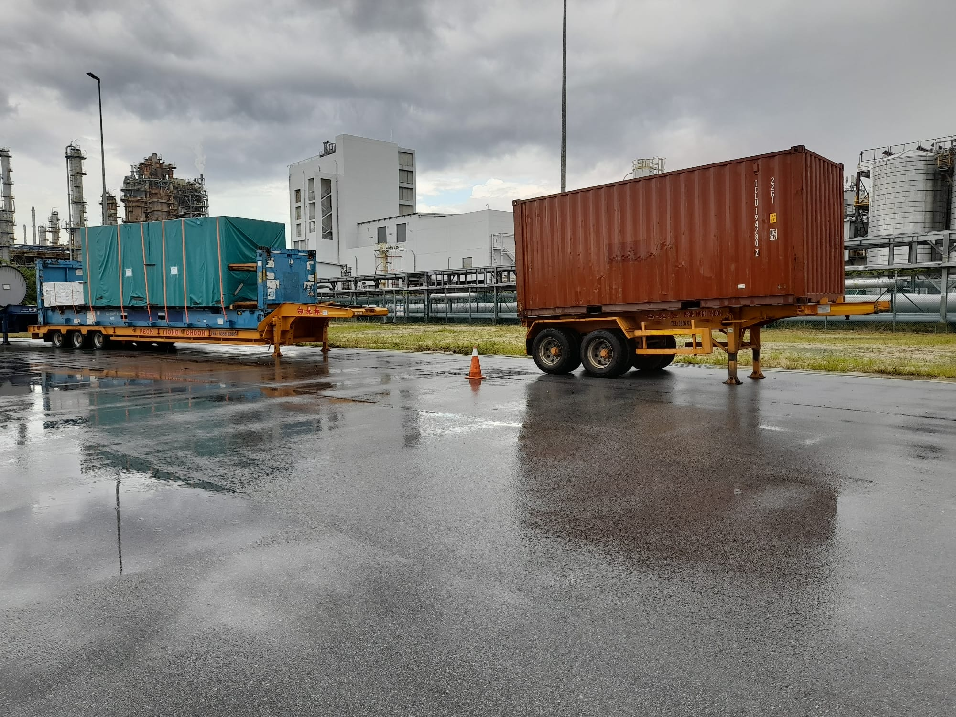
PROJECT REFERENCES
CASE STUDY – CRISP Project Package C
Project Name: CRISP Project
Client: Tecnicas Reunidas Singapore Branch On Behalf Of Exxon Mobil Asia Pacific Pte.Ltd (Singapore)
Project Owner: BJC Heavy Industries Public Company Limited (Thailand)
STP & I Public Company Limited (Thailand)
Volume: Appr. 100 Frtons of FCL containerized, Break Bulk and Roro
Commodity: Machinery and Equipment use for construction of Refinery Plant
Origin: Singapore
Destination: Laem Chabang, Thailand
Project duration: 2022-Ongoing
Scope:
Export handling in Singapore,
Arrange road transport with Haulier from Jurong Island to PSA port or Jurong Port
Site co-ordination with TR site team of the project
Co-ordination with Agents and Carrier

