Slide 1
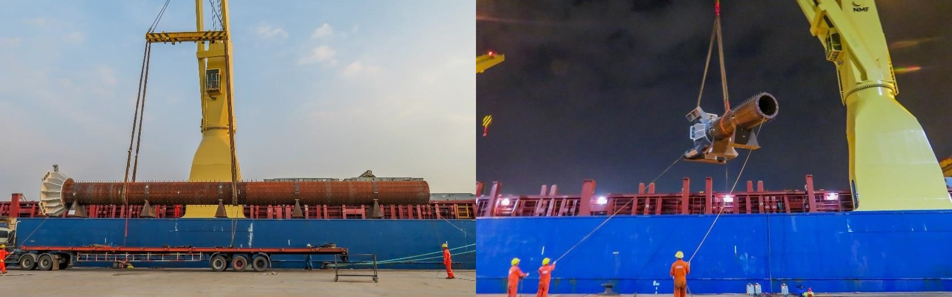
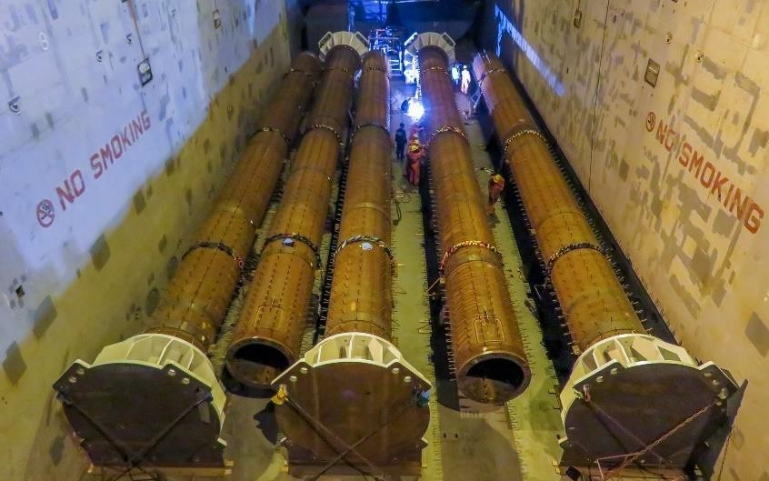
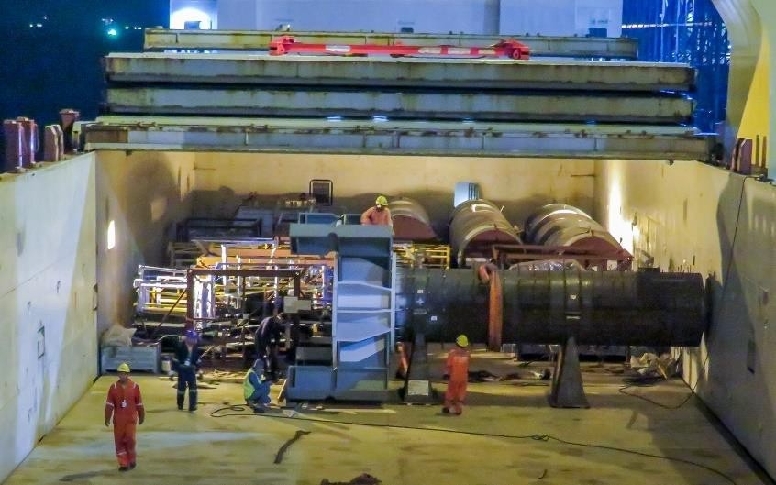
PROJECT REFERENCES
CASE STUDY – LA RAMS STADIUM
Project Name: LA Rams Stadium
Volume: Commodity: Origin: Destination:
2,000 cbm, max. GW 35 MT Steel pipe column
Thailand
Los Angeles, USA
Scope:
Pre-Carriage EXW to Laem Chabang port
Re-loading and FAS delivery at Laem Chabang port
Loading and securing onto break bulk vessel
Break bulk ocean freight from Laem Chabang port up to Port of Los Angeles + on-carriage to site

