Slide 1
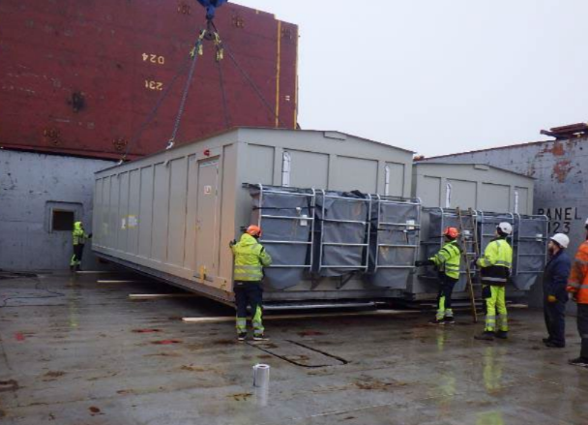
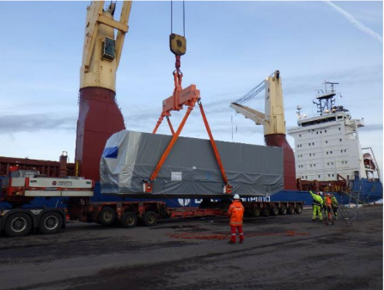
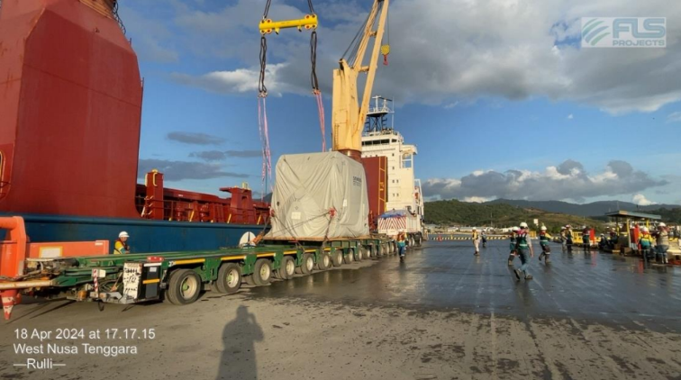
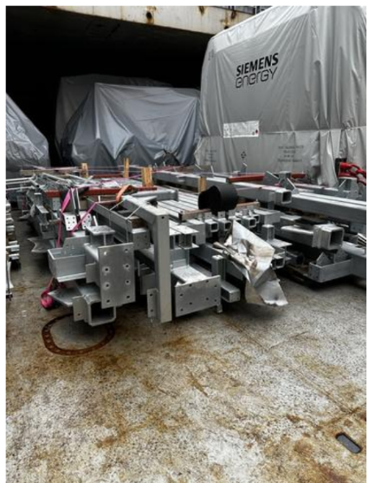
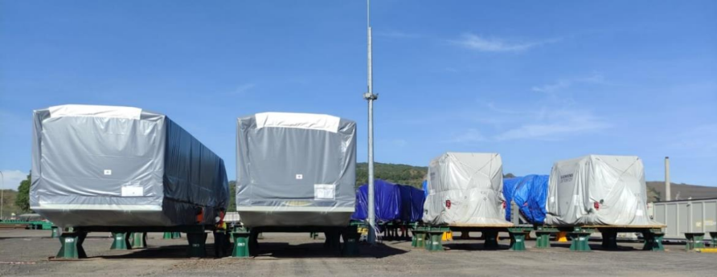
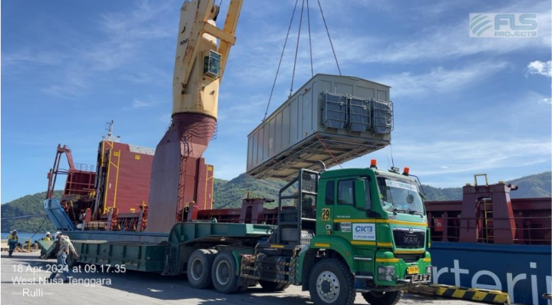
PROJECT REFERENCES
CASE STUDY – BATU HIJAU CCPP-1 PROJECT
Project Name: BATU HIJAU CCPP-1 PROJECT
Client /EPC: Jurong Engineering
Cargo: GAS TURBINE GENERATOR SYSTEM
EX NRK: 73 PKGS / 327,640.00 KGS / 1,447.836 CBM (Heaviest: 90MT)
EX HAM: 80 PKGS / 370,092.76 KGS / 1,560.838 CBM (Heaviest: 86MT)
EX HAY: 26 PKGS / 81,746.00 KGS / 1,139.633 CBM
Shipper: Siemens Energy AB
Destination: Benete Bay
Scope:
Loading from Ex Norrkoping, Hamburg & Haydarpasa and discharge at Benete Bay
1

