Slide 1
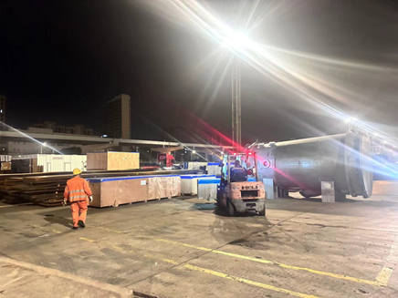
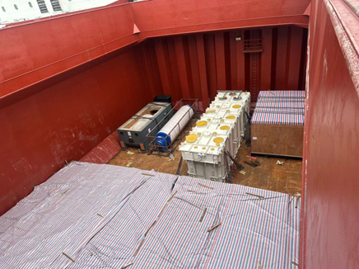
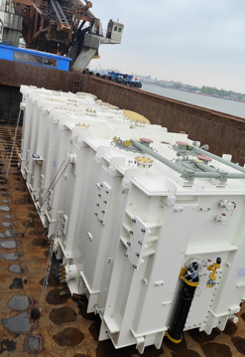
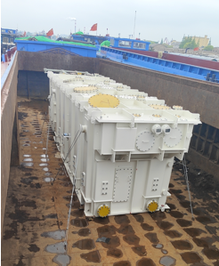
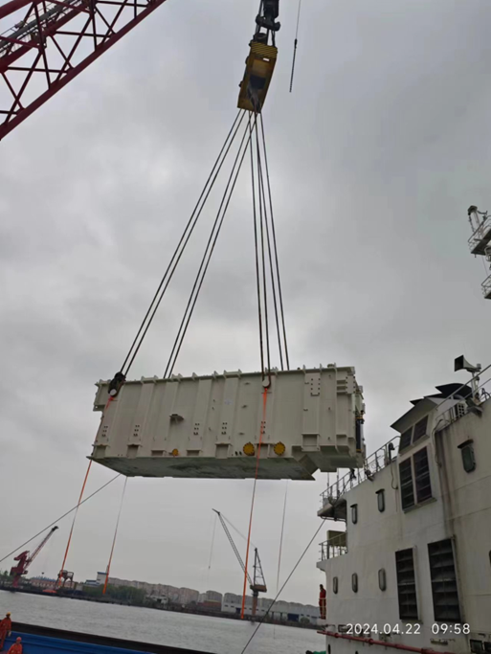
PROJECT REFERENCES
Case Study – 354m3, 173 tONS pre-carriage and port handling
Volume: 354 m3 ,173tons heavy 1x145tons
25 packages
Origin: Shanghai port, China
Destination: Hai Phong, VietNam
Scope:
Pre-carriage from Changzhu factory and pre-carriage to Shanghai port
Port handling and discharge to FAS
Pre-carriage and port handling incl appropriate cargo stow arrangements. Cargo hold preparation for loading by FLS own stevedores
Discharge and load under supervision by FLS supervisor

