Slide 1
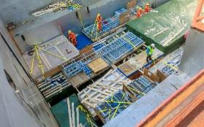
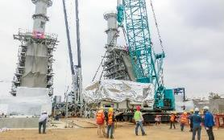
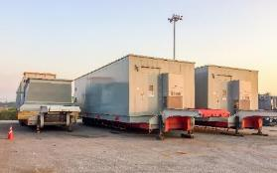
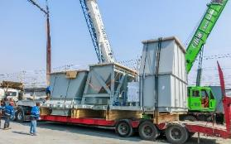
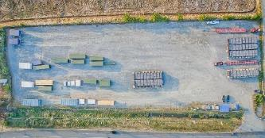
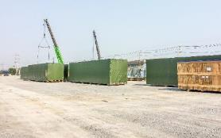
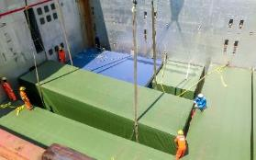
PROJECT REFERENCES
CASE STUDY – GULF NC PROJECT COMBINED CYCLE PP
Project Name:
Volume:
Commodity:
Origin:
Destination:
Gulf NC Project Combined Cycle PP
5,000 cbm
Breakbulk, Substation, Modules
Houston, USA
Laem Chabang, Thailand
Scope:
Receiving cargo alongside the vessel at LCB port, total 3 vessel.
Moving cargo from LCB port to FLS storage yard, off-loading cargo and re-loading cargo.
Delivery cargo to job site.

