Slide 1
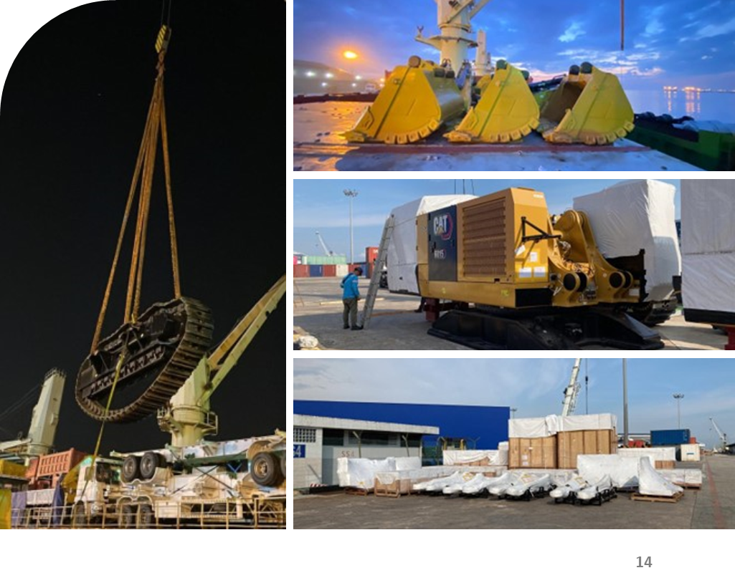
PROJECT REFERENCES
CASE STUDY – HEAVY EQUIPMENT – 4 X 6015B ACC
Project Name: Heavy equipment – 4 x 6015b acc
Client /EPC: Caterpillar INC
Cargo: Heavy equipment – 4 x 6015B ACC
236.43 m3 (135,165 kg)
Shipper: Caterpillar, Batam, Indonesia
Destination: Durban (South Africa) & Luanda (Angola)
Scope:
Chartering of Breakbulk from Batam to Durban & Luanda via Singapore Port
Transport cargo from CIB to Batu Ampar Port & from CIB to SCN Port Kabil
Port Supervision in Batam for loading
Arrangement and procurement of lifting gears
Transferred onto Barge to Singapore Port

