Slide 1
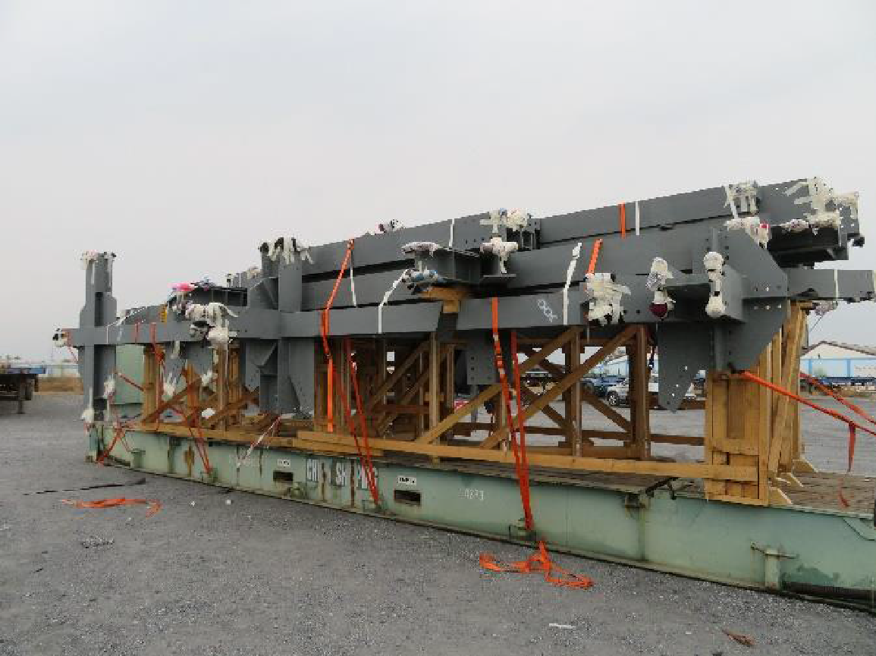
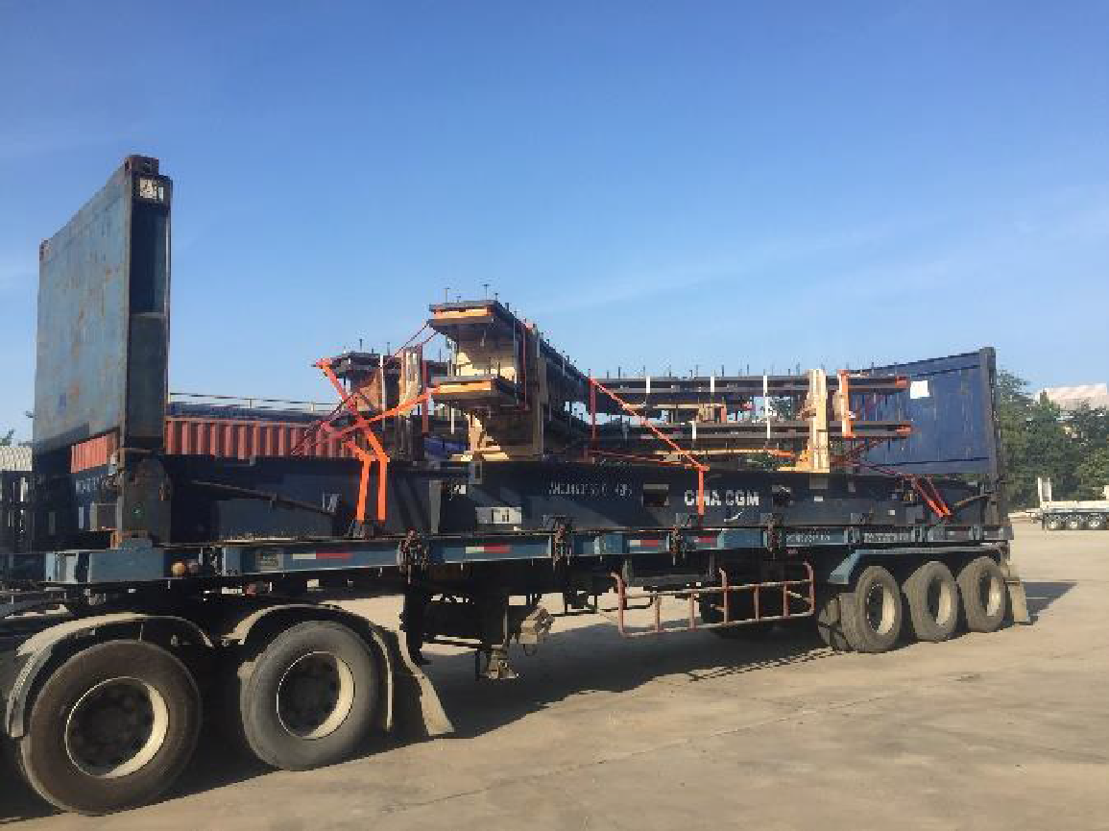
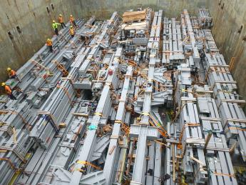
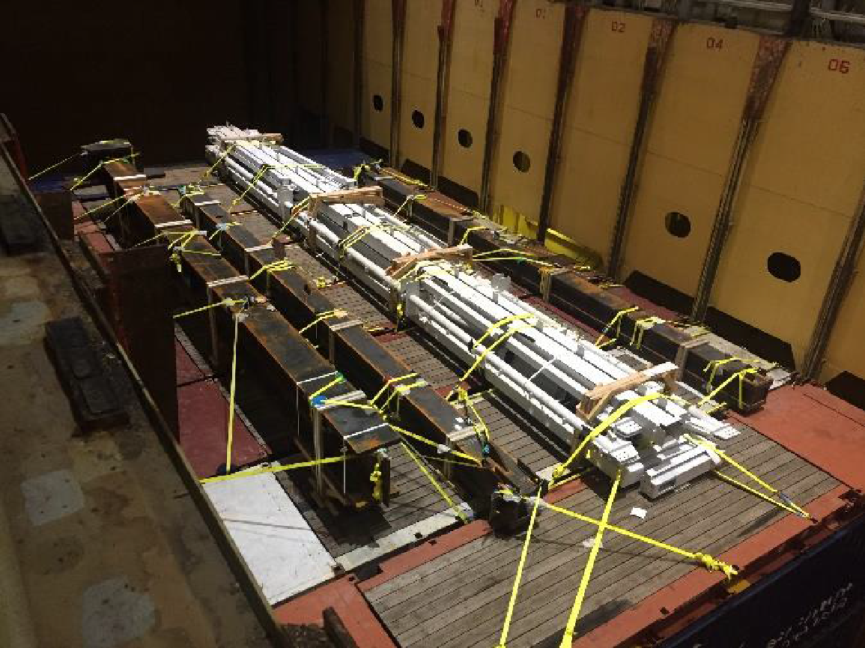
REFERENCE PROJECTS
CASE STUDY - STEEL STRUCTURE PROJECTS
Project Name: Los Angeles Stadium and Entertainment and Lucas Museum Project
Commodity: Steel Structure
Origin: Laem Chabang, Thailand
Destination: USWC
Scope:
  Arranging for pre-carriage, lashing container, cleaning cargo
  operational FAS delivery and loading supervision
  Designing solutions to stacking cargo closely with port captain of the vessel
  Coordinating with container terminal for loading BB on container vessel for smooth and safety
  Ocean freight by BB vessel, BB on container vessel and FR container
  Arranging for on-carriage in USA to site
  Customs clearance both ends

